Slide 1
CSCE 1035 – Computer Programming I
Chapter 6 Functions

Slide 2
Reasons for Defining Functions

Slide 3
Motivation for functions
This program is one long, complex sequence of statements.
statement
statement
statement
statement
statement
statement
statement
statement
statement
statement
statement
statement
statement
statement
statement
statement
statement
statement
statement
statement
This program divided into small tasks (functions), each of which is performed.
def function1():
statement
statement function
statement
def function2():
statement
statement function
statement
def function3():
statement
statement function
statement
def function4():
statement
statement function
statement

Slide 4
Benefits
The benefits of using functions include
Simpler code
Code re-use
Write the code once, and call it multiple times
Better testing and debugging
Can test and debug each function individually
Faster development
Easier facilitation of teamwork
Different team members can write different functions

Slide 5
User-Defined Function Basics

Slide 6
Function Basics
A function is a block of organized, reusable code that is used to perform a single, related action
Think re-usable modules
Functions provide better modularity for applications
We have already seen that Python supports many built-in functions such as print() and input()
We can create our own user-defined functions
Is like a subprogram, a small program inside a program
The basic idea is to write a sequence of statements and then give that sequence a name
We can execute this sequence at any time by referring to the name

Slide 7
Function Definition
The part of the program that creates a function is called the function definition
Function blocks begin with the keyword def followed by the function name and parentheses ()
Any input parameters or arguments should be placed within these parentheses
The code block within every function starts with a colon : and is indented
The statement return [expression] exits a function, optionally passing back an expression to the caller
A return with no arguments is the same as return None
When the function is used in a program, we say the definition is called or invoked

Slide 8
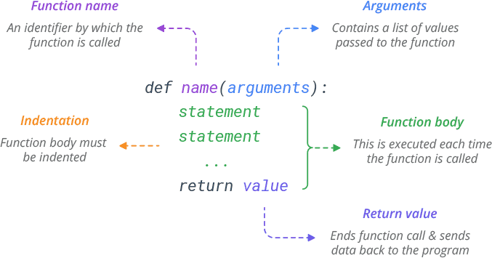
Function Definition

Slide 9
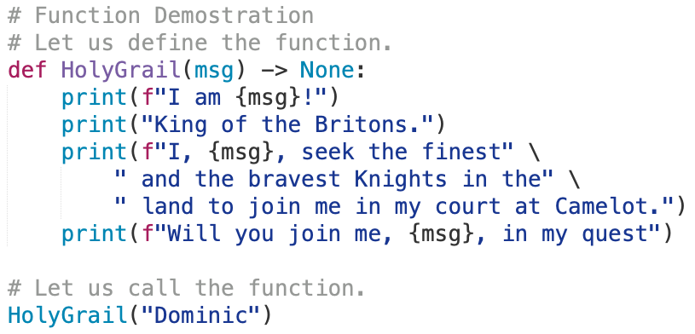
Defining and Calling a Function
Declaration of the
user-defined function
This Statement calls the
user-defined function,
causing it to execute.
Output:
I am Dominic!
King of the Britons.
I, Dominic, seek the finest and the bravest Knights in the land to join me in my court at Camelot.
Will you join me, Dominic, in my quest

Slide 10
Function Parameters

Slide 11
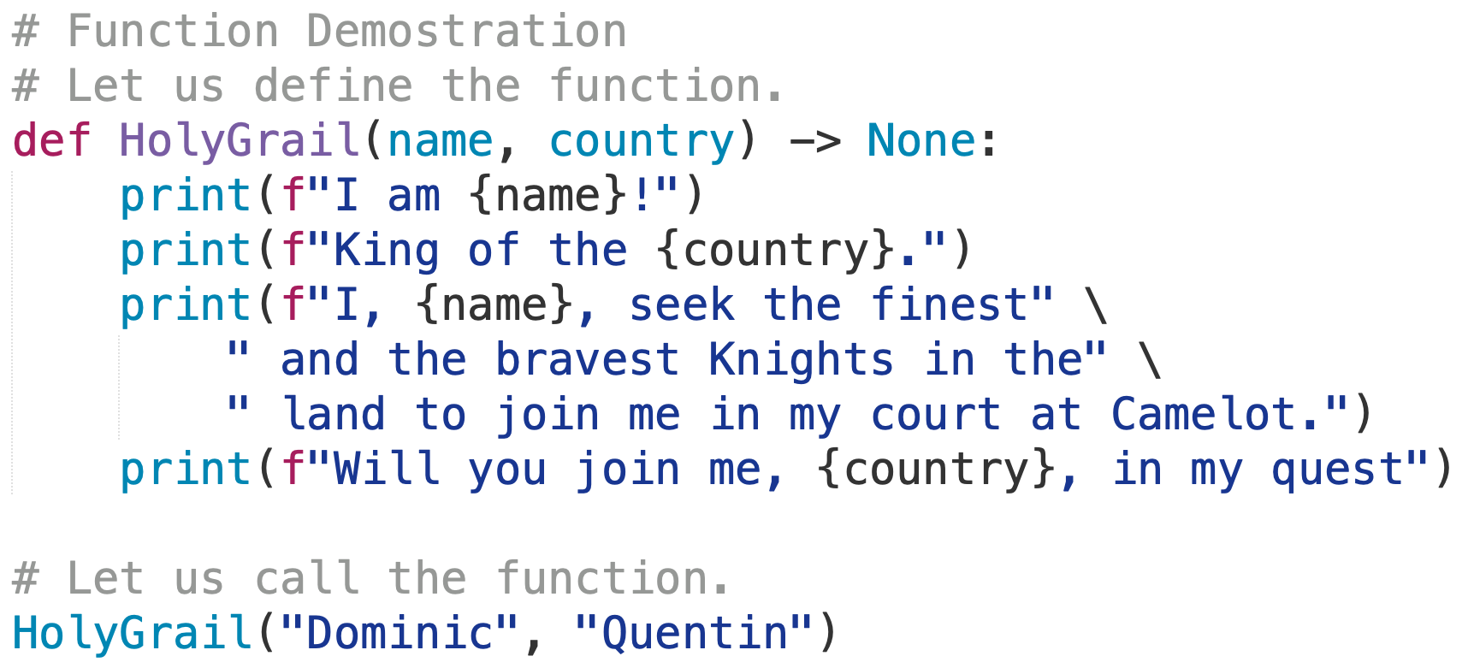
Function Arguments
Parameters act as input to a function as function variables
Every Python object can be passed as argument to a function
Even a function call be be the argument of a function too
Multiple parameters can be passed to a function
In this case, the order of the arguments in the caller (i.e., the statement that calls the function) must be exactly the same as in the function definition
These are called positional arguments

Slide 12
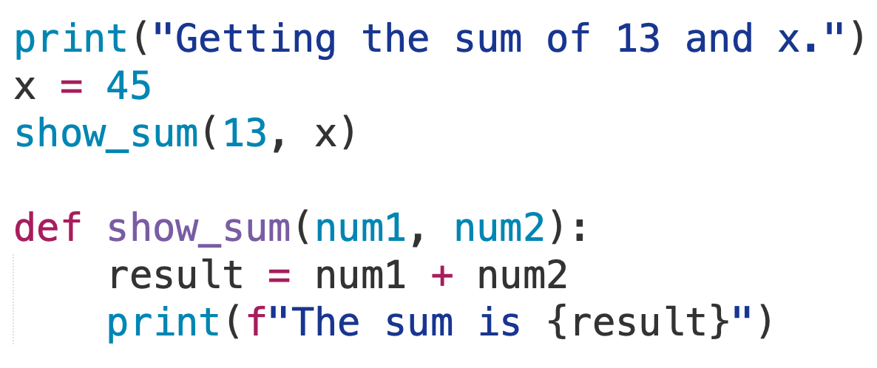
Function Arguments
If we reverse the order in which the arguments are listed in the function call, then 45 would be passed to num1 parameter and 12 would be passed to the num2 parameter
Two of the arguments are passed as two parameters.
Output:
Getting the sum of 13 and x.
The sum is 58

Slide 13
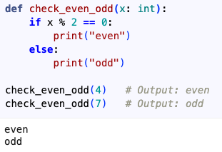
Function Exercise
Define a function to check whether x is even or odd
If x is even, print even on the screen, otherwise, print odd on the screen.

Slide 14
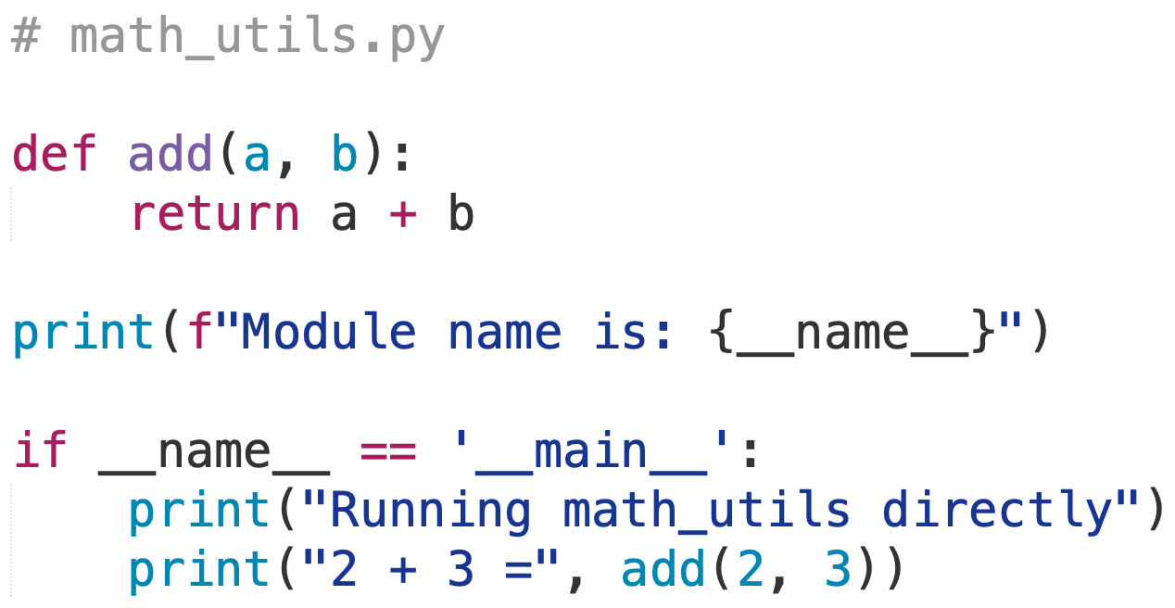
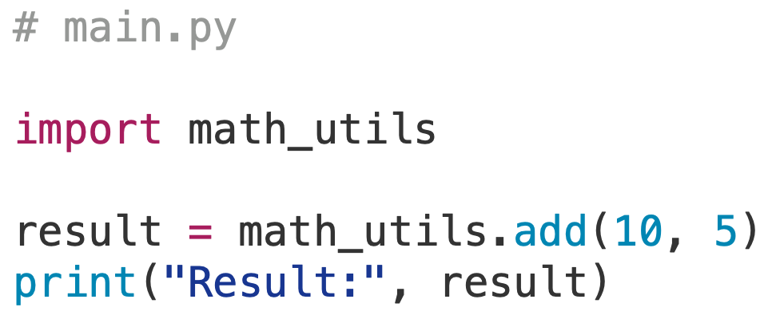
Executing Imported Modules
From Chapter 2
Modules have the __name__ variable set to the module name
The __name__ is a special built-in variable that evaluates to the name of the current module
If a module is being run directly (from the command line), the __name__ instead is set to the string '__main__'
When a Python file is called as a script, the __name__ is set to '__main__'
This allows you to create modules that can also be executed as scripts
Adding if __name__ == '__main__' allows code inside block to execute when file is passed to the interpreter directly, not imported
Command-line:
$ python3 math_utils.py
Module name is: __main__
Running math_utils directly
2 + 3 = 5
$ python3 main.py
Module name is: __main__
Result: 15

Slide 15
Returning Values from Functions

Slide 16
Function Returns
When Python encounters a return statement, it exits the function and returns control to the point where the function was called
The item (as a variable, container, expression, or even a function call) provided in the return statement is sent back to the caller
We can assign the returned item to a variable object or print out the returned result
All functions have a return value, even if no return line
A function may return one item using a return statement
Although a list or tuple with multiple elements can be returned
Functions without a return return the special value None
None is a special constant used like NULL
None is also the logical equivalent to False

Slide 17
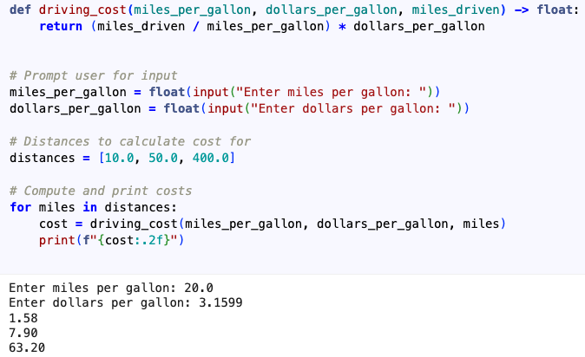
Function Return Exercise
Define a function driving_cost() with input parameters miles_per_gallon, dollars_per_gallon, and miles_driven, that returns the dollar cost to drive those miles.
All items are of type float.
Prompt and read in the miles_per_gallon and dollars_per_gallon in the program.
Output the gas cost by calling your driving_cost() function three times
For 10 miles, 50 miles, and 400 miles
Output each floating-point value with two digits after the decimal point.
Example Input and Output: arguments (20.0, 3.1599, 50.0), returns 7.89975.
Example Output:
Enter miles per gallon: 20
Enter dollars per gallon: 3.1599
1.58
7.90
63.20

Slide 18
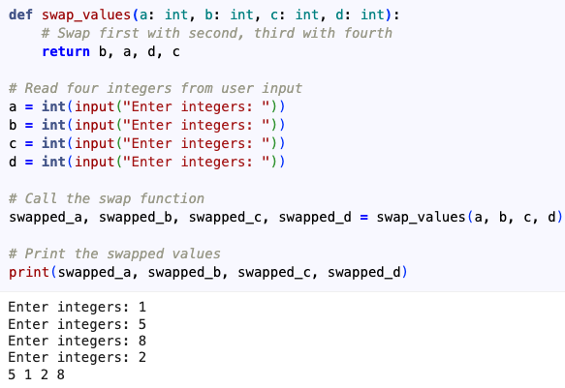
Function Exercise
Write a main program that reads four integers from a user input.
Define a function named swap_values() with 4 input parameters and swaps the first with the second, and the third with the fourth.
Call the function swap_values() to swap the values and prints the swapped values on a single line separated with spaces.

Slide 19
Dynamic Type and Polymorphism

Slide 20
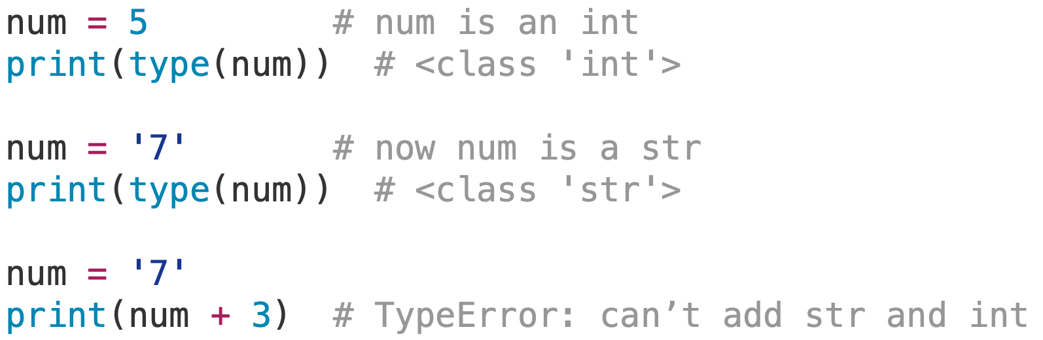
Dynamic Typing
Python uses dynamic typing to determine the type of objects as a program executes
The type of a variable can change during a program, depending on the value it references
E.g., num = 5, then num = '7'
The interpreter is responsible for checking that all operations are valid as the program executes

Slide 21
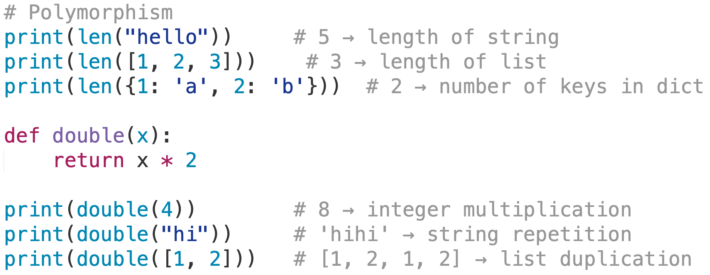
Polymorphism
We can call the same function with parameters, and depending on the parameters, it will yield different results
A function that can operate on different object types is said to be polymorphic
Polymorphism means "many forms":
A function or method can operate on different types of objects.
Behavior adapts based on the type of input.

Slide 22
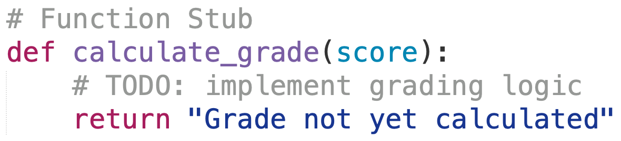
Function Stubs
Here is a problem when writing a program with functions
How does incremental development fit in?
If our program calls a function, then we need a definition for it.
If there are many functions, this means that a large amount of code needs to be written before we can test any of them.
A solution is to create function stubs
A stub is a skeleton function that acts as a placeholder until a final version is completed
Another alternative is to test out a function before adding it to a program
Write a small program that supplies the function with the necessary information to work
These are called driver programs

Slide 23
Functions: Common Errors

Slide 24
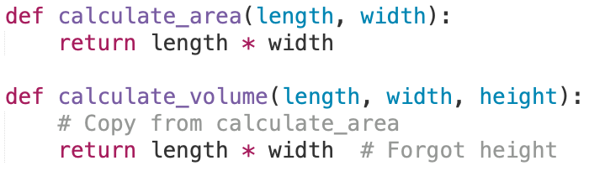
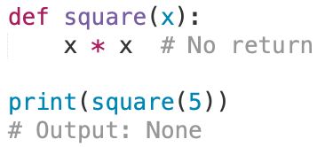
Common Problems with Functions
Copy-and-paste errors
Copy-and-paste code among functions, but forgetting to complete all necessary modifications
Return errors
Every function returns something
Functions without an explicit return pass back a special object called None
None is the absence of a value
Writing a function that returns a value, but forgetting to…
include the return statement
assign that value to anything

Slide 26
Scope of Variables and Functions

Slide 27
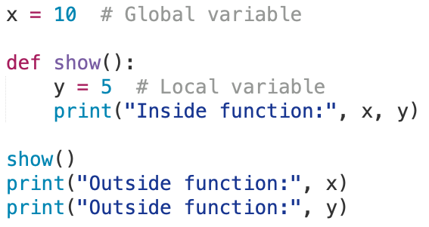
Local and Global Scope
All variables in a program may not be accessible to all locations in that program
This depends on where the variable is declared
The scope of a variable determines the portion of the program where you can access a particular identifier
Local scope: Variables declared inside a function body.
Global scope: Variables declared outside a function body.
Local variables can be accessed only inside the function whereas global variables can be accessed throughout the program body by all functions
When you call a function, the variables declared outside are brought into scope
How can we fix this?
y is local and only known inside function show()
Will generate an error since y is not defined here

Slide 28
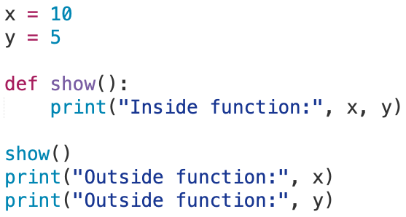
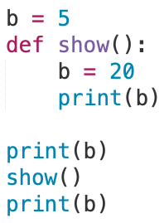
Local and Global Scope
How can we fix this?
We can define the variable y outside of the function, which will make it a global variable
What about this?
Output:
5
20
5

Slide 29
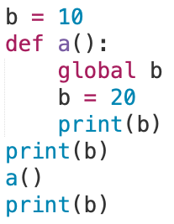
Forcing Local Assignment to Global
We can force a local assignment to a global variable using the global keyword
WARNING using global variables in functions as they can be confusing or have side effects that make it hard for a programmer to recognize
Good practice is to limit the use of global variables to defining constants that are independent of any function
Output:
10
20
20

Slide 30
Namespaces and Scope Resolution

Slide 31
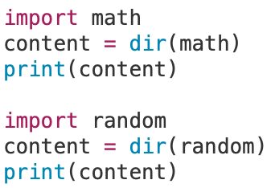
The dir() Function
The dir() built-in function returns a sorted list of strings containing the names defined by a module
The list contains the names of all the modules, variables, and functions that are defined in a module
Example:
Output:
['__doc__', '__file__', '__loader__', '__name__', '__package__', '__spec__', 'acos', 'acosh', 'asin', 'asinh', 'atan', 'atan2', 'atanh', 'cbrt', 'ceil', 'comb', 'copysign', 'cos', 'cosh', 'degrees', 'dist', 'e', 'erf', 'erfc', 'exp', 'exp2', 'expm1', 'fabs', 'factorial', 'floor', 'fma', 'fmod', 'frexp', 'fsum', 'gamma', 'gcd', 'hypot', 'inf', 'isclose', 'isfinite', 'isinf', 'isnan', 'isqrt', 'lcm', 'ldexp', 'lgamma', 'log', 'log10', 'log1p', 'log2', 'modf', 'nan', 'nextafter', 'perm', 'pi', 'pow', 'prod', 'radians', 'remainder', 'sin', 'sinh', 'sqrt', 'sumprod', 'tan', 'tanh', 'tau', 'trunc', 'ulp']
['BPF', 'LOG4', 'NV_MAGICCONST', 'RECIP_BPF', 'Random', 'SG_MAGICCONST', 'SystemRandom', 'TWOPI', '_ONE', '_Sequence', '__all__', '__builtins__', '__cached__', '__doc__', '__file__', '__loader__', '__name__', '__package__', '__spec__', '_accumulate', '_acos', '_bisect', '_ceil', '_cos', '_e', '_exp', '_fabs', '_floor', '_index', '_inst', '_isfinite', '_lgamma', '_log', '_log2', '_os', '_parse_args', '_pi', '_random', '_repeat', '_sha512', '_sin', '_sqrt', '_test', '_test_generator', '_urandom', 'betavariate', 'binomialvariate', 'choice', 'choices', 'expovariate', 'gammavariate', 'gauss', 'getrandbits', 'getstate', 'lognormvariate', 'main', 'normalvariate', 'paretovariate', 'randbytes', 'randint', 'random', 'randrange', 'sample', 'seed', 'setstate', 'shuffle', 'triangular', 'uniform', 'vonmisesvariate', 'weibullvariate']

Slide 32
Namespaces
A namespace is a mapping from names (identifiers) to objects (values)
More precisely, a namespace is like a dictionary of variable names (keys) with their corresponding objects (values).
A Python statement can access variables in a local and in the global namespace
If a local and a global variable have the same name, the local variable shadows the global variable so that the global name is not accessible
Each function has its own local namespace
Class methods (i.e., member functions) follow the same scoping rule as ordinary functions
Namespace Type | Scope | Example
Global | Whole module | x = 10 outside functions
Local | Inside function/method | x = 5 inside def demo()
Shadowing | Local hides global | Local x overrides global x
Class Method | Same as function | Local variables inside def method()

Slide 33
globals() and locals() Namespaces
The globals() and locals() functions can be used to return the names in the global and local namespaces, respectively, depending on the location from where they are called
If locals() is called from within a function, it will return all the names that can be accessed locally from that function
If globals() is called from within a function, it will return all the names that can be accessed globally from that function
The return type of both these functions is a dictionary
Therefore, names can be extracted using the keys() function

Slide 34
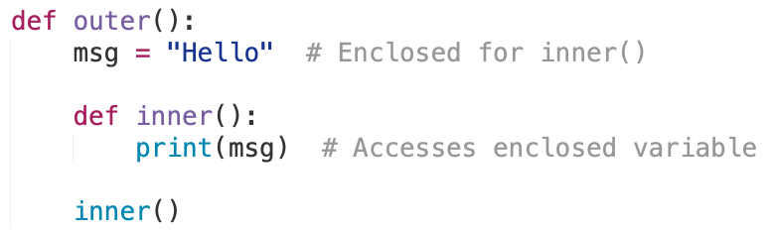
Enclosed Namespace
Created when a function is defined inside another function.
The inner function can access variables from the outer function.

Slide 35
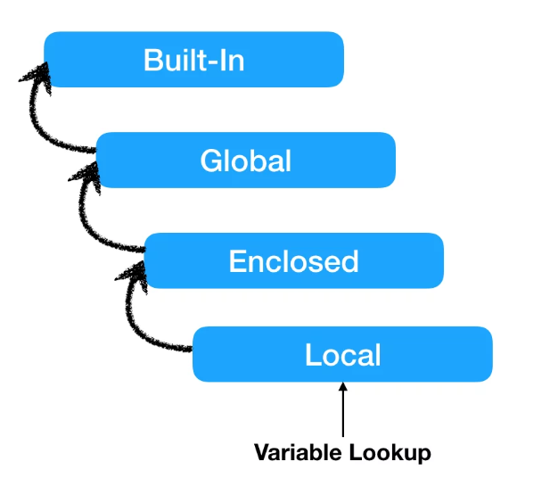
Scope Resolution
Python supports the following namespaces in the following order of lookup
Local namespace
Specific to the current function or class method
Same as global scope if no function is executing
Global namespace
Specific to the current module
Contains all globally defined names outside of any functions
Enclosed Namespace
When a function is defined inside a function, it creates an enclosed namespace. Its lifecycle is the same as the local namespace.
Built-in namespace
Global to all modules
Contains all built-in names such as int(), str(), list(), etc.
Python variables are searched in the following order of namespaces.

Slide 36
Function Arguments

Slide 37
Passing Arguments to Functions
Two ways in which arguments can be passed to functions
Pass by value
Function creates a copy of the object passed to it as an argument
The actual object is not affected
The object is an immutable type (cannot be modified)
Pass by reference
The actual object is passed to the called function
All changes made to object inside function affect its original value
The object is a mutable type
Since mutable objects can be changed, the passed objects are updated
Can make a mutable object immutable by passing a copy of it instead (e.g., passing my_list[:] instead of my_list)
pass-by-value | Immutable Objects | int, str, tuple
pass-by-reference | Mutable Objects | list, dict, set

Slide 38
Keyword Arguments

Slide 39
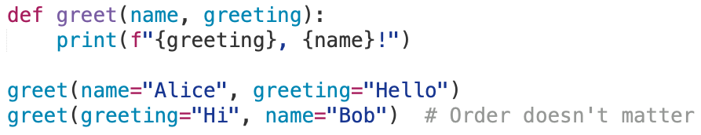
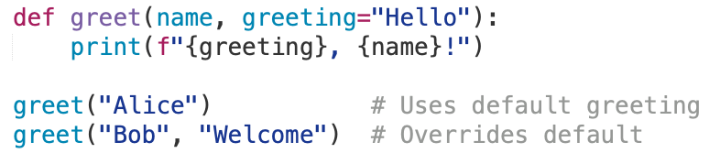
Keyword and Default Arguments
Python allows you to pass arguments to functions by name, not just by position.
Keyword arguments identify arguments by parameter name
It is also possible to use default arguments
A parameter’s default value is used in the absence of an argument in the function call
These optional arguments must be placed in the last position(s) of the function definition
Be careful about working with mutable objects (e.g., a list) using a default parameter
Default arguments are created only once, so a default empty list with multiple calls may not be empty after first function call

Slide 40
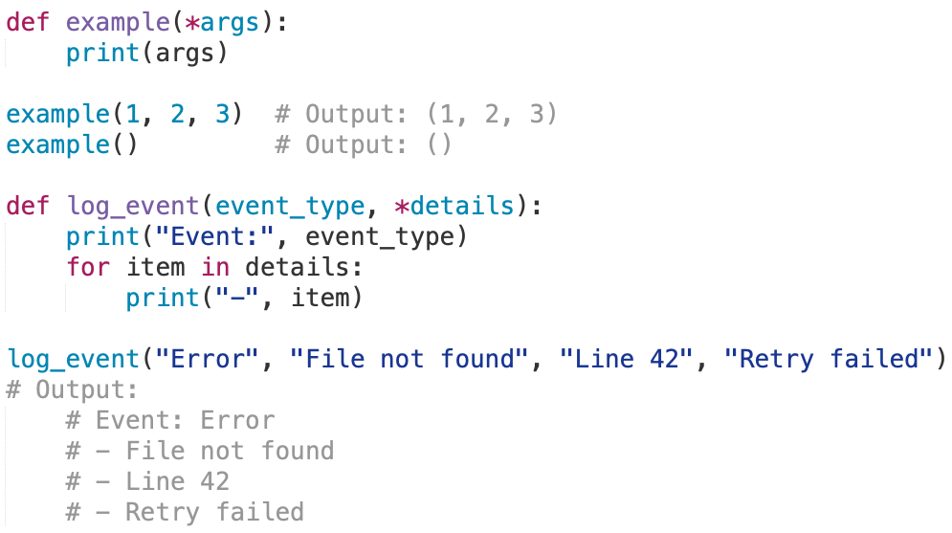
Non-Keyword Arguments
The special syntax *args in function definitions is used to pass a variable number of arguments to a function
Let’s you define a function that accepts a variable number of positional arguments, as a tuple.
By convention, it is often used with the word args
The *args allows more arguments than the number of formal arguments defined by the function
With *args, any number of extra arguments can be tacked on to your current formal parameters (including zero extra arguments)
Using the *, the variable that we associate with the * becomes an iterable, meaning that you can do things like iterate over it

Slide 41
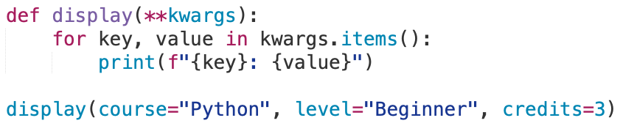
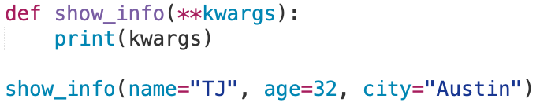
Keyword Arguments
The special syntax **kwargs in function definitions is used to pass a key-worded, variable-length argument list
The name kwargs is used with the double star because it allows us to pass through keyword arguments (and any number of them)
A keyword argument is where you provide a name to the variable as you pass it into the function
You can think of kwargs as being a dictionary that maps each keyword to the value that we pass alongside it
That is why when we iterate over the kwargs, there does not seem to be any order in which they were printed out
Output:
{'name': ‘TJ', 'age’: 32, 'city': 'Austin'}
Output:
course: Python
level: Beginner
credits: 3

Slide 42
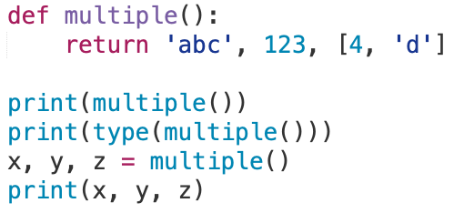
Returning Multiple Values
In Python, a function can return multiple values
Specified in the return statement separated by commas
return expression1, expression2, etc.
When you call a function with multiple return values in an assignment statement, you need to separate the variables on the left side of the assignment operator = with commas to receive each returned value
Output:
('abc', 123, [4, 'd'])
<class 'tuple'>
abc 123 [4, 'd']
Assigning multiple return values to different variables is known as unpacking

