Slide 1
CSCE 1035 – Computer Programming I
Chapter 7 Strings

Slide 2
String Slicing

Slide 3
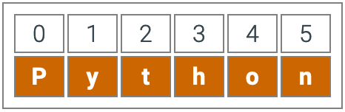
String
From Chapter 3
A string is a sequence of characters
A string is a literal enclosed by a single or double quotes
Using the input()can create a string
Examples:
var1 = “Welcome to Class”
var2 = ‘Introduction to Python’
Python sequence types like the string type order items from first to last.
Character indexes are string positions.
name = “Dominic”
The first character is at index 0, the second at 1, etc.
print(name[0]) => “D”
print(name[1]) => “o”
String slice: varName[startIdx:endIdx]
name[0:2] is “Dom”
Use len() to find the length of a string
String are immutable (i.e., read only)
Let’s go into more detail!

Slide 4
String: Selecting Characters
A string is an ordered collection of characters
The character positions are identified by an index beginning at 0
Initialized the string greet = 'hello, world', the characters are arranged as follows
Selecting a character:
greet[i], where i is the index for desired character, left to right index counting
greet[-i], where -i is the negative indexing for desired character, right to left index counting
Therefore, the expressions str[7] and str[-5] both return the one-character string 'w' that appears at index 7 or -5
h
e
l
l
o
,
w
o
r
l
d
0
1
2
3
4
5
6
7
8
9
10
11
-12
-11
-10
-9
-8
-7
-6
-5
-4
-3
-2
-1

Slide 5
String: Selecting Characters
Let’s practice
Assume greet = 'hello, world’
What are the following:
How to get the ’,’ character?
What does greet[6] get us?
What does greet[-3] get us?
What does greet[-10] get us? What is the other way to get same character?
What does greet[‘6’] get us?
h
e
l
l
o
,
w
o
r
l
d
0
1
2
3
4
5
6
7
8
9
10
11
-12
-11
-10
-9
-8
-7
-6
-5
-4
-3
-2
-1

Slide 6
String: Exercise
Goal: Print out all the characters in the string with an even index
Program Structure:
Create a user-defined function:
Call it even_char with one string argument.
returns all characters with an even index.
In the main part of the program:
Prompt the user for and read in a string.
Call the even_char function, passing in the user-inputted string.
Print the return.

Slide 7
String Slicing
Slicing is known as extract a substring by specifying a range of index positions
Slice operation is providing the parameters: [start:end]
start is the index position where the slice begins
end is the index position before the slice ends, exclusive
The start and end components of a slice are optional, but the colon “:” must be present
If start is missing, it defaults to 0
If end is missing, it defaults to the length of the string
A third parameter called stride can be used:[start:end:stride]
A stride indicates how many positions are omitted between selected characters
A stride can be negative, basically operating in the reverse, right to left from the end of the string
h
e
l
l
o
,
w
o
r
l
d
0
1
2
3
4
5
6
7
8
9
10
11

Slide 8
String Slicing
Let’s practice
Assume greet = 'hello, world’
What are the following:
How to get the ’hello’ substring?
What does greet[7:11] get us? Is greet[7:] the same?
What does greet[:6:1] get us? What are other way to get same substring?
Would greet[5::-1] get the same substring but in reverse?
What does greet[::2] get us?
What about greet[11::-1] get us?
h
e
l
l
o
,
w
o
r
l
d
0
1
2
3
4
5
6
7
8
9
10
11
-12
-11
-10
-9
-8
-7
-6
-5
-4
-3
-2
-1

Slide 9
String Slicing Practice
Consider a string ALPHABET initialized as
ALPHABET = 'ABCDEFGHIJKLMNOPQRSTUVWXYZ'
so that the index numbers (in both directions) appear as follows
What are the values of the following slice expressions?
A
B
C
D
E
F
G
H
I
J
K
L
M
N
O
P
Q
R
S
T
U
V
W
X
Y
Z
0
1
2
3
4
5
6
7
8
9
10
11
12
13
14
15
16
17
18
19
20
21
22
23
24
25
-26
-25
-24
-23
-22
-21
-20
-19
-18
-17
-16
-15
-14
-13
-12
-11
-10
-9
-8
-7
-6
-5
-4
-3
-2
-1
ALPHABET[7:9]
ALPHABET[1:-1]
ALPHABET[-3:-1]
ALPHABET[0:5:2]
ALPHABET[:3]
ALPHABET[::-1]
ALPHABET[-1:]
ALPHABET[5:2:-1]
ALPHABET[14:-12]
ALPHABET[14:10:-2]

Slide 10
String: Exercise
Goal: Print out all the characters in the string with an even index
Program Structure:
Create a user-defined function:
Call it even_char with one string argument.
returns all characters with an even index.
In the main part of the program:
Prompt the user for and read in a string.
Call the even_char function, passing in the user-inputted string.
Print the return.
Hint: Use the stride in slicing
What does str[::2]get us?

Slide 11
Advance String Formatting

Slide 12
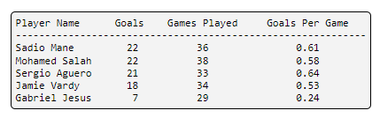
String Formatting
Consider one of the following to print a variable to an output:
print(’{}{}’.format(name, age))
print(f’{name}{age}’)
The output is not that readable, especially when printing multiple names, and ages. Also, not including additionally information like addresses, phone numbers, etc.
String formatting contains replacement fields surrounded by curly braces {}
Anything not within the braces is considered literal text that is printed to the output
Here are the replacement field is
f"{ [var] ["!" conversion] [":" format_spec] }"
Output
Dominic29
Dominic29
Attempt to do on Notebook

Slide 13
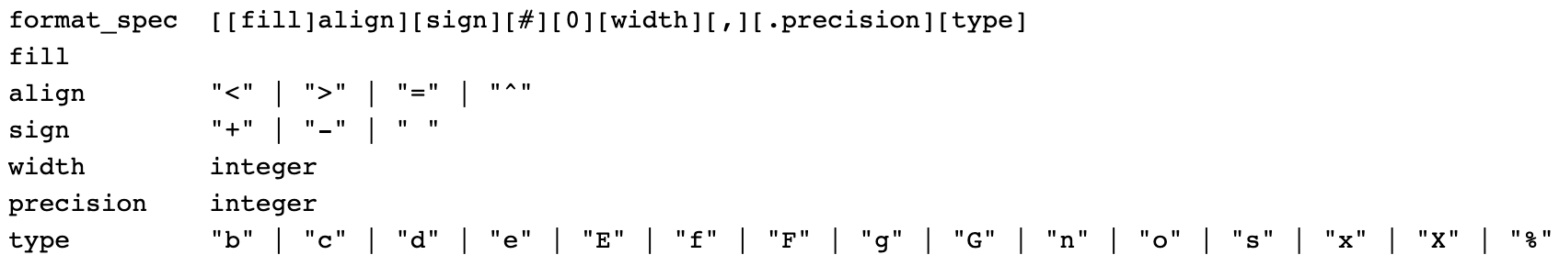
String Formatting
f"{ [var] ["!" conversion] [":" format_spec] }"
format_spec must be in the correct order or Python will interpret it differently.
For more information view the Python Documentation for string: LINK

Slide 14
String Formatting
f"{ [var] ["!" conversion] [":" format_spec] }"
fill defines the fill character used when displaying data that is too small to fit within the assigned space
align specifies the alignment of data within the display space
'<' left aligned
'>' right aligned
'=' justified
'^' centered

Slide 15
String Formatting
f"{ [var] ["!" conversion] [":" format_spec] }"
sign determines the use of signs for the output
'+' positive numbers have a plus sign and negative numbers have a minus sign
'-' negative numbers have a minus sign
' ' positive numbers are preceded by a space and negative numbers have a minus sign
'#' specifies that output should use alternative display for numbers
For example, hexadecimal numbers will have the 0x prefix
'0' specifies that output should be sign aware and padded with zeros as needed to provide consistent output

Slide 16
String Formatting
f"{ [var] ["!" conversion] [":" format_spec] }"
width determines the full width of the data field (even if the data won’t fit in the space provided)
',' specifies that numeric data should have commas as a thousand's operator
.precision determines number of characters after the decimal point

Slide 17
String Formatting
f"{ [var] ["!" conversion] [":" format_spec] }"
type specifies the output type, even if the input type doesn’t match
String
Use an s or nothing at all to specify a string
Integer
b (binary), c (character), d (decimal), o (octal), x or X (hexadecimal), and n (locale-sensitive decimal)
Floating Point
e or E (exponent), f or F (fixed point), g or G (general format), n (locale-sensitive general format), and % (percentage)

Slide 18
String Formatting
Could you do this?
Attempt it and we will look at them Wednesday!

Slide 20
String Formatting
Could you do this?
Attempt it and we will look at them Wednesday!

Slide 21
String Methods

Slide 22
Replacing Substrings
Recall that strings are immutable
However, remember just reassign to the same or new variable with a different string value
General format for the string replace() method:
<string object>.replace(old, new[, count])
replace() returns a new string with occurrences of old replaced by new
replace() is case-sensitive ( “Cat” ≠ “cat” )
If old is not found, the original string is returned unchanged
If count is omitted, all occurrences of old are replaced, number of replacements from left to right are limited by count
Can be chained with other string methods for compounding transformations
Utilize for sanitization, normalizing, or reformatting text
Works on any substring in a full string, not the whole word.

Slide 23
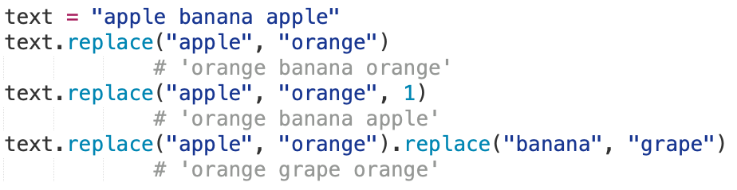
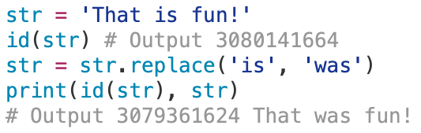
Replacing Substrings Examples
Simple Example:
Understanding new string replacement:
Chaining:
Common use cases:
Sanitizing input: <string object>.replace(”<”, “&lt;”)replace start HTML tags
Normalizing text: <string object>.replace(“-”, “ “).replace(“_”, “ “)

Slide 24
Searching Substrings
find() method searches for specified substring within string
Returns an index of the first occurrence of the substring, or return -1 if not found
General format for the string find() method:
<string object>.find(substring[, start[, end]])
Optional start and end allow range-limited searching
start is the starting index with a default of 0
end is the ending index with a default equal to the length of the string (i.e., len(string))
Can be used to check existence of a substring (if string.find(...) != -1:)
find() is case-sensitive ( “Cat” ≠ “cat” )
Can be chained with other string methods for compounding transformations
Utilize for parsing, validation, and conditional logic

Slide 25
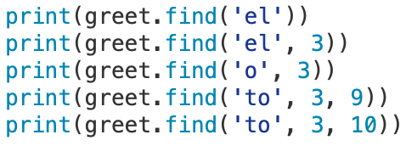
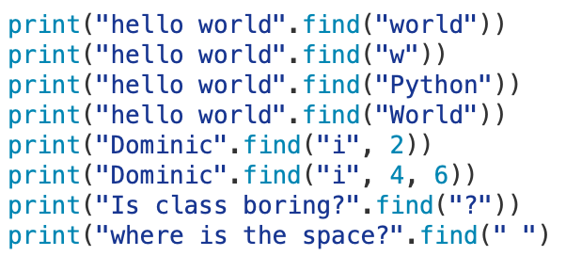
Searching Substrings Examples
greet = ‘Welcome to python’
What about these?
W | e | l | c | o | m | e |  | t | o |  | p | y | t | h | o | n
0 | 1 | 2 | 3 | 4 | 5 | 6 | 7 | 8 | 9 | 10 | 11 | 12 | 13 | 14 | 15 | 16
Output
1
-1
4
-1
8
Output
6
6
-1
-1
3
5
15
5

Slide 26
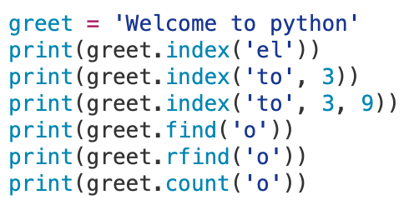
Searching Substrings
index() works the same as find() method, except that it raises an exception if the substring does not exist
rfind() returns the last index where the substring is found, or -1 otherwise
count() returns number of times a substring occurs in string
W | e | l | c | o | m | e |  | t | o |  | p | y | t | h | o | n
0 | 1 | 2 | 3 | 4 | 5 | 6 | 7 | 8 | 9 | 10 | 11 | 12 | 13 | 14 | 15 | 16
Would this throw an error?

Slide 27
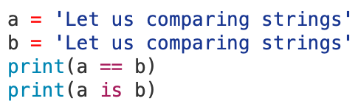
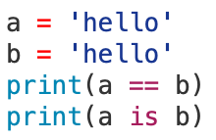
Comparing Strings
Comparison between strings is typically performed character-by-character using the ASCII values
Criteria also includes character order and length of string
String objects can be compared using
Relational operators
< <= > >=
Equality operators
== !=
Membership operators
(does substring exist in string?)
in not in
Identity operators
(are strings bound to same object?)
is is not
True
False
Python Optimization
What about this comparison?
True
True

Slide 28
Test Methods for Strings
String methods can test a string for specific characteristics
Method | Description
isalnum() | Returns True if the string contains only alphabetic letters or digits and is at least one character in length. Returns False otherwise.
isalpha() | Returns True if the string contains only alphabetic letters and is at least one character in length. Returns False otherwise.
isdigit() | Returns True if the string contains only numeric digits and is at least one character in length. Returns False otherwise.
islower() | Returns True if all alphabetic letters in the string are lowercase, and the string contains at least one alphabetic letter. Returns False otherwise.
isspace() | Returns True if the string contains only whitespace characters and is at least one character in length. Returns False otherwise. Whitespace includes spaces, newlines (\n), and tabs (\t).
isupper() | Returns True if all alphabetic letters in the string are uppercase, and the string contains at least one alphabetic letter. Returns False otherwise.
Also test if a string startswith() or endswith() a specific value

Slide 29
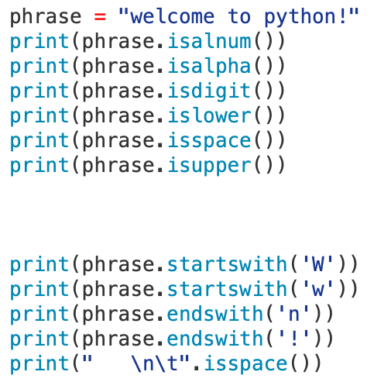
Test Methods for Strings
Which one of these is True?
What are True or False?

Slide 30
Modification Methods for Strings
Method | Description
lower() | Returns a copy of the string with all alphabetic letters converted to lowercase. Characters already lowercase or non-alphabetic remain unchanged.
lstrip() | Removes all leading whitespace characters (spaces, \n, \t) from the string.
lstrip(char) | Removes all instances of the specified char from the beginning of the string.
rstrip() | Removes all trailing whitespace characters (spaces, \n, \t) from the string.
rstrip(char) | Removes all instances of the specified char from the end of the string.
strip() | Removes all leading and trailing whitespace characters from the string.
strip(char) | Removes all instances of the specified char from both the beginning and end of the string.
upper() | Returns a copy of the string with all alphabetic letters converted to uppercase. Characters already uppercase or non-alphabetic remain unchanged.

Slide 31
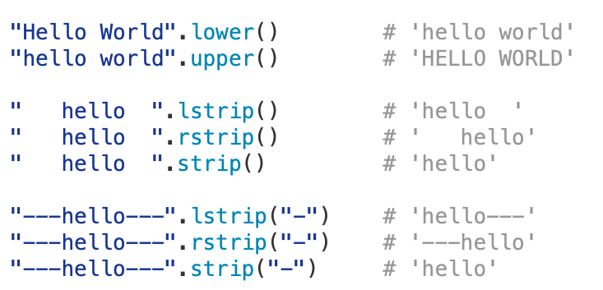
Modification Methods for Strings
Let’s look a few modifications to strings

Slide 32
Splitting Strings
split() divides a string into a list of substrings based on a separator.
The returns a list of substrings (aka tokens) that forms part of a larger string
Splitting is performed left to right
Commonly used for tokenizing, parsing, and preprocessing text
General format for the string split() method:
<string object>.split([separator][, maxsplit])
The separator specifies the delimiter to be used for splitting, is case-sensitive
If the separator is omitted it defaults to a whitespace (spaces, tabs, newlines)
Consecutive whitespace is treated as a single delimiter when separator is omitted.
maxsplit limits the number of splits; remaining string is returned as the final element.
Default value for maxsplit is -1, which means all occurrences

Slide 33
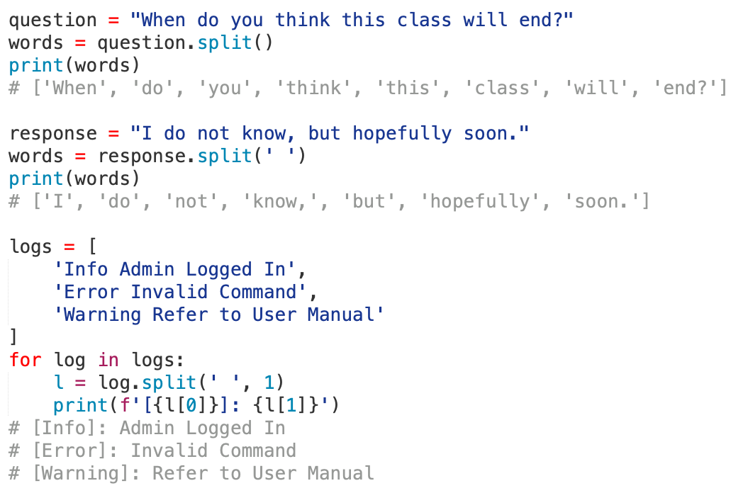
Splitting Strings Example
L for each iteration:
['Info', 'Admin Logged In']
['Error', 'Invalid Command']
['Warning', 'Refer to User Manual']

Slide 34
Joining Strings
The join() method joins a list of strings together to create a single string
General format for the string join() method:
<string object>.join(iterable)
The string object is the separator between elements which returns a single string
Common separators are:
Empty: ””
Space: “ ”
Comma: ”,”
Newline: “\n”
Slash: “/”
Used with iterable objects (list, set, tuples, dictionary)
iterable must contain only string values
Commonly used are list, tuples, and generators
Utilize for reconstructing sentences in AI, CSV formatting, or path building

Slide 35
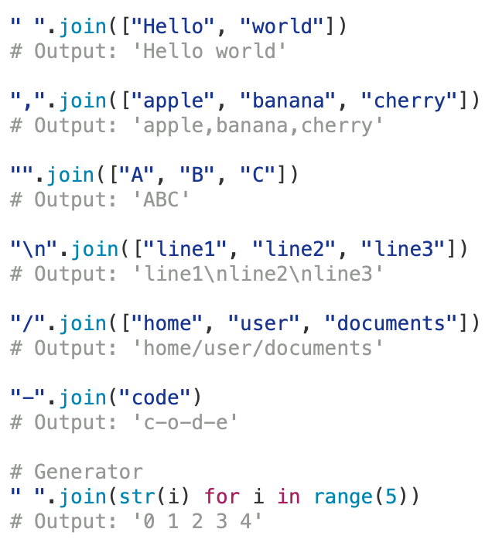
Joining Strings

Slide 36
Full Method List for Strings
print(dir(str))
['__add__', '__class__', '__contains__', '__delattr__', '__dir__', '__doc__', '__eq__', '__format__', '__ge__', '__getattribute__', '__getitem__', '__getnewargs__', '__gt__', '__hash__', '__init__', '__init_subclass__', '__iter__', '__le__', '__len__', '__lt__', '__mod__', '__mul__', '__ne__', '__new__', '__reduce__', '__reduce_ex__', '__repr__', '__rmod__', '__rmul__', '__setattr__', '__sizeof__', '__str__', '__subclasshook__', 'capitalize', 'casefold', 'center', 'count', 'encode', 'endswith', 'expandtabs', 'find', 'format', 'format_map', 'index', 'isalnum', 'isalpha', 'isdecimal', 'isdigit', 'isidentifier', 'islower', 'isnumeric', 'isprintable', 'isspace', 'istitle', 'isupper', 'join', 'ljust', 'lower', 'lstrip', 'maketrans', 'partition', 'replace', 'rfind', 'rindex', 'rjust', 'rpartition', 'rsplit', 'rstrip', 'split', 'splitlines', 'startswith', 'strip', 'swapcase', 'title', 'translate', 'upper', 'zfill’]
For more information on Python string methods: LINK

