Slide 1
Groovy AST Transformations
Who Am I?: David Clark
Contact Info: david@psionicwave.com
Presentation Information:
https://github.com/dwclark/AstTransformations
Notes:
See ast.odt/ast.pdf in git hub repo

Slide 2
How do you make the perfect logging statement in Java?

Slide 3
What is Wrong Here?
This will result in a concatenation operation even if the debug level is not enabled

Slide 4
Fix #1
This fixes the problem of concatenation always happening, stuff is passed to the log.debug(), and will only be evaluated if the debug method performs a log operation.
However, this only works if stuff.toString() does the “right thing.” So what do we do if stuff.toString() doesn't give us what we want?

Slide 5
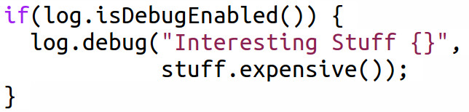
Fix #2
This fix is “correct” and does the “right thing.” stuff.expensive() is only called if the debug level is enabled. We could even go back to simple string concatenation and not use the template braces.
However, this is 1) much uglier, 2) Adds visual noise, and 3) introduces a new possible problem: If we decide to change this to log at a different level (say the warn level) then we have to remember to change it in both places. Anyone here ever guarded a warn logging statement with an isDebugEnabled() method call.

Slide 6
What's the Real Fix?
Go back to the original version!
And get a real programming language!

Slide 7
The Real Problem is With the Language
It's important to keep in mind that your logging library knows exactly when it should log something, this is not a problem of lack of information.
But, the string concatenation will happen before the your logging library can do something intelligent to stop it.
The string template approach only works some of the time and solves the problem by exploiting a separate feature of the language, the fact that we can sometimes arrange things so that argument evaluation is cheap.
But the only way to really solve the problem in java is to duplicate the logic for deciding when to debug. It's already inside the logging statements, now have to move it outside too.
To solve the problem completely we need to change the semantics of Java. We need a way to tell it to only do the concatenation if the proper level is enabled (which Java knows).

Slide 8
Enter
Groovy AST
Transformations

Slide 9
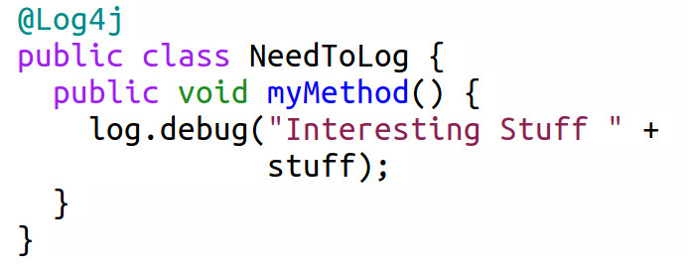
What Does This Do?
@Log4j tells the groovy compiler to load an AST transformation which:
Alters the NeedToLog class and gives it a private static final log variable and initializes it with the appropriate Logger.
Wraps all log statements inside the NeedToLog class with the appropriate guards. The log.debug() call will be wrapped inside an isDebugEnabled() guard.
Technically groovy cheats a little and uses a ternary expression to make the transformation easier, but it does the same thing as the if guard.

Slide 10
Time For
A Little
Compiler
Theory.
Don't worry, this shouldn't hurt (well that much anyway).
Cheating is encouraged.

Slide 11

How Does Groovy See This?
As a BlockStatement which contains a single Statement
That single statement is an ExpressionStatement
That ExpressionStatement wraps a DeclarationExpression
That DeclarationExpression has a VariableExpression on the left side
And that DeclarationStatement has a BinaryExpression on the right side
That BinaryExpression contains two ConstantExpressions and a '+' Token
Duh? Right? What you call yourselves programmers?
Don't worry, I cheated to figure this out, and you can cheat too.

Slide 12
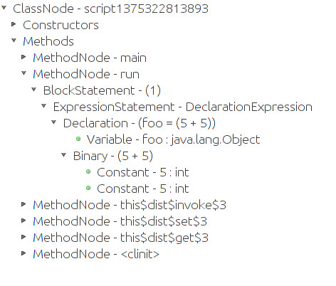
Groovy Console, The Cheating AST Programmer's Best Friend

Slide 13
The Basic Idea For Writing Any Groovy AST Transformation
Write the code that you would write by hand if you were not writing an AST transformation (i.e. write source code not AST nodes).
Load the script into the Groovy Console and see how Groovy makes your source code into an AST.
Using the groovy AST packages build up AST nodes in code. This is nothing more than regular object oriented programming. The only difference is that you are modelling source code, not business requirements.
Run the AST transformation inside Groovy Console and analyze both 1) the source code that your AST produces and 2) The actual AST that your code produces.
Repeat steps 3 and 4 iteratively and converge onto your solution
Profit!!

Slide 14
Example #1: Writing Methods With AST Transformations
Motivation: I often want two methods that do the exact same thing except that one of them runs synchronously and the other asynchronously.
The Wrong Solution: Write two methods. One that does the normal synchronous stuff and a second that invokes the first method from inside a Runnable or Callable.
Why Is This The Wrong Solution?: I don't want to test two methods. It is tedious and error prone. The asynchronous method is something I SHOULD test since I wrote it, but testing asynchronous stuff is difficult.
The Right Solution: Get the compiler to write the asynchronous method for me. The compiler already knows the method name and signatures. It knows where the threading stuff is located. As a bonus, if the signatures of the method changes, the asynchronous method will change too. If the synchronous method goes away, so does the asynchronous method.
Source Files: *AsyncPair*.groovy files (Note, 3 Files used here)

Slide 15
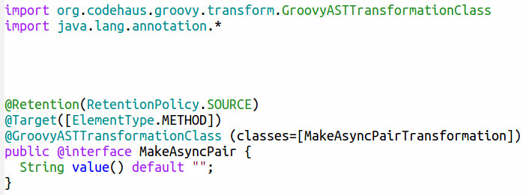
Source Code File #1:
The Java Annotation
1) This is a regular Java Annotation
2) No need for runtime retention
3) When the groovy compiler finds this annotation invoke the specified transformation, passing it the annotated element. In this case it will be a method node

Slide 16
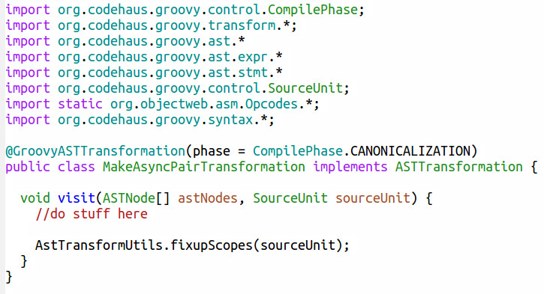
Source Code File #2:
The AST Transformation
1) Standard imports for an AST Transformation
2) There are 9 compiler phases, CANONICALIZATION is a good default.
3) Implement ASTTransformation, it has a single method, visit.
4) Magic happens here. Without this all kinds of weird errors pop up. Trust me, just stick it at the end of visit().

Slide 17
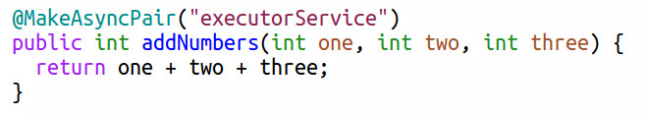
Source Code File #3:
Use The Annotation

