Slide 1
Concurrent/Multi-Threaded Programming on the JVM with Groovy and GPars
Who Am I?: David Clark
Contact Info: dclark@photonfunding.com
Presentation Information:
https://github.com/dwclark/GroovyThreading

Slide 2
Single
Core
Processor?

Slide 3
Free
Lunch

Slide 4
Free
Lunch

Slide 5
3.4

Slide 6
> 3.4 Ghz?

Slide 7
3.4 Ghz Max!

Slide 8
Moore's Law?

Slide 9
Moore's Law!!

Slide 10
Java

Slide 11
1.0

Slide 12
Thread

Slide 13
Runnable

Slide 14
synchronized

Slide 15
final

Slide 16
volatile

Slide 17
etc.

Slide 18
Mistakes?

Slide 19
Locks

Slide 20
void run()

Slide 21
Memory
Model

Slide 22
Synchronize
By Default

Slide 23
No Pools!

Slide 24
Roll Your Own

Slide 25
5.0

Slide 26
Fixes!

Slide 27
Locks and Atomics

Slide 28
Callable

Slide 29
Futures

Slide 30
Memory
Model

Slide 31
Unsynchronized

Slide 32
Pools!

Slide 33
GPars

Slide 34
Built on JDK 5-7

Slide 35
Immutability

Slide 36
Heisenbugs

Slide 37
Read The Bible

Slide 38
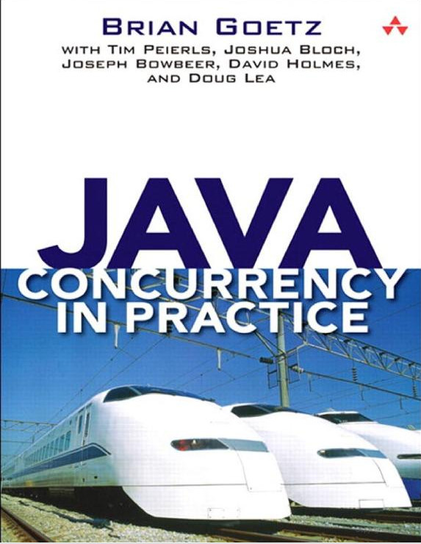

Slide 39
Performance?

Slide 40
Design!!

Slide 41
Groovy

Slide 42
Immutability!!
See: DemoValues.groovy and ImmutableList.groovy

Slide 43
Thread Control
See: Interrupts.groovy and DemoInterrupts.groovy

Slide 44
Locking
See: DemoLocking.groovy

Slide 45
GPars

Slide 46
Pools and Asynchronous
Invocation
See: Email.groovy

Slide 47
Email Requirements
Thread safe Email class
Be able to send email synchronously
Be able to send 1..n emails asynchronously
Asynchronous sends must use a thread pool
Need to either “fire and forget” emails to wait on futures

Slide 48
Actors
See: FileManager.groovy, DemoEachFileParallel.groovy, DemoWebServer.groovy.

Slide 49
Dataflow
See: DemoWebCrawling.groovy

Slide 50
Web Crawler Requirements
Parse urls file to figure out which urls to download
Download each url
Save the url contents to a file with a unique name
Index the contents of the url
Write the index information, associated with the file created in #3 to an analysis file
When processing is complete, save the analysis file in the appropriate folder
Shutdown cleanly
Possible future enhancement, resubmit index info to #2

Slide 51
Parse Url
Download Url
Save Contents
Index Contents
Write Index Info
Save Analysis
And
Shutdown

Slide 52
Fork/Join
See: DemoForkJoin.groovy

Slide 53
Parallel Collections
See: DemoParallelArrays.groovy

Slide 54
YouTube
See: https://www.youtube.com/watch?v=qrCUy9H76IA

Slide 55
Thank You!
Who Am I?: David Clark
Contact Info: dclark@photonfunding.com
Presentation Information:
https://github.com/dwclark/GroovyThreading
Notes:
See groovy_gpars.odt/groovy_gpars.pdf in git hub repo

