Slide 1
Multi-Threaded Programming with GPars
Who Am I?: David Clark
Contact Info: dclark@photonfunding.com
Presentation Information:
https://github.com/dwclark/GroovyThreading

Slide 2
Diagram Legend
Functionality, code that does something such as a closure, method, object, etc.
Thread of Execution
Invoke Code
Synchronize Data
Synchronization Point

Slide 3
Fire and (Maybe) Forget Concurrency

Slide 4
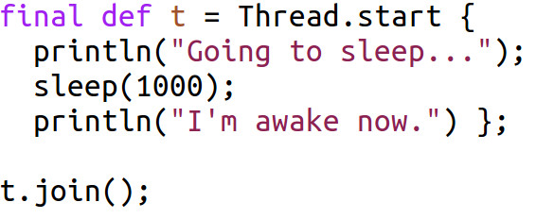
Using Thread.start

Slide 5
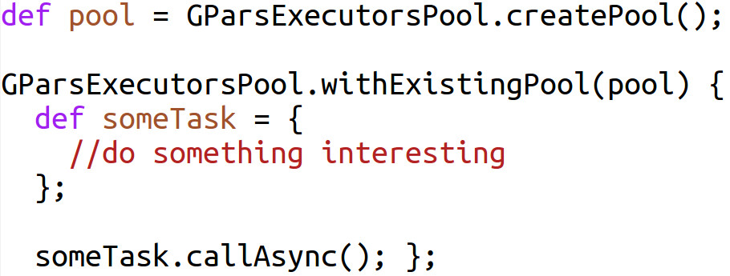
Using callAsync()

Slide 6
Sample Files
DemoThreadCreate.groovy
DemoAysnchronous.groovy

Slide 7
Simple Dataflow Concurrency
NOTE: No explicit invocation of functionality. Invocation of code is dependency based and is mostly based on dependency management done by GPars.

Slide 8
Complex Dataflow Concurrency
NOTE: No explicit invocation of functionality. Invocation of code is dependency based and is mostly based on dependency management done by GPars.

Slide 9
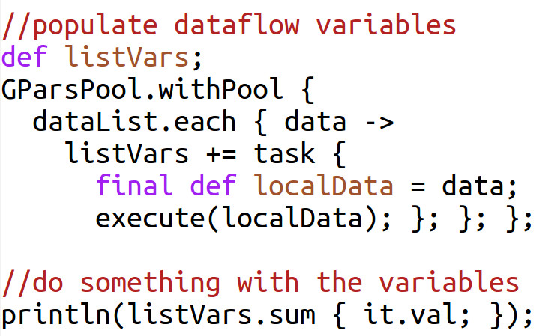
Using Dataflow Variables

Slide 10
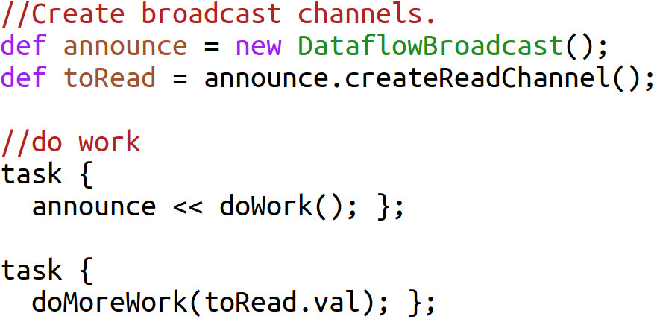
Dataflow Queues and Channels

Slide 11
Sample Files
Integrate.groovy and DemoIntegrate.groovy
DemoWebCrawling.groovy

Slide 12
Actors
NOTES: Invocation should always be done via message passing. Active objects can simulate method calls, but use message passing under the hood. Actors can always manipulate their own state without fear of threading issues, but any state shared between actors must be done via message passing. This allows the synchronization points to ensure that data access is thread safe and follows the Java memory model.

Slide 13
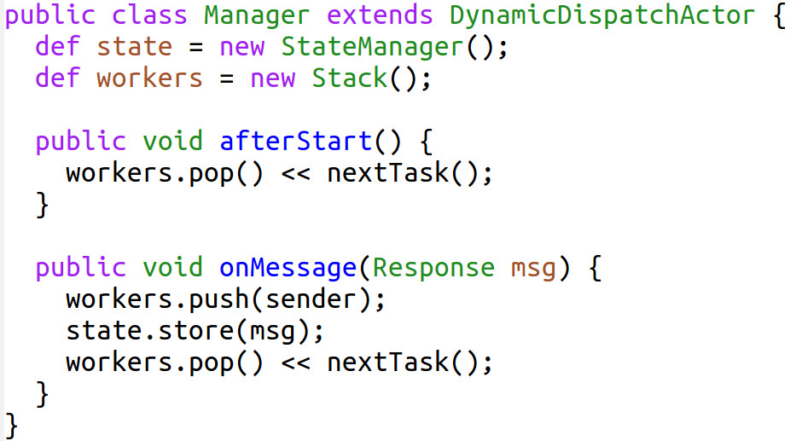
Actor as Manager

Slide 14
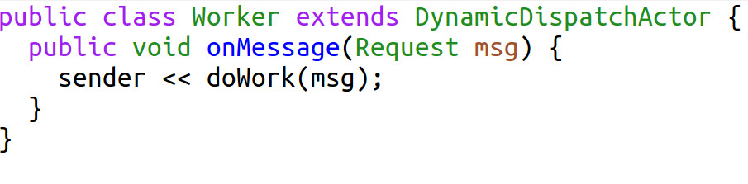
Actor as Worker

Slide 15
Sample Files
FileManager.groovy, FileWorker.groovy, DemoEachFileParallel.groovy
DemoWebServer.groovy

Slide 16
Fork/Join Framework
Single thread, one function invokes another and returns the result.
One large task is recursively (or iteratively) broken down into smaller tasks. This is the “fork” part of the algorithm. Next the results of the tasks are combined together. This is the “join” part of the algorithm

Slide 17
Sample Files
DemoForkJoin.groovy
Notes: Unfortunately, setting up tasks for Fork/Join can involve a bit of set up code. This code can be abstracted using inheritance and hidden using Groovy's meta programming magic. This means it is hard to excerpt the essence of fork/join. The above code has several examples and should show you how to use fork/join on your projects.

Slide 18
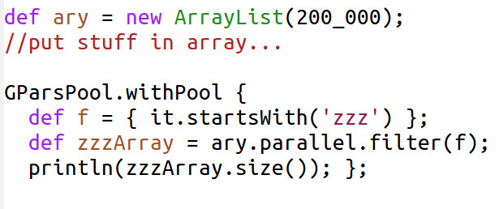
Parallel Arrays
NOTE: filter performs the same operation as findAll() in groovy.

Slide 19
Sample Files
DemoParallelEach.groovy
DemoParallelArrays.groovy

Slide 20
Thank You!
Who Am I?: David Clark
Contact Info: dclark@photonfunding.com
Presentation Information:
https://github.com/dwclark/GroovyThreading

