Slide 1
Multi-Threaded Programming in Groovy
Who Am I?: David Clark
Contact Info: dclark@photonfunding.com
Presentation Information:
https://github.com/dwclark/GroovyThreading
Notes:
See groovy.odt in git hub repo

Slide 2
Single
Core
Processor?

Slide 3
Free
Lunch

Slide 4
Free
Lunch

Slide 5
> 3.4 Ghz?

Slide 6
3.4 Ghz Max!

Slide 7
Moore's Law?

Slide 8
Moore's Law!!

Slide 9
Java

Slide 10
1.0

Slide 11
Mistakes?

Slide 12
Locks

Slide 13
Runnable

Slide 14
Memory
Model

Slide 15
Synchronize
By Default

Slide 16
No Pools!

Slide 17
Roll Your Own

Slide 18
5.0

Slide 19
Fixes!

Slide 20
Locks and Atomics

Slide 21
Callable

Slide 22
Futures

Slide 23
Memory
Model

Slide 24
Unsynchronized

Slide 25
Pools!

Slide 26
Roll Your Own?

Slide 27
GPars

Slide 28
Built on JDK 5-7

Slide 29
Roll Your Own?

Slide 30
No!

Slide 31
Tips and Tricks

Slide 32
Immutability

Slide 33
Immutability!!!!

Slide 34
Heisenbugs

Slide 35
Read The Bible

Slide 36
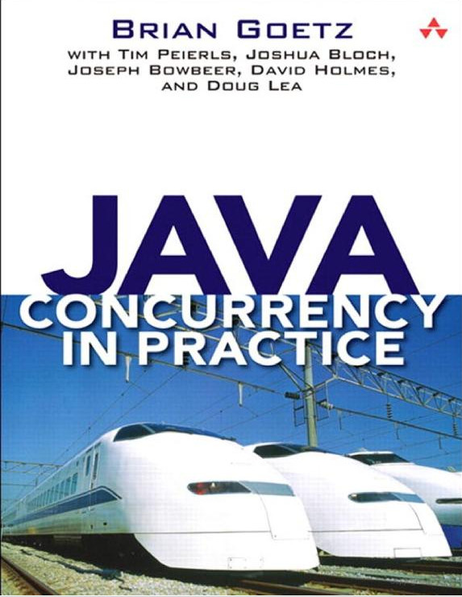

Slide 37
TMTOWDI

Slide 38
Performance?

Slide 39
Design!!

Slide 40
Scala and Clojure

Slide 41
Groovy

Slide 42
Closures

Slide 43
Lexical Scoping

Slide 44
Interface Implementation

Slide 45
Currying

Slide 46
AST Transformations

Slide 47
Specifically...

Slide 48
Timing
See: Timing.groovy

Slide 49
Thread Creation
See: DemoThreadCreate.groovy

Slide 50
Thread Termination
See: Interrupts.groovy and DemoInterrupts.groovy

Slide 51
Immutability
See: DemoValues.groovy and ImmutableList.groovy

Slide 52
Synchronization
See: DemoLocking.groovy

Slide 53
Futures and Callables
See: DemoParallelCollect.groovy

Slide 54
Modern Threading

Slide 55
Less Explicit Thread Creation

Slide 56
Less Manual Synchronization

Slide 57
Immutability

Slide 58
Isolated Mutability

Slide 59
Thank You!
Who Am I?: David Clark
Contact Info: dclark@photonfunding.com
Presentation Information:
https://github.com/dwclark/GroovyThreading
Notes:
See notes.txt in git hub repo

