Slide 1
Modern Groovy Domain Specific Languages
Who Am I: David Clark
Where Do I Work: Principal Engineer, Research Now
Where Do I Code: https://github.com/dwclark
Where Is This Presentation:
Why Is This Presentation So Boring And On A White Background?:
Because “creative” presentations inevitably involve dark backgrounds and dark text. Within 30 seconds of seeing a dark background someone in the audience will ask to change to a white background. Let's all just cut to the chase and go with boring black on white, besides it's the content you care about anyway, right?

Slide 2
What a DSL is NOT
Usually it isn't domain specific, unless you define “domain” very generically.
It definitely isn't a new language. A new language is going to involve parsers, lexers, interpreters/compilers, debuggers, runtime libraries and a lot more.
It's not just a matter of leaving off semi-colons and parenthesis or other syntactic tricks, though this can be a part of a good DSL.
It's not the first thing you do in a project, you don't write a DSL at the beginning of a project. You write it at the earliest in the middle of a project.
It's almost certainly not going to be used by non-programmers, definitely not going to be used by non-technical people.

Slide 3
What a DSL is
A readable expression of what the code does, not how it does it.
Encapsulation of the essence of the problem you are solving in syntax.
Usually occupies a middle ground between configuration and code; configuration with small amounts of executable code.
A creative use of delaying code evaluation. Normal code gets executed now, DSLs get a lot of their power from evaluating code at unexpected times.
A shared vocabulary for expressing shared concepts. The concepts part is key here. Libraries provide shared ways of doing things, DSL's should be about concepts.

Slide 4
Ladies and Gentleman, we now bring you this rant completely free of charge!

Slide 5

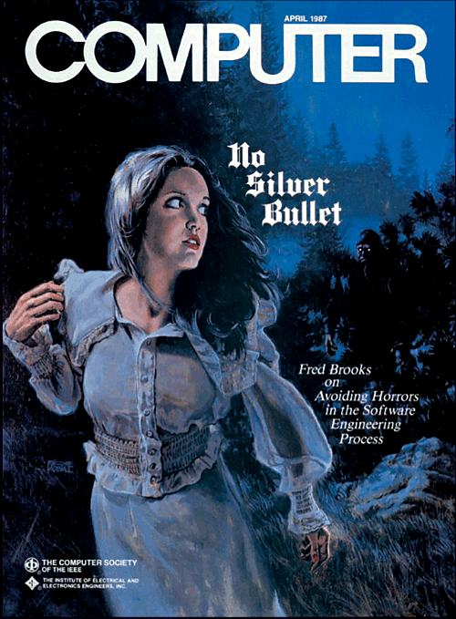
OO?
Functional?
Reactive?
Agile?
Testable?
Readable?
Anyone read Brooks?

Slide 6
Solve The Problem By Avoiding It
First off, DSL's are NOT a silver bullet, programming is just plain hard.
Avoid the OO/Functional battle with DSL's, you can't tell what is behind the curtain.
DSL's should be small. Small enough is always readable enough.
Anything can be agile, since a DSL is something, it can be agile.
The syntax of the DSL shouldn't need testing.
The DSL engine is usually easily tested
Is a DSL reactive? Maybe. Who knows? Who cares?
Again NOT a silver bullet, but a valuable way to avoid BS and focus on the essence of the problem.

Slide 7
Ladies and Gentleman, we now return to our regularly scheduled presentation. Now with even more black text on white background!

Slide 8
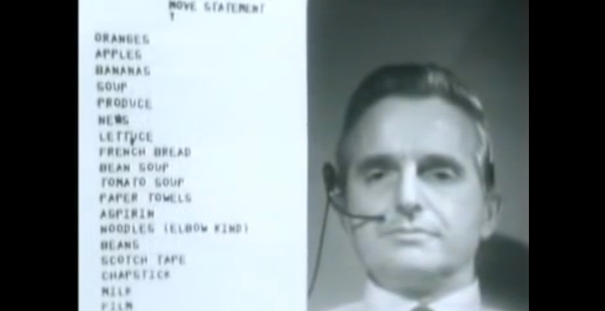
DEMOS

