Slide 1

Twits: perusing GNIP Twitter data
By Dodge Coates

Slide 2
Lots of data

Slide 3
Lots of data
~5,500 json files

Slide 4
Lots of data
~5,500 json files
~2 terabytes in size, uncompressed

Slide 5
Lots of data
~5,500 json files
~2 terabytes in size, uncompressed'
This was reduced to ~250 gigabytes of csv

Slide 6
Lots of data
~5,500 json files
~2 terabytes in size, uncompressed
This was reduced to ~250 gigabytes of csv
No schema available for the dataset

Slide 7

Gnip Enterprise Access to Twitter Data
Provide 1/10 of the twitter firehose
Accessed for roughly 2 ½ weeks, between late January and mid February, 2012

Slide 8
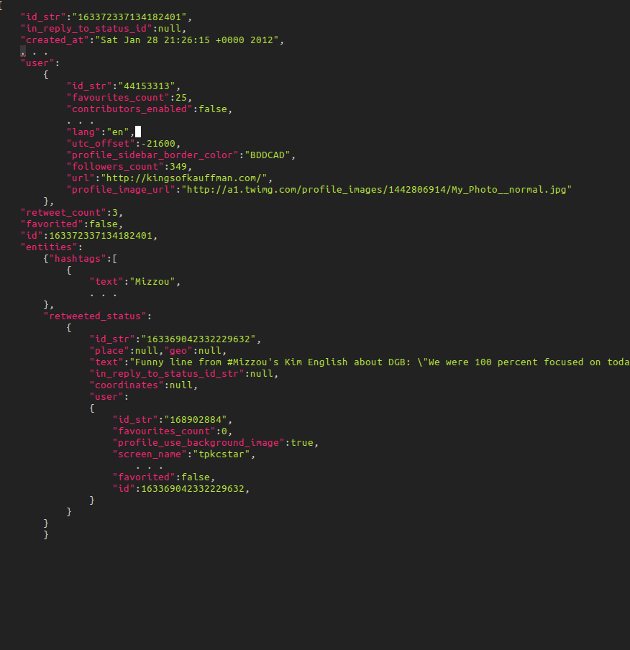
Data Sample

Slide 9

Goals

Slide 10
Goals
Exploring the data

Slide 11
Goals
Exploring the data
Developing an interesting prediction

Slide 12
Goals
Exploring the data
Developing an interesting prediction
Get a feel for working with a large dataset

Slide 13
The Data
A lot to process!

Slide 14
Storage
SQL

Slide 15
Storage
SQL
Distributed file systems (Hadoop)
  Hardware is too expensive
  API is too time-consuming

Slide 16
Storage
SQL
Distributed file systems (Hadoop)
  Hardware is too expensive
  API is too time-consuming
Settled on sampling

Slide 17

Preprocessing

Slide 18
Preprocessing
Takes about 20-30 hours on my desktop, depending on the complexity of the preprocessing

Slide 19
Preprocessing
Takes about 20-30 hours on my desktop, depending on the complexity of the preprocessing
Produces ~5,500 csv files

Slide 20
Preprocessing
Takes about 20-30 hours on my desktop, depending on the complexity of the preprocessing
Produces ~5,500 csv files
Each file contains 38 rows

Slide 21
Sampling
A sampling script is used to to uniformly sample the thousands of files

Slide 22
Sampling
A sampling script is used to to uniformly sample the thousands of files
Because each file represents a 3 minute portion of twitter activity, there is high variance between file sizes

Slide 23
Sampling
A sampling script is used to to uniformly sample the thousands of files
Because each file represents a 3 minute portion of twitter activity, there is high variance between file sizes
Therefore sampling must be done carefully to not distort time series data

Slide 24
Inspecting Data Features
Complete json object contains ~130 attributes
Components:
  User data
  Tweet data
  Original retweet data (a copy of the outer user/tweet data)
Reduced to 38 features in the processed data

Slide 25

Developing a Model Target: what to look for?

Slide 26
retweet_count
The current retweet number for a given tweet

Slide 27
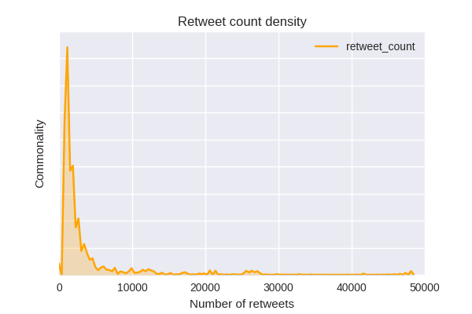
retweet_count
The current retweet number for a given tweet
    Not including zero retweets

Slide 28
Transforming retweet_count

Slide 29
Transforming retweet_count
sklearn.preprocessing.StandardScaler applied to a log transform (offset by 1)

Slide 30
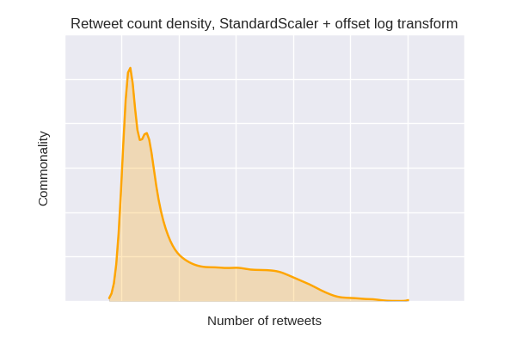
Transforming retweet_count
sklearn.preprocessing.StandardScaler applied to a log transform (offset by 1)

Slide 31
Transforming retweet_count
sklearn.preprocessing.StandardScaler applied to a log transform (offset by 1)

Slide 32
Apply clustering method to classify the response variable

Slide 33
Apply clustering method to classify the response variable
Use K-means, cluster the transformed distribution

Slide 34
Apply clustering method to classify the response variable
Use K-means, cluster the transformed distribution, 3 ways
Partitioning the tweets and encoding them yields the labels for classification

Slide 35
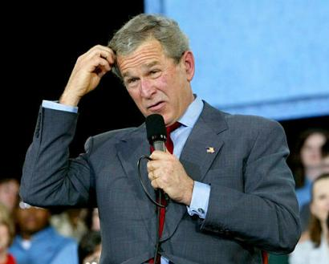
Transforming retweet_count
Doesn't work.

Slide 36
retweet_count is a bad target
Very highly correlated with number of followers

Slide 37
retweet_count is bad
Very highly correlated with number of followers
Very easy to predict

Slide 38
retweet_count is bad
Very highly correlated with number of followers
Very easy to predict
Not very interesting

Slide 39
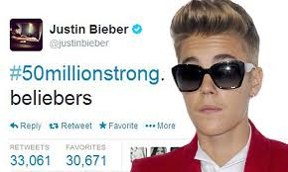
Tweetability

Slide 40
Tweetability
retweet_count / followers_count

Slide 41
Target: Tweetability
retweet_count / followers_count
More interesting idea for getting at the “goodness” of a tweet

Slide 42
Target: Tweetability
retweet_count / followers_count
More interesting idea for getting at the “goodness” of a tweet
Foolish to presume that tweetability corresponds with “goodness”?

Slide 43
Target: Tweetability
retweet_count / followers_count
More interesting idea for getting at the “goodness” of a tweet
Foolish to presume that tweetability corresponds with “goodness”?
    Probably.

Slide 44
Target Penalty
Add a constant penalty
    Low retweet counts should be disproportionately rewarded for high retweet/followers ratio
    Goal is not to maximize predictability

Slide 45
Tweetability
Add a constant penalty
    Low retweet counts should be disproportionately rewarded for high retweet/followers ratio
    Goal is not to maximize predictability
Add a penalty for diminishing returns

Slide 46
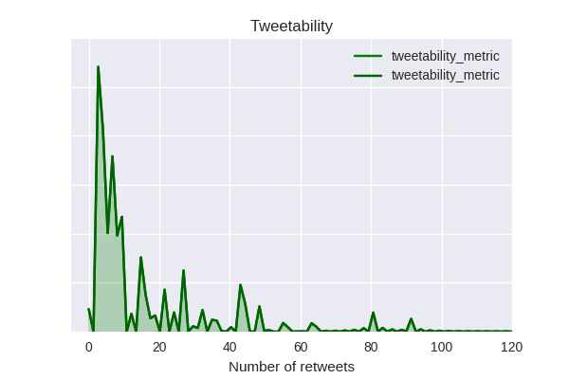
Tranforming Tweetability

Slide 47
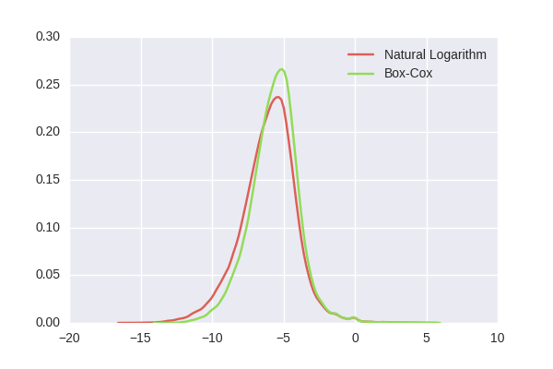
Transforming Tweetability
After Transformations

Slide 48
Transforming Tweetability
After Transformations
Minimized variance made partitioning better than k-means clustering for categorization

Slide 49
Engineered features
Hashtag count, user mention count
sentiment polarity
text diversity
punctuation score
word count
hashtag popularity
Etc.

Slide 50
Models
RandomForest and simple decision trees quite well
Both achieve about 70% accuracy, but high log loss
Interestingly, the additional features past three or four core features (statuses count, favorites count, etc) barely improved accuracy (~1 point) and often harmed log loss.

Slide 51
Models (cont.)
Voting classifier
  Consists of Random forest, Naive Bayes, and Logistic regression estimators
  Originally reduced log loss
  Yet to run again on corrected data

Slide 52
Takeaways and thoughts
Large datasets are brutal.
Carefully examine foreign data, particularly variable json, for structure and message, not just content
    The invested time is worth it.
Feature engineering can be very unintuitive

