Slide 1
Stepwise
IELTS Writing Feedback
& Model Essays
Milestone 2 · MLOps Infrastructure
Bei Li · Ernest Ferdian · Dimitris Pipinis · Xiahui Huang
Notes:
1 minute. AC215 Fall 2026 MS2. Team: Bei Li, Ernest Ferdian, Dimitris Pipinis, Xiahui Huang. Typed/pasted IELTS Academic Task 2 only. Source: https://harvard-iacs.github.io/2026-AC215/milestone2/

Slide 2
Containerized pipeline
make run
Ingest → Chunk → Embed / index → Qdrant
Web → FastAPI → Official context → Gemini
Frozen uv environments and source hashes.
Startup gates and persistent vector storage.
Source IDs, criterion coverage and essay quotes checked.
Notes:
2 minutes. Five custom Dockerfiles and five pyproject.toml/uv.lock pairs. Data services finish successfully before API/web start. Qdrant stores vectors persistently. Google Vertex AI performs actual inference; evidence validation rejects unchecked outputs. References: https://github.com/dlops-io/cheese-app-v0 and https://github.com/rahuldave/babykev. See compose.yaml and docs/setup.md.

Slide 3
Official knowledge sources
131
20
official source chunks
including every band 0–9
detailed official checks
TR 5 · CC 5 · LR 6 · GRA 4
Complete band PDF + key criteria + British Council guidance.
Task 2 / shared rules only during assessment.
8,049 candidate essays reserved for MS3; zero loaded now.
Notes:
2 minutes. 131 total: 80 cells, 20 subcriteria, 5 definitions, 7 rules, 9 descriptor pages and 10 teaching pages. Both tasks are indexed for full source coverage; Task 1 is excluded from scoring. Sources: https://ielts.org/cdn/ielts-guides/ielts-writing-band-descriptors.pdf ; https://ielts.org/cdn/ielts-guides/ielts-writing-key-assessment-criteria.pdf ; https://takeielts.britishcouncil.org/sites/default/files/writing_task_2_-_answer_the_questions.pdf . The third source is older supplementary guidance. MS3 candidates are excluded. Evidence: docs/evidence/data_quality.json.

Slide 4
Retrieval and scoring context
“How can I develop and support my position
with specific examples?”
Task Response · Target 6.5 → Bands 6 and 7
Each match includes URL, page, band and stable chunk ID.
Assessment retrieves the complete Task 2 band ladder.
40 criterion-band cases verified; Task 1 excluded.
Notes:
2 minutes. Demonstrate POST /api/retrieve with criterion TR and target 6.5. Returns bands 6 and 7. Scoring does not use the target: filtered mandatory coverage gets all 40 Task 2 cells, 20 checks and applicable definitions/rules; semantic search adds teaching context. Do not confuse cosine similarity with an essay score. Evidence: docs/evidence/retrieval_example.json and rag_verification.json. BAAI/bge-small-en-v1.5, CPU ONNX, 384 dimensions.

Slide 5
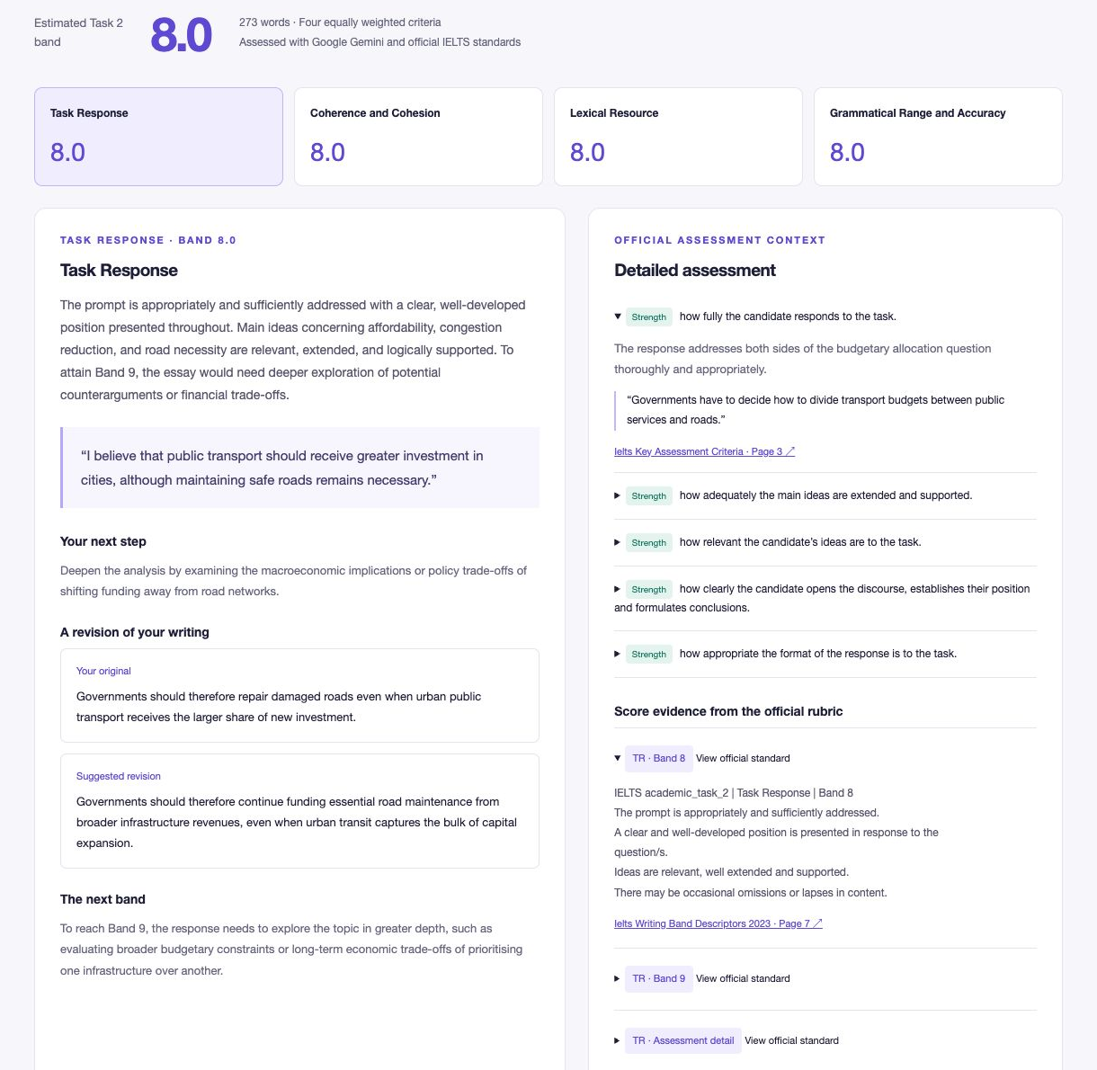
Real criterion feedback
Four criterion scores
Exact draft quotations
Specific revision examples
20 official detailed checks
Source and page links in every criterion
Notes:
2 minutes. Live sample: 273 words, overall 8.0 and four criterion scores 8. These are observed model outputs, not externally validated accuracy. Each tab gives exact original evidence, practical next steps and a revision. The right panel contains official subcriteria, not duplicated score summaries. Source/excerpt checks are structural; they cannot prove the model reasoning is correct. Evidence: docs/evidence/feedback_output.json and app-feedback.png.

Slide 6
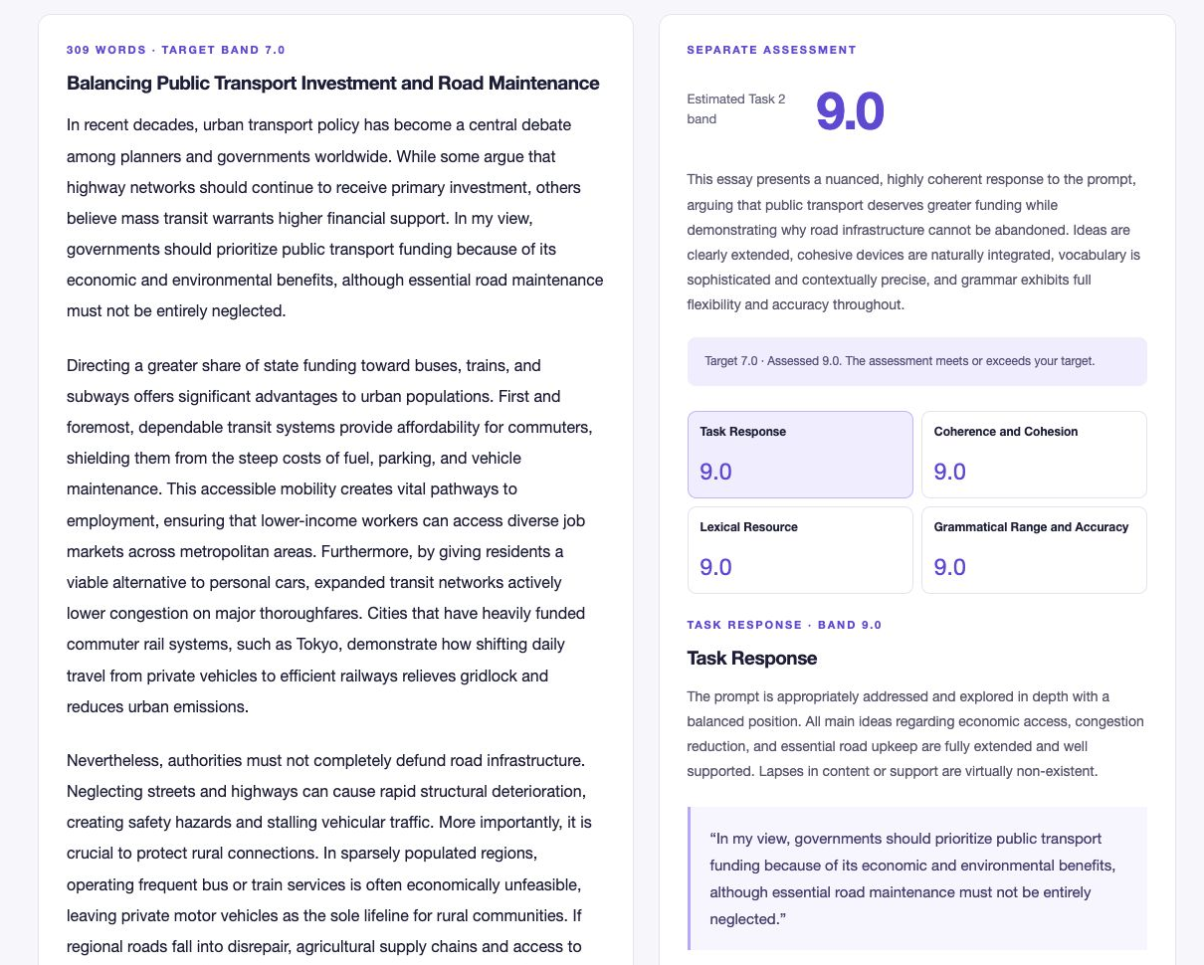
Model essay and separate assessment
Target 7.0
Assessed 9.0
Full prose
Your position and ideas
Fresh assessment
Explained criterion scores
Notes:
3 minutes. Show Goals: target band, position and ideas. Then show complete model essay. A separate fresh Gemini assessment receives only the question and essay, not target/generator notes. The target 7.0 essay was assessed 9.0. This proves the workflow and also exposes target deviation / calibration work. Show the score difference honestly; do not claim a certified score or guaranteed target match. Sources: docs/evidence/model_essay_request.json, model_essay_output.json, app-model.png.

Slide 7
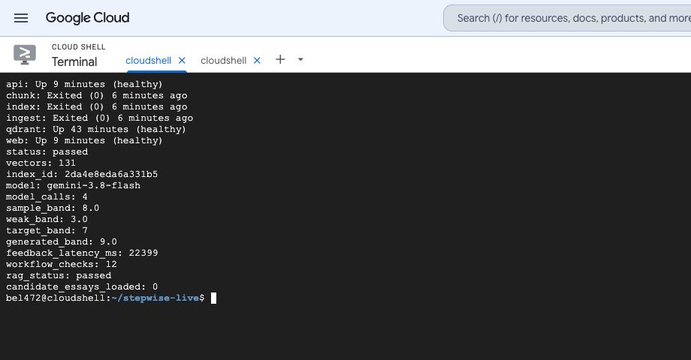
Verified cloud run
18 local tests
12 workflow checks
40 retrieval cases
131 indexed points
make evidence captures receipts without repeating model calls
Notes:
2 minutes. Dedicated project stepwise-ac215-20261010, Harvard self-paid folder, Vertex API and billing enabled. Cloud Shell is temporary, not a persistent production deployment. Source snapshot 3aea32a1828dd022, chunk snapshot 52814016b8103614, index 2da4e8eda6a331b5. Model gemini-3.8-flash. 12 workflow checks, 18 local unit tests, separate 40-case retrieval check. Weak essay 3.0 < sample 8.0. Draft feedback 22.4 seconds in this one run. Receipts include response IDs and token counts. Source: docs/evidence/verification.json, index.json and pipeline.log.

Slide 8
MS3: adaptation and scoring evaluation
Reliable Task 2 data and leakage checks
Prompting vs official RAG vs open-model LoRA
Criterion agreement and repeated-run variance
Target-band deviation, latency and inference cost
Notes:
1 minute. Audit data reuse, score provenance, near duplicates and prompt families before adaptation. Compare prompting vs official RAG vs open-model LoRA. Track criterion MAE, within-0.5 agreement, repeated-run variance, target deviation, latency and tokens. Current integration success is not scoring calibration. Every team member should understand the entire code and demo. Repository https://github.com/dwcqwcqw/stepwise/tree/milestone2 .

