Slide 1
U.S. Births & Unemployment Rate
Daniel Dittenhafer
Final Project
IS607 – Data Acquisition & Management

Slide 2
Data Sets
Natality
Population
Unemployment Rate

Slide 4
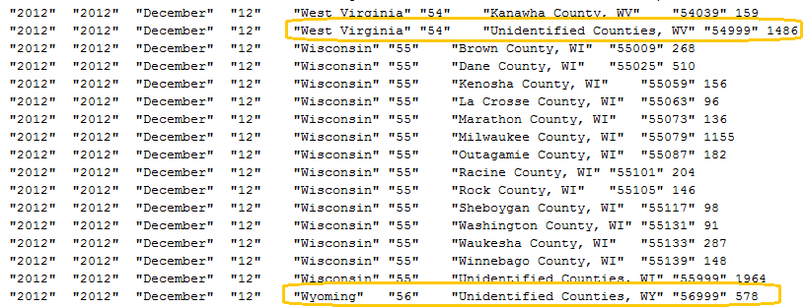
Unidentified Counties

Slide 5
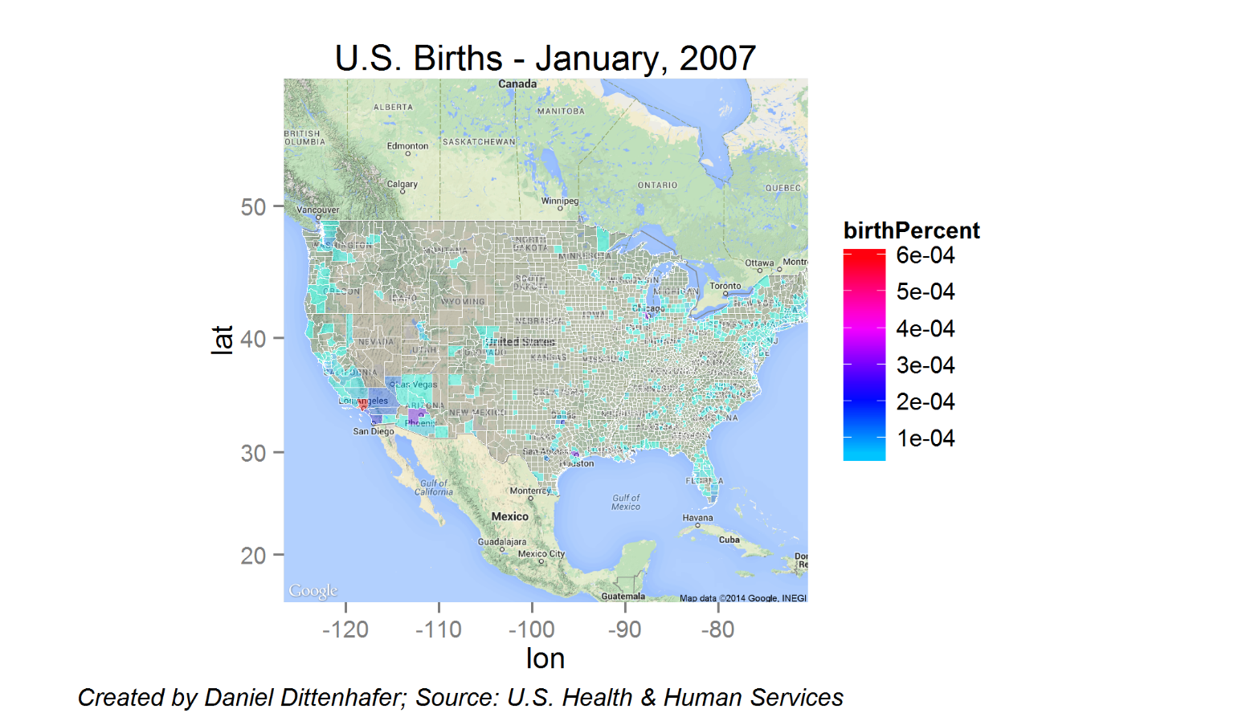

Slide 6
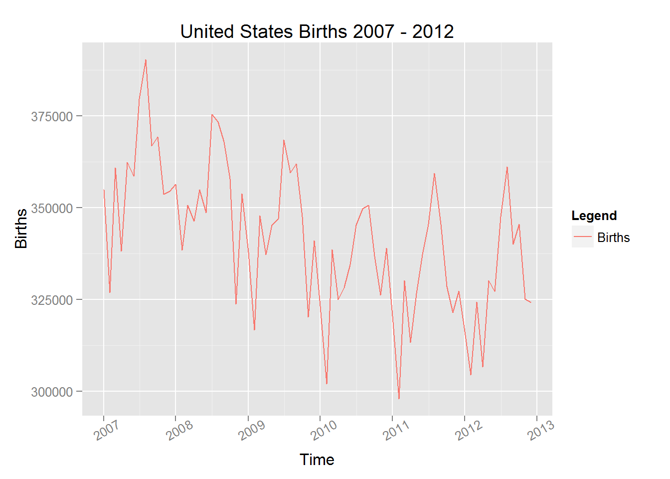
United States Births

Slide 7
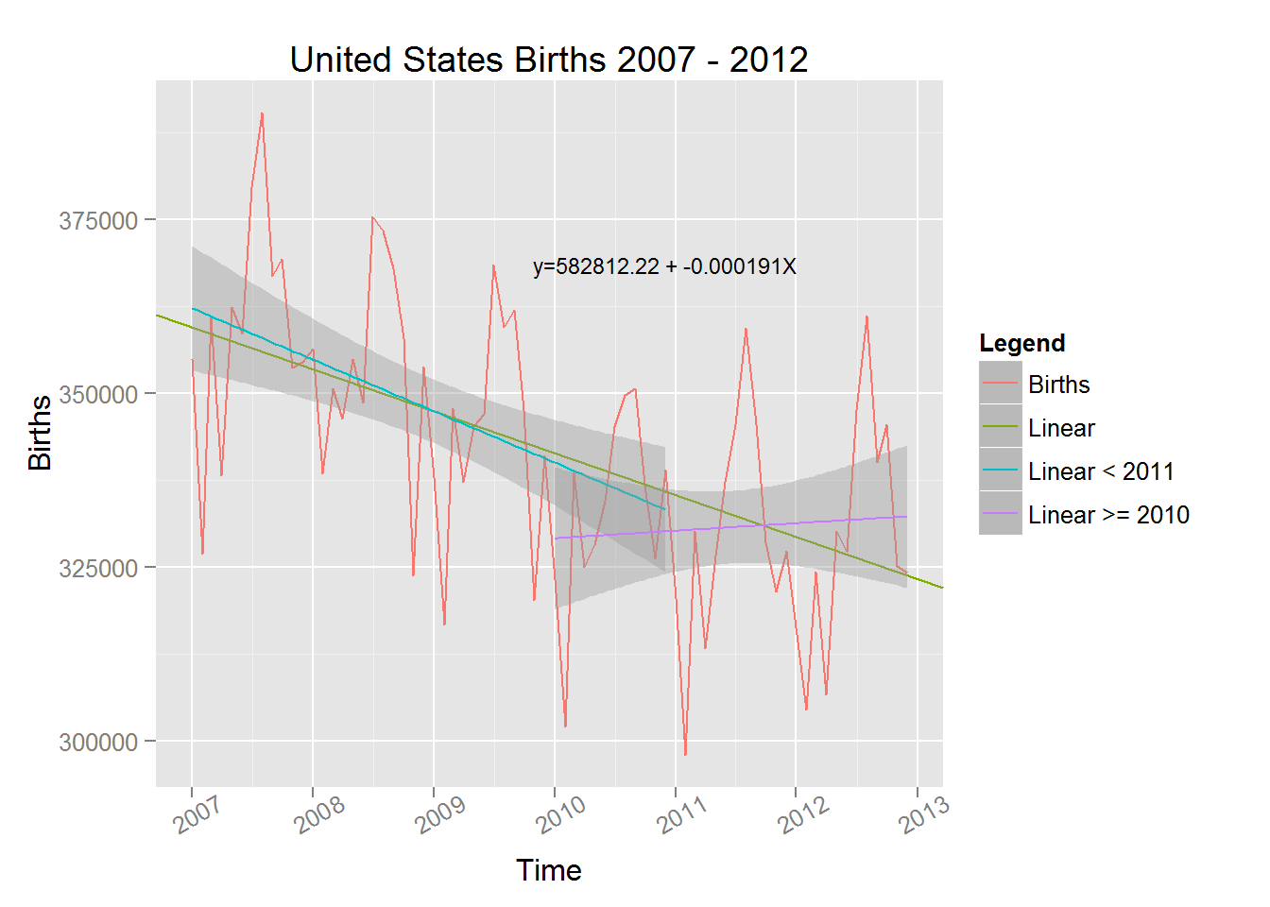
United States Births

Slide 8
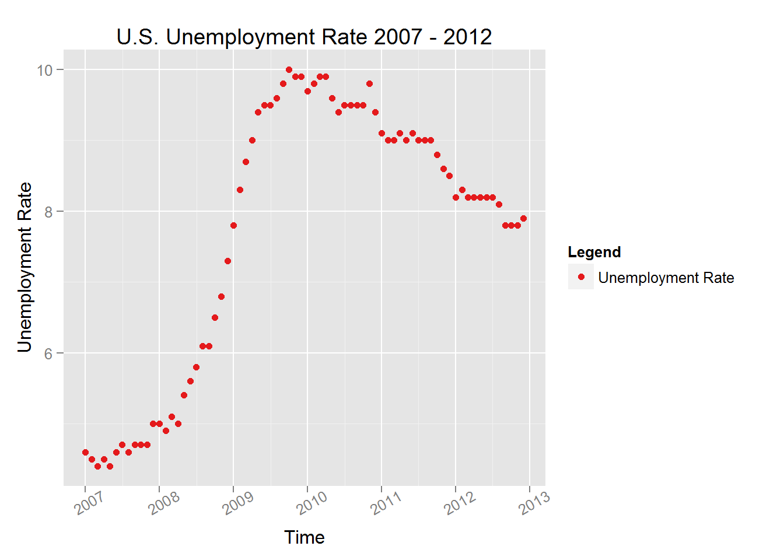
Unemployment Rate

Slide 9
Functional Form
$$y=B_{0}+B_{1}X_{1}+B_{2}\sqrt[3]{X_{1}}+B_{3}X_{1}\sqrt[3]{X_{1}}$$
Why cube roots?

Slide 10
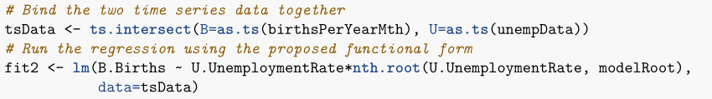




Functional Form
$$y=B_{0}+B_{1}X_{1}+B_{2}\sqrt[3]{X_{1}}+B_{3}X_{1}\sqrt[3]{X_{1}}$$
$$B_{0}=−5255729.04$$
$$B_{1}=−1723085.49$$
$$B_{2}=6049241.70$$
$$B_{3}=454700.50$$

Slide 11
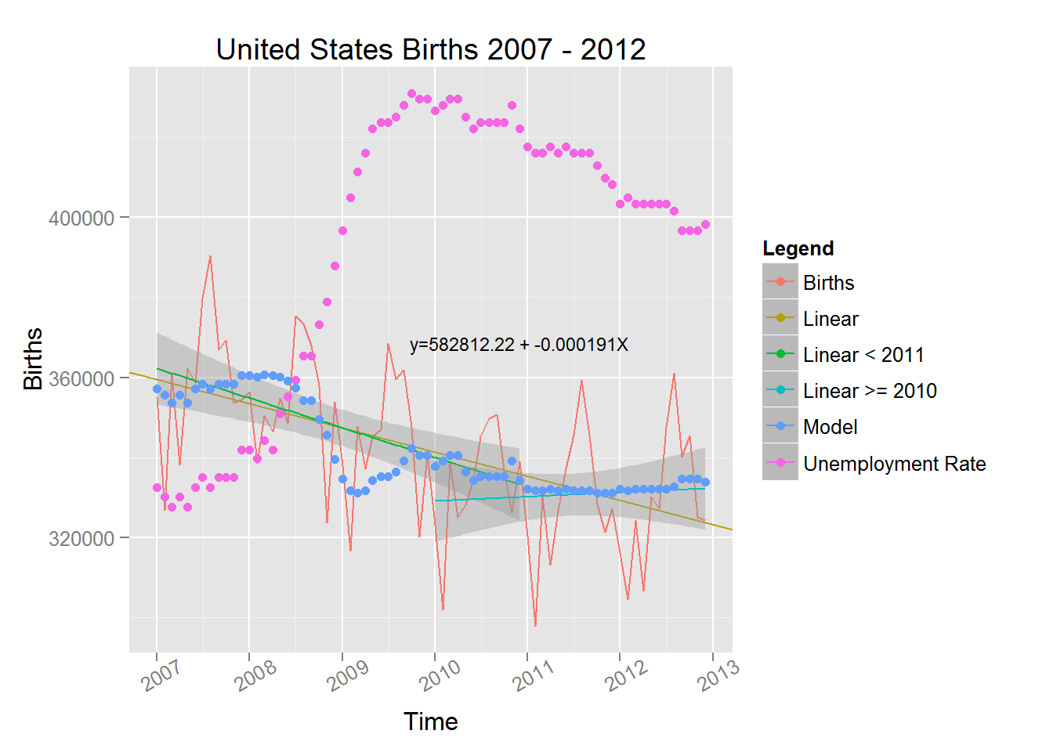
All Together Now

Slide 12
Next Steps
Validation
Seasonality

Slide 13
Conclusion
Relationship?
Predictor?

Slide 14
Questions?
Thank you!

