Slide 1
U.S. Births & Unemployment Rate
Daniel Dittenhafer
Final Project
IS607 – Data Acquisition & Management

Slide 2
Data Sets
Natality
Centers for Disease Control
Population
U.S. Census Bureau
Unemployment Rate
U.S. Bureau of Labor Statistics

Slide 4
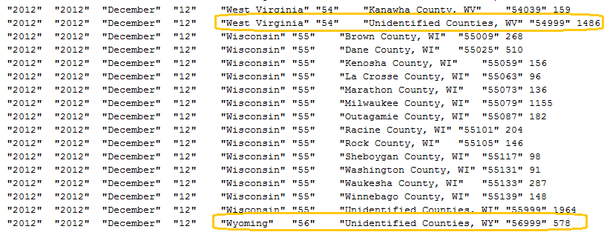
Unidentified Counties

Slide 5
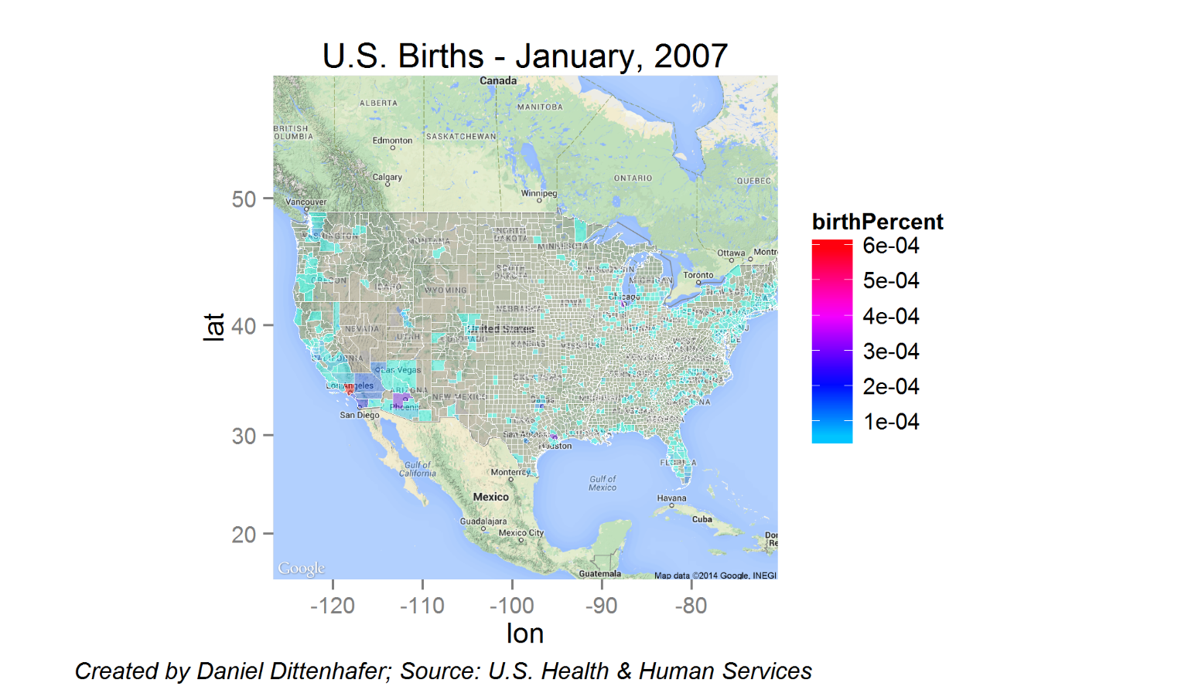

Slide 6
The Question
How does the state of the economy, using Unemployment rate as a proxy, relate to the birth rate in the United States?

Slide 7
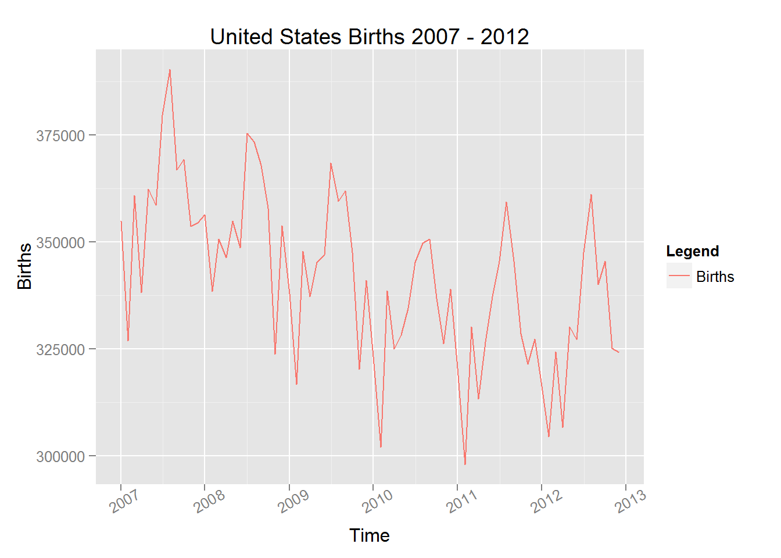
United States Births
Notes:
3,952,841 births in 2012.
3,953,590 births in 2011

Slide 8
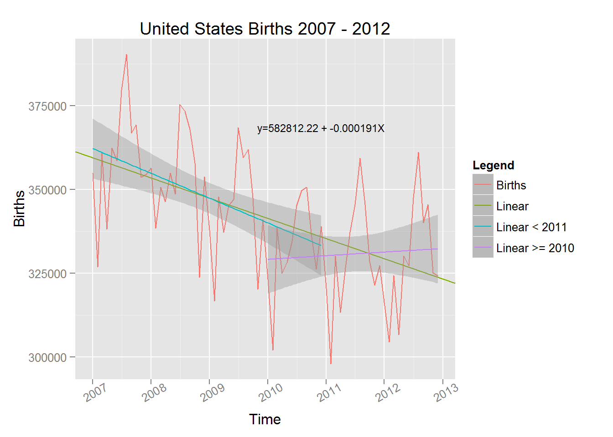
United States Births

Slide 9
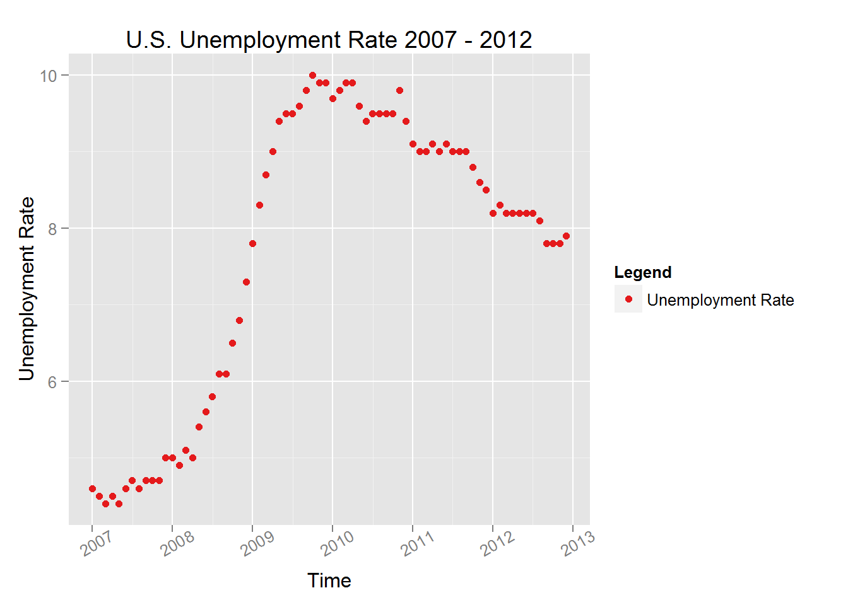
Unemployment Rate

Slide 10
Functional Form
$$y=B_{0}+B_{1}X_{1}+B_{2}\sqrt[3]{X_{1}}+B_{3}X_{1}\sqrt[3]{X_{1}}$$
Why cube roots?

Slide 11
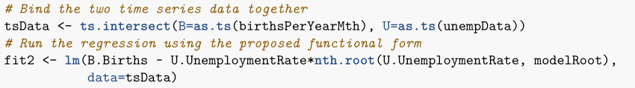




Functional Form
$$y=B_{0}+B_{1}X_{1}+B_{2}\sqrt[3]{X_{1}}+B_{3}X_{1}\sqrt[3]{X_{1}}$$
$$B_{0}=−5255729.04$$
$$B_{1}=−1723085.49$$
$$B_{2}=6049241.70$$
$$B_{3}=454700.50$$

Slide 12
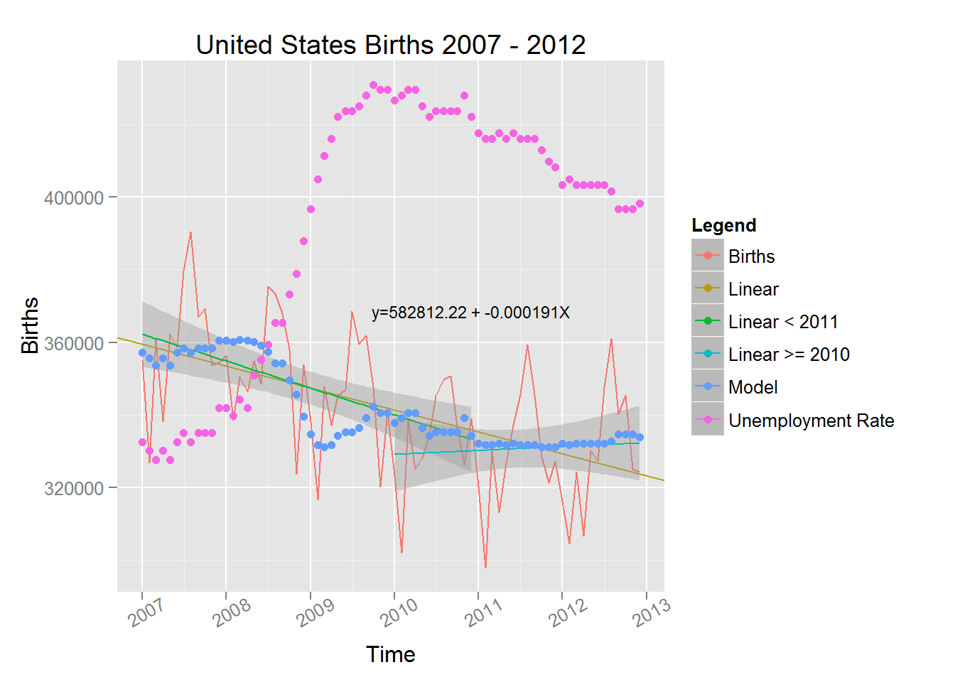
All Together Now

Slide 13
Next Steps
Validation
Seasonality

Slide 14
Conclusion
Relationship?
Predictor?

Slide 15
Questions?
Thank you!

