Slide 1
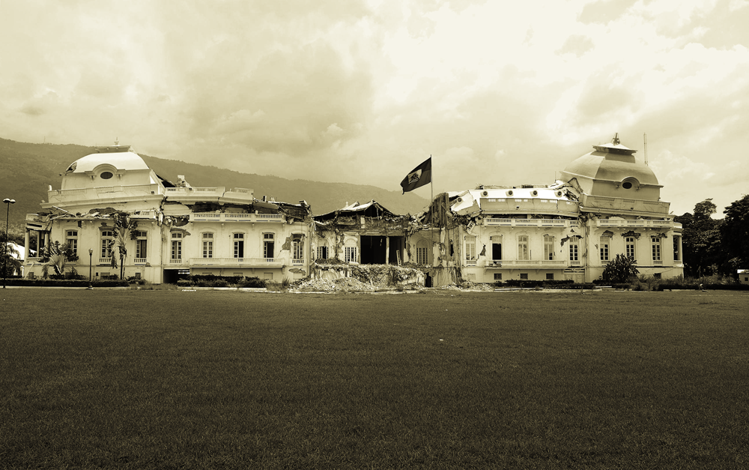
Humanitarian Logistics
A Simulation in Simio

Slide 2

Team Members
Daniel Dittenhafer
Jay Narhan

Slide 3

Background
Development
Longer term programs in stable areas that are aimed at raising the standard of living of a population of beneficiaries over the longer term.
Disaster
Humanitarian interventions that are started with limited notice, are relatively short in duration and are aimed at immediate life saving and life prolonging activities for the beneficiaries over the shorter term.

Slide 4
Relief Logistics
“The basic task of a logistics system is to deliver the appropriate supplies in good condition, in quantities required, and at the place and time they are needed”
Logistics, UNDP Disaster Management Training Program

Slide 5
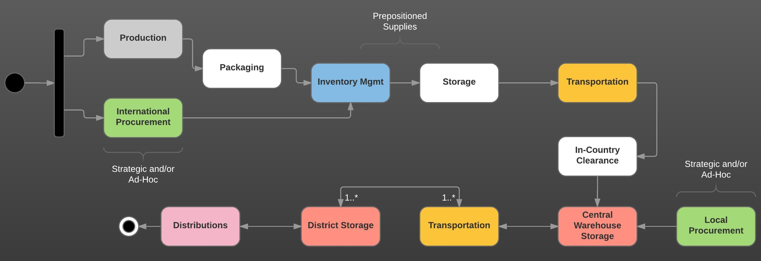
International Logistics Chain
Notes:
Can be very complex.
Example Procurement:
Is it One time purchase or Establishing a supply chain?
Do we source Local or are there Global Agreement
Is procurement Off the shelf, is there a Tendering and bidding process
What Framework agreement are in place
What agreement are there on Payment
What are the INCOTERMS

Slide 6
Objective
Model key aspects of the Humanitarian Logistics Chain (HLC) using Computer Simulation System
Model the movement of supplies (relief aid)
Include the last-mile component

Slide 7
Creating the Model
Entities
Suppliers
Relief Supplies
Warehouse
Transportation
Distribution Sites
Beneficiaries

Slide 8
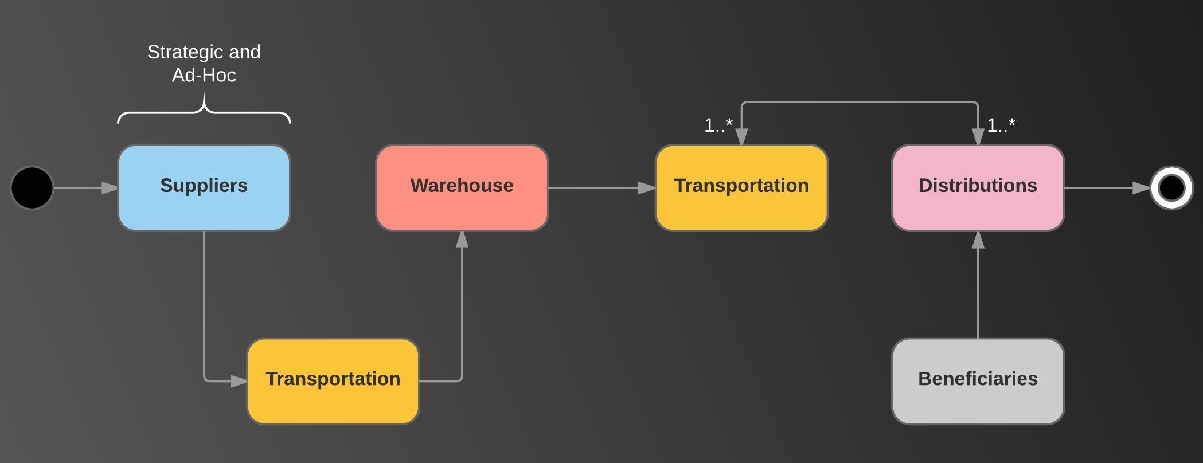
HLC Model Simplification

Slide 9
The Model in Action
Insert video of model in action

Slide 10
Experiments
Reliability of supply pipeline
Impact of Ad-Hoc versus Preferential Supplier Partners
Breakdown of vehicles == delay of arrival of supplies
Loss of supplies in transit?
Modeling distance from storage to distribution sites
Closing access to beneficiaries – closing distribution sites
Impact on numbers served
Impact on buffer sizes/queue time on available sites

Slide 11
Measurements
Time in System
Beneficiaries
Relief Supplies – Implications on perishable supplies
Supplies distributed
(Number destroyed == Number distributed)

Slide 12
Results

