Slide 1

Music Recommendation System
By Abhiram Bondada

Slide 2



Introduction
A simple recommendation system for music
Leverages existing libraries such as sklearn and matplot
Addresses the problem of everyone needs new music

Slide 3

Motivation
Love listening to music
Need more music recommendations
Need to explore more a bit
Obscure Artists sometimes make bops

Slide 4
High Level Solution
To DISPLAY DATA
TO ANALYZE AND RETURN RECOMMENDATIONS
Import necessary modules
Parse the data
Create Graphs based on data
Import necessary modules
Parse data
Create algorithm
Use algorithm to generate best recommendations.

Slide 5
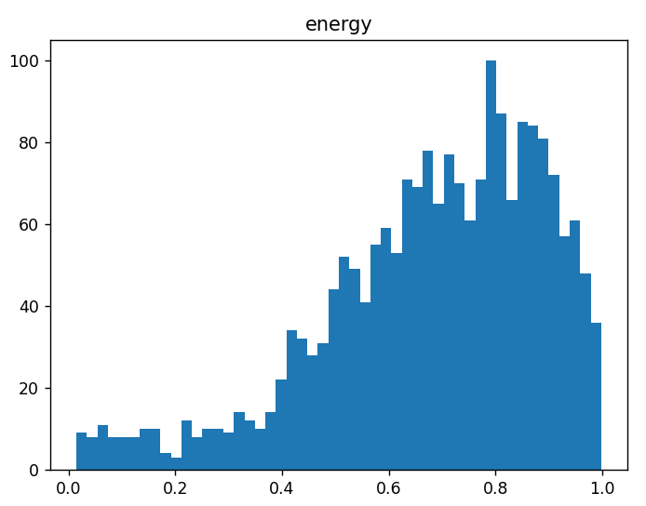
Example Graph of Energy

Slide 6
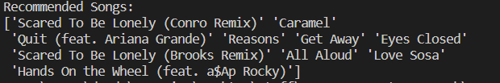

Results of cosine similarity
Results of sigmoid kernel

