Slide 1

Multi scale preconditioner to solve elliptic problems with high order methods with p4est
David Weicker
Supervisors : Jean-François Remacle – Michael Hanke
Reader : Philippe Chatelain
September 2017

Slide 2

Multi scale preconditioner to solve elliptic problems with high order methods with p4est

Slide 3
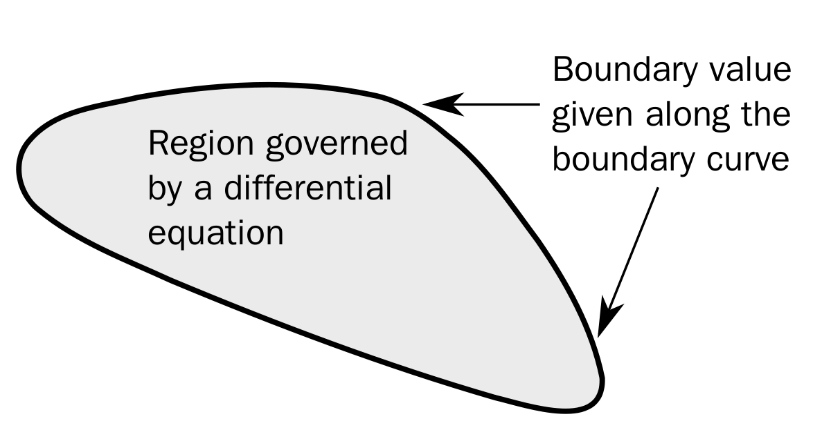

Poisson’s equation
$∇^{2}u=f$ on $Ω$
$u=u_{0}$ on $∂Ω$

Slide 4
In typical problems :
The geometry Ω is very complex
We need a highly accurate numerical solution
The forcing term f has very localized features
We need a fast way to compute highly accurate solutions to Poisson’s equation on complex geometries

Slide 5
Outline
Objectives
State of the art
The algorithm
Non conforming meshes with p4est
The spectral element method
The preconditioned conjugate gradients
Multi scale
Performances of the algorithm
Conclusion

Slide 6
Objectives
Investigate the properties of a chosen algorithm to solve Poisson’s equation and their theoretical basis
Implement, from scratch, the algorithm in C
Discuss the performances of the Poisson solver and compare them with the theoretical results

Slide 7
State of the art
Based on the FFT
Domain Decomposition methods
Multigrid methods (geometric – algebraic)
Fast Multipole method

Slide 8
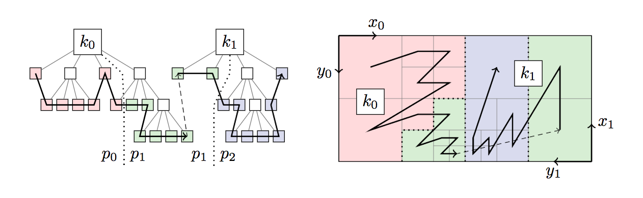
Multi scale preconditioner to solve elliptic problems with high order methods with p4est

Slide 9
Multi scale preconditioner to solve elliptic problems with high order methods with p4est

Slide 10
Multi scale preconditioner to solve elliptic problems with high order methods with p4est

Slide 11
Multi scale preconditioner to solve elliptic problems with high order methods with p4est

Slide 12
Multi scale preconditioner to solve elliptic problems with high order methods with p4est

Slide 13
Multi scale preconditioner to solve elliptic problems with high order methods with p4est

Slide 14
Multi scale preconditioner to solve elliptic problems with high order methods with p4est

