Slide 1

Multi scale preconditioner to solve elliptic problems with high order methods with p4est
David Weicker
Supervisors : Jean-François Remacle – Michael Hanke
Reader : Philippe Chatelain
September 2017

Slide 2

Multi scale preconditioner to solve elliptic problems with high order methods with p4est

Slide 3
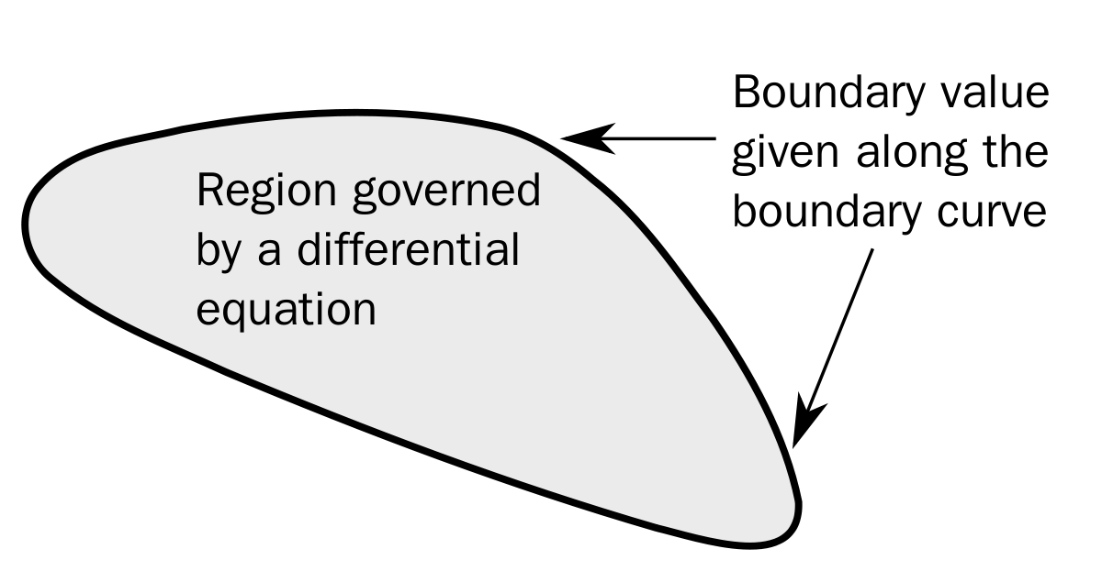

Poisson’s equation
$∇^{2}u=f$ on $Ω$
$u=u_{0}$ on $∂Ω$

Slide 4
In typical problems :
The geometry Ω is very complex
We need a highly accurate numerical solution
The forcing term f has very localized features
We need a fast way to compute highly accurate solutions to Poisson’s equation on complex geometries

Slide 5
Outline
Objectives
State of the art
The algorithm
Non conforming meshes with p4est
The spectral element method
The preconditioned conjugate gradients
Multi scale
Performances of the algorithm
Conclusion

Slide 6
Objectives
Investigate the properties of a chosen algorithm to solve Poisson’s equation and their theoretical basis
Implement, from scratch, the algorithm in C
Discuss the performances of the Poisson solver and compare them with the theoretical results

Slide 7
State of the art
Based on the FFT
Domain Decomposition methods
Multigrid methods (geometric – algebraic)
Fast Multipole method

Slide 8
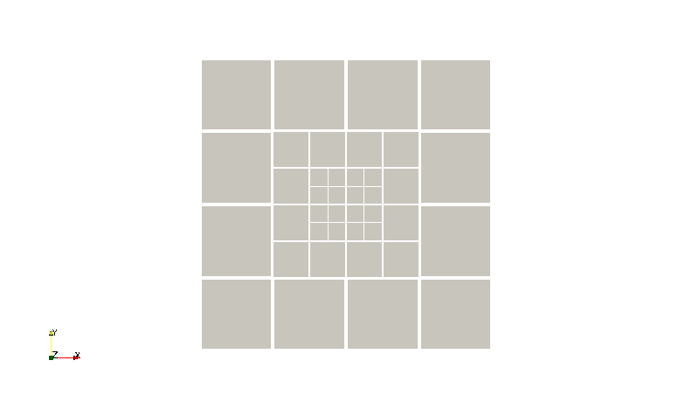
Adaptive Mesh Refinement (AMR) adapts the elements to the problem

Slide 9
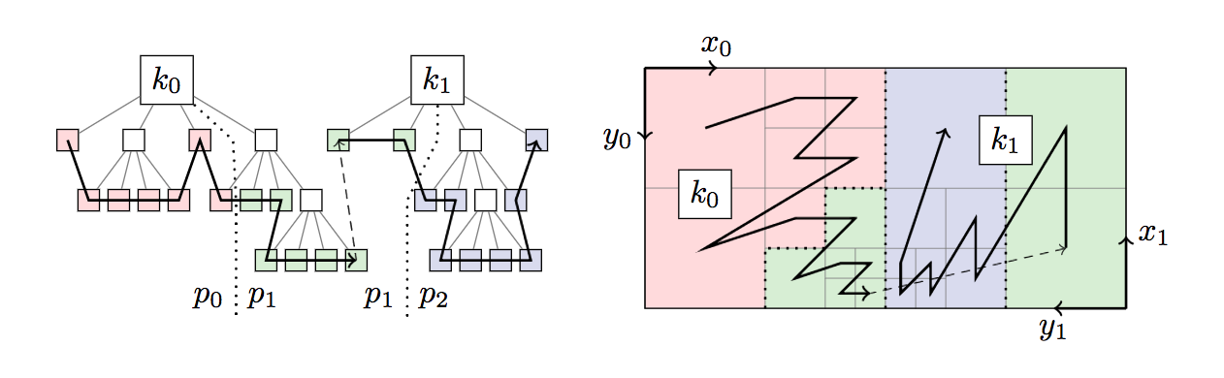
Multi scale preconditioner to solve elliptic problems with high order methods with p4est

Slide 10
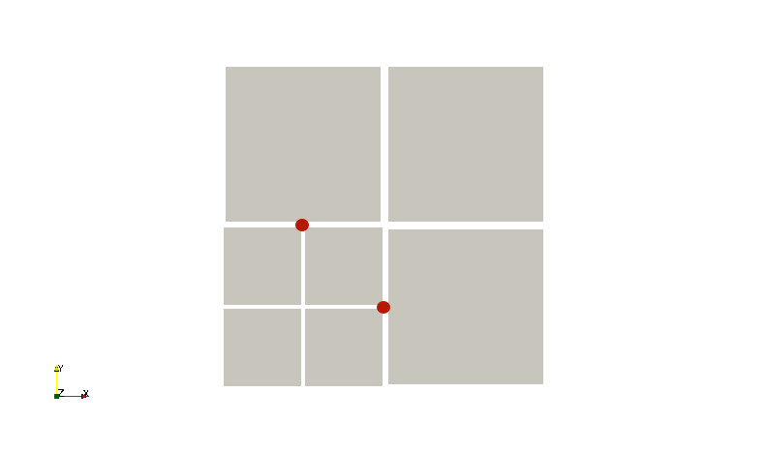
Hanging nodes must be treated carefully

Slide 11
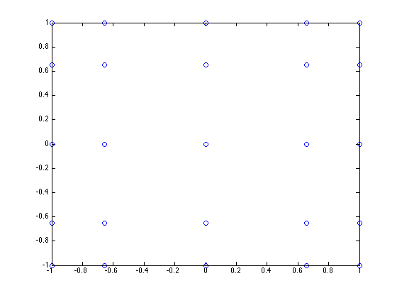

Multi scale preconditioner to solve elliptic problems with high order methods with p4est
The discretization leads to a linear system
$AU=b$
Where
$A_{ij}=\int_{Ω}{∇φ_{i}⋅∇φ_{j}dxdy}$
$b_{i} =−\int_{Ω}{fφ_{i}dxdy}$

Slide 12
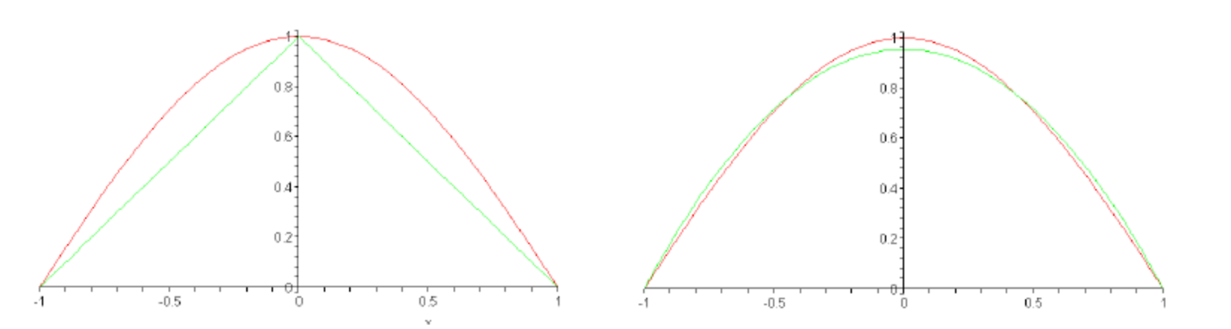
High order polynomials better interpolate smooth functions

Slide 13
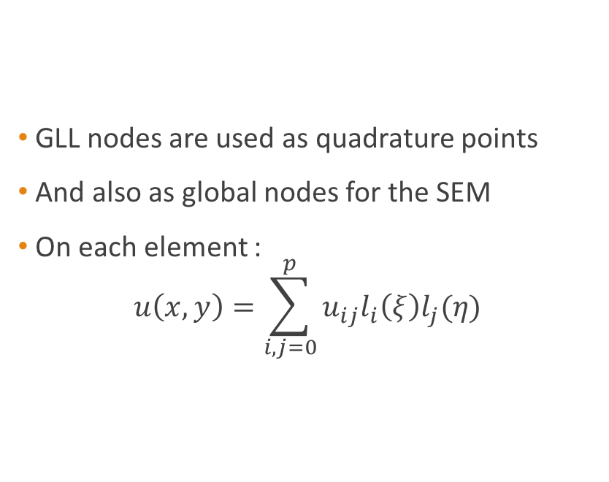
GLL quadrature points include the extremities of the interval
GLL nodes are used as quadrature points
And also as global nodes for the SEM
On each element : $u\left(x,y\right)=\sum_{i,j=0}^{p}{u_{ij}l_{i}\left(ξ\right)l_{j}(η)}$

Slide 14
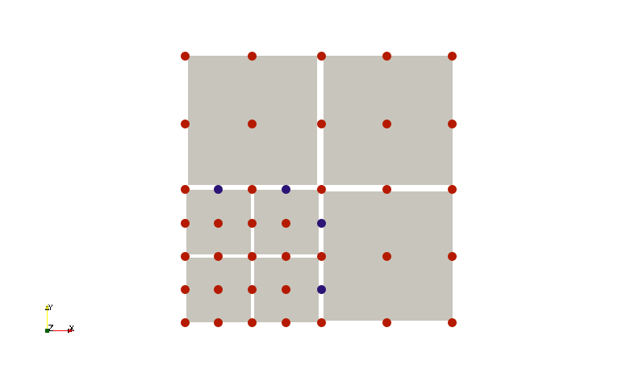
Example of a mesh with p = 2

Slide 15

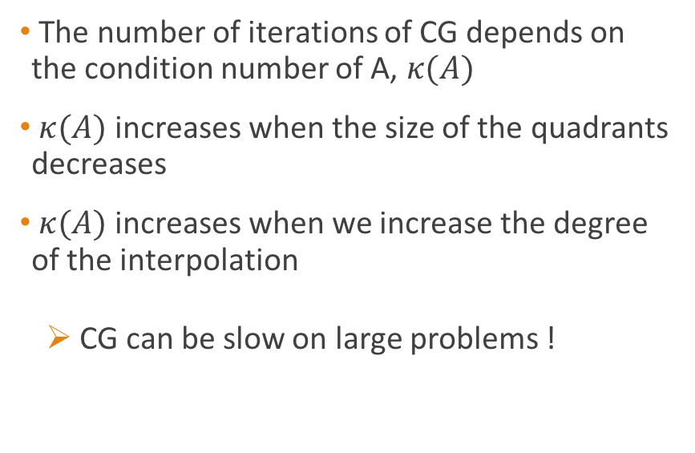

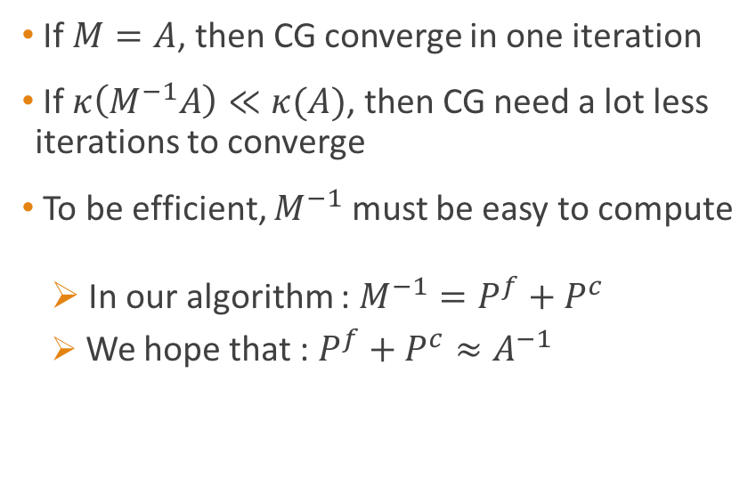
Multi scale preconditioner to solve elliptic problems with high order methods with p4est
$$AU=b$$
$$M^{−1}AU=M^{−1}b$$
The number of iterations of CG depends on the condition number of A, $κ(A)$
$κ(A)$ increases when the size of the quadrants decreases
$κ(A)$ increases when we increase the degree of the interpolation
CG can be slow on large problems !
If $M=A$, then CG converge in one iteration
If $κ\left(M^{−1}A\right)≪κ(A)$, then CG need a lot less iterations to converge
To be efficient, $M^{−1}$ must be easy to compute
In our algorithm : $M^{−1}=P^{f}+P^{c}$
We hope that : $P^{f}+P^{c}≈A^{−1}$

Slide 16
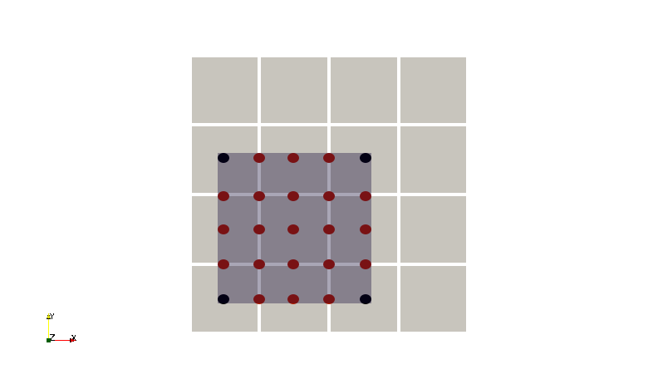
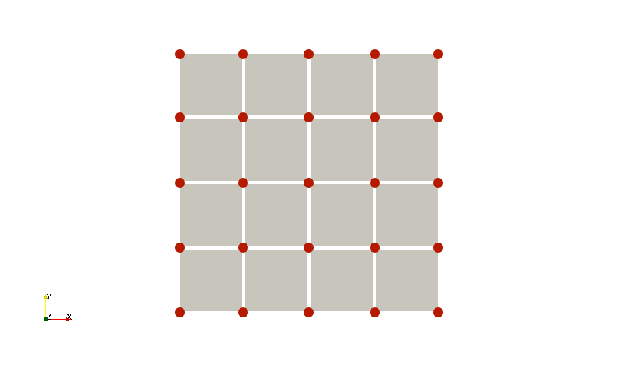
Multi scale preconditioner to solve elliptic problems with high order methods with p4est
Fine scale : Domain Decomposition (OAS)
Coarse scale : Geometric multigrid

Slide 17
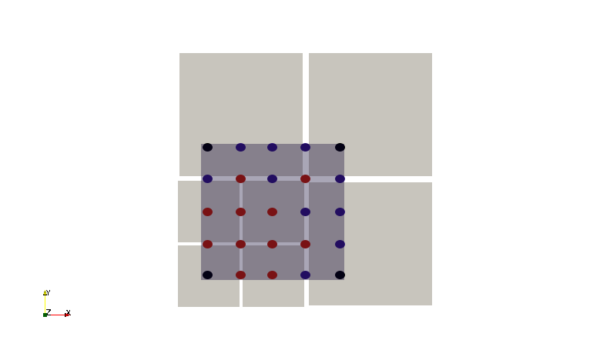
The fine scale preconditioner solves the problem exactly on each quadrant
We add one layer of nodes on each side to obtain overlapping subdomains
If we have hanging nodes, we need to interpolate the residual
We assume that the quadrant is aligned with the axes
allows us to solve the problem analytically

Slide 18
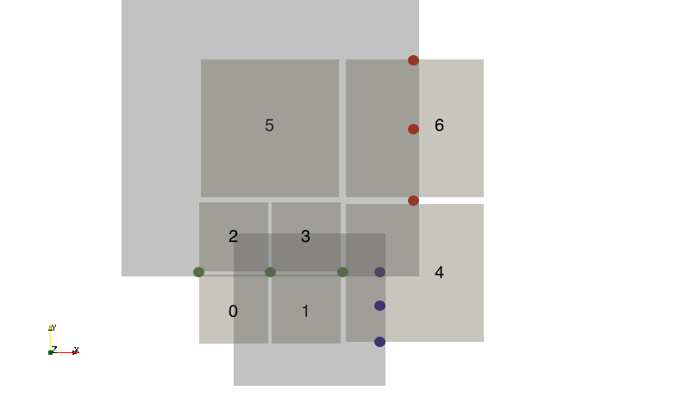
A quadrant can have four types of neighbours

Slide 19
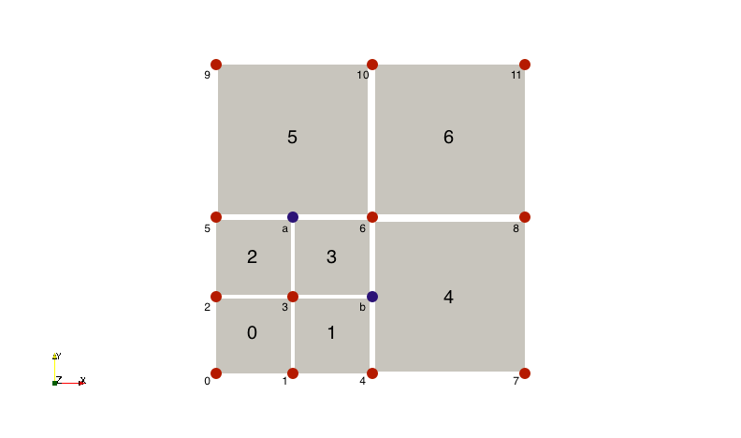
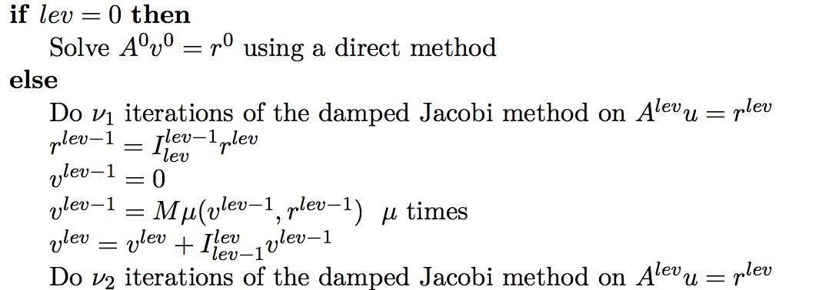
The coarse scale correction solves a low order problem on the whole domain
Geometric multigrid method

Slide 20
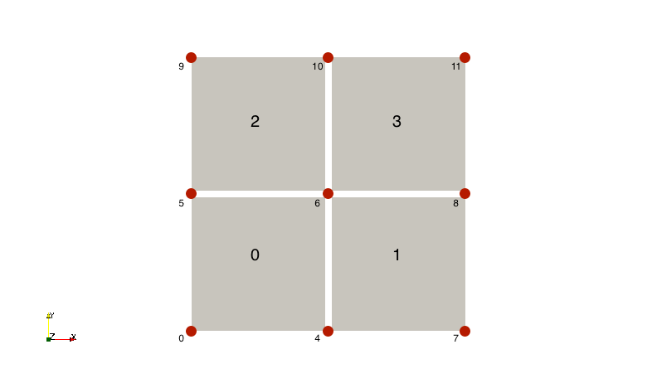
The levels are defined naturally using the forest of quadtrees
Level 1
Level 0

Slide 21
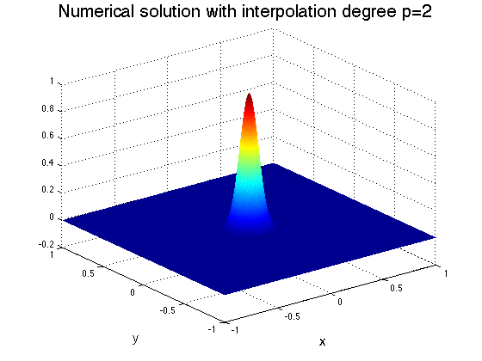

Problem used for the different tests
$∇^{2}u=e^{−\frac{x^{2}+y^{2}}{σ^{2}}} \frac{4x^{2}+4y^{2}−4σ^{2}}{σ^{4}}$ on ${Ω=\left[−1;1\right]}^{2}$
$u=e^{−\frac{x^{2}+y^{2}}{σ^{2}}}$ on $∂Ω$
Where $σ=0.1$

Slide 22
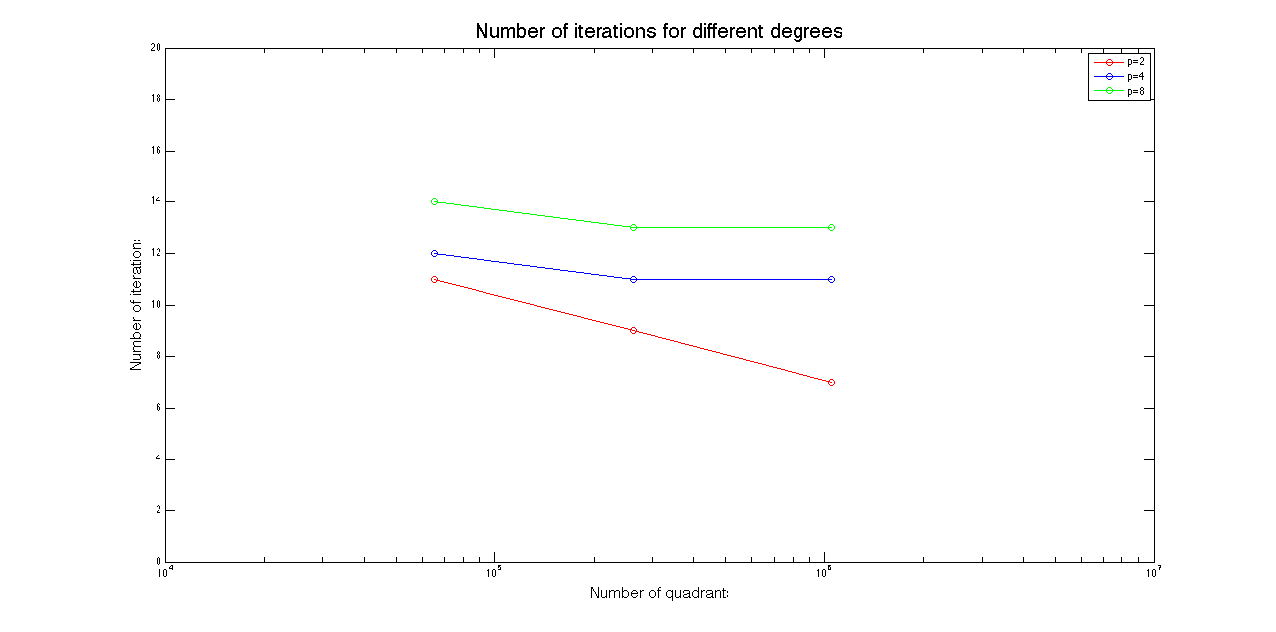
The coarse scale preconditioner provides h-independent convergence

Slide 23
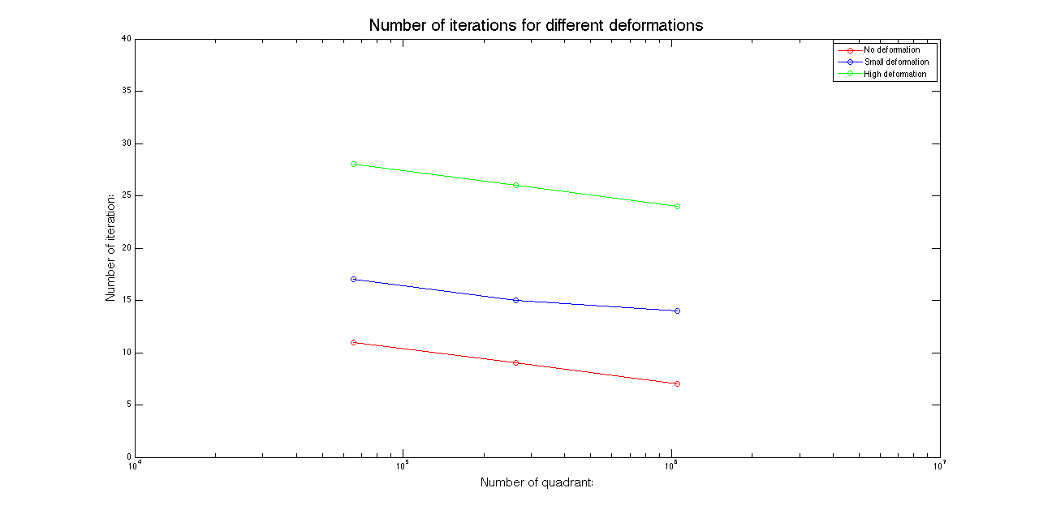
The number of iterations increases when we deform the elements

Slide 24
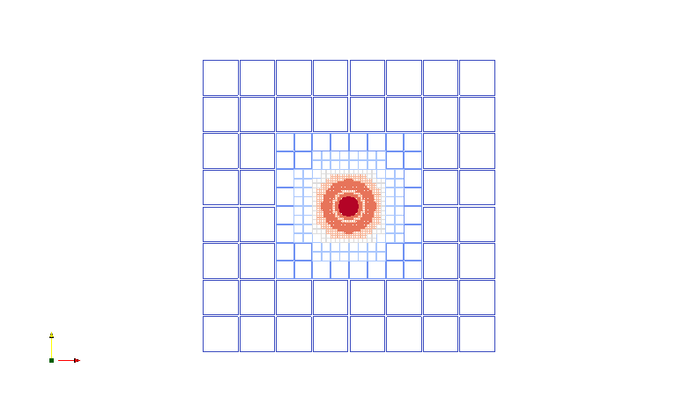

AMR keeps the number of quadrants down
$\left|u\left(\overline{x},\overline{y}\right)−\overline{u(x,y)}\right|<u_{max}tol$

Slide 25
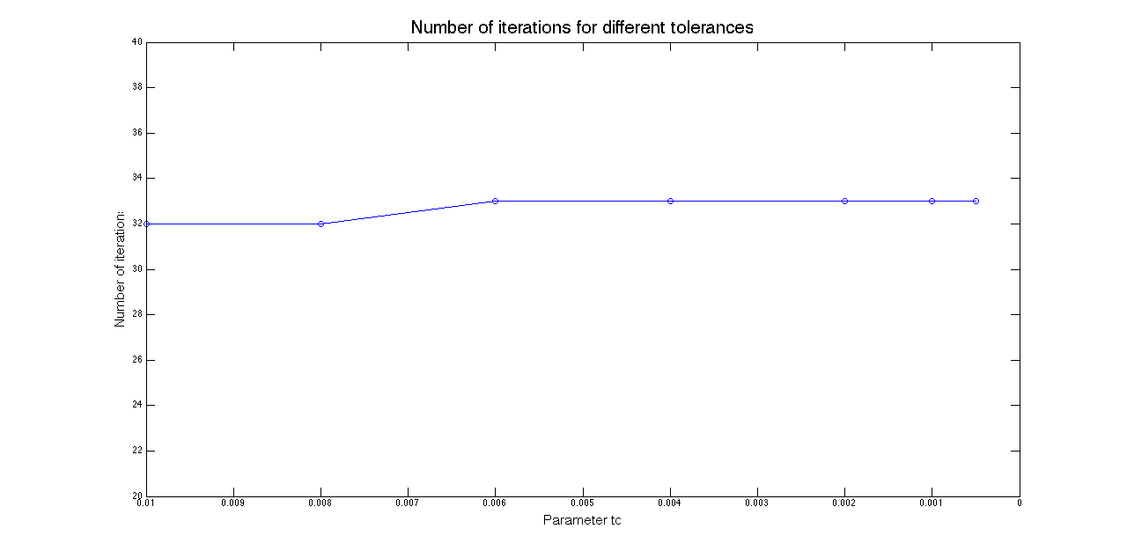
The number of hanging nodes does not influence the number of iterations

Slide 26
Conclusion
Performances
Improvements
Coarse grid correction allows for h-independent convergence
Increasing the degree increases the number of iterations since the overlap decreases
The fine preconditioner is computed efficiently and works best with quadrants aligned with the axes
The number of hanging nodes does not influence the number of iterations
Try and keep the overlap constant to obtain a p-independent convergence
Being able to handle other boundary conditions : Neumann, mixed or periodic
Parallelize the code
Apply the algorithm to 3D problems

Slide 28
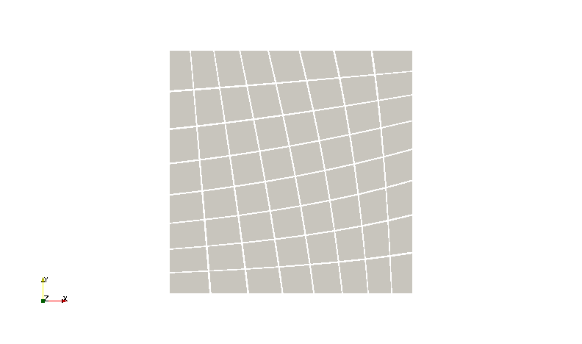
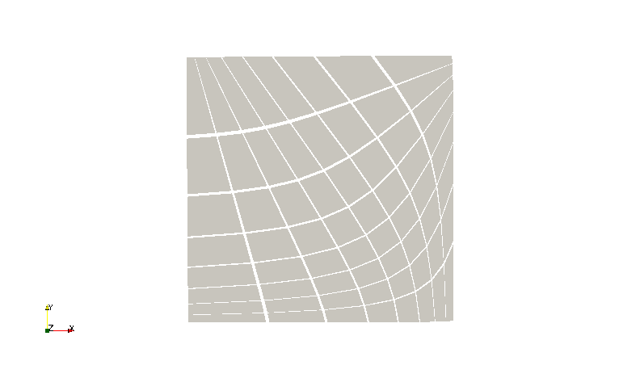
Appendix – Deformed meshes
Small deformation
High deformation

