Slide 1
Spotify Ratings & Ticket Sales
Discovering Correlations
ARTHUR ADJAMOFLIAN
DEWITT TSAI
RAY SPEAKMOORE
BRENT LEE

Slide 2
Motivation – Underdog Music Industry
There are millions of artists trying to make a name for themselves.
The creation of music is easily accessible and affordable.
The sharing of music has become the norm as streaming services and pay-per-song online services has risen.
Revenue from streaming services is unreliable for rising artists.
Primary source of monetization comes from concert sales.

Slide 3
Summary
Who is the issue holder?
Fictional music talent agency that focuses on up-and-coming artists.
What is the problem?
Profits are not as high as they hoped. Mismatch in turn-out vs. venue size.
Concerts with large venues have low turn out.
Concerts with small venues have high turn out.
Insights from Concert Consumer Data
Poor concert experiences are typically blamed to the artist, negatively impacting their reputation.
Impacts long term success trajectory as well as bottom-line profits.
Maximizing venue attendance enhances the overall user experience.

Slide 4
Scenario’s Main Question
Concerts = Main source of revenue
Primary Concern
Maximizing profits of concerts for artists in different genres and different popularity levels.
Primary Question
How can we determine the appropriate venue size for an artist to maximize potential profit?
Examples
How can we measure an artist’s popularity to make sure we book a large venue for a large turn-out or a small venue for a small turn-out consistently?

Slide 5
Questions - Significance
Q: Do higher Popularity Ratings equate to higher Concert Ticket Sales?
Sig: If false, there is more to be considered regarding higher sales
Q: Is the trend between Follower Count vs. Ticket Sales similar to Popularity vs. Ticket Sales?
Sig: Both metrics should have similar trends, but this should be tested to see if one metric has higher accuracy over the other.
Q: Do certain genres have a greater consistent trend for Follower/Popularity vs. Ticket Sales over other genres?
Sig: The communities for different genres have different trends. Isolating by genre will help provide accurate expectations for each genre’s community.
Q: What key genres underperform and overperform?
Sig: For our factitious agency, this would be useful information to focus on certain genres over others.

Slide 6
Questions – Results
Q: Do higher Popularity Ratings equate to higher Concert Ticket Sales?
A: Not necessarily. However it does equate to a higher value ceiling.
Q: Is the trend between Follower Count vs. Ticket Sales similar to Popularity vs. Ticket Sales?
A: Absolutely not for the top artists. Follower count is an opt-in metric in Spotify, meaning there will be no meaningful correlation.
Q: Do certain genres have a greater consistent trend for Popularity Count vs. Ticket Sales over other genres?
A: There are no traditional trends, but they have their respective popularity ranges that they occupy.
Q: What key genres underperform and overperform?
A: All genres performed at a similar spread, except Ed Sheeran.

Slide 7
Theory and Preparing
What is their core query?
Is there a way where they can choose an appropriately sized venue per artist to maximize profits?
What is the trend between an artist’s popularity vs. ticket sales?
What data sources can be useful?
First, streaming of music is the most dominant form of consumption:
Spotify API – Pull rating data for specific artists
Second, concert data is available, but we want to know the best selling concerts of the previous fiscal year.
Published Data for Top Concert Sales from Ranking Lists

Slide 8
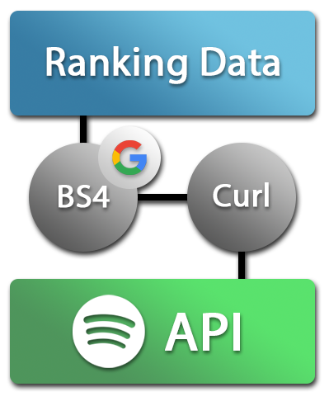
The How: Exploration and Clean Up
PDF’s table for the Ticket Sales for the Top Ranked Concerts
Input: PDF into Python
Output: Data frame containing Artist Name and Ticket Sales
Run Spotify API to find popularity data for Artist Names
Input: Artist Name
Output: Spotify’s Artist Name string, # of Followers, Popularity, and Genre.

Slide 9
The How: Exploration and Clean Up
First Issue: Spotify API uses an Artist ID that is unique to each Artist Name
Solution: Used BS4 to parse HTML pages from Google queries to scrape Artist ID per Artist Name.
Second Issue: Spotify API documentation is focused on HTML formatting.
Solution: Used Curl Trillworks to convert HTML query into a workable Python format.
https://curl.trillworks.com/
Other Issues: PDF contains events such as WWE or Cirque du Soleil.
Solution: Iteration for data pull would skip when the “Artist Name” contains quotes within the string.
Example: “WWE” or “Cirque du Soleil” vs. Beyonce

Slide 10
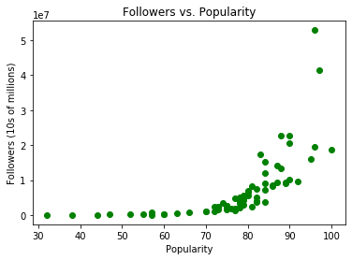
Data Analysis: Followers vs. Popularity
Positive relation between followers and popularity.
Rate of increase is exponential.
Until 70% popularity, the amount of followers on Spotify is roughly the same.
Past 70% popularity, significant growth proceeds to accelerate faster.
Past 80%, follower quantity is extremely erratic but still follows exponential trend.
Having a higher popularity rating does not necessary equates to higher amount of followers.

Slide 11
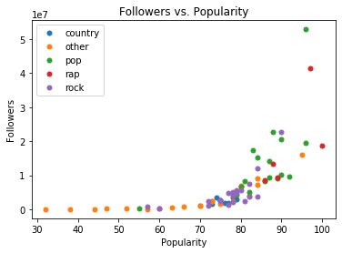
Data Analysis: Followers vs. Popularity
Owing to its label nomenclature, the Pop genre is mostly located above 80% popularity.
The Rap genre seems to have similar results as Pop.
Rock has a concentrated cluster focused between 70% to 85% popularity, rarely exceeding 10 million followers vs. Ed Sheeran’s +50 million followers.
Post Malone, who has 100% popularity, simply only has 20 million followers to Ed Sheeren’s +50 million despite being at sub 100% popularity
Increased Popularity != Increased # of Followers

Slide 12
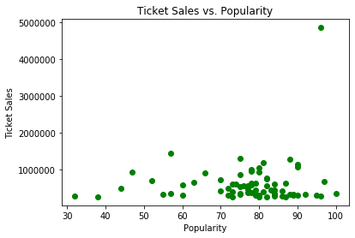
Data Analysis: Ticket Sales vs. Popularity
The highest point, Ed Sheeran, holds the highest amount of ticket sales in 2018.
The right most point, Post Malone, holds an amount in the lower quadrant of our data despite a 100% popularity rating.
Across the board, majority of artists did not exceed 1 million sold tickets.
The lowest popular artists can have concert sales that match Post Malone at 100% popularity rating.
Thoughts:
Increased popularity != Higher ticket sales

Slide 13
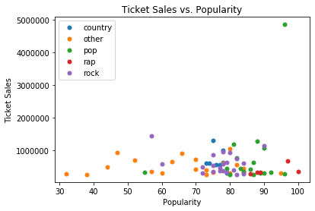
Data Analysis: Ticket Sales vs. Popularity
Rock, out of all genres, has a consistent popularity rating between 70% to 85% but results mostly in about 500 thousand ticket sales in 2018.
When compared to Rap, Rock has a higher amount of artists that hit the 1 million mark.
However, Rap artists seem to mainly be around the 200 thousand mark with a higher popularity rating.
Interesting note:
For the plots above 1 million tickets sold, a country artist with ~75% popularity was beaten by a rock artist at ~57%.
Rock artist is Roger Waters
Country artist is Kenny Chesney

Slide 14
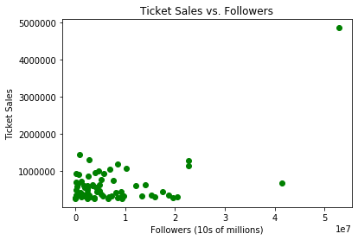
Data Analysis: Ticket Sales vs. Followers
Follower count is an unreliable value to predict ticket sales.
An artist at 20 million followers may sell just as many tickets than an artist under 10 million followers.
Majority of the Top 100 artists in 2018 never exceeded over 1 million ticket sales
Significant amount of artists on the Top 100 list have almost 0 followers but manage to reach 1 million tickets sold.
Thoughts: Spotify’s following feature is an opt-in feature which may possibly explain a lack of any correlation or trend.

Slide 15
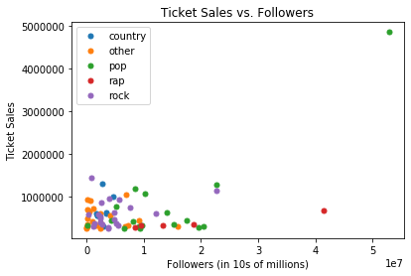
Data Analysis: Ticket Sales vs. Followers
Pop and Rap have a wider spread that passes 20 million followers.
Rock and Country are focused primarily under 10 million.
Both do not have any sort of correlation in terms of ticket sales.
When comparing clusters, the Other cluster, despite having low amount of followers, can easily contend with the main genres in ticket sales.

Slide 16
Implications
Amount of followers and popularity are not end-all metrics to determine total ticket sales.
For Spotify, if your popularity is at 70%, your amount of followers could still equal the amount for someone at 10% popularity.
If you’re a workaholic like Ed Sheeran, you could also destroy expectations without being considered an outlier.

Slide 17
Implications
Main Takeaway: Spotify is a poor metric to determine the tickets sold in a year for an artist.
Music stream popularity or follower amounts seem to only affect each other.
This may extend to other services such as Apple Music, Amazon Music, and Google Music.
Other factors must be in play which may provide a more direct correlation to tickets sold.
Marketing budget
Amount of total concerts per tour
Direct engagement with public
Social media popularity

Slide 18
Post Mortem - Difficulties
Spotify API documentation were written in HTML without any available Python resources.
Used curl.trill website to convert HTML commands from Spotify API guide into Python format.
Spotify API genre value contains multiple genres.
Created a double iteration loop to replace values in Genre with a generalized label.
Example: Indie Rock would be converted into Rock

Slide 19
Post Mortem - Difficulties
Ticket sales data per concert for artists proved difficult to find through public databases.
Most accessible information is from the previous year 2018 and for tours.
What would have been more useful:
Data that contains tickets sold for all concerts individually of their tour total.
Certain artists belonged in multiple genres
Resorted in applying generalized genres instead of more appropriate labels that would provide additional analytical accuracy.

Slide 20
Post Mortem – Additional Thoughts
If we had additional resources…
Receive data for the top 1,000 selling concerts for music artists using paid access to databases.
Expand research to be based either worldwide data or focused on USA.
Investigate, separately, concert data for specific artists that have shown a recent explosive growth in popularity in 2019 using data scraping.
If we had additional time…
Bin the data set either by popularity or by followers.
Proceed to run analysis per bin label.
Investigate getting data for lesser known artists with ticket data.

Slide 21
Post Mortem – Additional Thoughts
If this a real scenario, how would we proceed with these findings?
First, lower the scope of our data. Instead of focusing on the top selling concerts, our data may provide helpful insights by avoiding the most popular artists.
Second, we would include popularity metrics from all streaming services.
Third, if available, data in terms of marketing budget, fan engagement, and song metrics would be added.
Lastly, if similar results return that mirror our current findings, then we would advise the focus of this endeavor to veer away from streaming metrics.

Slide 22
Q & A

