Slide 1
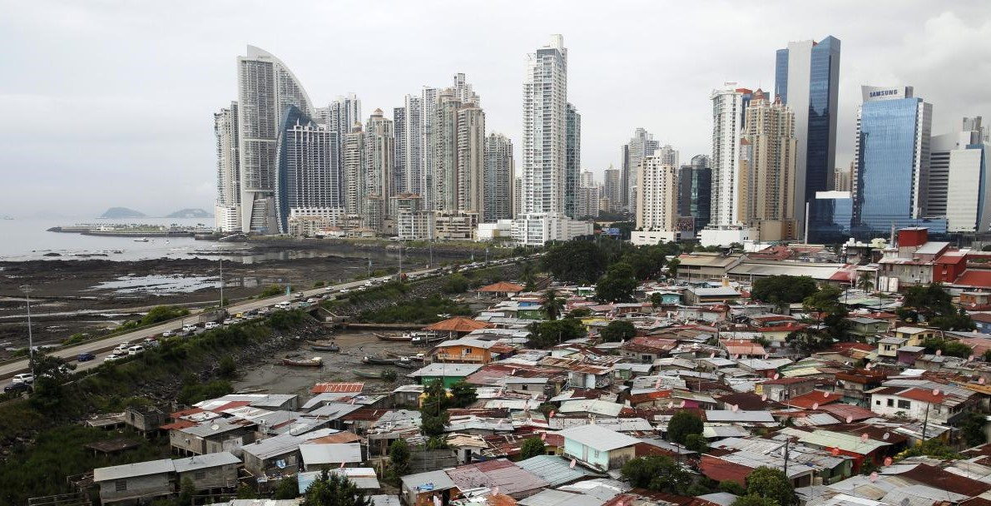

Health Inequality and Public Policy
(1)
Introduction
Monday, 15. September 2025
Ass.-Prof. Dr. David Weisstanner
Faculty of Health Sciences and Medicine
University of Lucerne

Slide 2
What does our title picture show?
Notes:
Where is it?
The picture shows a low-income neighbourhood called “Boca la Caja”, right in front of the business district in Panama City.
https://www.reuters.com/article/verm-gen-armut-oxfam-idDEKCN1PF0G3
What does it symbolize?

Slide 3
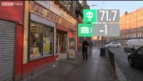
what does this have to do with health?
Danny Dorling, Professor of Human Geography at the University of Oxford
https://www.youtube.com/watch?v=KvwIW2dlUj8
Notes:
Watch full video (3 mins)
Inequality → health?

Slide 4

Also in Switzerland?
https://magazin.nzz.ch/nzz-am-sonntag/wissen/geld-macht-gesund-die-gesundheitliche-ungleichheit-nimmt-zu-ld.1740208

Slide 5











Health equity
Facts and figures for Switzerland
Life expectancy
Life expectancy varies by place of residence
Although life expectancy is high in Switzerland, it can vary significantly. The lower the socioeconomic status (SES) of a commune or district,
the lower the life expectancy. For example, between 78 and 83
for 30-year-old men and between 83.5 and 87 for 30-year-old women.
In Bern and Lausanne, for example, in districts with a low SES, men die 4.5 years earlier on average and women 2.5 years earlier than in high SES districts.
83
YEARS
78.5
YEARS
AVERAGE LIFE EXPECTANCY OF 30-YEAR-OLD MEN
2018
Focus on equality of opportunity
LOW SES DISTRICTS
HIGH SES DISTRICTS
© FOPH 2018
5
https://www.bag.admin.ch/de/chancengleichheit-zahlen-und-fakten

Slide 6

What can/should we do about these inequalities?
Sir Michael Marmot
Professor of Epidemiology at University College London
Director of the UCL Institute of Health Equity, and Past President of the World Medical Association.
https://www.youtube.com/watch?v=0B5bAXtLPo4

Slide 7
Six Policy areas to address health inequality
Give every child the best start in life
Education and lifelong learning
Employment and working conditions
Minimum income necessary for a healthy life
Healthy and sustainable places in which to live and work
Taking a social determinants approach to prevention
Prof. Marmot: “The evidence shows that we can take action on those”
…but are countries moving in this direction?

Slide 8
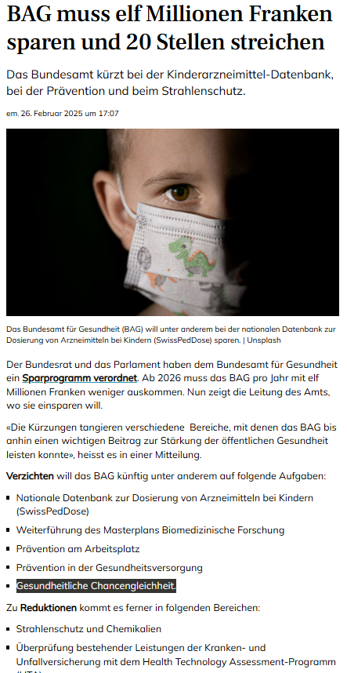


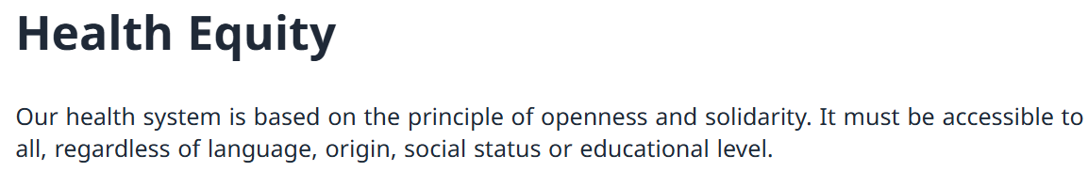

https://www.medinside.ch/bag-muss-elf-millionen-franken-sparen-und-20-stellen-streichen-20250226
https://www.bag.admin.ch/en/health-equity

Slide 9
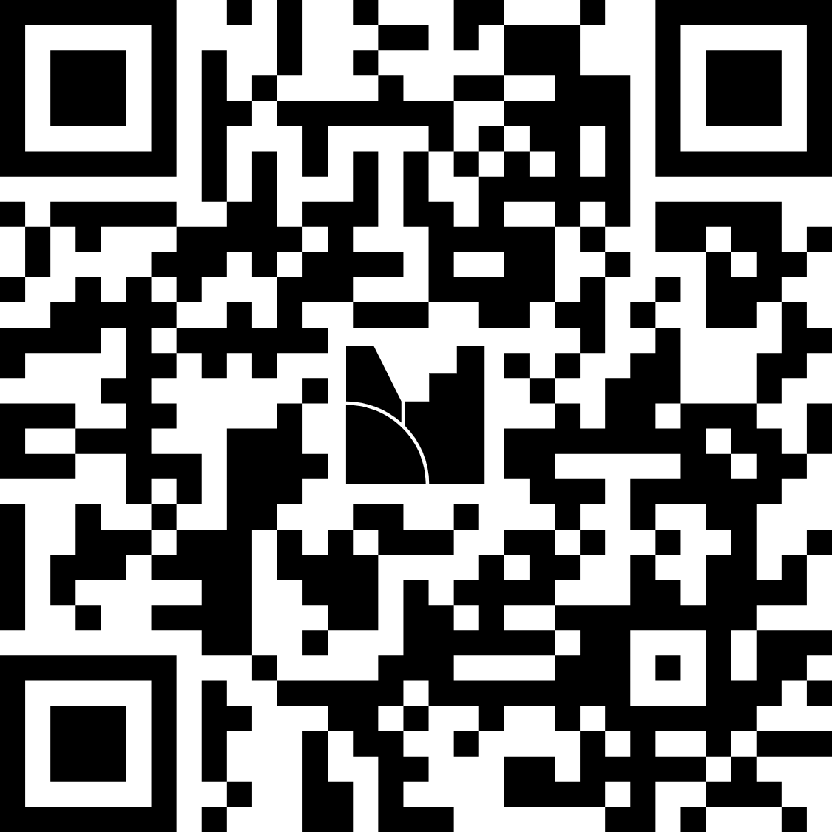
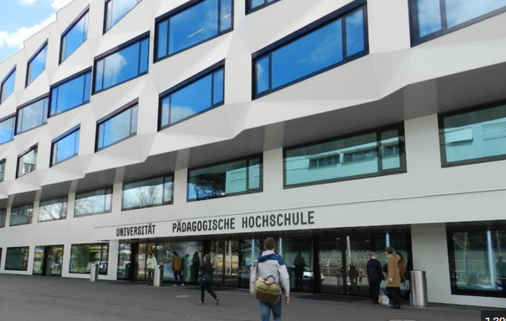



Round of introduction
About you:
Who are you?
Have you come across the topic of health inequality in other courses?
What do you expect/wish to learn in this course?
About me:
Teaching:
Health and social policy
Health inequality
Swiss health policy
Research interests:
Comparative health and social policy
Inequality (health, social, economic)
The politicization of health care
Electoral politics

Slide 10
Course objectives
Describe the concept and measurement of health inequality
Analyse health inequalities using cross-national survey data (ISSP, ESS)
Compare patterns across countries and over time
Evaluate how public policies and social contexts shape health inequality
Develop an own empirical research project

Slide 11
Course contents
Part 1: Introduction; what is health inequality? today, 22.9.
Part 2: Theories and causes of helath inequality 29.9., 6.10.
Part 3: Areas of health inequality (SES, ethnic, spatial, health care) 13.10., 20.10., 27.10., 03.11.
Part 4: When and how to address health inequality 10.11., 17.11.
Part 5: Student presentations and conclusion 24.11., 01.12., 15.12.
Guests:
  Guest talk by Barbara Hosch, Sans-Papiers Zentralschweiz (week 6)
  Author Q&A with Prof. Katherine Smith, University of Strathclyde, Glasgow (week 10)

Slide 12



Materials
+ recent articles

Slide 13

https://open.spotify.com/show/0JyHnF4L5HYzUw52h4VRQu

Slide 14
Course format
Conceptual part (usually morning, 10:15-11:50)
  Concepts, theories, literature, measurements
Applied part (usually afternoon, 12:30-13:45)
  Using survey data to describe, compare, and explain health inequalities across countries & over time
      International Social Survey Programme (ISSP 2011 & 2021 “Health and Health Care” modules)
      European Social Survey (ESS Round 7, 2013-14 and Round 11, 2023-24 “Social Inequalities in Health” modules)
  Develop an own empirical project using ISSP or ESS data
      Motivation: practice core academic skills
        Implement an own empirical research project from A-Z
        Apply basic survey research methods, data management, analytical strategies, etc.
        Practice with the datasets in class, give & receive feedback on your projects
        Not a methods course – focus on applying methods (at any level of methodological training)

Slide 15
Assessment
Written paper (65%): empirical research paper using ISSP or ESS data
Individual work: 2500-3000 words
  or
  group work (2 students): 3500-4000 words
Preliminary draft due the week before presentation
Final paper due 29th January 2026, 23:59 CET (delays: -0.5 grade points per day delayed)
Presentation of preliminary findings (25%)
24th November or 1st December
Active participation (10%)
Come prepared to class, having read the mandatory reading, able to summarise its main points, and ready to discuss it with questions or ideas

Slide 16
Getting started - ISSP
Register with GESIS, to be able to download ISSP data: https://login.gesis.org/
Set up a folder called «DATA»
Download the 2011 and 2021 datasets (store in your «DATA» folder):
      ISSP 2011:
      Dataset information: ISSP 2011 - "Health and Health Care“
      Download link: https://search.gesis.org/research_data/ZA5800
      ISSP 2021:
      Dataset information: ISSP 2021 - "Health and Health Care II“
      Download link: https://search.gesis.org/research_data/ZA8000?doi=10.4232/5.ZA8000.1.0.0
Open the datasets with your Stata or R, explore the data, make sure it has loaded correctly

Slide 17
Getting started - ESS
Register with the ESS Data Portal (log in with Google account or create a new login): Logg inn
Download the round 7 and round 11 datasets and main questionnaires (store in the DATA folder):
      ESS round 7 - 2014:
      Dataset information: ESS round 7 - 2014. Immigration, Social inequalities in health | ESS - Sikt
      Download under Datafiles (“ESS7 - integrated file”)
      ESS round 11 - 2023:
      Dataset information: The European Social Survey (ESS) | ESS - Sikt
      Download under Datafiles (“ESS11 - integrated file”)
Open the datasets with your Stata or R, explore the data, make sure it has loaded correctly

Slide 18
Outlook next week
2 22.09.2025 What is health inequality?
Reading: Mackenbach, J. P. (2019). Health Inequalities. Persistence and Change in European Welfare States. Oxford University Press. Chapter 2 “Patterns of health inequalities”, pp. 13-47.
Applied focus: First basic descriptive health inequality indicators in the ISSP/ESS

Slide 19

Questions?

Slide 20
Thank you for your attention!
 david.weisstanner@unilu.ch

