Slide 1
IMF Variations in SDSS Galaxies Hoversten & Glazebrook 2008
Max Genecov | UC Berkeley | November 9 ,2016

Slide 2
Improving on Kennicutt 1983
(B-V) vs. log(Hα EW) can differentiate IMF tracks
Via integrated stellar population synthesis
This paper adds a lot more data, metallicity , SFH
Evidence of a varying IMF
“We can rebuild [it]. We have the [robust data and Bayesian statistics]. Better. Stronger. Faster [--but not really because of all the data and MC].”
Notes:
Ha and continuum flux have different origins, so we get different physical insights from it

Slide 3
Improving on Kennicutt 1983
Sources of error in K83
Hα contamination -> high-res SDSS spectra can find emission line ratios to remove AGNs from sample
Hα emission flux underestimation -> new pipeline accurately measures continuum flux to compare
Assumed [N II]/ Hα -> again, high-res SDSS spectra
Assumed extinction corrections -> SDSS can measure Balmer decrement
Also, the sample size is over 100,000, which helps!

Slide 4
Improving on Kennicutt 1983
Ages were assumed in K83
K83 finds evidence of a universal IMF
Requires a smoothly varying SFH for Hα EW to be a proper correlate
Will come back to later!

Slide 5
Selecting the Sample
Taken from Main Galaxy Sample in SDSS
Errors < 0.5 mag
Remove a bad run
Remove AGN by [O III] and [N II] test
Bring back weak metal line galaxies with no AGN
Creates a luminosity and color bias
Redshift cut 0.005<z<0.25
Aperture cut
One galaxy is removed for having negative Hα EW
All cuts leave 130,602 galaxies (>30% of MGS)
Notes:
Aperture cut is 10% of galaxy light within spectroscopic aperture

Slide 6
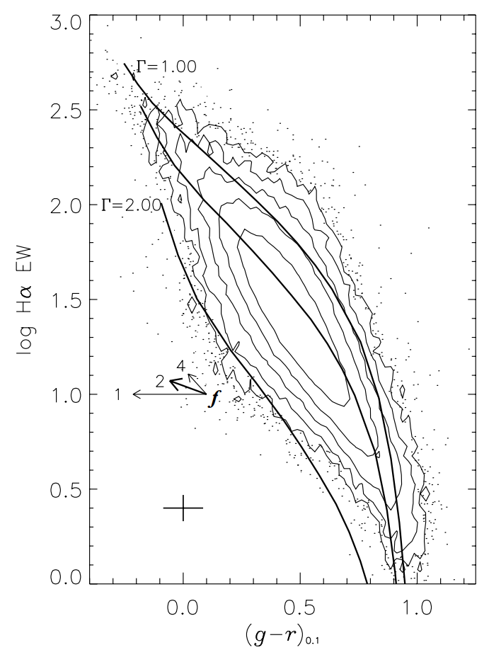
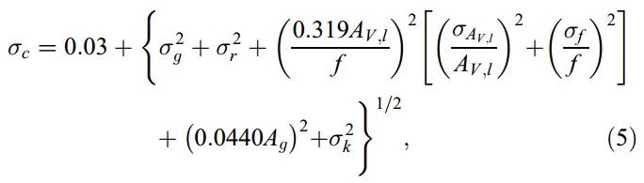
Corrections and Errors
Data is corrected assuming the true Balmer decrement is 2.86
K-corrected
Assume ratio of continuum/emission extinction, f = 2.0

Slide 7
Models
1 Myr – 13 Gyr
25 different SFHs (most exp. decaying)
Constant metallicities through time
Z = 0.005, 0.010, 0.020, 0.025
External extinction correction (!!!)
Broken power-law (Г=.5 for <.5 Msun, Г fit above that)
Not enough low-mass detection for log-normal to matter
“pseudo-χ-squared” minimization
Mean χ is what is important
Notes:
Calculating c and w bits separately, can lead to overfitting
Still fits bad fits that are still IMFs

Slide 8
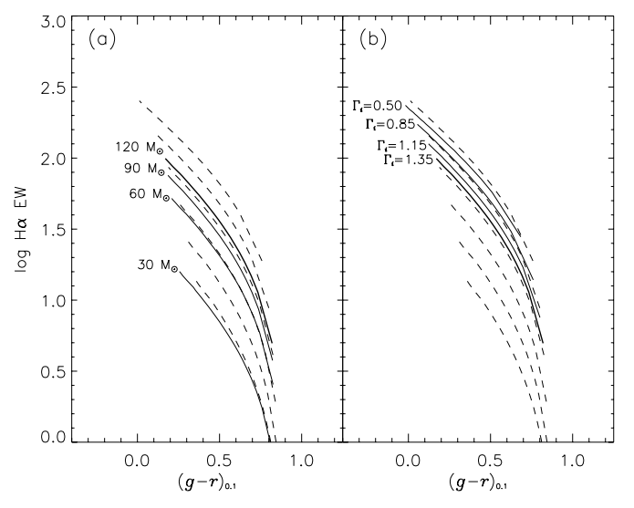

Slide 9
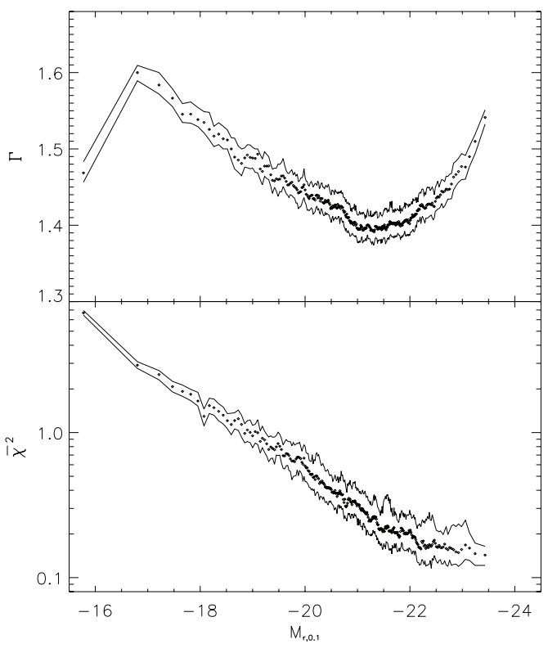
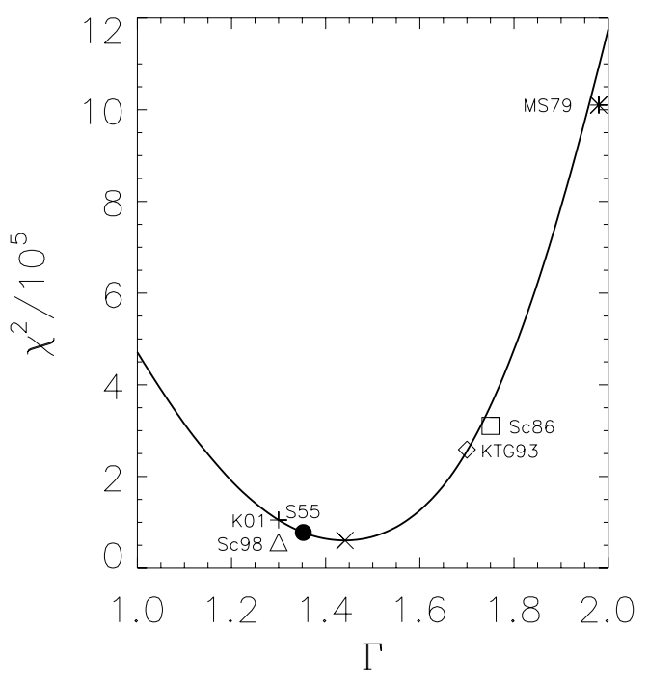
Results! Finally!
Notes:
They don’t try to explain the faint point. Almost all the bins clump up in the middle. Very close to Salpeter, even though we’re not necessarily probing the Salpeter regime (very little low mass info).

Slide 10
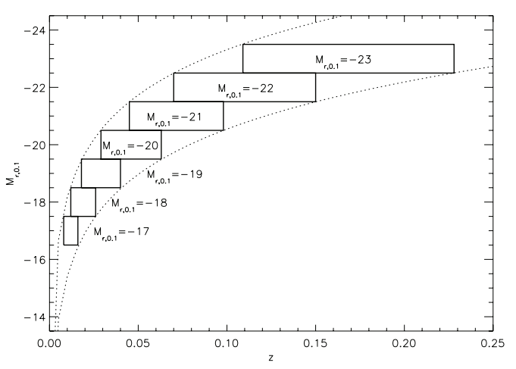
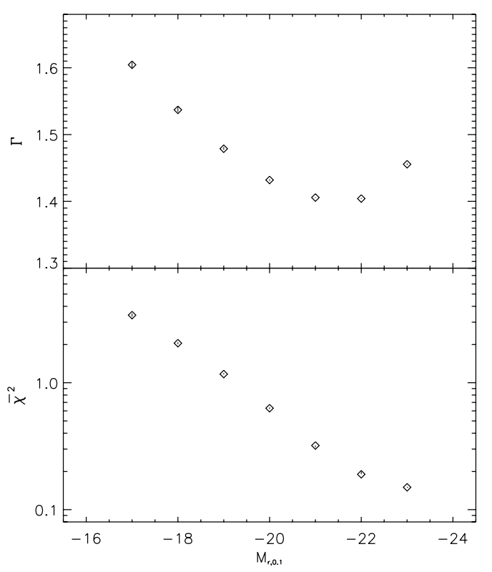





Bias
A universal IMF would be universal even in a biased sample, but anyway…
Magnitude-limited sample -> corrected volumes still show same trends
We good!

Slide 11
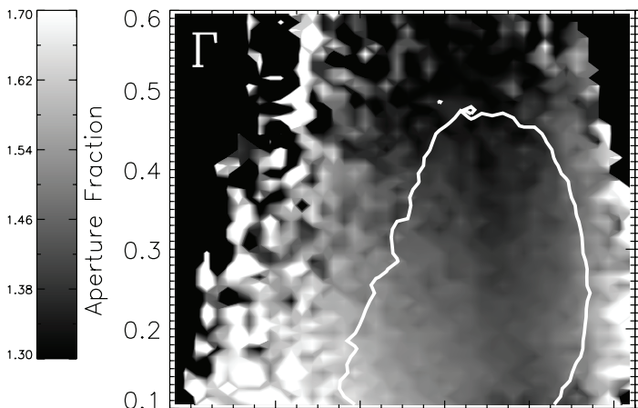
Bias
Aperture effects:
Physical area contained in aperture increases with distance, same with galaxy size
Something of a trend
Against physical intuition of systematic bias

Slide 12
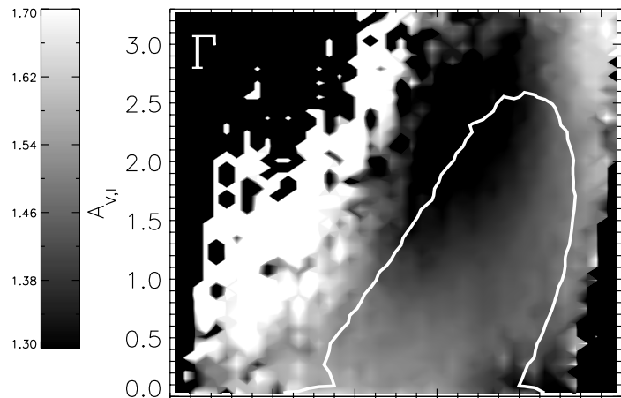
Bias
Extinction Correction:
IMF consequences
Again against intuition
What would this paper look like with better dust modelling?

Slide 13
Bias (Summary)
Two interpretations of potential biases
Systematic effects due to measurement of Г
Spooky physical effects
They’re there, but the authors say little other than that.

Slide 14
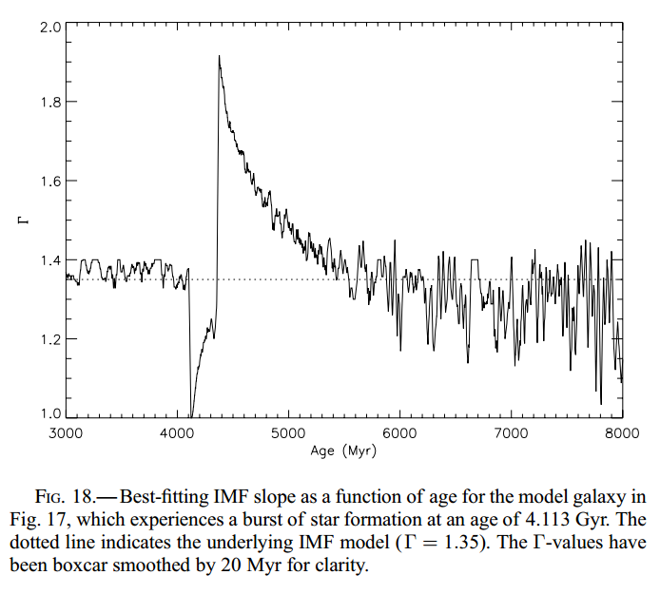
Star Formation History
Sharp SF bursts mess with Hα EW measurement
Excess of red giants after O and B stars die
Increases the continuum around the line, drops EW
Creates a lot of jitter in the calculated IMF slope

Slide 15
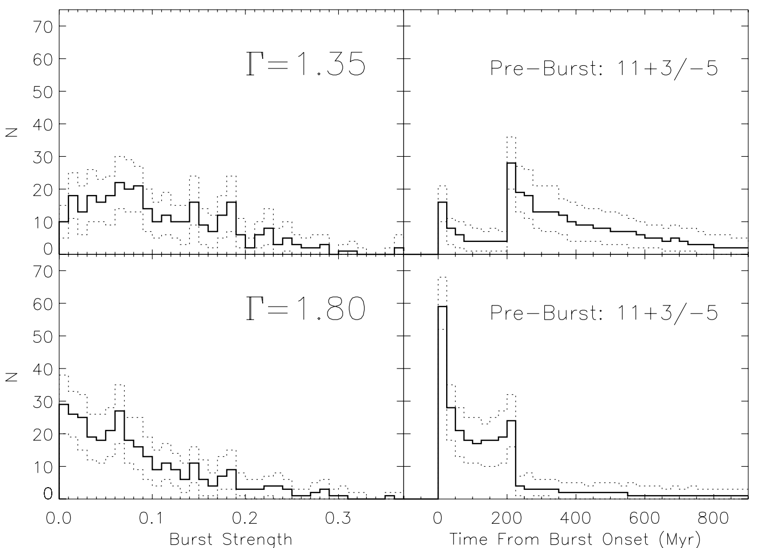
Single Burst Model
Fits are bad! As if there is a coordinated era of SF, which is unlikely to say the least.
Same goes for multi-burst models
Notes:
H delta stuff – There is no satisfactory model to account for the distribution in low luminosity galaxies

Slide 16
Conclusions
What do we get in combining K83 method with SDSS, fancy computers, and high-res instruments?
Claims that that “conservatively” the systematic bias is +/- 0.1
Found by looking at the ranges in Γ in the bias analyses
“It is also possible that the IMF is in fact universal, but the way in which it is sampled in embedded star clusters leads to an integrated galaxial IMF which varies from the true IMF”
Future work: Test more indicators!

