Slide 1
GCs: Multiple Stellar Populations- Theory
Deepthi Gorthi

Slide 2
Observational Constraints
GC Specificity
Ubiquity
Cluster-to-cluster variety
Predominance
Discreteness

Slide 3
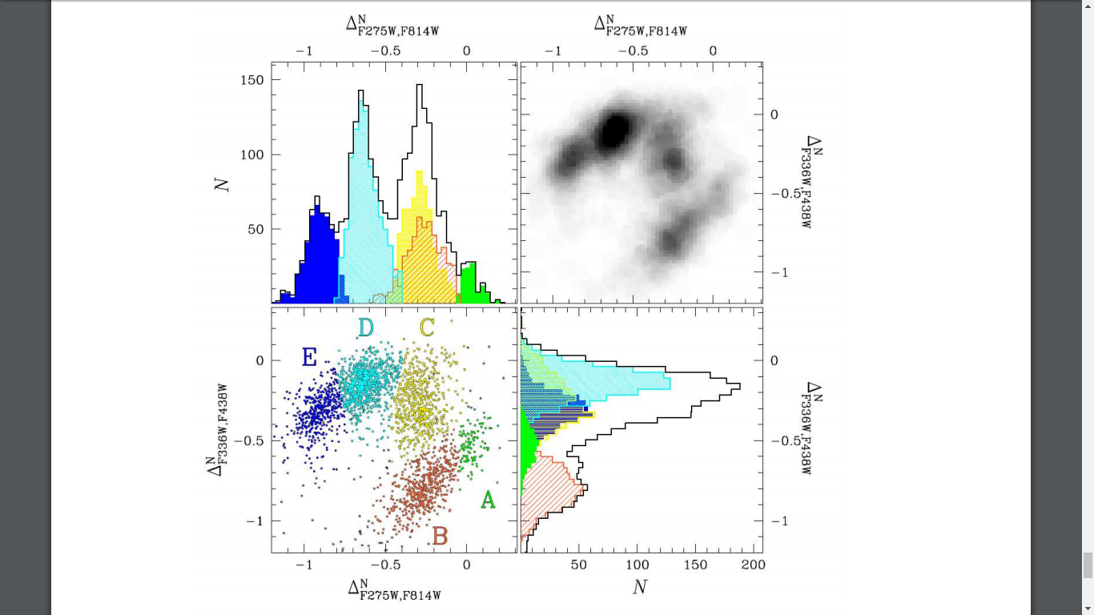

Slide 4
Observational Constraints
GC Specificity
Ubiquity
Cluster-to-cluster variety
Predominance
Discreteness
Supernova Avoidance
Hot CNO and Ne-Na processing
Helium Enrichment
Mass Budget

Slide 5
GC Formation Scenarios
Super Massive Stars
Fast Rotating Massive Stars
Massive Interacting Binaries
AGB Stars

Slide 6
Super Massive Stars
GC Specificity | Variety | Predominance | Discreteness | Supernova Avoidance | Composition | Mass budget
OK | OK | OK | OK | Nix | Nix | Nix

Slide 7
Fast Rotating Massive Stars
GC Specificity | Variety | Predominance | Discreteness | Supernova Avoidance | Composition | Mass budget
Nix | TBD | OK | Nix | Nix | TBD | TBD

Slide 8
Massive Interacting Binaries
GC Specificity | Variety | Predominance | Discreteness | Supernova Avoidance | Composition | Mass budget
OK | OK | OK | Nix | Nix | TBD | TBD

Slide 10
AGB Stars
GC Specificity | Variety | Predominance | Discreteness | Supernova Avoidance | Composition | Mass budget
OK | OK | OK | OK | OK | TBD | TBD

Slide 11
AGB Stars -- Problems
Carbon stars
Time boundedness
Dilution with pristine gas
O-Na anticorrelation
Mass budget -different IMF?

Slide 12
O-Na anticorrelation
Begin AGB phase- Slight oxygen depletion and sodium enrichment
HBB Process
Both start getting destroyed in p-capture processes
Observation- Na rich, O poor stars

Slide 13
