Slide 1

Dust Extinction in Starburst Galaxies Calzetti et al., 1994
Spooky Halloween Edition!
Max Genecov | UC Berkeley | October 31, 2016

Slide 2
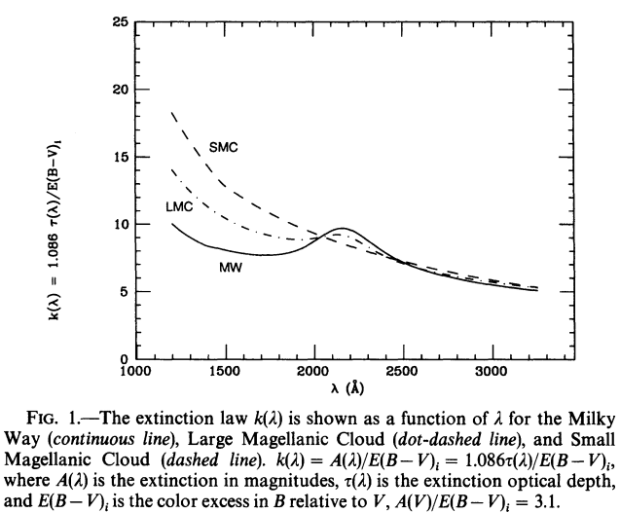

UV and Optical Extinction
MW, LMC, and SMC extinction laws are well-known
Different trends < 2600 A
2175 A dust feature varies in strength
Difference attributable to metallicity? Only partially.
There isn’t enough of a trend to extrapolate!

Slide 3
Dust Extinction in Extended Regions
Depends on chemical composition, grain size, distribution
Very difficult to pin down
Geometrical considerations
For extended objects, a theoretical uniform dust screen isn’t a good approximation.
Location of gas and dust is important!
Miscalculation can lead to improper luminosities and SFRs

Slide 4
A General Extinction Law?
Other galaxies’ extinction laws looks different from MW, even when they have similar metallicities
No 2175 A bump!
This paper looks at 39 starburst galaxies and BCGs
Balmer line ratios
UV continuum
Ignores any possible 2175 A bumps that may or may not exist

Slide 5
Data and Analysis
UV spectra from IUE
Optical spectra from observing runs on various telescopes
Aperture as close as possible to IUE size
Comparable regions sampled
Total E(B-V) (intrinsic + foreground) derived from Balmer line ratios
Dereddened oxygen abundance, electron density and temperature
Compare Balmer line ratios to UV properties to find extinction

Slide 6
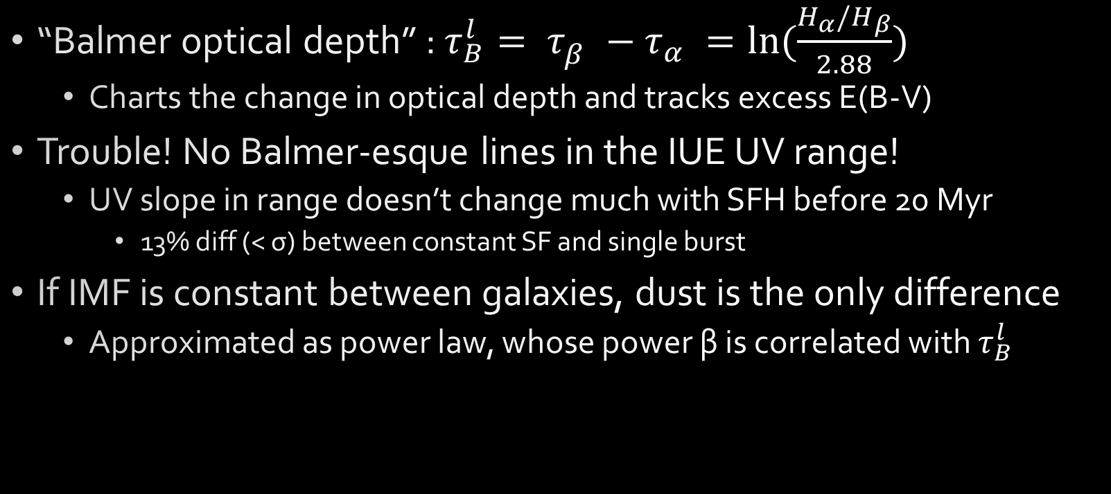
Optical Depth and UV Slope
“Balmer optical depth” : $τ_{B}^{l}= τ_{β}^{}−τ_{α}^{}=ln⁡(\frac{H_{α}/H_{β}}{2.88})$
Charts the change in optical depth and tracks excess E(B-V)
Trouble! No Balmer-esque lines in the IUE UV range!
UV slope in range doesn’t change much with SFH before 20 Myr
13% diff (< σ) between constant SF and single burst
If IMF is constant between galaxies, dust is the only difference
Approximated as power law, whose power β is correlated with $τ_{B}^{l}$

Slide 7
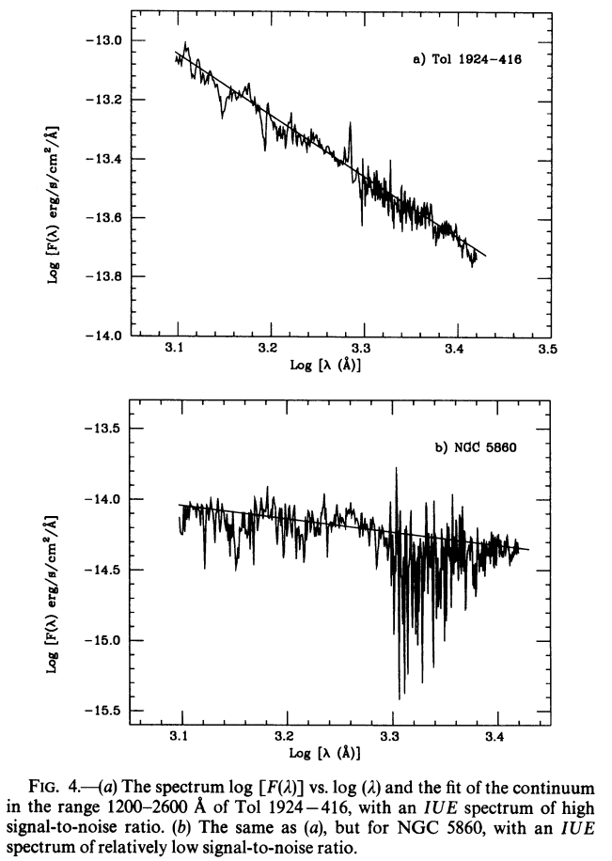
Optical Depth and UV Slope
Ignoring any 2175 A bump in all S/N
Spooky!

Slide 8
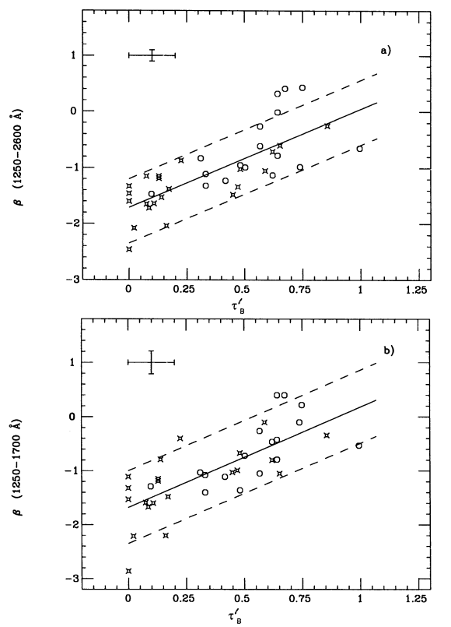
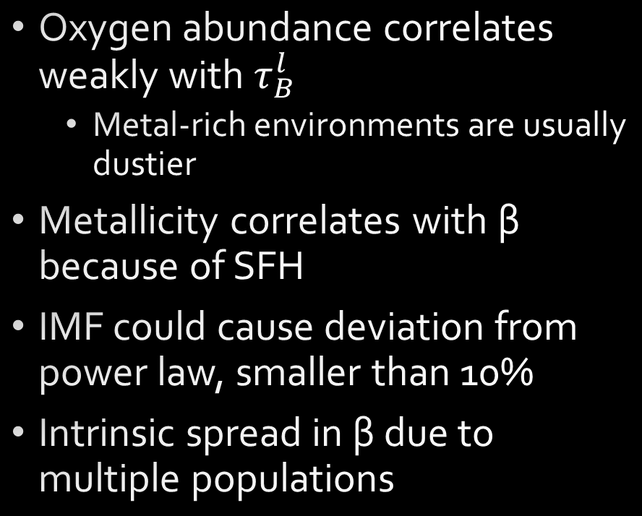
Stellar Populations and the UV Slope
Oxygen abundance correlates weakly with $τ_{B}^{l}$
Metal-rich environments are usually dustier
Metallicity correlates with β because of SFH
IMF could cause deviation from power law, smaller than 10%
Intrinsic spread in β due to multiple populations

Slide 9
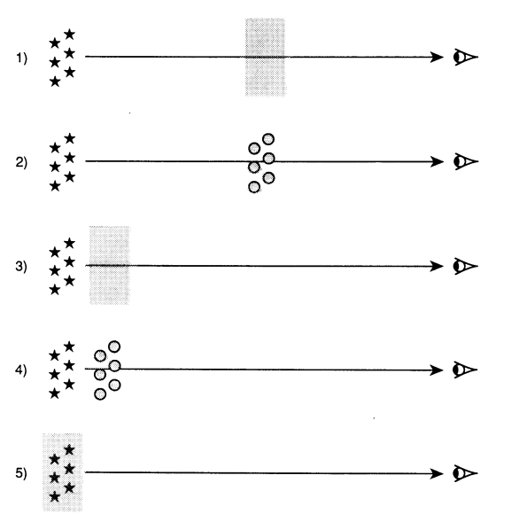
Dust Models
Uniform dust screen
Clumpy dust screen
Uniform “scattering slab”
Clumpy “scattering slab”
Internal dust
Can calculate all five theoretical optical depth curves.
Use MW and LMC metallicities

Slide 10
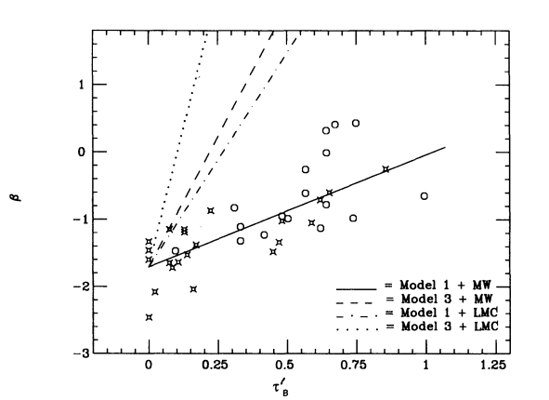
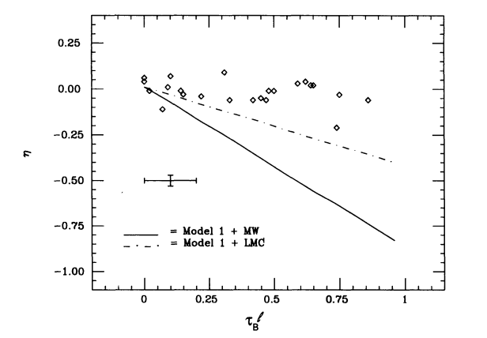
Model and Observation Comparison
Uniform dust distributions
Only dust screen + MW model agrees with the data
But this is with the 2175 A bump removed!

Slide 11
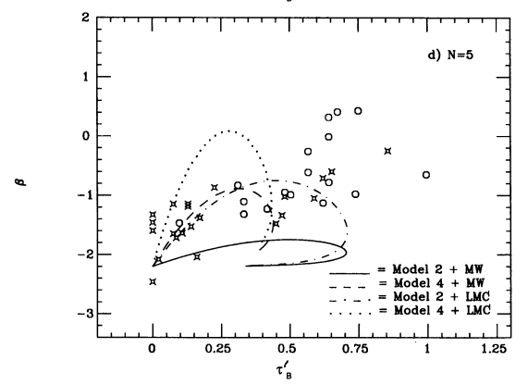
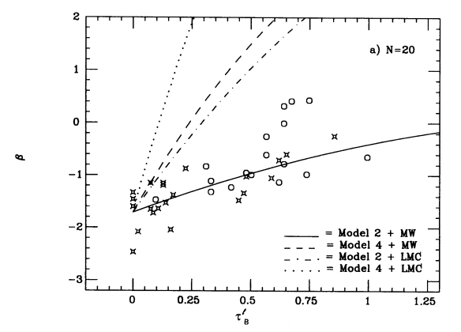
Model and Observation Comparison
Clumpy dust distributions
Work better because there is another free parameter (clumps in los)
They “have attempted to fit” the clumpy models, but “no fit gives satisfactory results”

Slide 12
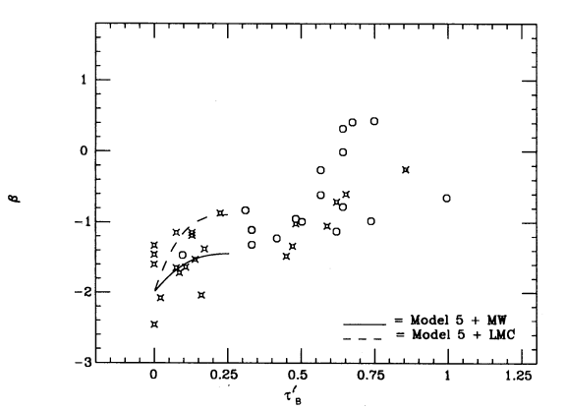
Model and Observation Comparison
Internal dust models don’t do any better!
Asymptotic behavior that can’t explain most galaxies
Internal dust is realistic on some level, but obviously not the whole picture
The dust model is a ghost!!

Slide 13
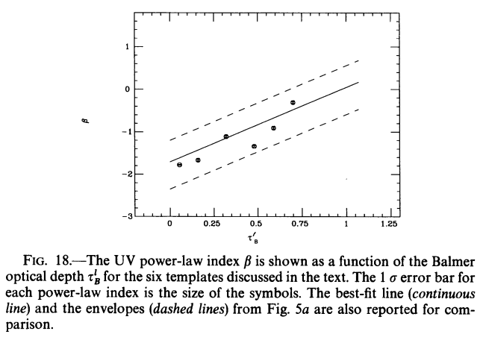

Making an Extinction Law
In the absence of a toy model of the dust, what does the curve look like if templates of the studied galaxies are used?
Fit into six groups of low to high $τ_{B}^{l}$
Assume a linear dependence between β and $τ_{B}^{l}$ with averaged templates
Like a uniform dust screen
Average the template extinction laws -> an effective extinction law

Slide 14
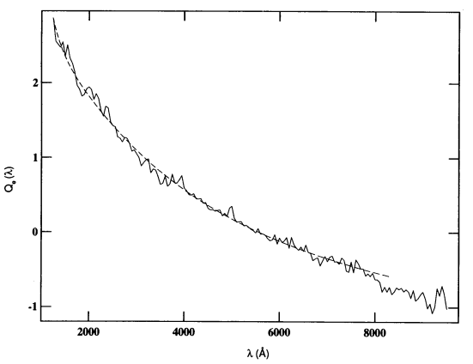
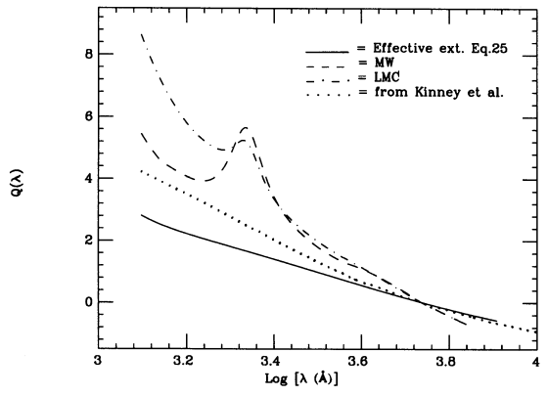
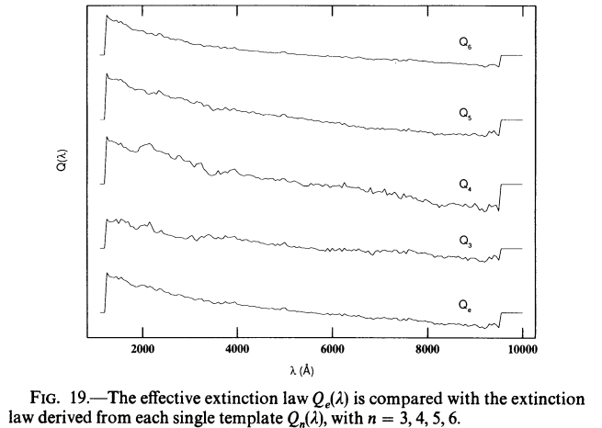
Making an Extinction Law

Slide 15
Conclusions
MW and LMC extinction laws are by no means universal, and the naïve models of where the dust congregates don’t apply either.
No attempt at a geometrical or theoretical backing for this new law
Seems really difficult with lots of degeneracy between composition, physics, and geometry
“The effective extinction law probes regions of small optical depth; therefore, it is not strictly related to the total amount of dust in the galaxy.”
Who knows what spookiness governs these extinction laws???

