Slide 1
COSC 320 Advanced Data Structures and Algorithm Analysis
Instructor: Dr. Enyue (Annie) Lu
  Office hours: Dr. Lu’s Schedule
  Office room: HS114
  Email: ealu@salisbury.edu
Course information:
  Website: http://faculty.salisbury.edu/~ealu/COSC320/COSC320.htm.
Notes:
Course schedule: Dates and topics are subject to change as required by class progress

Slide 2
Prerequisite:
Computer Science II (COSC 220) completed with a grade of C or better; and
Discrete Mathematics (MATH 210) completed with a grade of C or better.
If you have any question about prerequisite, talk to you instructor
DON’T TAKE THE COURSE IF YOU DON’T SATISFIED THE PREREQUISITE

Slide 3
Course overview
Covered topics:
  Asymptotic Analysis, Recursion, Master Theorem,
  Trees, Binary Search Trees, BST Iterators
  Associative Containers
  Hashing
  Heaps and Priority Queues
  Graphs
  Divide and Conquer Algorithms, Greedy Algorithms, Dynamic Programming
Optional topics: parallel algorithms, security algorithms, clustering algorithms, stable matching algorithms

Slide 4
Algorithm Analysis
Asymptotic notations
Best, worst, average cases

Slide 5
Algorithm
Algorithm: A sequence of computational steps that transform the input into the output
Example: A sorting algorithm for integers
  Input: A sequence of n numbers
  Output: A permutation (reordering) of the n numbers
An instance of a problem
A correct algorithm: for every input instance, it halts with the correct output

Slide 6
Asymptotic Analysis of Algorithms
How to measure the algorithm performance (efficiency) --- Complexity: the rate at which storage or time grows as a function of the problem input size ( for example, the size of the data on which an algorithm operates)
  Time Complexity: how much time will it take?
  Space Complexity: how much storage will it need?
How to analyze the complexity ---
Asymptotic Analysis: a method of classifying limiting behavior, by concentrating on some trend.
  An algorithm is asymptotically more efficient will be the best choice for all but very small inputs

Slide 7
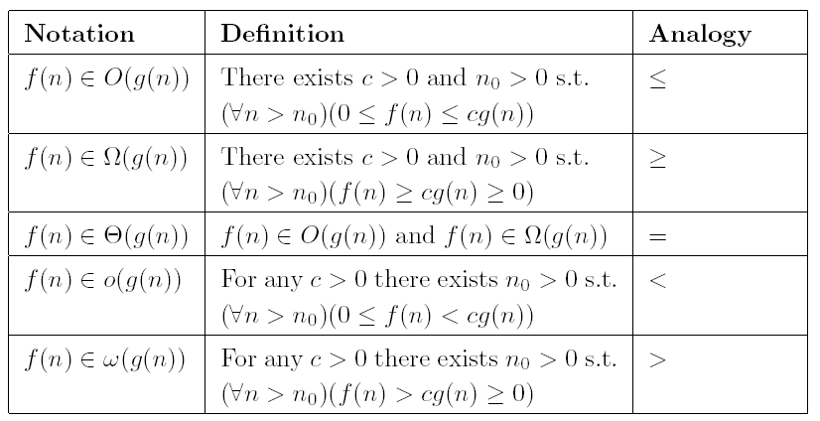
Asymptotic notations

Slide 8
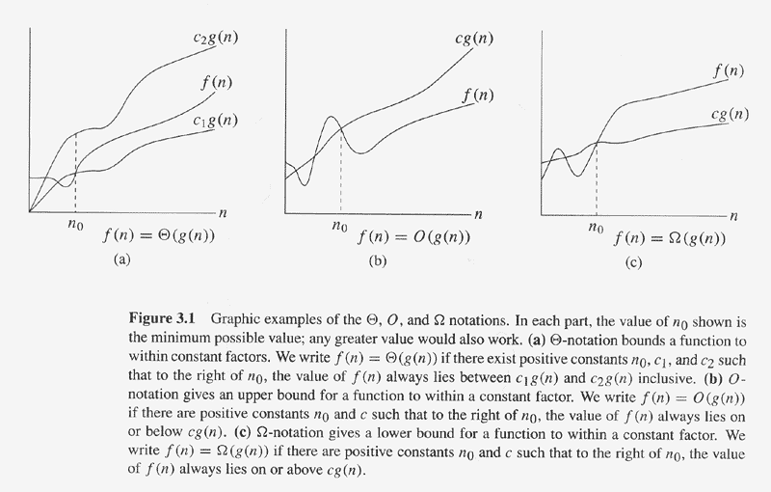
Copyright © The McGraw-Hill Companies, Inc. Permission required for reproduction or display.

Slide 9
Examples:

Slide 10
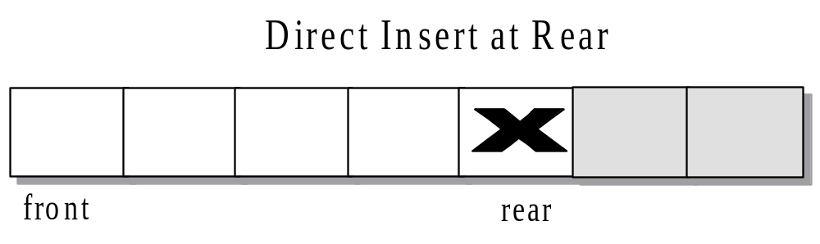
Constant Time Algorithms
An algorithm is O(1) when its running time is independent of the number of data items. The algorithm runs in constant time.
The storing of the element involves a simple assignment statement and thus has efficiency O(1).

Slide 11
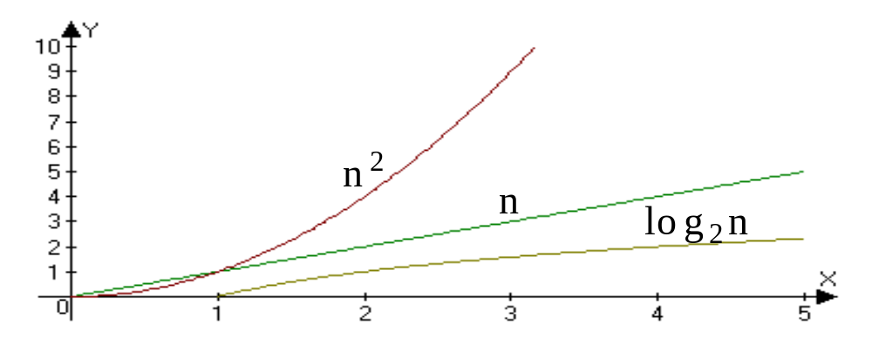
Logarithmic Time Algorithms
The logarithm of n, base 2, is commonly used when analyzing computer algorithms.
Ex. log₂(2) = 1
log₂(75) = 6.2288
When compared to the functions n and n², the function log₂ n grows very slowly.

Slide 12
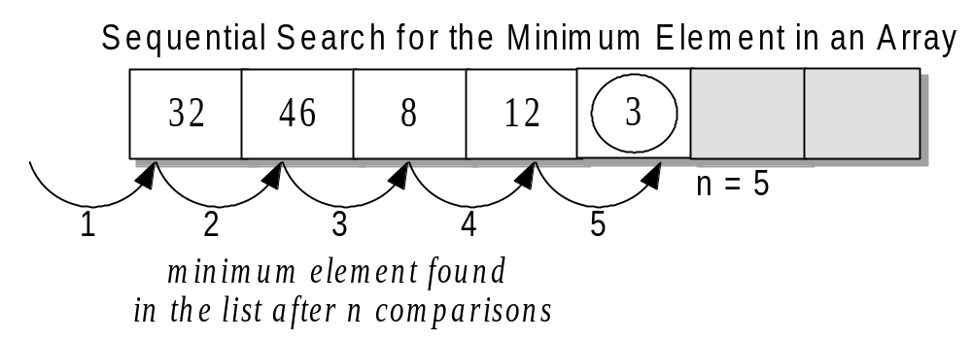
Linear Time Algorithms
An algorithm is O(n) when its running time is proportional to the size of the list.
When the number of elements doubles, the number of operations doubles.

Slide 13
Polynomial Algorithms
Algorithms with running time O(n²) are quadratic.
  practical only for relatively small values of n.
    Whenever n doubles, the running time of the algorithm increases by a factor of 4.
Algorithms with running time O(n³)are cubic.
  efficiency is generally poor; doubling the size of n increases the running time eight-fold.

Slide 14
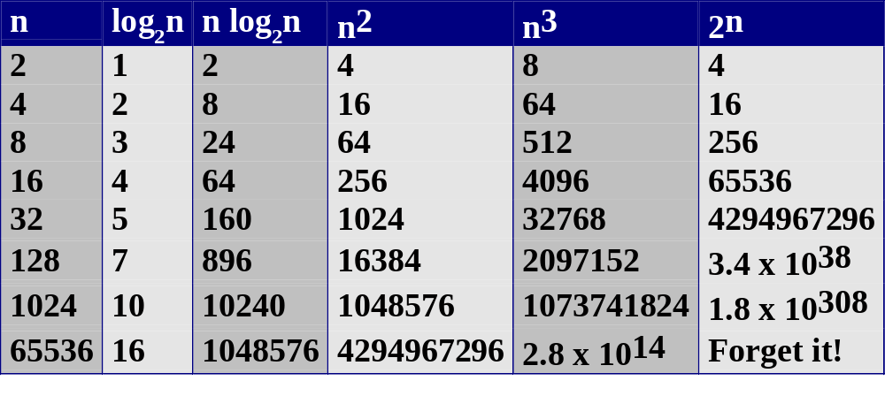
Comparison

Slide 15

Practical Complexity
© David Luebke <number>

Slide 16

Practical Complexity
© David Luebke <number>

Slide 17

Practical Complexity
© David Luebke <number>

Slide 18

Theorems
Notes:
[Class 1]
[Class 2: proof, exercise]

Slide 19
Best, Worst, and Average Cases
The best case for an algorithm is that property of the data that results in the algorithm performing as well as it can.
The worst case is that property of the data that results in the algorithm performing as poorly as possible.
The average case is determined by averaging algorithm performance over all possible
Examples: linear search, binary search

Slide 20
The Linear Search
This is a very simple algorithm.
It uses a loop to sequentially step through an array, starting with the first element.
It compares each element with the value being searched for and stops when that value is found or the end of the array is reached.

Slide 21
Binary Search
The binary search is much more efficient than the linear search.
It requires the list to be in order.
The algorithm starts searching with the middle element.
  If the item is less than the middle element, it starts over searching the first half of the list.
  If the item is greater than the middle element, the search starts over starting with the middle element in the second half of the list.
  It then continues halving the list until the item is found.

Slide 22
Efficiency of the Binary Search
Much more efficient than the linear search.
The minimum number of comparisons that the binary search will perform is 1
The maximum number of comparisons that the binary search will perform is x, where:
2^{X} > N where N is the number of elements in the array
[ x=log₂N comparisons where N = array size ]

