Slide 1
Algorithm Design Methods
  Divide-and-Conquer

Slide 2
Divide-and-Conquer Algorithms
Divide-and-conquer is problem-solving technique that makes use of recursion.
The strategy divides a problem into smaller subproblems that are solved as a stopping condition or in a recursive step.
The solutions to the subproblms combine to build (conquer) the solution to the original problem
Divide-and-conquer typically contains two or more recursive calls, which partition the data into disjointed collections and then work on the smaller data set.

Slide 3
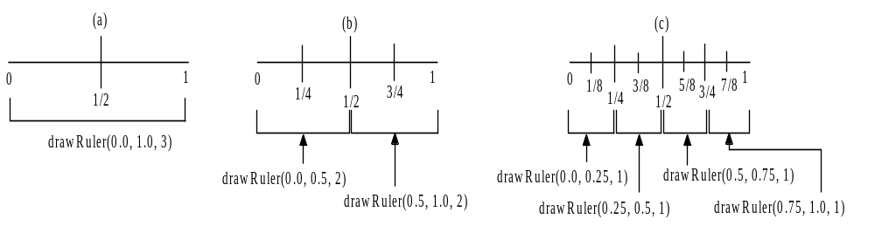
Building a Ruler: drawRuler()
Problem: create a program that draws marks at regular intervals on a line. The sizes of the marks differ, depending on the specific interval.

Slide 4
The Merge Sort Algorithm
Selection sort and insertion sort: O(n²)
Merge sort algorithm:
  recursively partitions a sequence into progressively smaller and smaller half-lists that are ultimately sorted.
  Recursive steps merge the sorted half-lists back into larger and larger ordered lists until the algorithm rebuild the original sequence in ascending order.

Slide 5
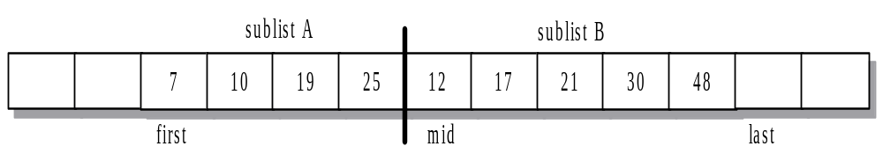
The Merge Algorithm Example
The merge algorithm takes a sequence of elements in a vector v having index range [first, last). The sequence consists of two ordered sublists separated by an intermediate index, called mid.

Slide 6
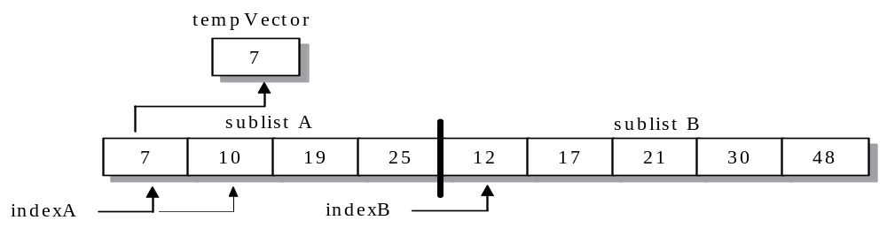
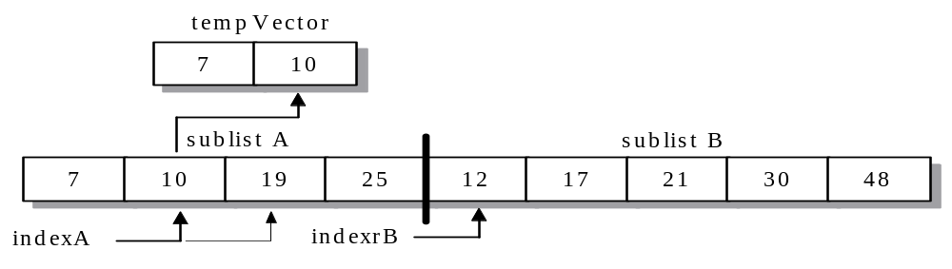
The Merge Algorithm… (Cont…)

Slide 7
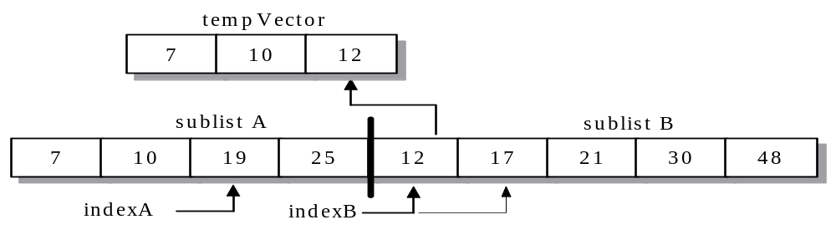
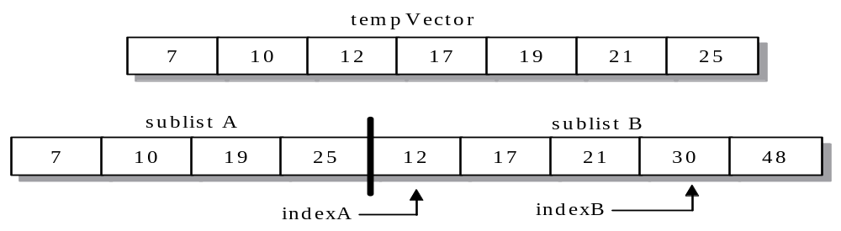
The Merge Algorithm… (Cont…)

Slide 8
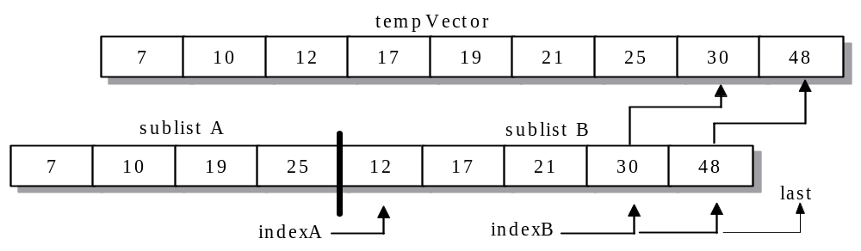
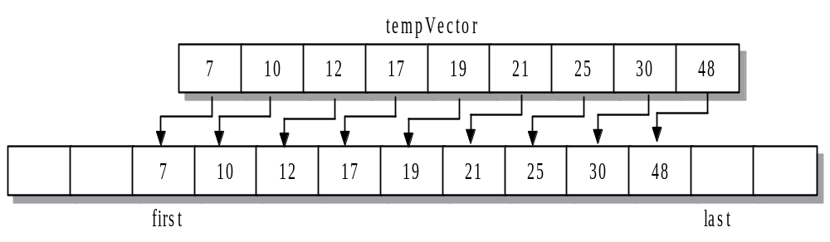
The Merge Algorithm… (Cont…)

Slide 9
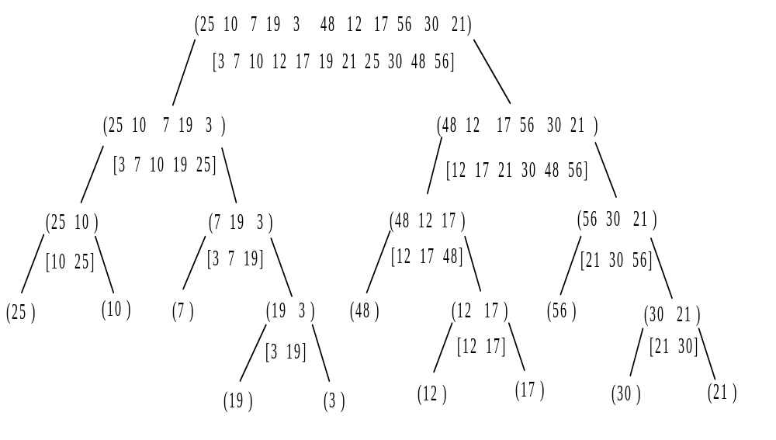
Partitioning and Merging of Sublists in mergeSort()

Slide 10
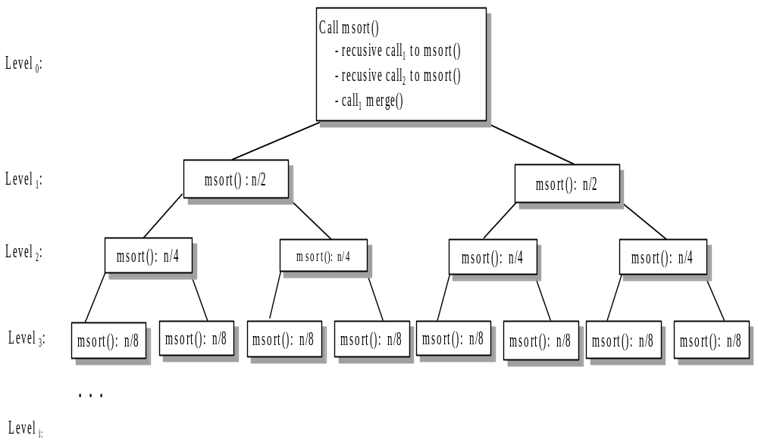
Function calls in mergeSort()
Running time: log₂n*O(n)=O(nlogn)

Slide 11
The Merge Sort Algorithm
Implementation
Time complexity: O(nlogn)

Slide 12
Quicksort algorithm
The quicksort algorithm uses a series of recursive calls to partition a list into smaller and smaller sublists about a value called the pivot.
Each step chooses as its pivot the value at midpoint of the list.
The partitioning algorithm performs exchanges so that the pivot is in its final location, the lower sublist has only elements that are no larger than the pivot, and upper sublist has only elements that are no less than the pivot.
An “in-place” sorting algorithm: reorders the list by exchanging elements within the list.
Notes:
Merge sort is not a in-place sorting algorithm.

Slide 13
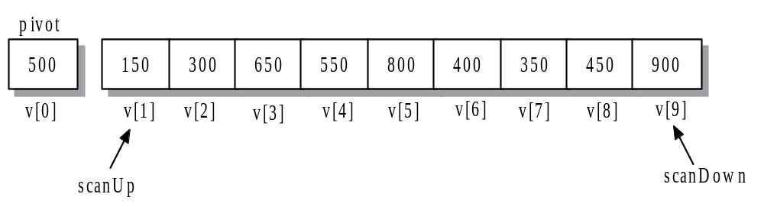
Quicksort Example
Example: Let v be a vector containing 10 integer values:
v = {800, 150, 300, 650, 550, 500, 400, 350, 450, 900}

Slide 14
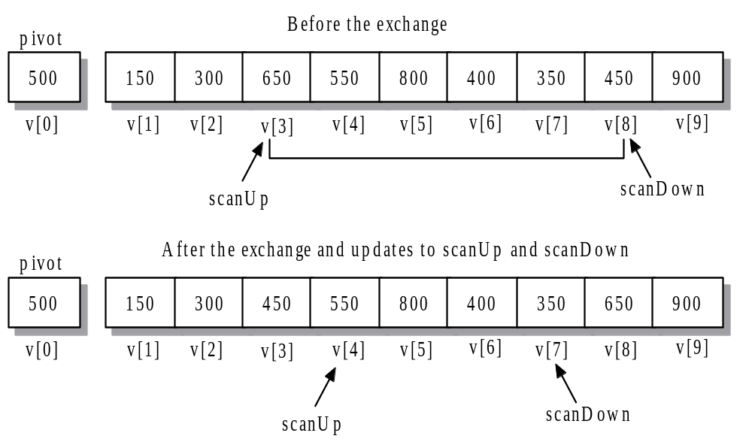
Quicksort Example (Cont…)

Slide 15
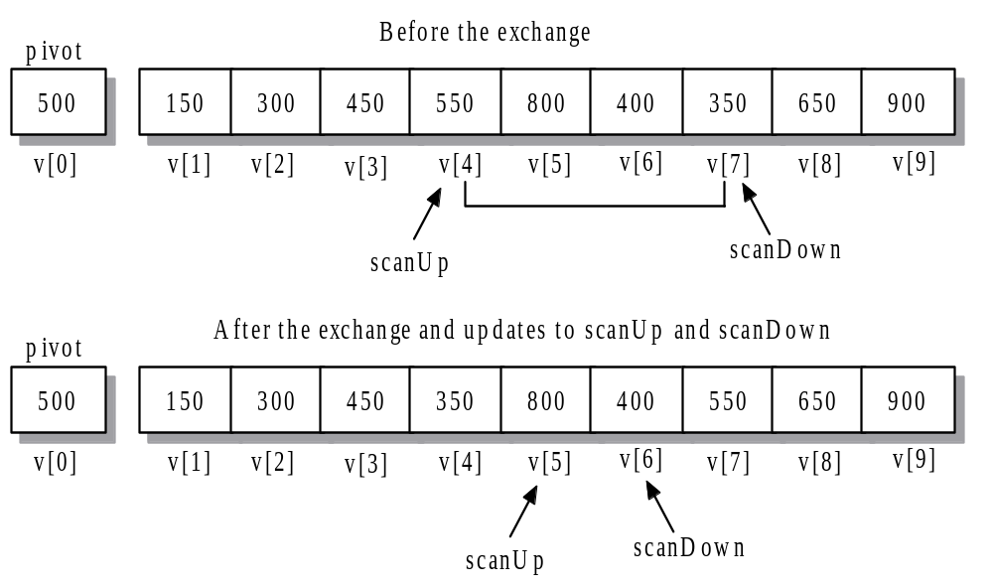
Quicksort Example (Cont…)

Slide 16
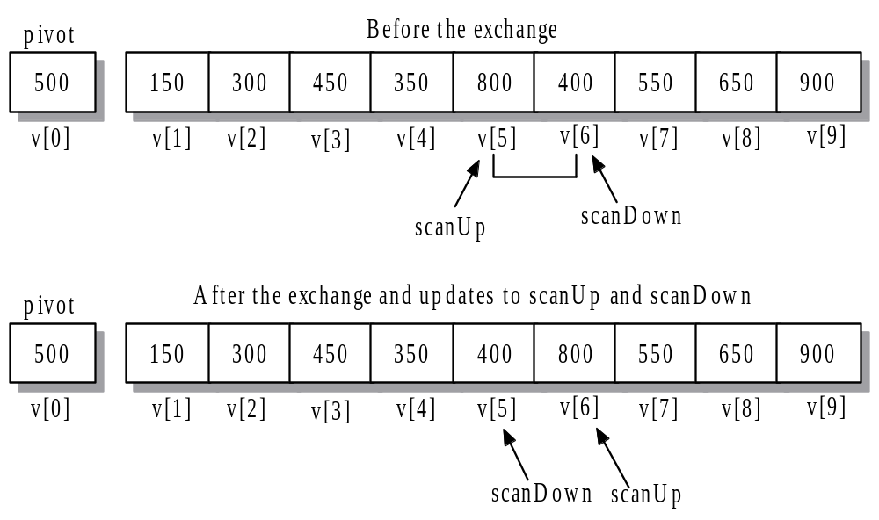
Quicksort Example (Cont…)

Slide 17
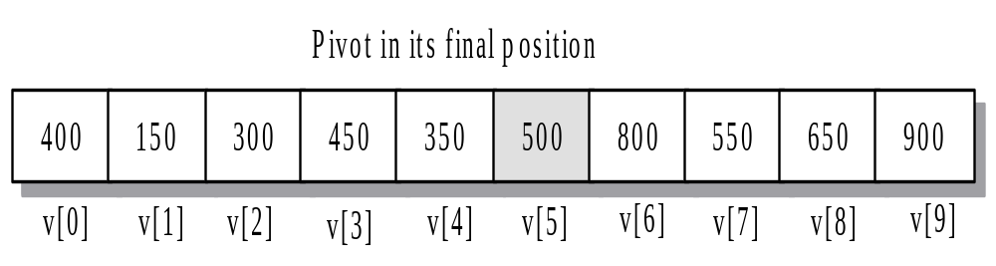
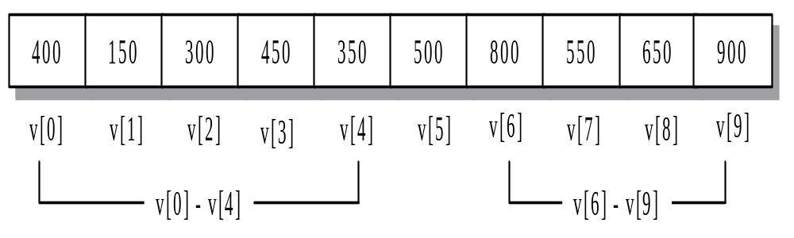
Quicksort Example (Cont…)

Slide 18
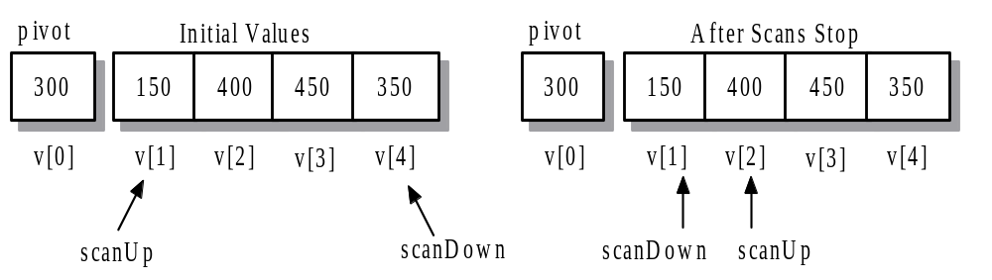
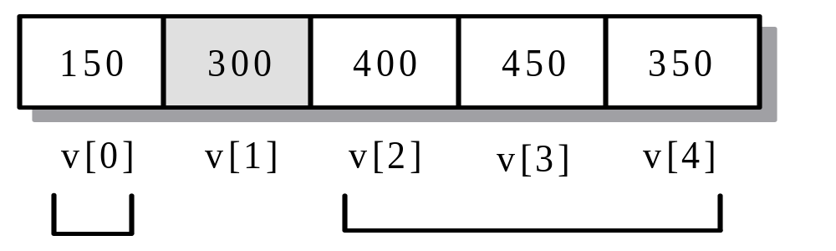
Quicksort Example (Cont…)

Slide 19
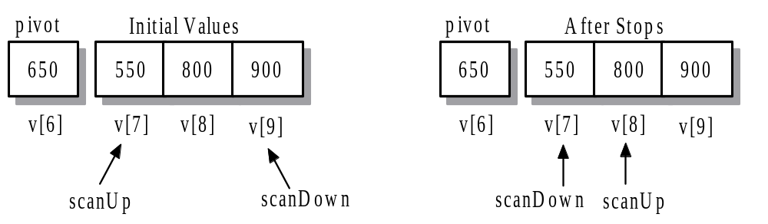
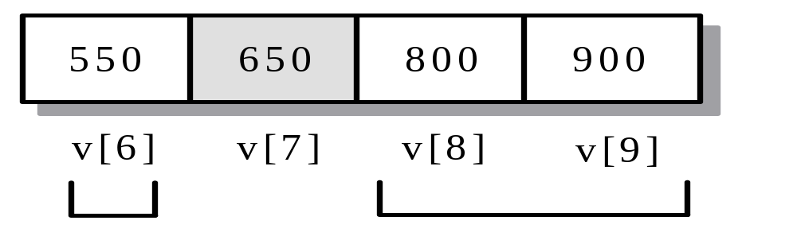
Quicksort Example (Cont…)

Slide 20
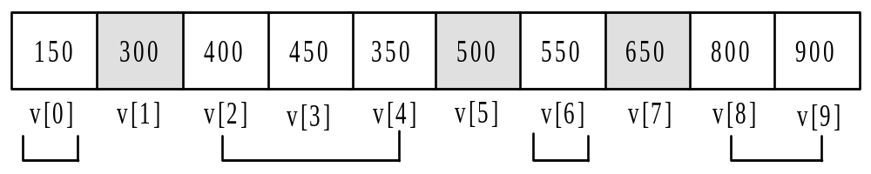
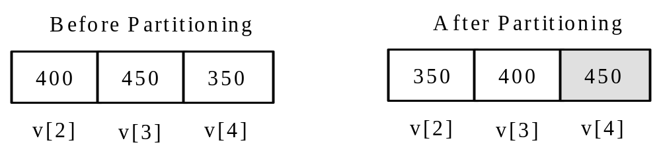
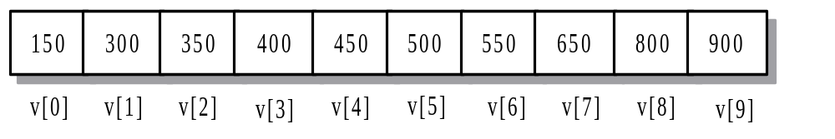
Quicksort Example (Cont…)

Slide 21
Quicksort algorithm
Implementation:
Running time: O(n²)

Slide 22
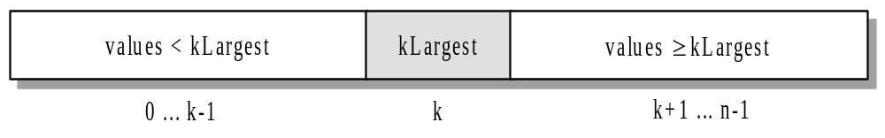
Finding K^{th} – Largest Element
To locate the position of the k^{th}-largest value (kLargest) in the list, partition the elements into two disjoint sublists. The lower sublist must contain k elements that are less than or equal to kLargest and the upper sublist must contain elements that are greater than or equal to kLargest. The elements in the lower sublist do not need to be ordered but only to have values that are less than or equal to kLargest. The opposite condition applies to the upper sublist.

Slide 23
Finding K^{th} – Largest Element
Implementation
Time Complexity: O(n²)

Slide 24
Summary Slide 1
§- Divide-and-Conquer Algorithms
- splits a problem into subproblems and works on each part separately
- Two type of divide-and-conquer strategy:
1) mergesort algorithm
- Split the range of elements to be sorted in half, sort each half, and then merge the sorted sublists together.
- running time: O(n log₂n), requires the use of an auxiliary vector to perform the merge steps.

Slide 25
Summary Slide 2
2) quicksort algorithm
- uses a partitioning strategy that finds the final location of a pivot element within an interval [first,last).
- The pivot splits the interval into two parts, [first, pivotIndex), [pivotIndex, last). All elements in the lower interval have values ≤ pivot and all elements in the upper interval have values ≥ pivot.
- worst case: of O(n²), highly unlikely to occur

Slide 26
Summary Slide 3
§- Recursion in Combinatorics
- A set of n elements has 2^{n} subsets, and the set of those subsets is called the power set. By using a divide and conquer strategy that finds the power set after removing an element from the set and then adds the element back into each subset, we implement a function that computes the power set. The section also uses recursion to list all the n! permutations of the integers from 1 through n. The success of this algorithm depends on the passing of a vector by value to the recursive function.

