Slide 1
Algorithm Design Methods
  Greedy Algorithm

Slide 2
Greedy Algorithm
It makes the choice that looks best at the moment and adds it to the current subsolution.
It makes a locally optimal choice in the hope that this choice will lead to a globally optimal solution.
Examples
  Prim/Kruskal’s MST algorithms
  Dijkstra’s mimimun path algorithm

Slide 3

The Knapsack Problem
A thief robbing a store finds n items
The i ^{th} item is worth (or gives a profit of) p_{i} dollars and weighs w_{i} pounds
Thief’s knapsack can carry at most M pounds
What items to select to maximize profit?
Notes:
Has anyone heard of knapsack problem before?
(Yes: Could you tell us what you know about it, excellent, great, Do you know how to solve it. It is interesting and fun)
(No: good. The knapsack problem is a very interesting and famous problem. I am going to talk about it. So later on, when people talk about knapsack problem, you can say something about it. Is it fun? this interesting problem to you)
We label n item from 0 to n-1
Each item has a value and a weight.
The thief wants to take as valuable a load as possible

Slide 4
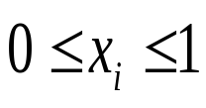
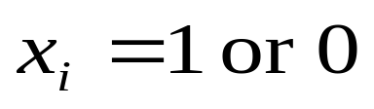
The Knapsack Problem
The fractional knapsack problem:
  Thief can take fractions of items
The binary knapsack problem:
  Each item is either taken or left entirely
  p_{i}, w_{i}, and M are integers
(0-1)
Let x_{i} be the fraction of item i, which will be put in the knapsack
Notes:
Today I will introduce 2 versions of knapsack problem: ….
We can think that in …. Problem, items can be Gold dusts, silver dusts, and so on.
Gold bars
If xi =0: item wil not be put in bag
1
½
1/3…
Think of items as gold dust
Think of items as gold ingots (bar)

Slide 5
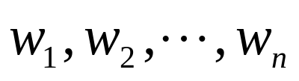
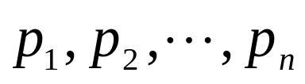

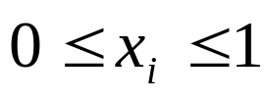
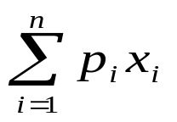
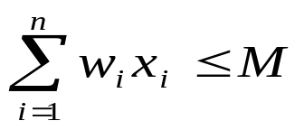
Fractional Knapsack Problem
The problem:
Given a knapsack with a certain capacity M,
n items, which are to be put into the knapsack,
each item has a weight and
a profit
.
The goal: find where
s.t. is maximized and
For item i:
The profit made for the selection: p_{i}x_{i}
The weight put into the knapsack: w_{i}x_{i}
Notes:
Let’s first talk about fractional knapsack problem.
What’s the notation for summation
Sum notation
P1*xi+P2*x2…
W1*x1+w2*x2

Slide 6
How to solve the fractional knapsack problem ?
Greedy method
  The thief will put items one by one
  Items are ordered in a way that the thief thinks that he can achieve the maximum profit at each time
Notes:
Dose anyone have any idea?

Slide 7
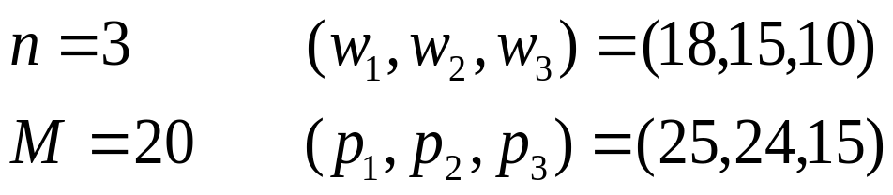
Example:
Greedy Strategy#1:
items are ordered in nonincreasing order of profits
(1,2,3)
2
(
x
,
x
,
x
)
=
(
1
,
,
0
)
1
2
3
15
3
2
∑
p
x
=
25
×
1
+
24
×
+
15
×
0
=
28
.
2
i
i
15
i
=
1
Greedy Strategy#2:
items are ordered in nondecreasing order of weights
(3,2,1)
2
(
x
,
x
,
x
)
=
(
0
,
,
1
)
1
2
3
3
3
2
∑
p
x
=
25
×
0
+
24
×
+
15
×
1
=
31
i
i
3
i
=
1

Slide 8
Example:
Greedy Strategy#3: items are ordered in nonincreasing order of p/w
p
25
1
=
≈
1
.
4
w
18
1
p
24
2
=
=
1
.
6
⇒
(
2
,
3
,
1
)
w
15
2
p
15
3
=
=
1
.
5
w
10
3
Optimal Solution?
1
(
x
,
x
,
x
)
=
(
0
,
1
,
)
1
2
3
2
3
1
∑
p
x
=
25
×
0
+
24
×
1
+
15
×
=
31
.
5
i
i
2
i
=
1

Slide 9
Proof of correctness
Proved by contradiction
Let X be the solution of greedy strategy #3
  Assume that X is not optimal
    There is an optimal solution Y and the profit of Y is greater than the profit of X
  Consider the item j in X but not in Y
    get rid of some items with total weight w_{j} (possibly fractional items) and add item j to Y
      The capacity remains the same
      Total value is not decreased
      One more item in X is added to Y
  Repeat the process until Y is changed to contain all items selected in X
    Total value is not decreased.
    The capacity remains the same
  X is optimal too
Contradiction!

Slide 10
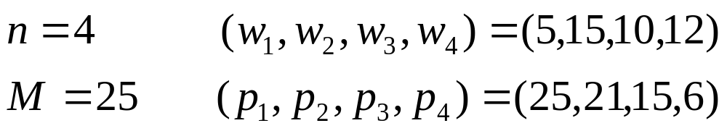
Greedy Algorithm
1. Calculate v_{i} = p_{i} / w_{i} for i = 1, 2, …, n
2. Sort items by nonincreasing v_{i}.
(all w_{i}, p_{i} are also reordered correspondingly)
3. Let M' be the current weight limit (Initially, M' = M and x_{i}=0 ).In each iteration, choose item i from the head of the unselected list.
If M' >= w_{i} , set x_{i}=1, and M' = M'-w_{i}
If M' < w_{i} , set x_{i}=M'/w_{i} and the algorithm is finished.
Exercise:
Work it out
Notes:
vI= 5, 1.4, 1.5, 1.2
Order item: item 1, item 3, item 2, item 4 (1,3, 2, 4)
Put item 1:
Put item 2,
Total value is 25+15+(2/3)*21=25+15+14=54

Slide 11
Time Complexity
O(nlogn)
O(n)
1. Calculate v_{i} = p_{i} / w_{i} for i = 1, 2, …, n
2. Sort items by nonincreasing v_{i}.
(all w_{i} are also reordered correspondingly )
3. Let M' be the current weight limit (Initially, M' = M and x_{i}=0 ).In each iteration, choose item i from the head of the unselected list.
If M' >= w_{i} , set x_{i}=1, and M' = M'-w_{i}
If M' < w_{i} , set x_{i}=M'/w_{i} and the algorithm is finished.
O(nlogn)
O(n)
O(1)

Slide 12
Greedy Algorithm
Greedy Choice Property: it makes the choice that looks best at the moment and adds it to the current subsolution.
Optimal Sub Structure: it makes a locally optimal choice in the hope that this choice will lead to a globally optimal solution.

Slide 13
0-1 Knapsack Problem (x_{i} can be 0 or 1)
Knapsack capacity: 50
0
+
100
+
60
=160
0
+
120
+
60
=180
0
+
120
+
100
=220
i | 1 | 2 | 3
p_{i} | 60 | 100 | 120
w_{i} | 10 | 20 | 30
Can 0-1 Knapsack be solved
by greedy algorithm?

Slide 14




Recursive Solution
Capacity
M
0
Profit
Item 1 not selected
1
Item 1 selected
M
0
M-w₁
p₁
2
2
M
0
M-w₂
p₂
M-w₁
p₁
M-w₁-w₂
p₁+p₂
M
0
M-w₃
p₃
M-w₁
p₁
M-w₁-w₃
p₁+p₃

Slide 15
Recursive Solution
Let us define P(i,k) as the maximum profit possible using items i, i+1,…,n and capacity k
We can write expressions for P(i,k) for i=n and i<n as follows
⎧
0
i
=
n
&
w
>
k
⎪
n
⎪
p
i
=
n
&
w
≤
k
P
(
i
,
k
)
=
⎨
n
n
⎪
P
(
i
+
1
,
k
)
i
<
n
&
w
>
k
i
⎪
Max{P(i+1,k), p_{i}+P (i+1,k-w_{i})}
i
<
n
&
w
≤
k
⎩
i
Item i is not chosen
Item i is chosen

Slide 16
Recursive Solution
Recursive algorithm will take O(2^{n}) time
  NP-complete problem
Inefficient because P(i,k) for the same i and k will be computed many times

Slide 17




Example: n=5, M=10, w=[2, 2, 6, 5, 4], p=[6, 3, 5, 4, 6]
P(1, 10)
P(2, 10)
P(2, 8)
P(3, 10)
P(3, 8)
P(3, 8)
P(3, 6)
Same subproblem

Slide 18
Dynamic Programming Solution
The inefficiency could be overcome by computing each P(i,k) once
storing the results in a table for future use

Slide 19
Example
n=5, c=10, w = [2, 2, 6, 5, 4], p = [2, 3, 5, 4, 6]
i\k | 0 | 1 | 2 | 3 | 4 | 5 | 6 | 7 | 8 | 9 | 10
5 | 0 | 0 | 0 | 0 | 6 | 6 | 6 | 6 | 6 | 6 | 6
4
3
2
1

Slide 20
Example
n=5, c=10, w = [2, 2, 6, 5, 4], p = [2, 3, 5, 4, 6]
i\k | 0 | 1 | 2 | 3 | 4 | 5 | 6 | 7 | 8 | 9 | 10
5 | 0 | 0 | 0 | 0 | 6 | 6 | 6 | 6 | 6 | 6 | 6
4 | 0 | 0 | 0 | 0 | 6 | 6 | 6 | 6 | 6 | 10 | 10
3
2
1

Slide 21
Example
n=5, c=10, w = [2, 2, 6, 5, 4], p = [2, 3, 5, 4, 6]
i\k | 0 | 1 | 2 | 3 | 4 | 5 | 6 | 7 | 8 | 9 | 10
5 | 0 | 0 | 0 | 0 | 6 | 6 | 6 | 6 | 6 | 6 | 6
4 | 0 | 0 | 0 | 0 | 6 | 6 | 6 | 6 | 6 | 10 | 10
3 | 0 | 0 | 0 | 0 | 6 | 6 | 6 | 6 | 6 | 10 | 11
2
1

Slide 22
Example
n=5, c=10, w = [2, 2, 6, 5, 4], p = [2, 3, 5, 4, 6]
i\k | 0 | 1 | 2 | 3 | 4 | 5 | 6 | 7 | 8 | 9 | 10
5 | 0 | 0 | 0 | 0 | 6 | 6 | 6 | 6 | 6 | 6 | 6
4 | 0 | 0 | 0 | 0 | 6 | 6 | 6 | 6 | 6 | 10 | 10
3 | 0 | 0 | 0 | 0 | 6 | 6 | 6 | 6 | 6 | 10 | 11
2 | 0 | 0 | 3 | 3 | 6 | 6 | 9 | 9 | 9 | 10 | 11
1

Slide 23
Example
n=5, M=10, w = [2, 2, 6, 5, 4], p = [2, 3, 5, 4, 6]
i\k | 0 | 1 | 2 | 3 | 4 | 5 | 6 | 7 | 8 | 9 | 10
5 | 0 | 0 | 0 | 0 | 6 | 6 | 6 | 6 | 6 | 6 | 6
4 | 0 | 0 | 0 | 0 | 6 | 6 | 6 | 6 | 6 | 10 | 10
3 | 0 | 0 | 0 | 0 | 6 | 6 | 6 | 6 | 6 | 10 | 11
2 | 0 | 0 | 3 | 3 | 6 | 6 | 9 | 9 | 9 | 10 | 11
1 | 0 | 0 | 3 | 3 | 6 | 6 | 9 | 9 | 11 | 11 | 11

Slide 24
Example
n=5, M=10, w = [2, 2, 6, 5, 4], p = [2, 3, 5, 4, 6]
i\k | 0 | 1 | 2 | 3 | 4 | 5 | 6 | 7 | 8 | 9 | 10
5 | 0 | 0 | 0 | 0 | 6 | 6 | 6 | 6 | 6 | 6 | 6
4 | 0 | 0 | 0 | 0 | 6 | 6 | 6 | 6 | 6 | 10 | 10
3 | 0 | 0 | 0 | 0 | 6 | 6 | 6 | 6 | 6 | 10 | 11
2 | 0 | 0 | 3 | 3 | 6 | 6 | 9 | 9 | 9 | 10 | 11
1 | 0 | 0 | 3 | 3 | 6 | 6 | 9 | 9 | 11 | 11 | 11
x = [0,0,1,0,1]
x = [1,1,0,0,1]

Slide 25
Dynamic programming
Identify a recursive definition of how a larger solution is built from optimal results for smaller sub-problems.
Create a table that we can build bottom-up to calculate results for sub-problems and eventually solve the entire problem.
Running time and space: O(nM).
For large M=O(2^{n}), it is still NP-complete problem

Slide 26
Dynamic Programming
The strategy of the dynamic programming handles divide-and-conquer algorithms that involved overlapping data

Slide 27
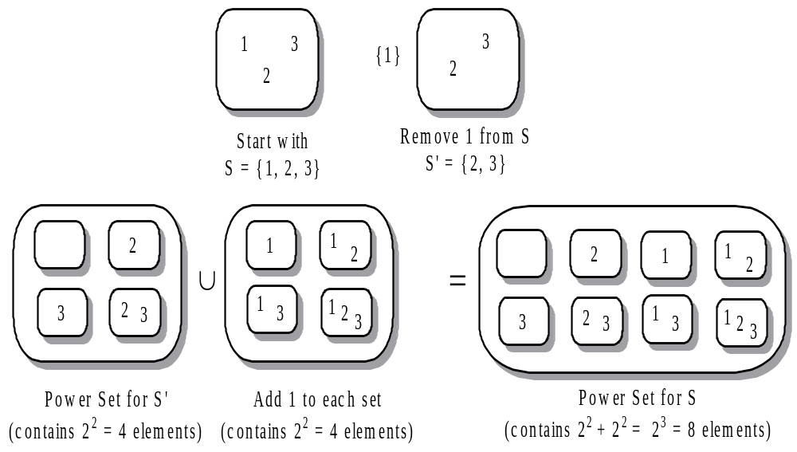
Finding all subsets powerSet() Example

Slide 28
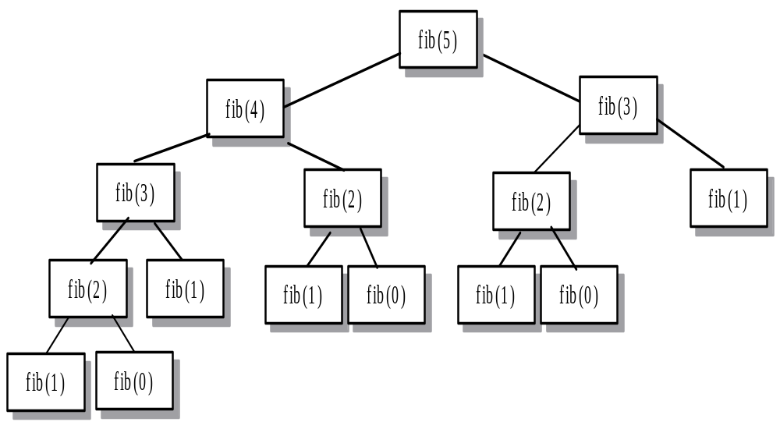
Recursive calls for fib(5)

Slide 29
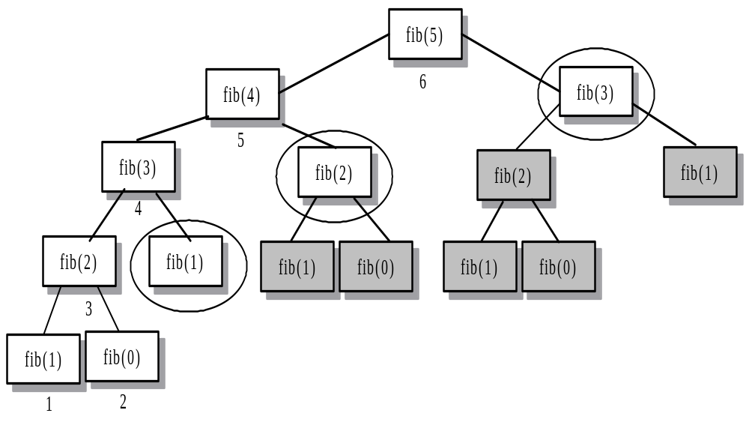
Affect of fib(5) Using Dynamic Programming

Slide 30
Summary Slide 4
§- Dynamic Programming
- Two type of dynamic programming:
1) top-down dynamic programming
- uses a vector to store Fibonacci numbers as a recursive function computes them
- avoids costly redundant recursive calls and leads to an O(n) algorithm that computes the n^{th} Fibonacci number.
- recursive function that does not apply dynamic programming has exponential running time.
- improve the recursive computation for C(n,k), the combinations of n things taken k at a time.

Slide 31
Summary Slide 5
2) bottom-up dynamic programming
- evaluates a function by computing all the function values in order, starting at the lowest level and using previously computed values at each step to compute the current value.
- 0/1 knapsack problem

