Slide 1
Algorithm Analysis
(for Divide-and-Conquer problems)
Recursion
Master theorem

Slide 2
Recursive Function
Recursion is a technique in which we break down a problem into one or more subproblems that are similar in form to the original problem.
A recursive function is one that calls itself (either directly or indirectly). It has two components:
  Base case(s): non-recursive operations
  Recursive case(s): involve recursive calls

Slide 3
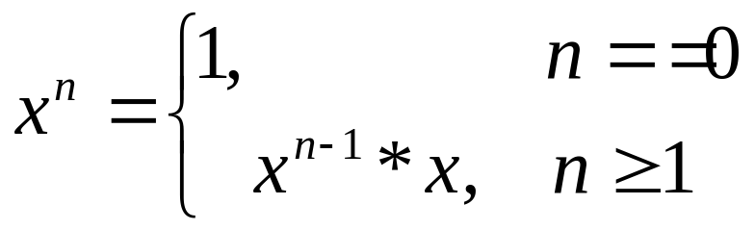
Example: Power Function
X^{n -} raise a number to a positive integer power
Base Case
Recursive case
Notes:
Correctness of recursive function, (page 2)

Slide 4
Stopping Conditions for Recursive Algorithms
Use a recursive function to implement a recursive algorithm.
  The design of a recursive function consists of
1. One or more stopping conditions that can be directly evaluated for certain arguments.
2. One or more recursive steps in which a current value of the function can be computed by repeated calling of the function with arguments that will eventually arrive at a stopping condition.

Slide 5
Implementing the Recursive Power Function
Recursive power():
double power(double x, int n) // n is a non-negative integer
{
if (n == 0)
return 1.0; // stopping condition
else
return x * power(x,n-1); // recursive step
}
Notes:
Picturing recursive (Page 5)

Slide 6
Implementing the Recursive factorial Function
The factorial of a nonnegative integer n is the product of all positive integers less than or equal to n.
Recursive factorial():
int factorial(int n) // n is a non-negative integer
{
if (n == 0)
return 1; // stopping condition
else
return n* factorial(n-1); // recursive step
}

Slide 7
Fibonacci numbers
Fibonacci numbers are the sequence of integers:
0,1,1,2,3,5,8,13,21,34
  The first two terms are 0 and 1 by definition.
  Then, each next term is the sum of the two previous terms.
Recursive fib():
int fib(int n) // n is a non-negative integer
{
if (n <= 1)
return n; // stopping condition
else
return fib(n-1)+ fib(n-2); // recursive step
}

Slide 8
Fibonacci Number using iteration
int fibiter(int n)
{
// integers to store previous two Fibonacci value
int oneback = 1, twoback = 0, current;
int i;
// return is immediate for first two numbers
if (n <= 1)
return n;
else
// compute successive terms beginning at 3
for (i = 2; i <= n; i++)
{
current = oneback + twoback;
twoback = oneback;// update for next calculation
oneback = current;
}
return current;
}

Slide 9
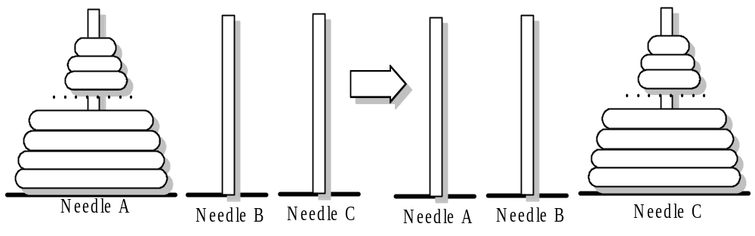
Tower of Hanoi Puzzle
Tower of Hanoi problem: there are a stack of n graduated disks and a set of three needles called A, B, and C. Originally, n disks are placed on needle A. The objective is to move the disks one at a time from needle to needle until the process rebuilds the original stack, but on needle C, such that at no time is a larger disk on the top of a a smaller one.

Slide 10
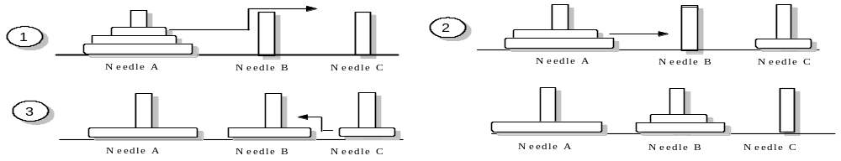
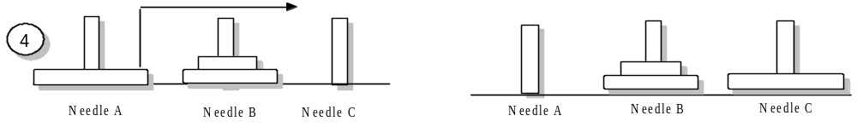
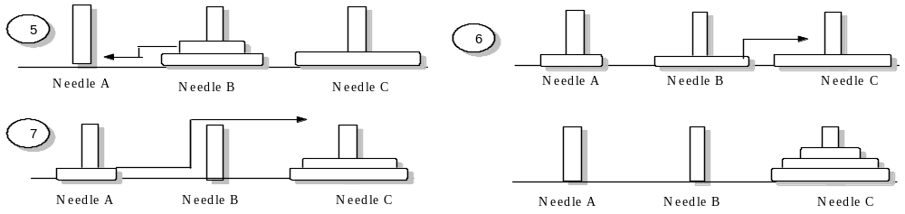
Solving the Tower of Hanoi Puzzle using Recursion
Stage 1:
Stage 2:
Stage 3
Notes:
[Class 3]
Recursion code implementation of the Tower of Hanoi Puzzle: book page 158, & note (last page)

Slide 11
Master Method/Theorem
Theorem: for T(n) = aT(n/b)+f(n),
  n/b may be ⎡n/b⎤ or ⎣n/b⎦.
  where a ≥ 1, b>1 are positive integers, f(n) be a non-negative function.
  If f(n)=O(n^{log}b^{a-ε}) for some ε>0, then T(n)= Θ(n^{log}bª).
  If f(n)= Θ(n^{log}bª), then T(n)= Θ(n^{log}bª lg n).
  If f(n)=Ω(n^{log}b^{a+ε}) for some ε>0, and if af(n/b) ≤cf(n) for some c<1 and all sufficiently large n, then T(n)= Θ(f(n)).

Slide 12
Implications of Master Theorem
Comparison between f(n) and n^{log}bª ,
the larger one determines the solution
Must be asymptotically smaller (or larger) by a polynomial, i.e., n^{ε} for some ε>0.
In case 3, the “regularity” must be satisfied, i.e., af(n/b) ≤cf(n) for some c<1 .
There are gaps
  between 1 and 2: f(n) is smaller than n^{log}bª, but not polynomially smaller.
  between 2 and 3: f(n) is larger than n^{log}bª, but not polynomially larger.
  in case 3, if the “regularity” fails to hold.

Slide 13
Where Are the Gaps
f(n), case 3, at least polynomially larger
n^{ε}
Gap between case 3 and 2
c₁
n^{logba}
f(n), case 2: within constant distances
c₂
n^{ε}
Gap between case 1 and 2
f(n), case 1, at least polynomially smaller
Note: 1. for case 3, the regularity also must hold.
2. if f(n) is lg n smaller, then fall in gap in 1 and 2
3. if f(n) is lg n larger, then fall in gap in 3 and 2
4. if f(n)=Θ(n^{logba}lg^{k}n), then T(n)=Θ(n^{logba}lg^{k+1}n).

Slide 14
Application of Master Theorem
T(n) = 9T(n/3)+n;
  a=9,b=3, f(n) =n
  n^{log}bª = n^{log}3⁹ = Θ (n²)
  f(n)=O(n^{log}3^{9-ε}) for ε=1
  By case 1, T(n) =Θ (n²).
T(n) = T(2n/3)+1
  a=1,b=3/2, f(n) =1
  n^{log}bª = n^{log}3/2¹ = Θ (n⁰) = Θ (1)
  By case 2, T(n)= Θ(lg n).

Slide 15
Application of Master Theorem
T(n) = 3T(n/4)+nlg n;
  a=3,b=4, f(n) =nlg n
  n^{log}bª = n^{log}4³ = Θ (n^{0.793})
  f(n)= Ω(n^{log}4^{3+ε}) for ε≈0.2
  Moreover, for large n, the “regularity” holds for c=3/4.
    af(n/b) =3(n/4)lg (n/4) ≤ (3/4)nlg n = cf(n)
  By case 3, T(n) =Θ (f(n))=Θ (nlg n).

Slide 16
Exception to Master Theorem
T(n) = 2T(n/2)+nlg n;
  a=2,b=2, f(n) =nlg n
  n^{log}bª = n^{log}2² = Θ (n)
  f(n) is asymptotically larger than n^{log}bª , but not polynomially larger because
  f(n)/n^{log}bª = lg n, which is asymptotically less than n^{ε} for any ε>0.
  Therefore, this is a gap between 2 and 3.

