Slide 1
Data Structures
Binary Trees

Slide 2
Outline
  Tree Structures
  Tree Node Level and Path Length
  Binary Tree Definition
  Binary Tree Nodes
  Binary Search Trees
  Locating Data in a Tree
  Removing a Binary Tree Node
  stree ADT
  Application of Binary Search Trees
  - Removing Duplicates
  Update Operations
    Insert & remove an item

Slide 3
Associative containers
Sequence containers (eg. array, vector, list) access items by position, A[i] or V[i]
Associative containers (eg. Sets and maps) access items by key (or by value).
  Objects are added, removed, or updated by value rather than by position.
  The underlying data structure for STL associative container is the binary search tree, which allow operations (insert, delete, find) in O(logn) time at worst case.

Slide 4
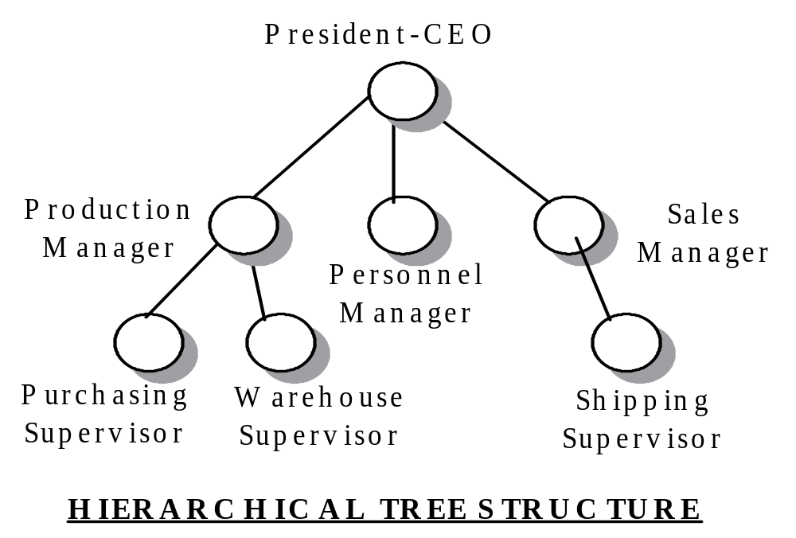
Tree Structures
Arrays, vectors, lists are linear structures, one element follows another. Trees are hierarchical structure.

Slide 5
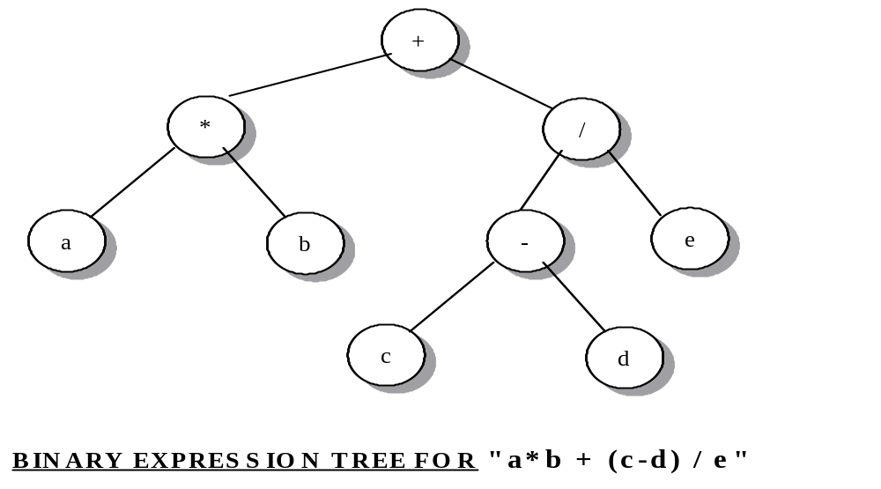
Tree Structures

Slide 6
Tree Terminology
Tree is a set of nodes. The set may be empty. If not empty, then there is a distinguished node r, called root, all other nodes originating from it, and zero or more non-empty subtrees T₁,T₂, …,T_{k}, each of whose roots are connected by a directed edge from r. (inductive definition)
r
T1
T2
Tk
…

Slide 7
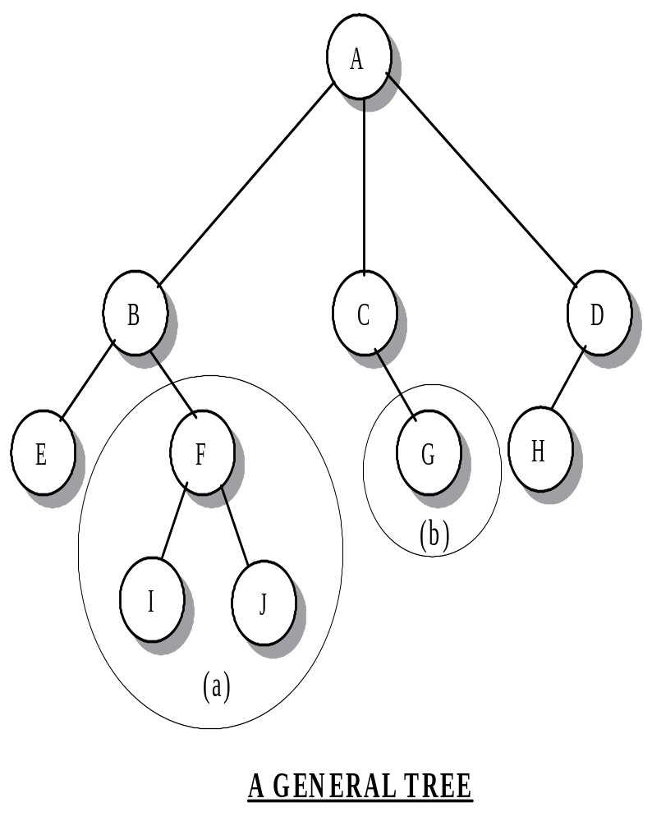
Tree Terminology
root
Nodes in subtrees are called successors or descendents of the root node
An immediate successor is called a child
A leaf node is a node without any children while an interior node has at least one child.
The link between node describes the parent-child relation.
The link between parent and child is called edge
A path between a parent P and any node N in its subtrees is a sequence of nodes P= X₀,X₁, …,X_{k}=N, where k is the length of the path. Each node X_{i} in the path is the parent of X_{i+1}, (0≤i<k)
Size of tree is the number of nodes in the tree
Notes:
Examples in note page 3
Description of recursive structure of tree (book Page 508: Example 10-1, note 10-5)

Slide 8
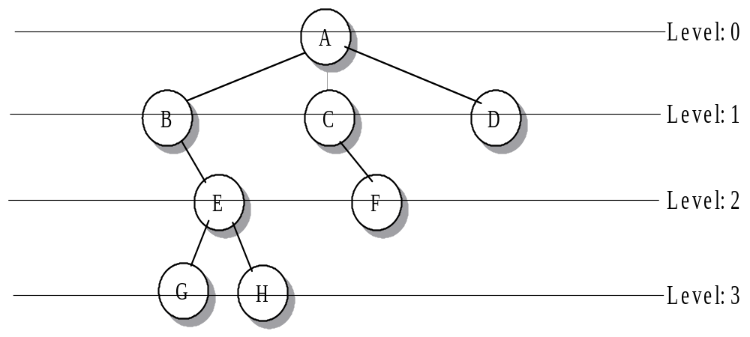
Tree Node Level and Path Length
The level of a node N in a tree is the length of the path from root to N. Root is at level 0.
The depth of a tree is the length of the longest path from root to any node.
Notes:
Depth?

Slide 9
Binary Tree
In a binary tree, no node has more than two children, and the children are distinguished as left and right.
A binary tree T is a finite set of nodes with one the following properties:
  T is a tree if the set of nodes is empty.
  The set consists of a root R and exactly two distinct binary trees. The left subtree T_{L} and the right subtree T_{R}, either or both subtree may be empty.
Notes:
Example see note 10-5, book 507-508

Slide 10
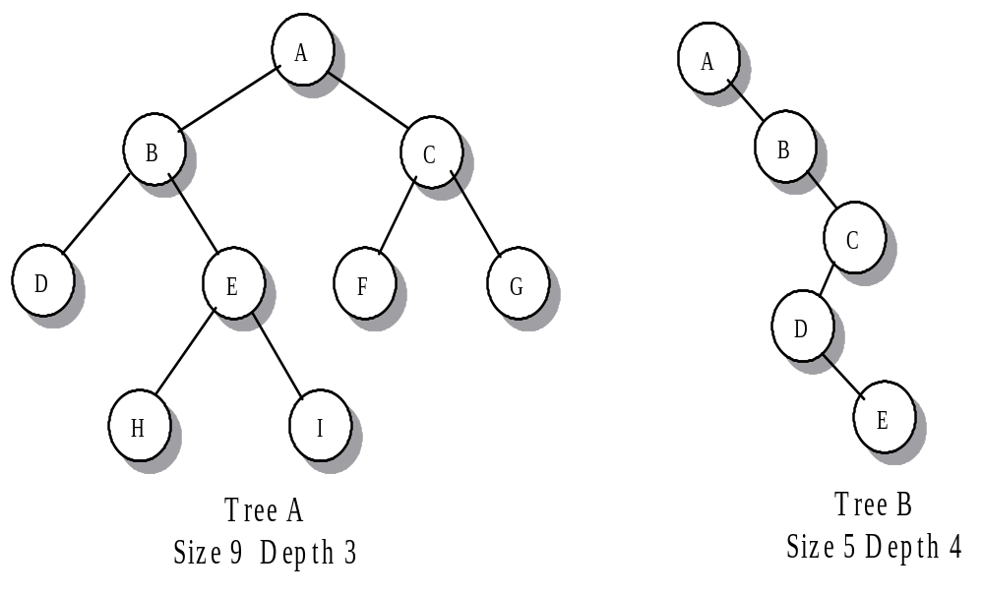
Examples of Binary Trees
Size? depth?

Slide 11
Density of a Binary Tree
At any level n, a binary tree may contain from 1 to 2^{n} nodes. The number of nodes per level contributes to the density of the tree.
Degenerate tree: there is a single leaf node and each interior node has only one child.
  An n-node degenerate tree has depth n-1
  Equivalent to a linked list
A complete binary tree of depth n is a tree in which each level from 0 to n-1 has all possible nodes and all leaf nodes at level n occupy the leftmost positions in the tree.

Slide 12
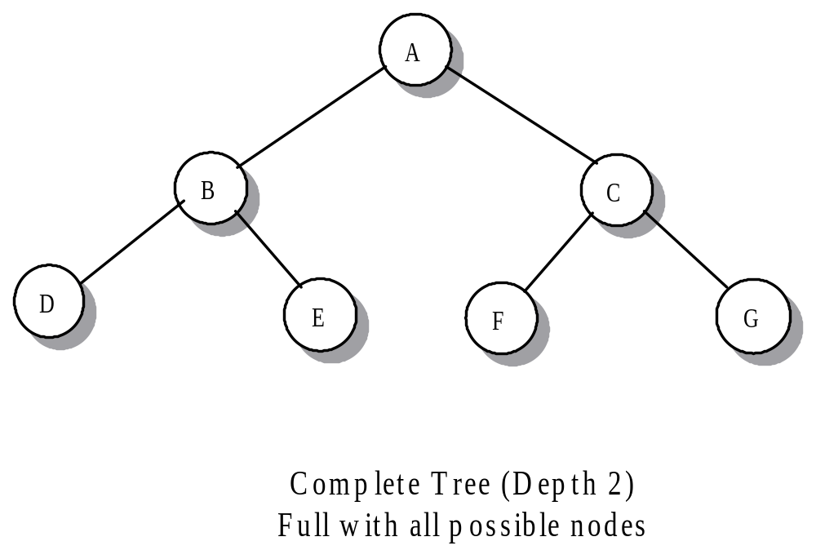
Complete or noncomplete?

Slide 13
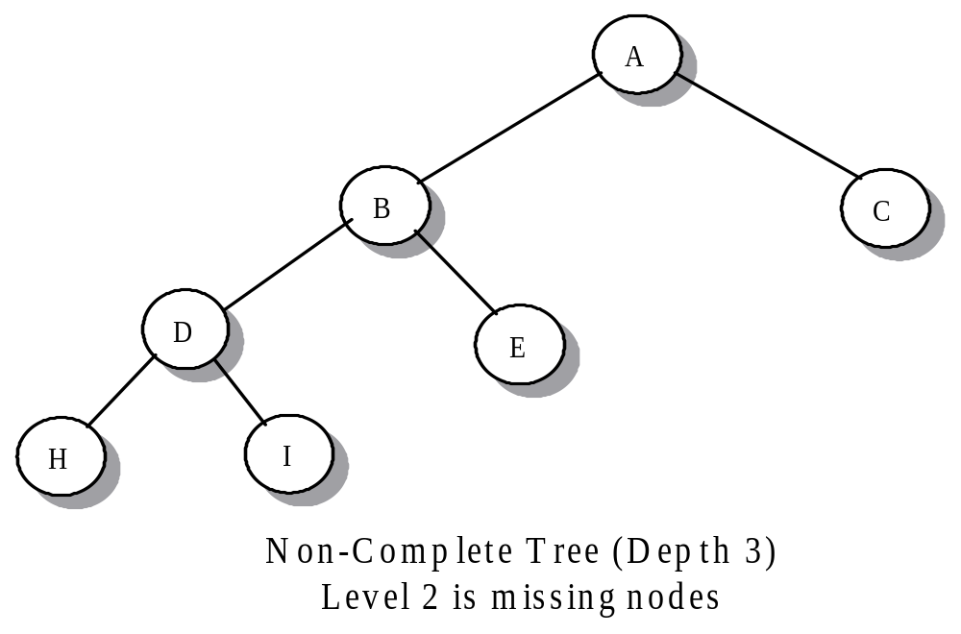
Complete or noncomplete?

Slide 14
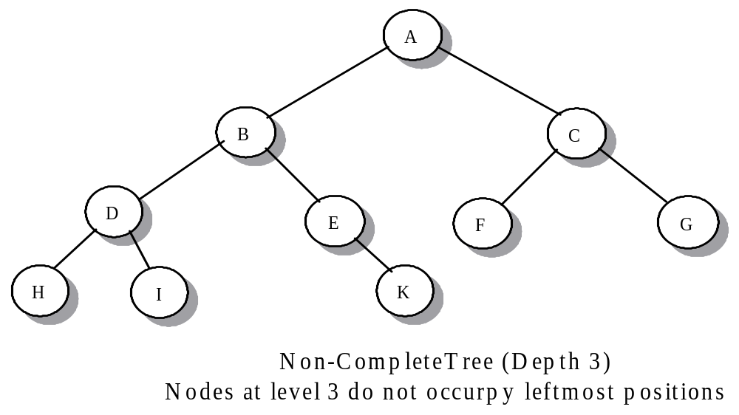
Complete or noncomplete?
occupy

Slide 15
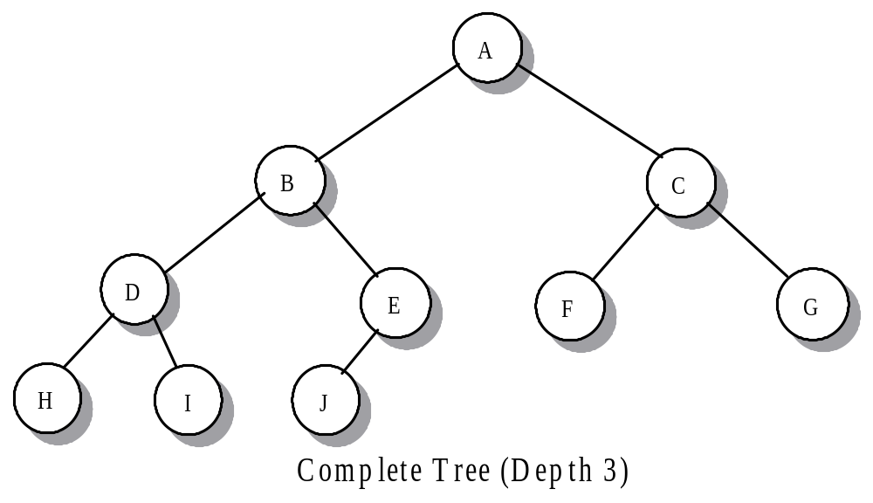
Complete or noncomplete?

Slide 16
Evaluating tree density
Max density: how many maximum nodes in a binary tree of depth d?
  Hint: At level k can have at most 2^{k} nodes
  Proof (by induction on depth)
Notes:
[Class 4]
Note: page 10-6-7 book: 509

Slide 17
Find depth
What’s the depth of a complete binary tree with n nodes?
  A perfect complete BT with depth d: a CBT with 2^{d+1}-1 nodes
  The smallest CBT with depth d: (2^{(d-1)+1}-1)+1=2^{d}
Notes:
Note: page 10-8-9 book: 509-510: d=int{log n}

Slide 18
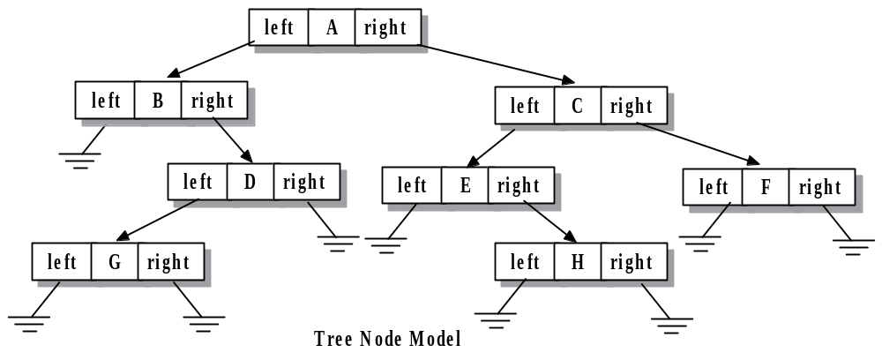
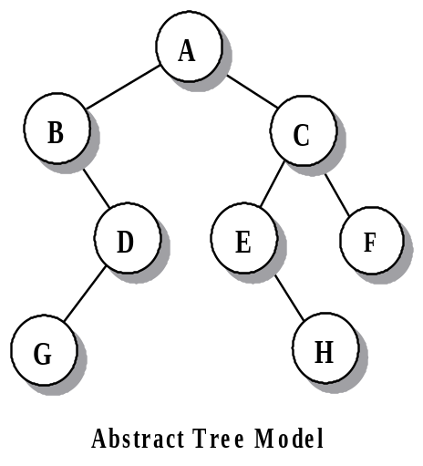
Implementing of BT
A binary tree node contains a data value, called nodeValue, and two pointers, left and right. A value of NULL indicates an empty subtree.
Declaration of CLASS tnode, d_tnode.h

Slide 19
Building a BT
A binary tree consists of a collection of dynamically allocated tnode objects whose pointer values specify links to their children.
Example 1:
Example 2:
4
q
8
p
10
root
20
30
p
r
40
Build a tree from the “bottom up”:
allocate the children first and then the parent
q

Slide 20
Tree traversals
In a traversal, we “visit” each node in a tree in some order.
  “visit” means “perform some operation” at the node. (eg. print the value, change the value, remove the node…)
Four fundamental traversals
  Recursive: pre-order, in-order, post -order
  Iterative: level-order

Slide 21
Recursive tree traversals
In-order: (LNR)
  Traverse the left subtree (“go left);
  Visit the node
  Traverse the right subtree (“go right”)
Pre-order: (NLR)
post –order: (LRN)
RNL, NRL, RLN
Example:
A
A
B
C
D
E
F
B
C
D
E
G
H
I
Notes:
[Class 5]
N: visiting the node & perform some task
L: making a recursive descent to the left subtree
R: making a recursive descent to the right subtree

Slide 22
Iterative tree traversals
Level-order:
  access elements by levels, with the root coming first (level 0), then the children of the root (level 1), followed by the next generation (level 2), and so forth.
  usually done as iterative algorithm using a queue
Example:
A
B
C
D
E
F
G
H
I
Notes:
Example in book page 518-520

Slide 23
Count leaves of BT
A node in a tree is a leaf if it has no children.
Scan each node and check for the presence of children
The order of the scan irrelevant
Example: using pre-order pattern
Θ(n)

Slide 24
Depth of BT
The depth of a tree is the length of the longest path from root to any node.
1+ max{depth(T_{L}), depth(T_{R})}
use post-order traversal
Θ(n)

Slide 25
Copy BT
Make new nodes for the copy
Use post-order traversal: the node is created after copying the subtrees.
Θ(n)
Notes:
Example note 10-18

Slide 26
Delete tree node & clear BT
Delete a tree node: (Post-order) delete all the nodes in both subtrees, then delete the node
Clear BT: deletes all nodes, then points the root to NULL (delete the root node)
Notes:
[Class 6]

Slide 27
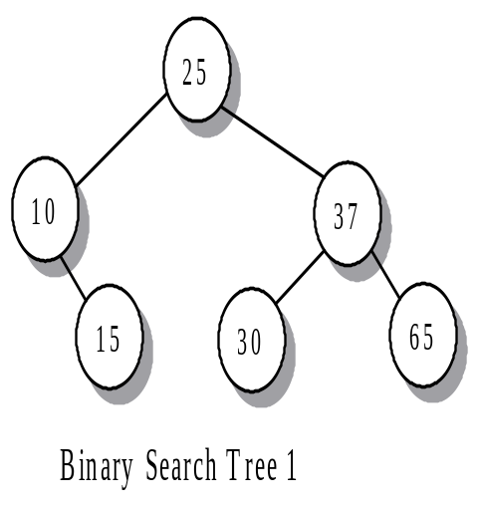

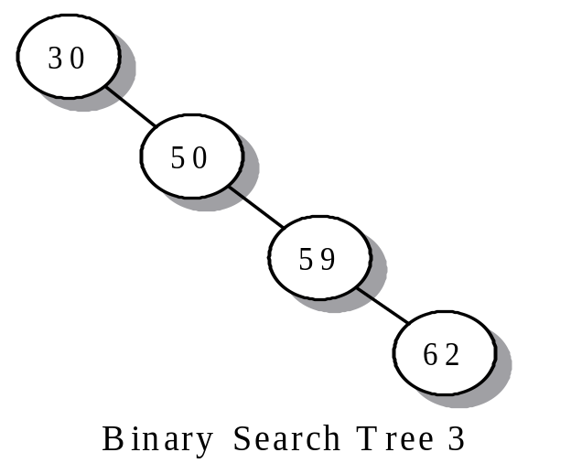
Binary Search Trees
A BST is a binary tree in which, at every node, the data value in the left subtree are less than the value at the node and the value in the right subtree are greater.
Not allow duplicated value

Slide 28
Implementing the stnode object
stnode object: three pointers, one value
left
parent
nodeValue
right

Slide 29
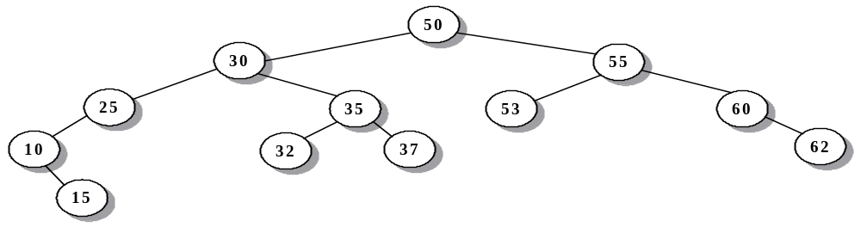
Locating data in a BST: O(depth)
Current Node Action
Root = 50 Compare item = 37 and 50
37 < 50, move to the left subtree
Node = 30 Compare item = 37 and 30
37 > 30, move to the right subtree
Node = 35 Compare item = 37 and 35
37 > 35, move to the right subtree
Node = 37 Compare item = 37 and 37. Item found.
Notes:
Code see note 10-23

Slide 30
Implementing location function
findNode( )
findNodeRec()

Slide 31
Insert a node into a BST
Insert a node: O(depth)
  Depth, worst case, is O(n)
  Best (and average) case is O(lgn)
Implementation
Notes:
Note 10-21-22

Slide 32
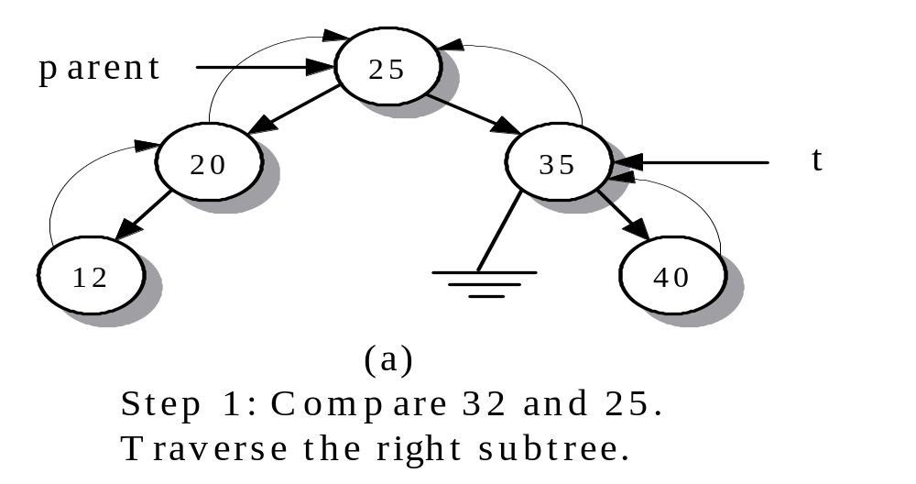
Example: insert 32: 1nd of 3 steps
1)- The function begins at the root node and compares item 32 with the root value 25. Since 32 > 25, we traverse the right subtree and look at node 35.

Slide 33
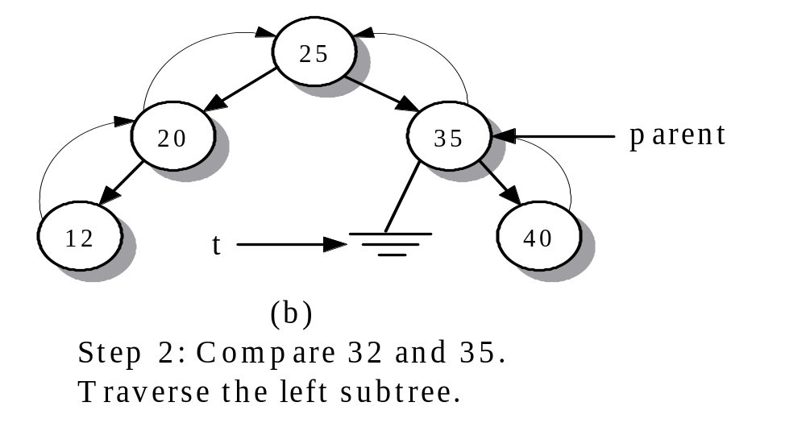
insert: 2nd of 3 steps
2)- Considering 35 to be the root of its own subtree, we compare item 32 with 35 and traverse the left subtree of 35.

Slide 34
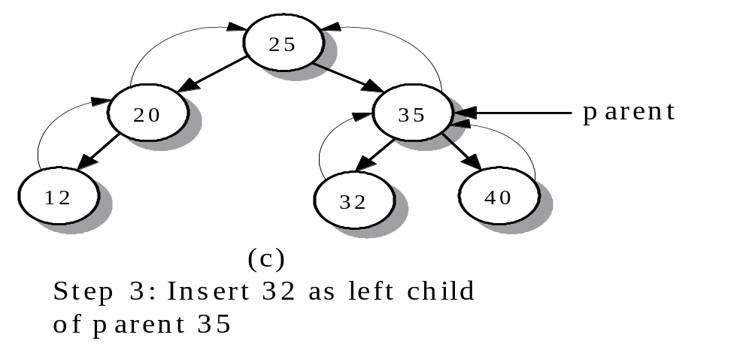
insert: 3nd of 3 steps
3)- Create a leaf node with data value 32. Insert the new node as the left child of node 35.
newNode = getSTNode(item,NULL,NULL,parent);
parent->left = newNode;

Slide 35
Operations: insert()
take a new data item, search the tree, add it in the correct location, and return iterator-bool pair
  if item is in the tree, return a pair whose iterator component points at the existing item and whose bool component is false.
  if item is not in the tree, insert it and return a pair whose iterator component points at item and whose bool component is true. And the tree size increases
  by 1
Iteratively traverses the path of the left and right subtress
Maintains the current node and parent of the current node
Terminates when an empty subtree is found
  New node replaces the NULL subtree as a child of the parent

Slide 36
Build a BST
The first element entering a BST becomes the root node
Subsequence elements entering the tree:
  If the value of the new element is less than the value of the current node, proceed to the left subtree of the node
    If the left subtree is not empty, repeat the process by comparing item with the root of the subtree
    If the left subtree is empty, allocate a new node with item as its value, and attach the node to the tree as the left child
  If the value of the new element is greater than the value of the current node, proceed to the right subtree of the node
    If the right subtree is not empty, repeat the process by comparing item with the root of the subtree
    If the right subtree is empty, allocate a new node with item as its value, and attach the node to the tree as the right child
  If the value of the new element is equal to the value of the current node, perform no action (no duplicate)

Slide 37
Examples
Example 1: Start with empty tree, and insert 35,18,25, 48,72, 60 in sequence
Example 2: Start with empty tree, and Insert 18,25,48,60,72
Example 3: Start with empty tree, and insert 72,60, 48,35,25,18
Time complexity to build a BST?

Slide 38
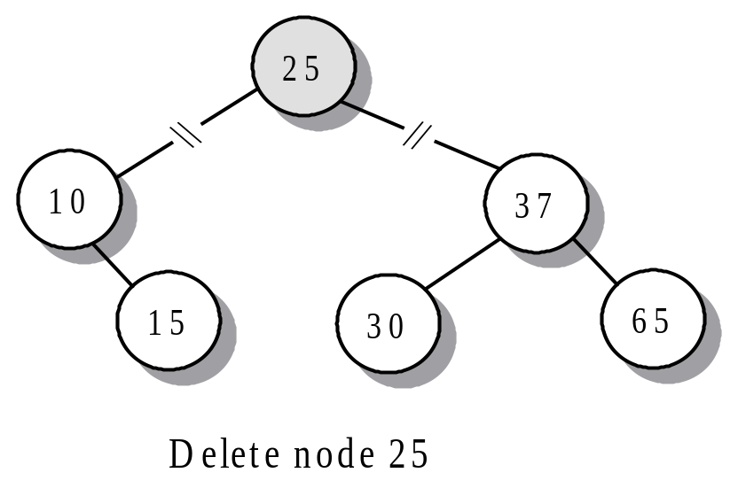
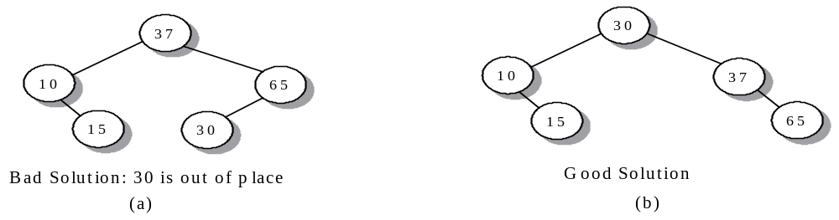
Removing a Binary Search Tree Node
We must maintain the BST property

Slide 39
Removing a Binary Search Tree Node
To delete a node D of a BST
  Case 1: D is a leaf
    Update the parent node P to have an empty subtree
  Case 2: D has a left child but no right child
    Attach the left subtree of D to the parent
  Case 3: D has a right child but no left child
    Attach the right subtree of D to the parent
  Case 4: D has both left and right non-empty subtrees
    replace r with the largest node in its left subtree or
    replace r with the smallest node in its right subtree

Slide 40
Implement Operations: erase()
Remove a node, maintain BST property
  D = node to be removed
  P = parent of D
  R = node that will replace D

Slide 41
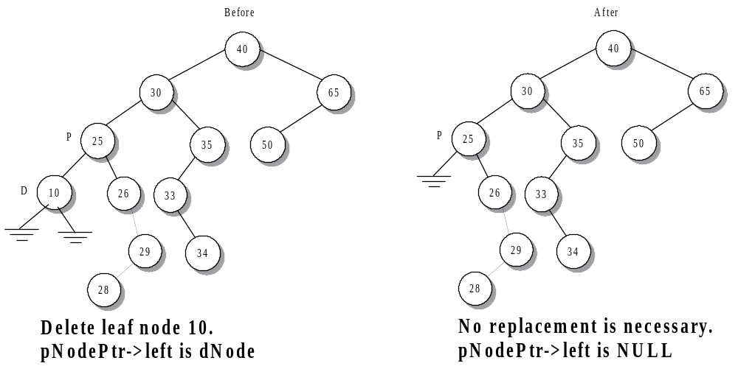
Case 1: D is a leaf
Update the parent node P to have an empty subtree

Slide 42
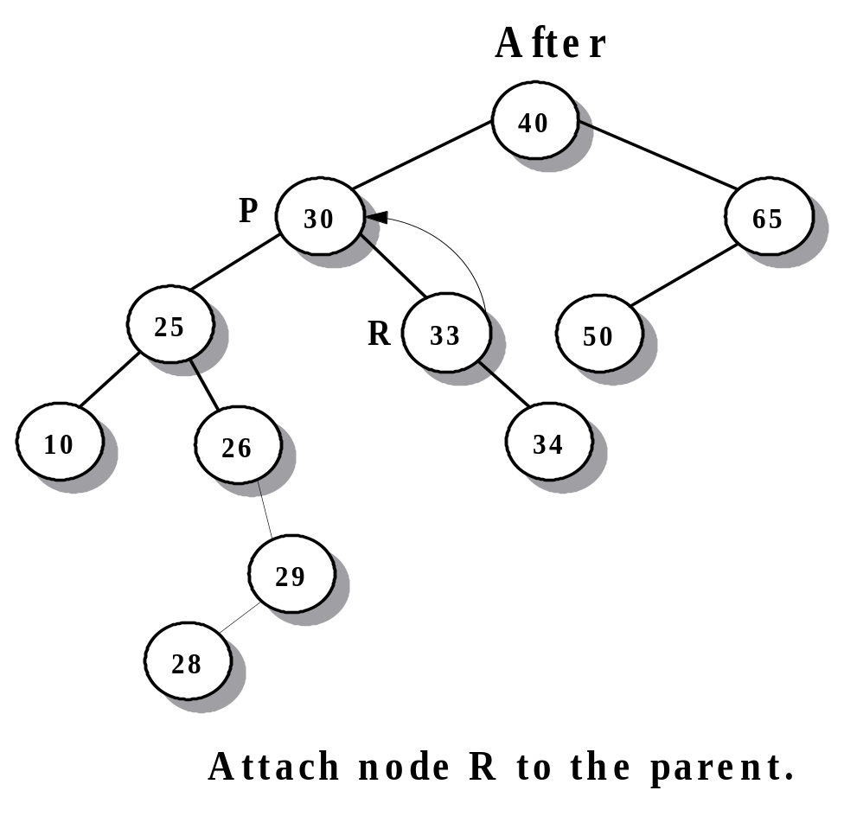
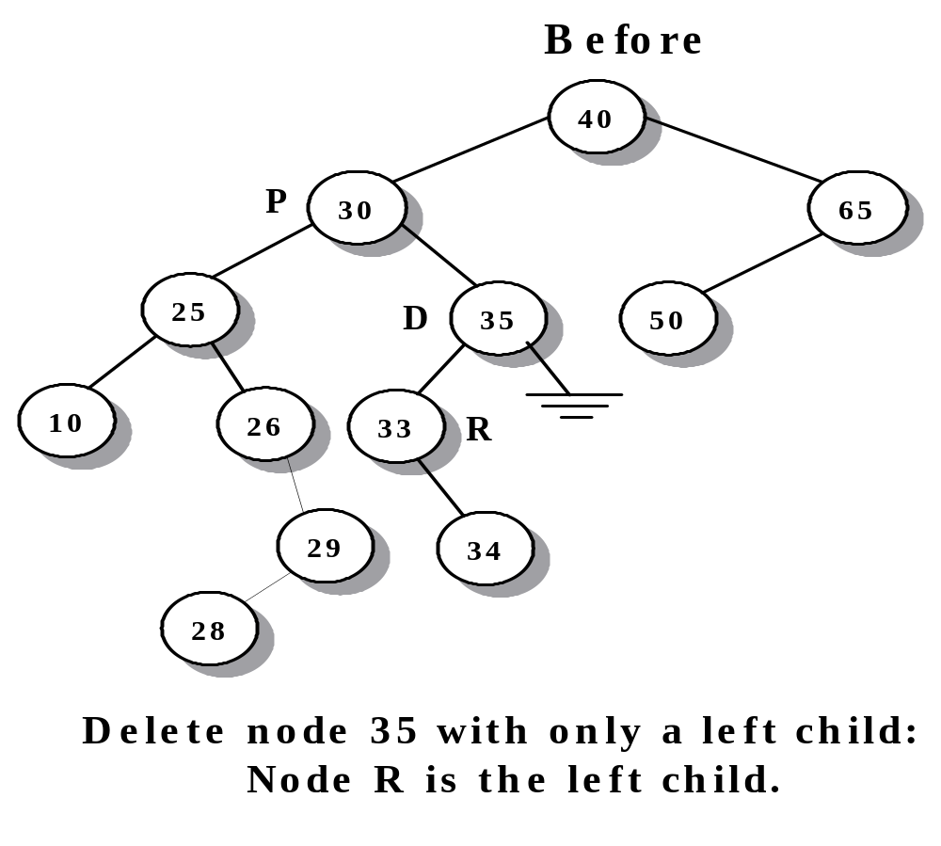
Case 2: D has a left child but no right child
Attach the left subtree of D (the tree with root R) to the parent P

Slide 43
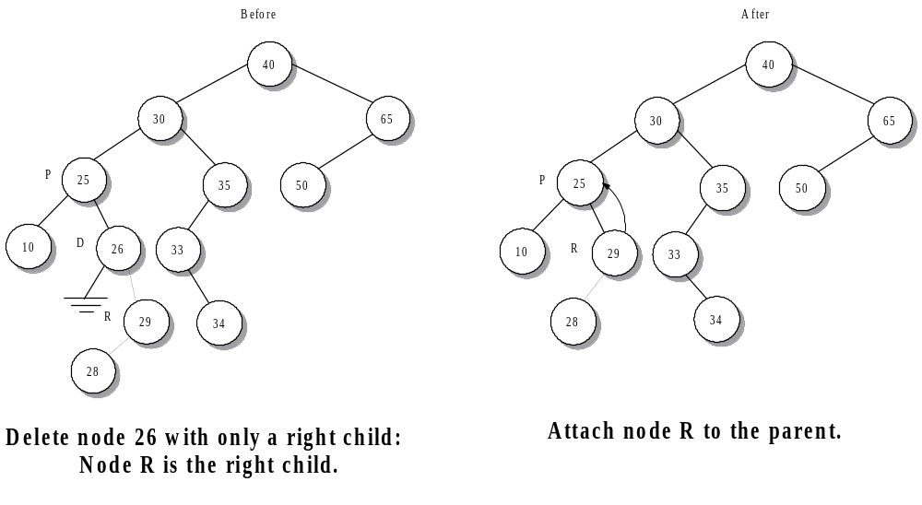
Case 3: D has a right child but no left child
Attach the right subtree of D (the tree with root R) to the parent P

Slide 44
Code implementing of cases 1,2, & 3
// assign pNodePtr the address of P
pNodePtr = dNodePtr->parent;
// If D has a NULL pointer, the
// replacement node is the other child
if (dNodePtr->left == NULL || dNodePtr->right == NULL)
{
if (dNodePtr->right == NULL)
rNodePtr = dNodePtr->left;
else
rNodePtr = dNodePtr->right;
if (rNodePtr != NULL) // D was not a leaf
// the parent of R is now the parent of D
rNodePtr->parent = pNodePtr;
}

Slide 45
Case 4: D has both left and right non-empty subtrees
R = leftmost (smallest) node in D_{R} (right subtree of D)
Delete R from D_{R}
Replace D with R
Tree size --

Slide 46
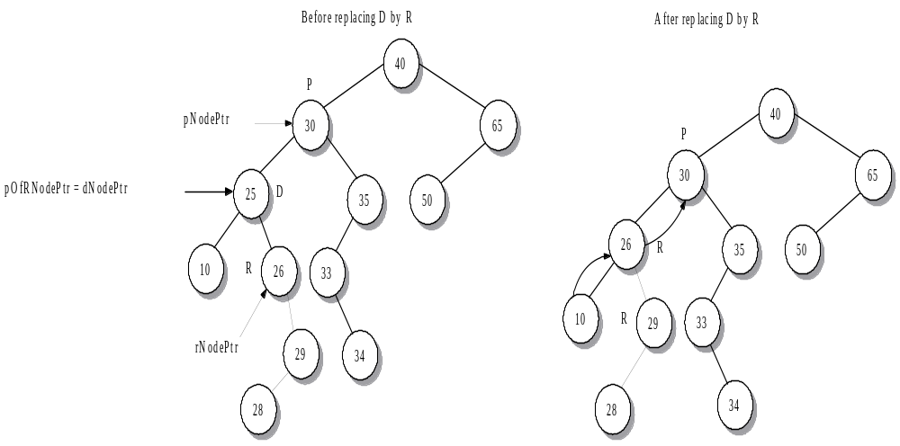
Example 1 for Case 4: remove 25

Slide 47
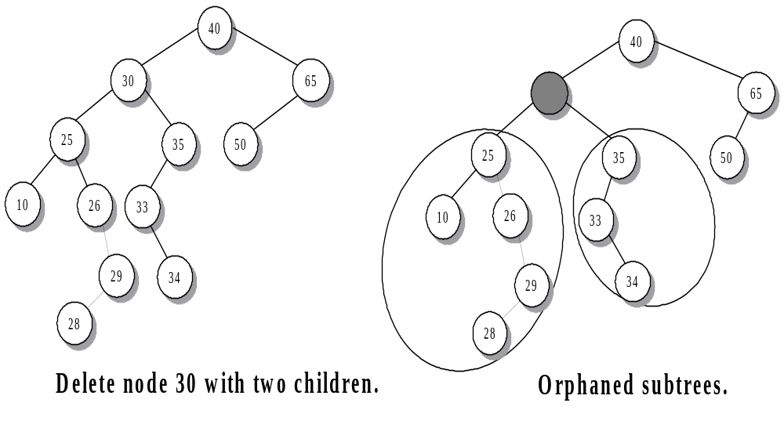
Example 2 for Case 4: remove 30

Slide 48
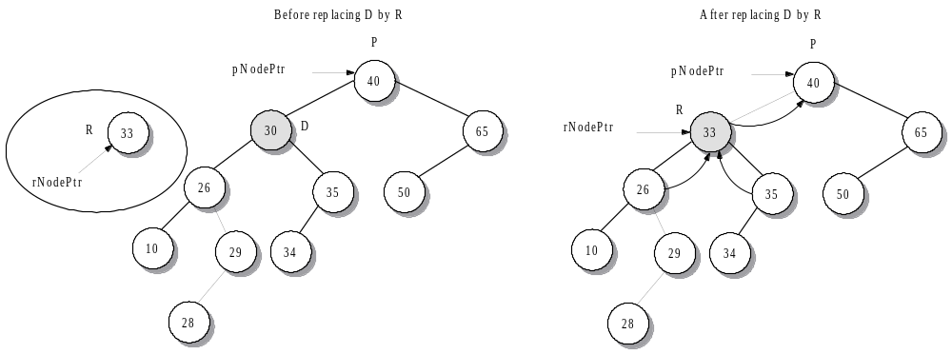
Example 2 for Case 4: remove 30
R = leftmost (smallest) node in D_{R} (right subtree of D)
Delete R from D_{R}
Replace D with R

Slide 49
CLASS stree
“d_stree.h”
Constructors
stree();
Create an empty search tree.
stree(T *first, T *last);
Create a search tree with the elements from the pointer range [first, last).
CLASS stree
“d_stree.h”
Opertions
void displayTree(int maxCharacters);
Display the search tree. The maximum number of characters needed to output a node value is maxCharacters.
bool empty();
Return true if the tree is empty and false otherwise.

Slide 50
CLASS stree
“d_stree.h”
Opertions
int erase(const T& item);
Search the tree and remove item, if it is present; otherwise, take no action. Return the number of elements removed.
Postcondition: If item is located in the tree, the size of the tree decreases by 1.
void erase(iterator pos);
Erase the item pointed to the iterator pos.
Precondition: The tree is not empty and pos points to an item in the tree. If the iterator is invalid, the function throws the referenceError exception.
Postcondition: The tree size decreases by 1.

Slide 51
CLASS stree
“d_stree.h”
Opertions
void erase(iterator first, iterator last);
Remove all items in the iterator range [first, last).
Precondition: The tree is not empty. If empty, the function throws the underflowError exception.
Postcondition: The size of the tree decreases by the number of items in the range.
iterator find(const T& item);
Search the tree by comparing item with the data values in a path of nodes from the root of the tree. If a match occurs, return an iterator pointing to the matching value in the tree. If item is not in the tree, return the iterator value end().

Slide 52
CLASS stree
“d_stree.h”
Opertions
Pair<iterator, bool> insert(const T& item);
If item is not in the tree, insert it and return an iterator- bool pair where the iterator is the location of the new element and the Boolean value is true. If item is already in the tree, return the pair where the iterator locates the existing item and the Boolean value is false.
Postcondition: The size of the tree is increased by 1 if item is not present in the tree.
int size();
Return the number of elements in the tree.

Slide 53
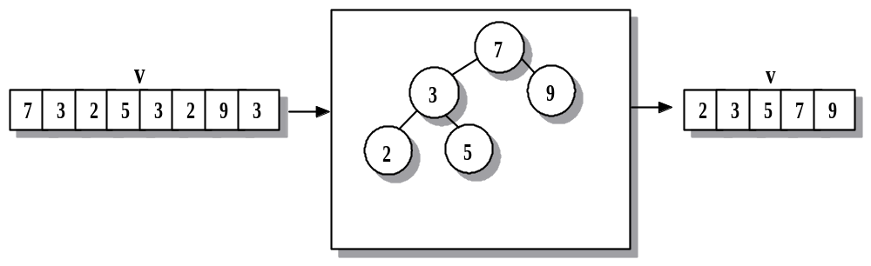
Using Binary Search Trees Application: Removing Duplicates
Use a BST as a filter:
Use vector iterator to copy vector elements to BST
Clear the vector
Use stree iterator to re-fill the vector
Time complexity?
Notes:
O(nlogn)-average case. O(n^2) worst case
LNR: the array in ascending order
RNL: the array in descending order

Slide 54
Using Binary Search Trees Application: The Video Store
A video store maintains an inventory of movies that includes multiples titles. When a customer makes an inquiry, the clerk checks the inventory to see whether the title is available. If so, the rental transaction will decreases the number of copies of the title in inventory and increments a similar rented-film entry. When a customer returns a film, the clerk reverses the process by removing a copy from the collection of rented films and adding it to the inventory.
--- two stree objects: inventory and rentals.
d_video.h, prg10_5
Notes:
[Class 7]

Slide 55
Summary Slide 1
§- trees
- hierarchical structures that place elements in nodes along branches that originate from a root.
- Nodes in a tree are subdivided into levels in which the topmost level holds the root node.
§- Any node in a tree may have multiple successors at the next level. Hence a tree is a non-linear structure.
- Tree terminology with which you should be familiar:
parent | child | descendents | leaf node | interior node | subtree.

Slide 56
Summary Slide 2
§- Binary Trees
- Most effective as a storage structure if it has high density
§- ie: data are located on relatively short paths from the root.
§- A complete binary tree has the highest possible density
- an n-node complete binary tree has depth int(log₂n).
- At the other extreme, a degenerate binary tree is equivalent to a linked list and exhibits O(n) access times.

Slide 57
Summary Slide 3
§- Traversing Through a Tree
- There are six simple recursive algorithms for tree traversal.
- The most commonly used ones are:
1) inorder (LNR)
2) postorder (LRN)
3) preorder (NLR).
- Another technique is to move left to right from level to level.
§- This algorithm is iterative, and its implementation involves using a queue.

Slide 58
Summary Slide 4
§- A binary search tree stores data by value instead of position
- It is an example of an associative container.
§- The simple rules
“== return”
“< go left”
“> go right”
until finding a NULL subtree make it easy to build a binary search tree that does not allow duplicate values.

Slide 59
Summary Slide 5
§- The insertion algorithm can be used to define the path to locate a data value in the tree.
§- The removal of an item from a binary search tree is more difficult and involves finding a replacement node among the remaining values.
Notes:
[Class 8]

