Slide 1
Associative Structures
Set & Map

Slide 2
Outline
  Sets
  Sets Defined by a key along with other data
  Map
  Map defined by Key-Value Data
  Set API
  Sieve of Eratosthenes
  Set Operators
  Maps
  Multiset API

Slide 3
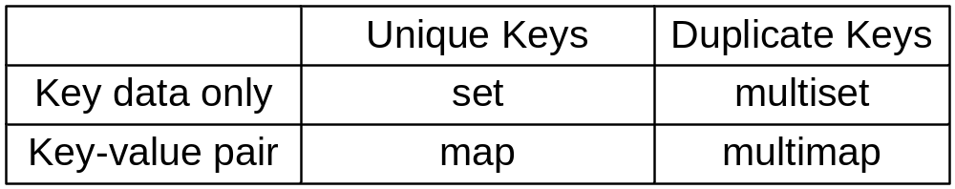
Associative containers
The main difference between sequence containers and associative containers is that associative container operations use the key rather than an index or a linear search algorithm to retrieve an element.
Associative container categories:

Slide 4
Set
A set is a template-based container with a single template type
  Store keys
  No duplicates
  Can be used to store structured data
    Choose one field as the key field
    Overload operators == and < by comparing key fields in the operands
  STL set class iterators scan the elements in ascending order of their keys

Slide 5
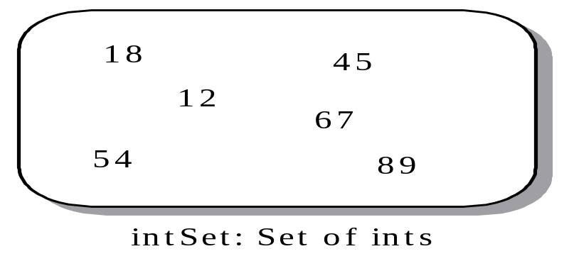
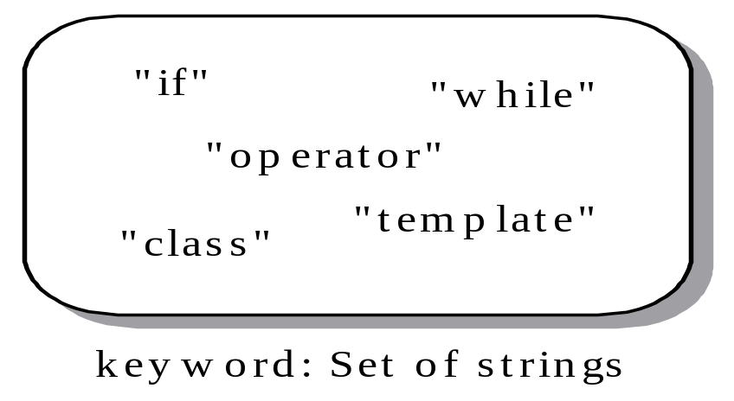
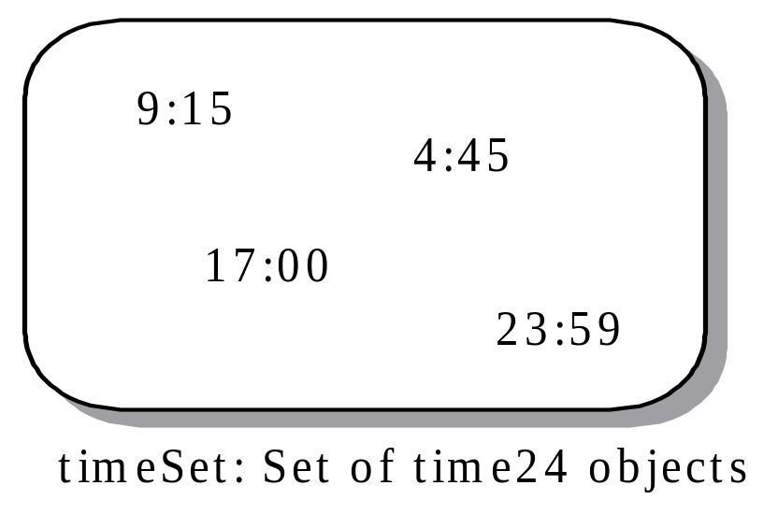
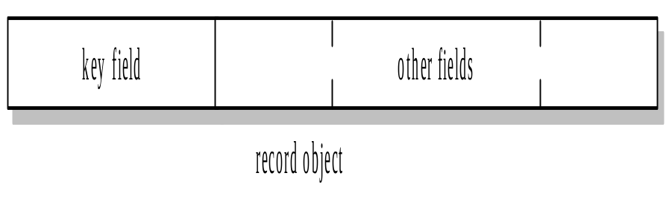
Sets --- Examples
set<int> intSet;
Sets defined by a key along with other data

Slide 6

Map
A map stores data as a key-value pair. In a pair, the first component is the key; the second is the value. Each component may have a different data type.

Slide 7
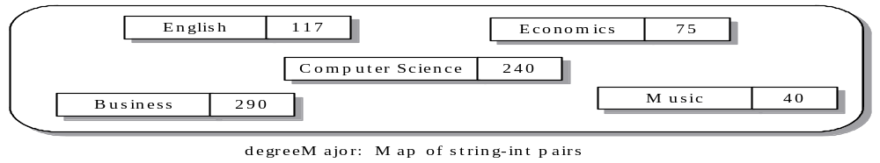
Map - Example
The property of a map using the key index to access the value component is analogous to an array that uses an integer index to access the value of an element.
  The index for a map is not limited to integer values, but can be of any type.
  The map index corresponds to the key, which is a component of the pair
map<string, int> degreeMajor;
degreeMajor[“Mathematics”]=54; // insert pair in the map
cout<<degreeMajor[“Computer Science”]; //access value for the key

Slide 8
CLASS set
<set>
Constructors
set();
Create an empty set. This is the Default Constructor.
set(T *first, T *last);
Initialize the set by using the address range [first, last).
CLASS set
<set>
Operations
bool empty() const;
Is the set empty?
int size() const;
Return the number of elements in the set.

Slide 9
CLASS set
<set>
Operations
int find(const T& key) const;
Search for key in the set and return 1 if it is in the set and 0 otherwise.
iterator find(const T& key);
Search for key in the set and return an iterator pointing at it, or end() if it is not found.
const_iterator find(const T& key) const;
Constant version.

Slide 10
CLASS set
<set>
Operations
pair<iterator, bool> insert(const T& key);
If key is not in the set, insert it and then return a pair whose first element is an iterator pointing to the new element and whose second element is true. Otherwise, return a pair whose first element is an iterator pointing at the existing element and whose second element is false.
Postcondition: The set size increases by 1 if key is not in the set.
int erase(const T& key);
If key is in the set, erase it and return 1; otherwise, return 0.
Postcondition: The set size decreases by 1 if key is in the set.

Slide 11
CLASS set
<set>
Operations
void erase(iterator pos);
Erase the item pointed to by pos.
Preconditions: The set is not empty, and pos points to a valid set element.
Postcondition: The set size decreases by 1.
void erase(iterator first, iterator last);
Erase the elements in the range [first, last).
Precondition: The set is not empty.
Postcondition: The set size decreases by the number of elements in the range.

Slide 12
CLASS set
<set>
Operations
iterator begin();
Return an iterator pointing at the first member in the set.
const_iterator begin(const);
Constant version of begin().
iterator end();
Return an iterator pointing just past the last member in the set.
const_iterator end() const;
Constant version of end().

Slide 13
Applications
A simple spelling checker
Sieve of Eratosthenes: find all prime numbers less than or equal to an integer value n.
  A prime p is an integer greater than 1 that is divisible only by 1 and p (itself)
  Idea:
    initializing a set to contain all of the integers in the range 2 to n.
    A loop makes multiple passes over the elements in the set, and each pass “shakes free” nonprime numbers and lets them “filter through the sieve”
    At the end, only the prime numbers remain.

Slide 14
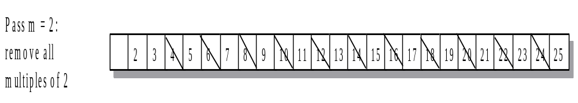
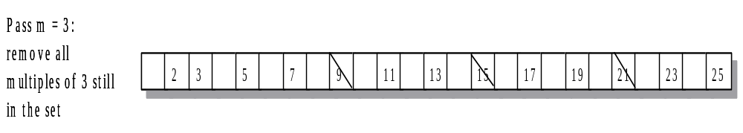
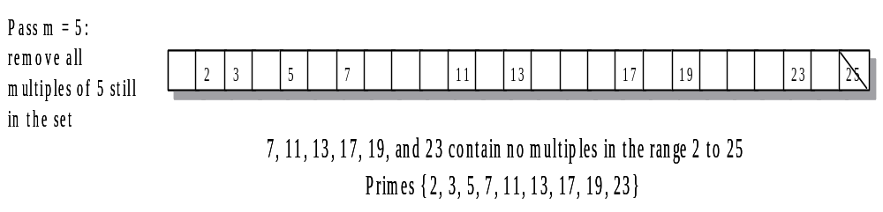
Sieve of Eratosthenes

Slide 15



Set Operations
A={1,3,8,9,10}
B={2,3,6,9}
A+B? A*B? A-B?
Set-Union Operator+ (A + B):
The set of all elements x such that x is an element in set A OR x is an element in set B.
Set-Intersection Operator* (A * B):
The set of all elements x such that x is an element in set A and x is an element in set B.
Set-Difference Operator- (A - B):
The set of all elements x such that x is an element in set A but x is not an element in set B.
Notes:
A + B = { 1, 2, 3, 6, 8, 9, 10}
A * B = { 3, 9}
A - B = { 1, 8, 10}

Slide 16
Implementing Set Intersection *
How to implement set union and set difference?
Use iterators to scan each of the ordered sets
Make pairwise comparison to look for a match that identifies an element as belonging to the intersection
Assume lhs and rhs are the two set operands
  If *lhsIter<*rhsIter, then *lhsIter is not an element in the intersection, and lhsIter moves forward to the next element in set lhs
  If *rhsIter<*lhsIter, then *rhsIter is not an element in the intersection, and rhsIter moves forward to the next element in set rhs
  If *lhsIter=*rhsIter, then the iterators point to elements with a common value. After inserting the value into the intersection, each iterator moves forward to the next value.
Notes:
[Class 9]
-Book Page 605 Figure 11-5
-Codes
-Application: Updating computer Accounts: Book Page 607

Slide 17
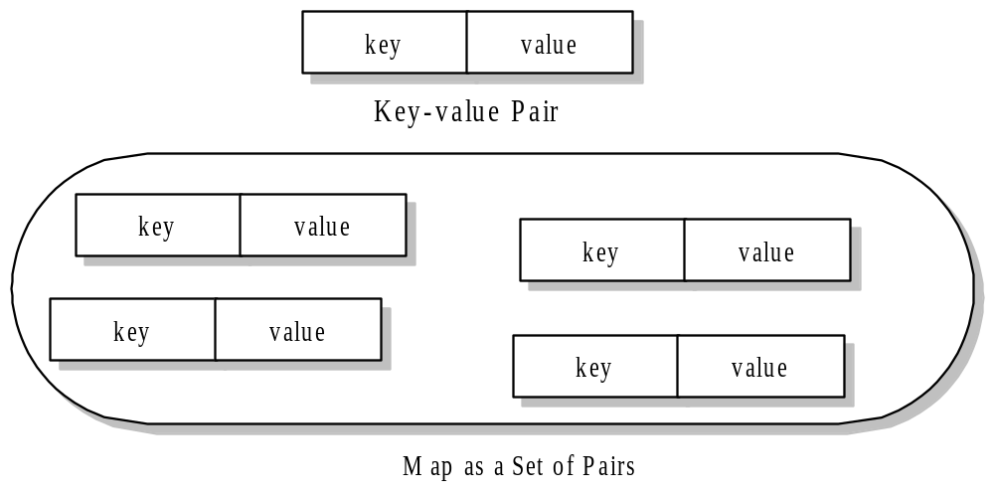
Maps
Notes:
Applications: student work time map book P616
Concordance: book P618

Slide 18
CLASS multiset
<set>
Operations
int count(const T& item) const;
Return the number of duplicate occurrences of item in the multiset.
pair<iterator, iterator> equal_range(const T& item);
Return a pair of iterators such that all occurrences of item are in the iterator range [first member of pair, second member of pair).
Multiset and multimap containers extend the set and map classes by allowing duplicate entries.

Slide 19
CLASS multiset
<set>
Operations
iterator insert(const T& item);
Insert item into the multiset and return an iterator pointing at the new element.
Postcondition: The element item is added to the multiset.
int erase(const T& item);
Erase all occurrences of item from the multiset and return the number of items erased.
Postcondition: The size of the multiset is reduced by the number of occurrences of item in the multiset.

Slide 20
Summary Slide 1
§- Set and map associative containers
- Both store and retrieve data by value rather by position.
- A set is a collection of keys, where each key is unique.
- A map is a collection of key-value pairs that associate a key with a value.
§- In a map, there is only one value associated with a key.

Slide 21
Summary Slide 2
§- Set and map implementation
- Binary search tree ideal, since it is an associative container and its iterators traverse its value in order.

Slide 22
Summary Slide 3
§- Map
- Often called an associative array because applying the index operator with the key as its argument accesses the associated value.

Slide 23
Summary Slide 4
§- Multiset
- Like a set, except a key can occur more than once.
- The member function count() and equal_range() deal with duplicate values.

