Slide 1
Advanced Associative Structures
Hash Tables

Slide 2
Outline
Hash Function
Hash table
Open probe addressing
Chaining with separate lists
Hash Iterator
Efficiency of Hash Methods

Slide 3
Associative structures
Ordered associative structures
  Binary search tree
Unordered associative structures
  Hash table
    Open probing
    Chaining with separate lists

Slide 4
Hashing
Hash table
  Store elements uniquely identified by their key
  Hash function: take a key as an argument and returns an entry point to the table
Notes:
Book page 649 figure

Slide 5
Using a hash function
hf: U→N
  U = set of all possible keys for the type of item
  N is the integer set
Then take hf(Key)%m to get the hash table index
  m is the table size (number of entries in the hash table)
Collision: hf(Key1) %m = hf(Key2) %m
  different items map to the same hash table index

Slide 6
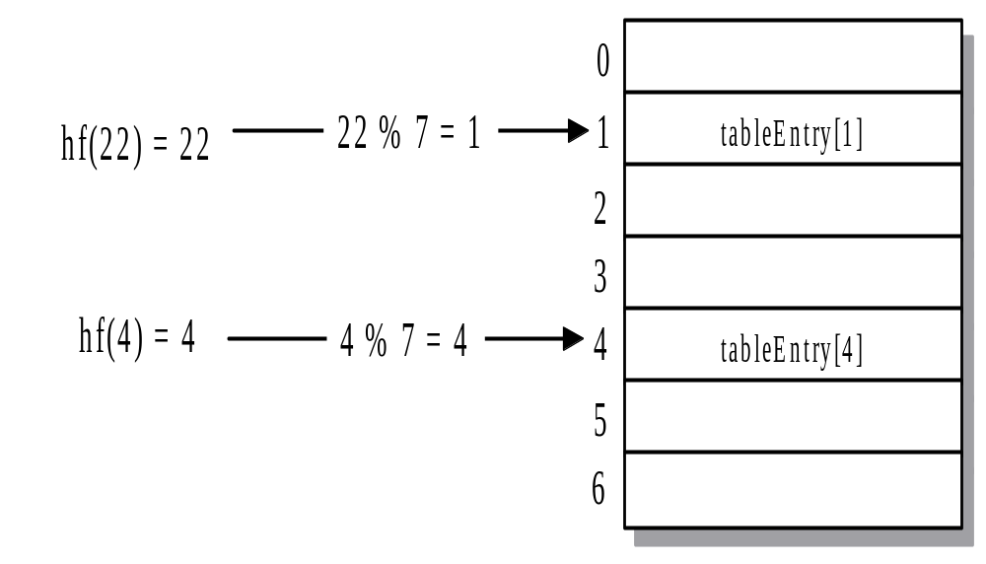
Example Hash Function

Slide 7
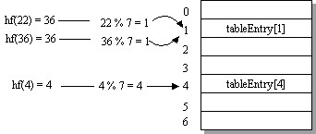
Example Hash Function
22

Slide 8
Design Hash functions
the hash function is Easy to compute
Minimize the collision
Uniform distribution of keys over hash table

Slide 9
Function objects
A function object is an object of a class that behaves like a function
  Can be created, stored, and destroyed
  Can have associated data members and operations
Notes:
Book p652: template for function objects and examples
Book 653: Example 12-1,2

Slide 10
Hash function: Key is an integer
Identity function
  Use mod operation (mod m) to get hash table index
  Collision
    If m=10^{b}, then collisions will occur for all keys that are the same in their rightmost b digits
    If m=2^{b}, then collisions will occur for all keys that are the same in their rightmost b bits (binary digits)
  Solution:
    choose m as a prime number
      Make sure the table is large enough to reduce the probability of collisions
      Choose m as the smallest prime number greater than m_min
    Mix up the digits in key (eg. MidSquare technique)
Notes:
[Class 11]
Note: page 12-3----12-5

Slide 11
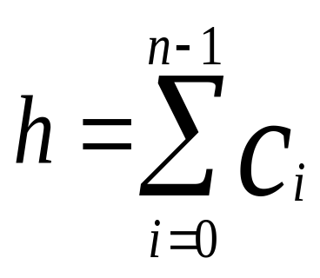
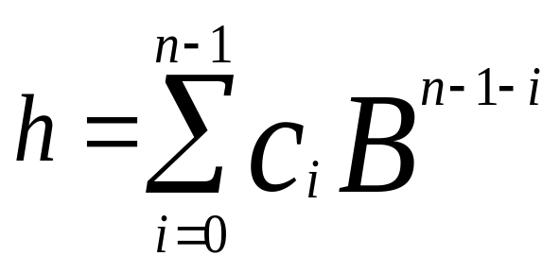
Hash function: Key is a string
Suppose string is c₀c₁c₂…c_{n-1}
  Method 1:
  Method 2:
Notes:
Note 12-6---12-8

Slide 12
Hash function: Key is not numbers or strings
Design a custom hash function object type for the key
Example

Slide 13
Design Hash Tables
Two basic approaches to handling collision in hash table
  Open addressing: when collision occurs, rehash to a different location
  Separate chaining: colliding elements are stored on a list for each has value

Slide 14
Open addressing
h: K × T -> M
  K: Key set, {0,1,2,…}, T: number of attempts, M {0,1, …, m-1} : the range of table size
  h(k,i) is the hash function for key k on the i-th attempt, each attempt is called a “probe”.
Linear probe
Quadratic probe
Notes:
Note 12-14---12-16
Note: 12-19

Slide 15
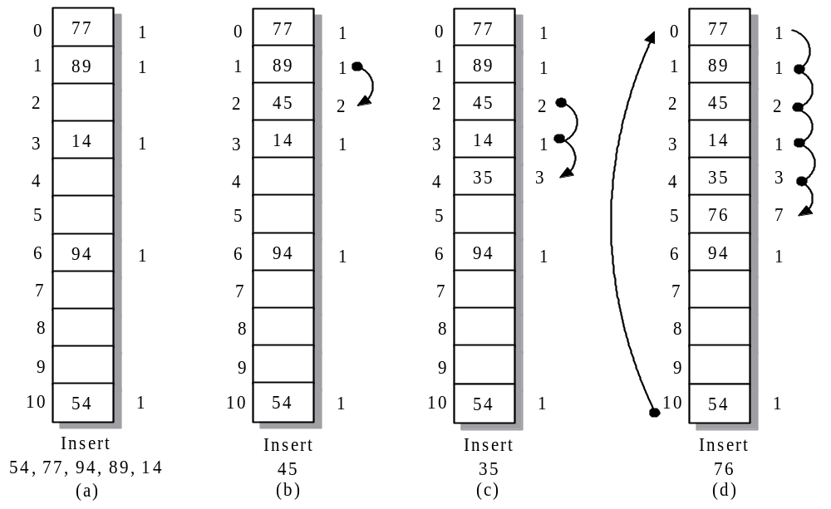
Hash Table Using Open Probe Addressing Example

Slide 16
Hash Table Using Open Probe Addressing
insert an item
  Clustering:
Find an item
Remove an item
Notes:
Note page 12-17 for clustering
Find item , remove item, note p12-18

Slide 17
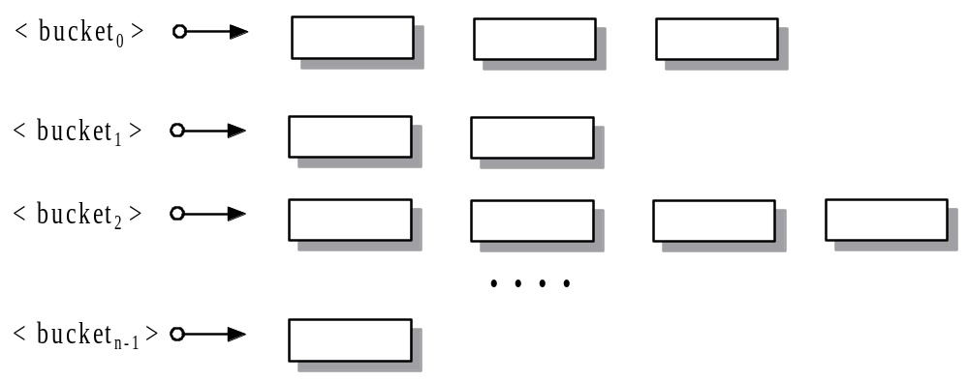
Chaining with separate lists
The hash table is defined as an indexed sequence of containers, such as vector or lists
Each container, called a bucket, holds a set of data items that has the same table location

Slide 18
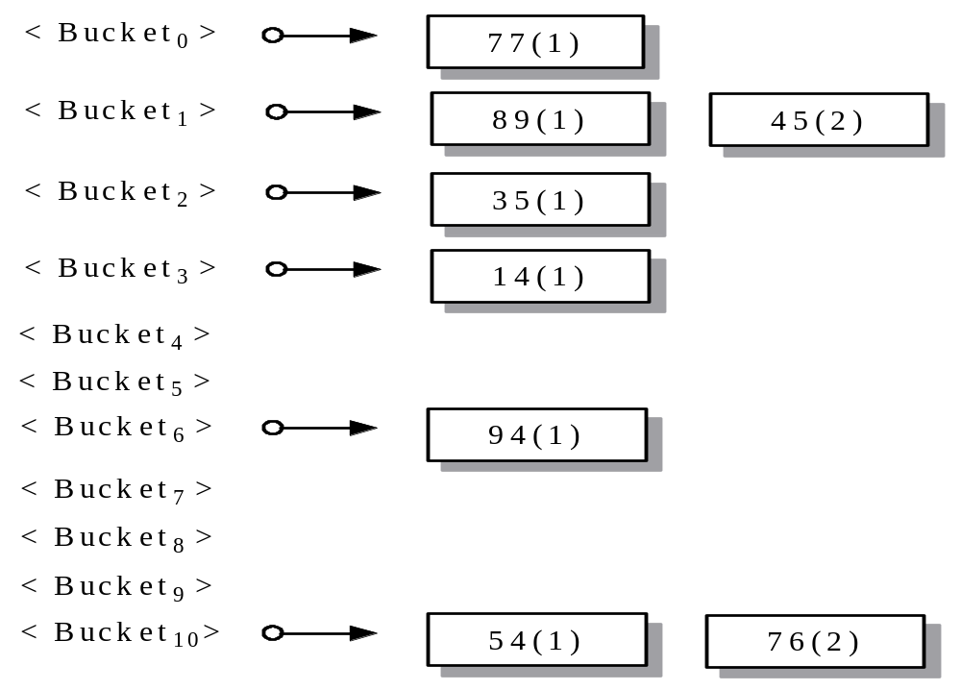
Chaining with Separate Lists Example

Slide 19
Hash table performance
Chaining:
  Unsuccessful search
  Successful search
Notes:
Chaining:
Unsuccessful search, p678
Successful search, p679
Fine-tuning hashing, p679

Slide 20
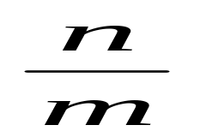
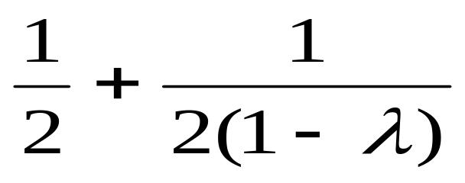
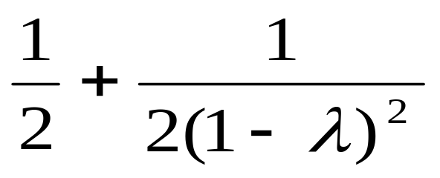
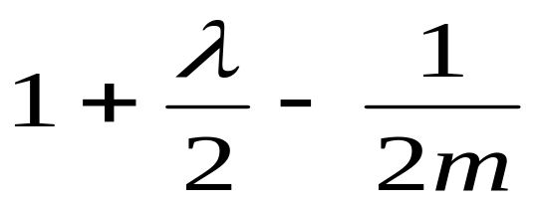
Efficiency of Hash Methods
Hash table size = m, Number of elements in hash table = n, Load factor λ =
Average Probes
for Successful Search
Average Probes
for Unsuccessful Search
Open
(linear) Probe
Chaining
λ
Notes:
Performance comparison: Note P12-20

Slide 21
The hash class
Implementation of hashing by using chaining with separate lists
  Stree class implements ordered sets and maps
  Hash class implement unordered sets and maps
Applications

Slide 22
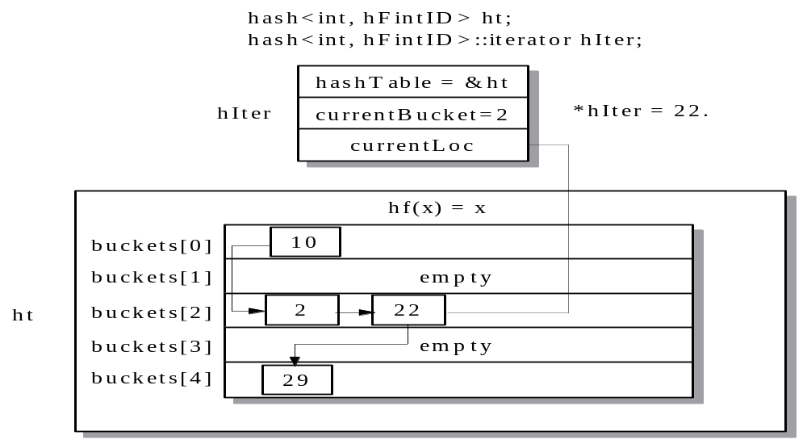
Hash Iterator hIter Referencing Element 22 in Table ht

Slide 23
Comparing search algorithm
Sequential search
Binary search
Binary search tree
hashing
Notes:
Time complexity?
Program 12-3

Slide 24
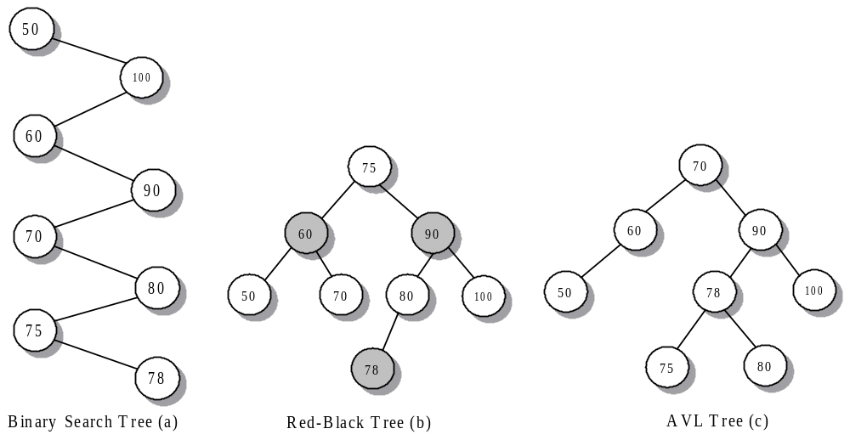
Binary Search Tree, Red-Black Tree and AVL Tree Example
Notes:
AVL (Adelson-Velskii-Landid) tree: For each node in an AVL tree, the difference in height between its two subtrees is at most 1.

Slide 25
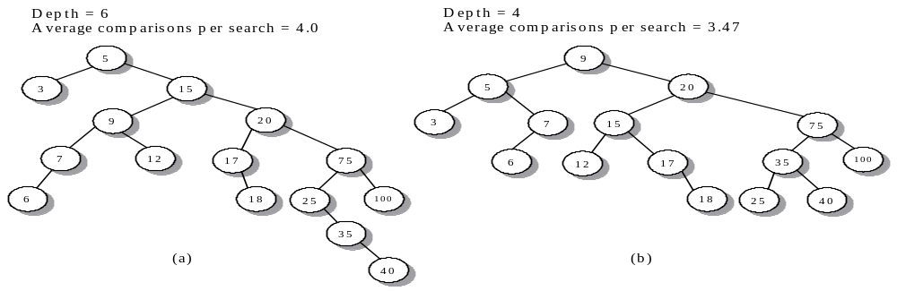
Two Binary Search Tree Example
5, 15, 20, 3, 9, 7, 12, 17, 6, 75, 100, 18, 25, 35, 40

Slide 26
Summary Slide 1
§- Hash Table
- simulates the fastest searching technique, knowing the index of the required value in a vector and array and apply the index to access the value, by applying a hash function that converts the data to an integer
- After obtaining an index by dividing the value from the hash function by the table size and taking the remainder, access the table. Normally, the number of elements in the table is much smaller than the number of distinct data values, so collisions occur.
- To handle collisions, we must place a value that collides with an existing table element into the table in such a way that we can efficiently access it later.

Slide 27
Summary Slide 2
§- Hash Table (Cont…)
- average running time for a search of a hash table is O(1)
- the worst case is O(n)

Slide 28
Summary Slide 3
§- Collision Resolution
- Two types:
1) linear open probe addressing
- the table is a vector or array of static size
- After using the hash function to compute a table index, look up the entry in the table.
- If the values match, perform an update if necessary.
- If the table entry is empty, insert the value in the table.

Slide 29
Summary Slide 4
§- Collision Resolution (Cont…)
- Two types:
1) linear open probe addressing
- Otherwise, probe forward circularly, looking for a match or an empty table slot.
- If the probe returns to the original starting point, the table is full.
- you can search table items that hashed to different table locations.
- Deleting an item difficult.

Slide 30
Summary Slide 5
§- Collision Resolution (Cont…)
2) chaining with separate lists.
- the hash table is a vector of list objects
- Each list is a sequence of colliding items.
- After applying the hash function to compute the table index, search the list for the data value.
- If it is found, update its value; otherwise, insert the value at the back of the list.
- you search only items that collided at the same table location

Slide 31
Summary Slide 6
§- Collision Resolution (Cont…)
- there is no limitation on the number of values in the table, and deleting an item from the table involves only erasing it from its corresponding list

