Slide 1
Advanced Associative Structures
Red Black Trees

Slide 2
Outline
2-3-4 Tree
Insertion of 2-3-4 tree
Red-Black Trees
Converting 2-3-4 tree to Red-Black tree
Four Situations in the Splitting of a 4-Node:
Building a Red-Black Tree
Red-Black Tree Representation

Slide 3
Associative structures
Ordered associative containers
  Binary search tree

Slide 4
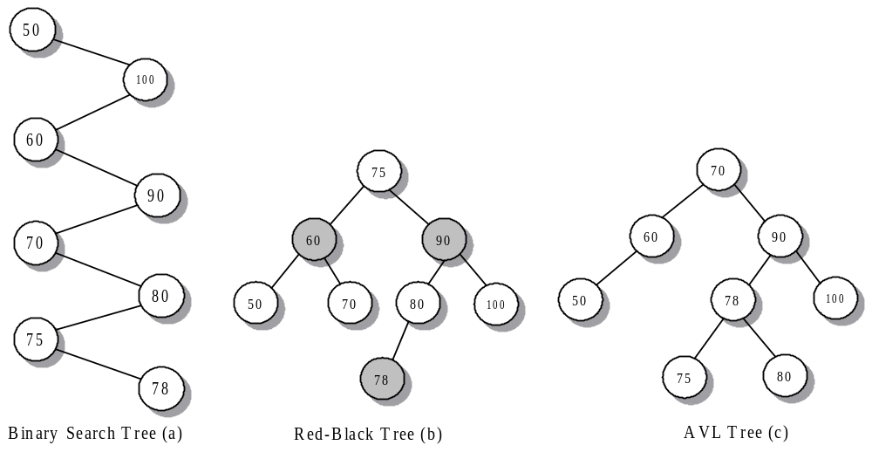
Binary Search Tree, Red-Black Tree and AVL Tree Example
Notes:
AVL (Adelson-Velskii-Landid) tree: For each node in an AVL tree, the difference in height between its two subtrees is at most 1.

Slide 5
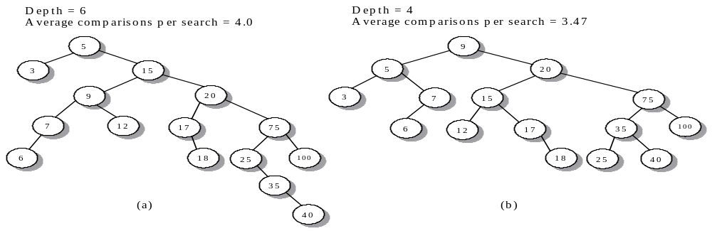
Two Binary Search Tree Example
5, 15, 20, 3, 9, 7, 12, 17, 6, 75, 100, 18, 25, 35, 40

Slide 6
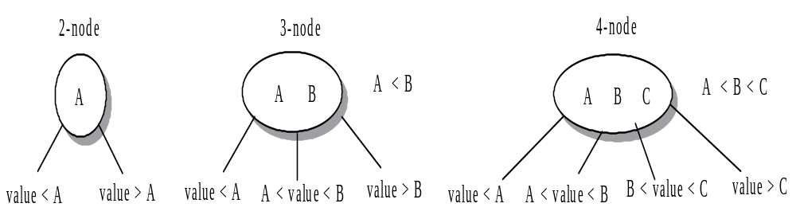
2-3-4 Tree Method
2-3-4 tree: each node has two, three, or four links (children) and the depths of the left and right subtrees for each node are equal (perfectly balanced)
  2 node: a node containing a data value and pointers to two subtrees.
  3 node: a node containing two ordered data values A and B such that A < B, as well as three pointers to subtrees
  4 node: a node containing three ordered data values A < B<C, along with four pointers to subtrees.

Slide 7
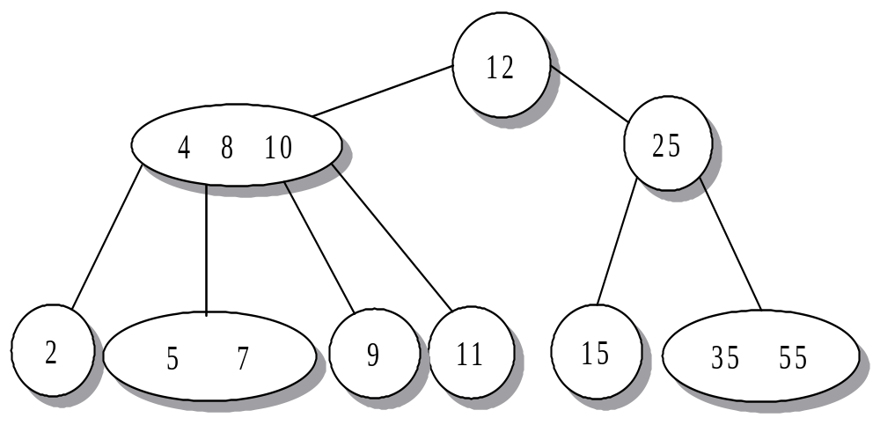
2-3-4 Tree Example: Search item
Search 7, 30?

Slide 8
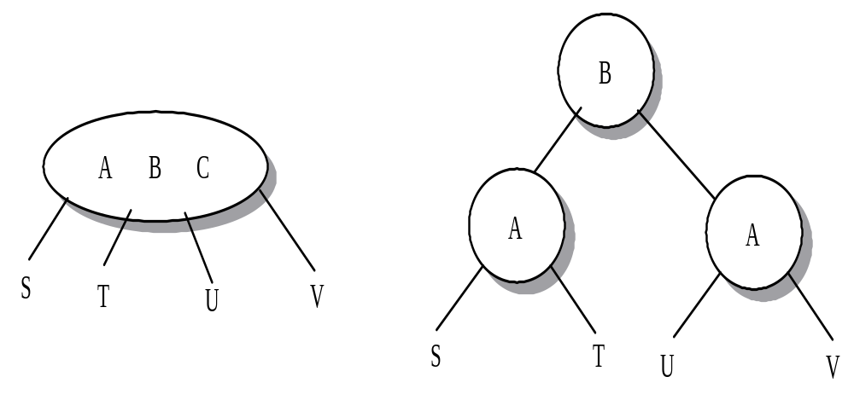
Insertion
Top-down approach to slitting a 4-node:
split the 4-node first, then do insertion
C

Slide 9
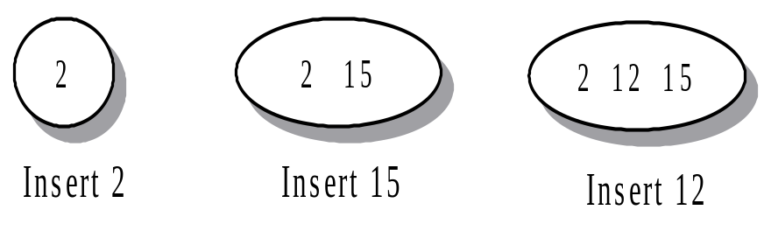
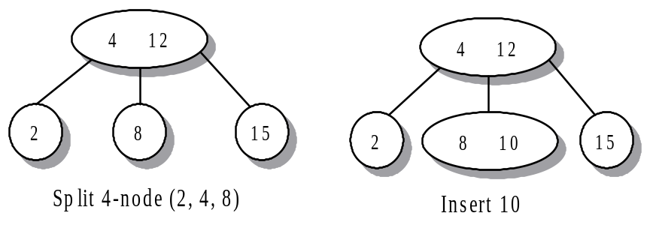
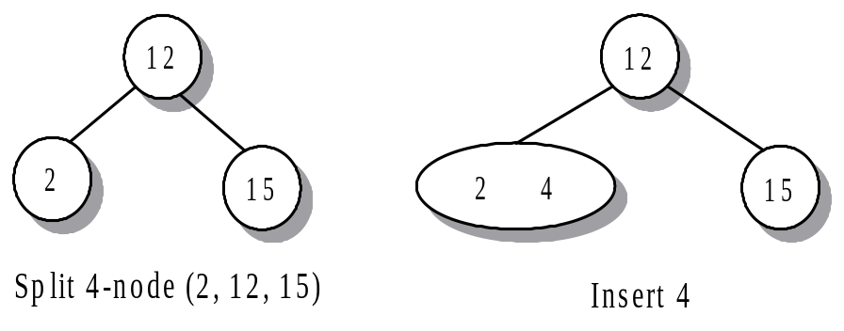
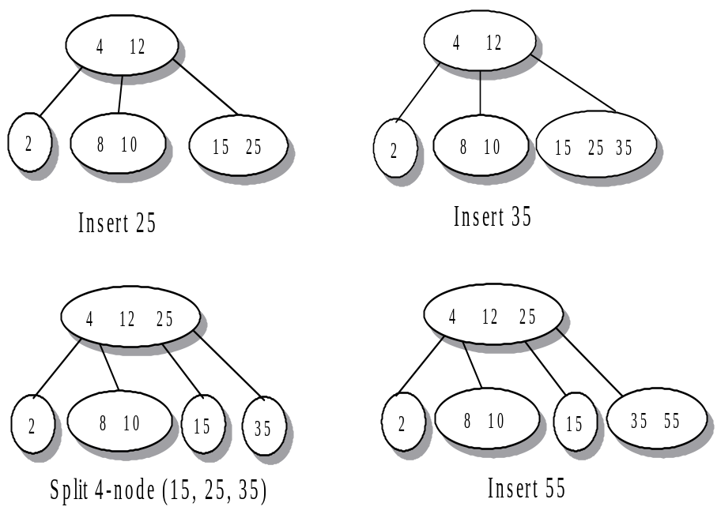
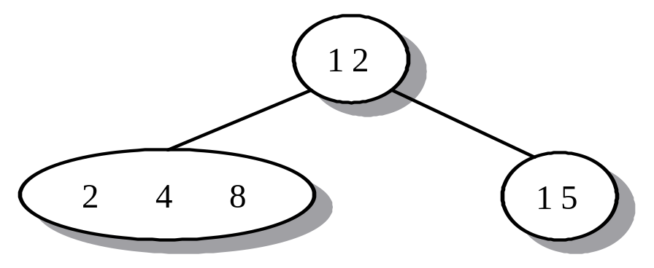
Example of Insertion of 2-3-4 Tree
Insertion Sequence: 2, 15, 12, 4, 8, 10, 25, 35, 55, 11, 9, 5, 7
Insert 8

Slide 10
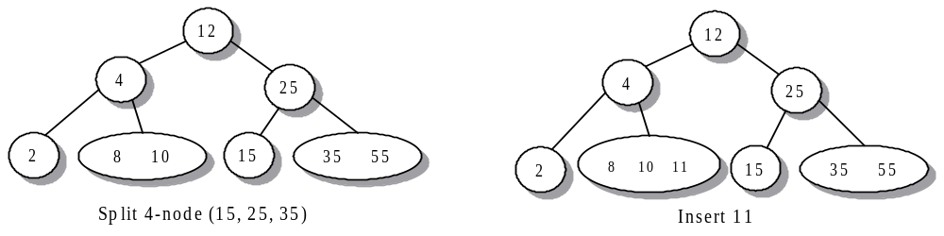
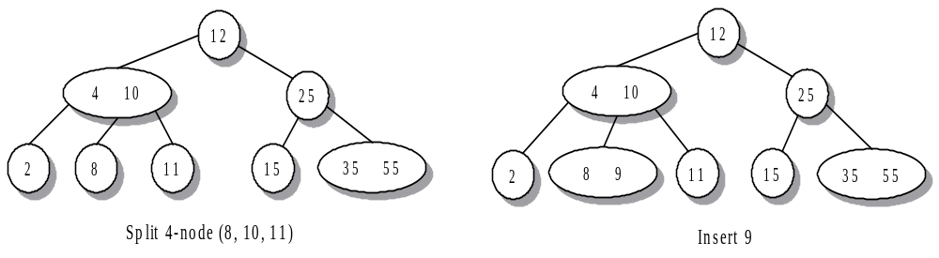
Example of Insertion of 2-3-4 Tree (Cont…)
Insertion Sequence: 2, 15, 12, 4, 8, 10, 25, 35, 55, 11, 9, 5, 7
(4,12,25 )

Slide 11
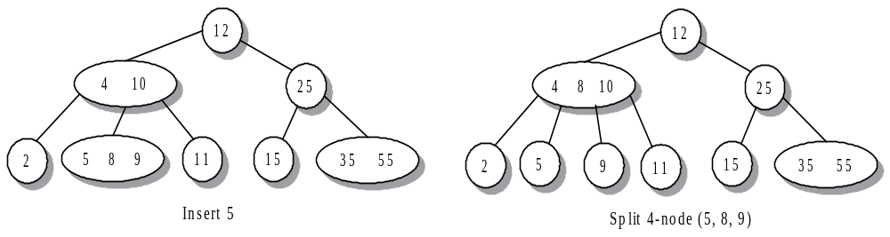
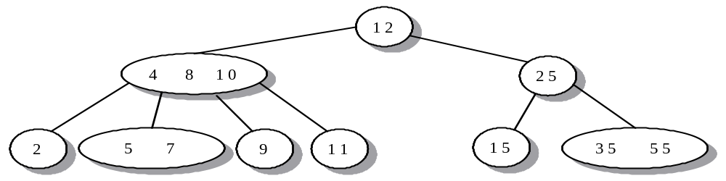
Example of Insertion of 2-3-4 Tree (Cont…)
Insertion Sequence: 2, 15, 12, 4, 8, 10, 25, 35, 55, 11, 9, 5, 7
Insert 7

Slide 12
Running time for 2-3-4 Tree Operations
Time complexity
  In a 2-3-4 tree with n elements, the maximum number of nodes visited during the search for an element is int(log₂n)+1
  Inserting an elements into a 2-3-4 tree with n elements requires splitting no more than int(log₂n)+1 4-nodes and normally requires fare fewer splits
Space complexity
  Each node can have 3 values and 4 pointers to children.
  Each node (except root) has a unique parent, tree has n-1 edges (pointer in use)
    The number of unused pointers is 4n-(n-1)=3n+1.
Notes:
Fact 1: complete binary tree with n nodes has depth int(log₂n). So the path to locate a node in nor more than int(log₂n)+1. For 3,4 –nodes, the length to of the path will be lower
Big waste of pointer

Slide 13
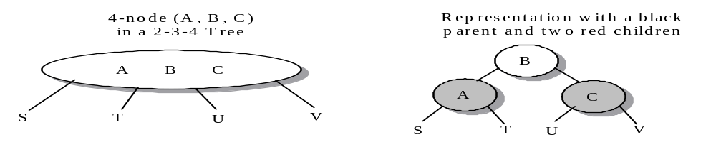
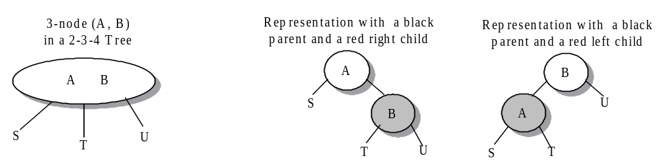
Red-Black Trees
A red-black tree is a binary search tree in which each node has the color attribute BLACK or RED.
It is designed as a representation of a 2-3-4 tree.

Slide 14
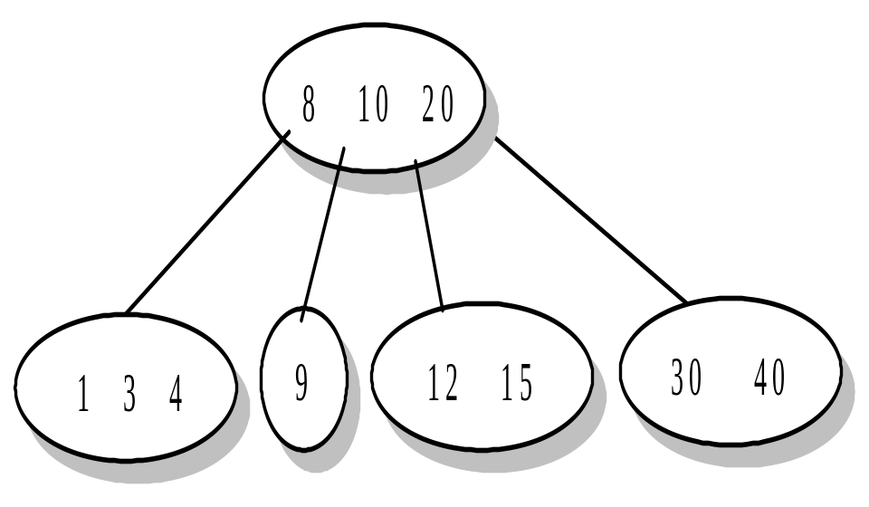
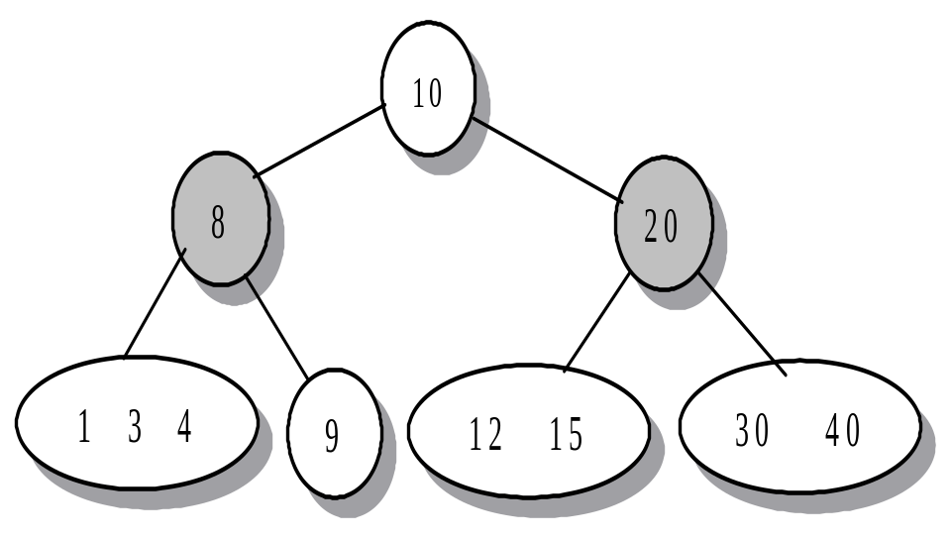
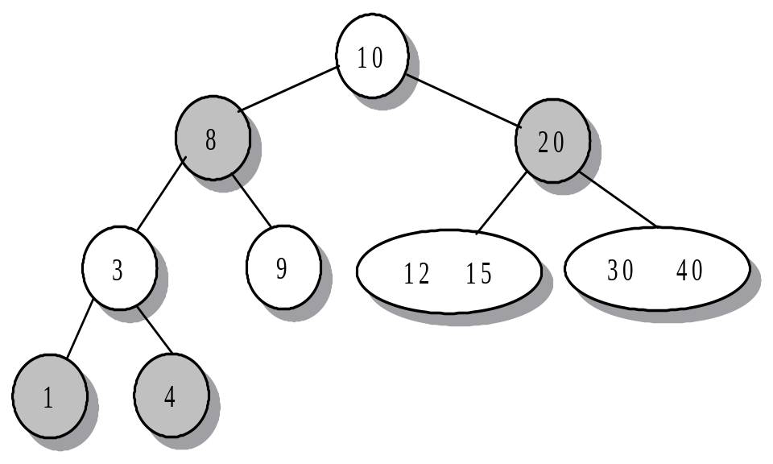
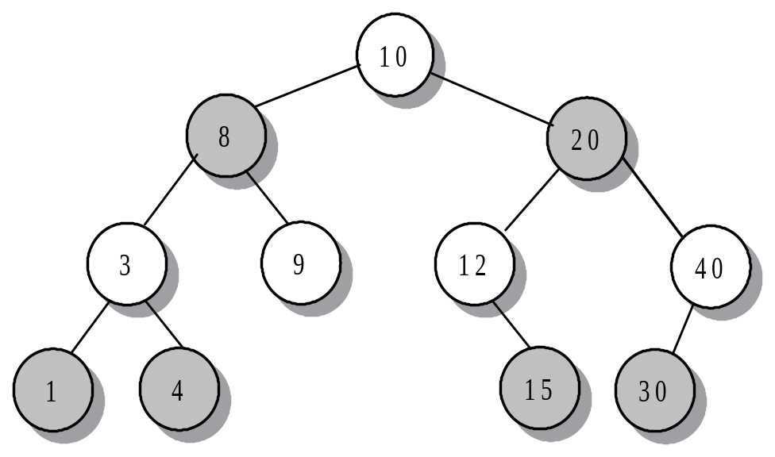
Converting a 2-3-4 Tree to Red-Black Tree Example
Property 1: The root of a red-black tree is BLACK
Property 2: A RED parent never has a RED child-never two RED nodes in succession
Property 3: Every path from the root to an empty subtree has the same number of BLACK nodes, called black height of the tree (the level of 2-3-4 tree)

Slide 15
Inserting nodes in a Red-Black tree
Difficulty: must maintain the black height balance of the tree
  Maintain the root as a BLACK node
  Enter a new node into the tree as a RED node
  Whenever the insertion results in two RED nodes in succession, rotate nodes to create a BLACK parent while maintaining balance
  When scanning down a path to find the insertion location, split any 4-node.

Slide 16
Insertion at the bottom of the tree
Insert
Insert followed by a single (left or right) rotation
Insert followed by a double (left-right, or right-left) rotation
Notes:
Book P695

Slide 17
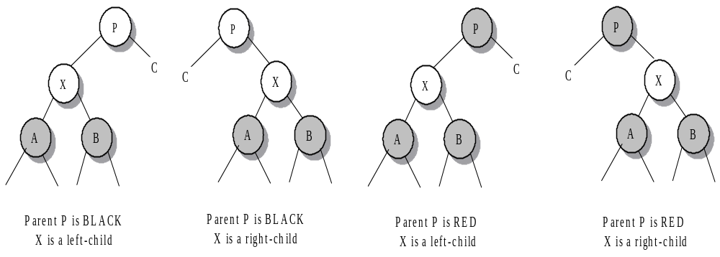
Splitting of a 4-Node (subtree that has a black parent and two RED children)
Four Situations:
The splitting of a 4-node begins with a color flip that reverse the color of each of the nodes
When the parent node P is BLACK, the color flip is sufficient to split the 4-node
When the parent node P is RED, the color filp is followed by rotations with possible color change

Slide 18
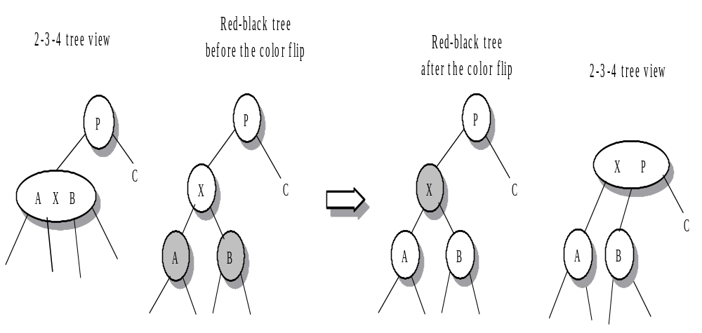
Left child of a Black parent P
Do color flip

Slide 19
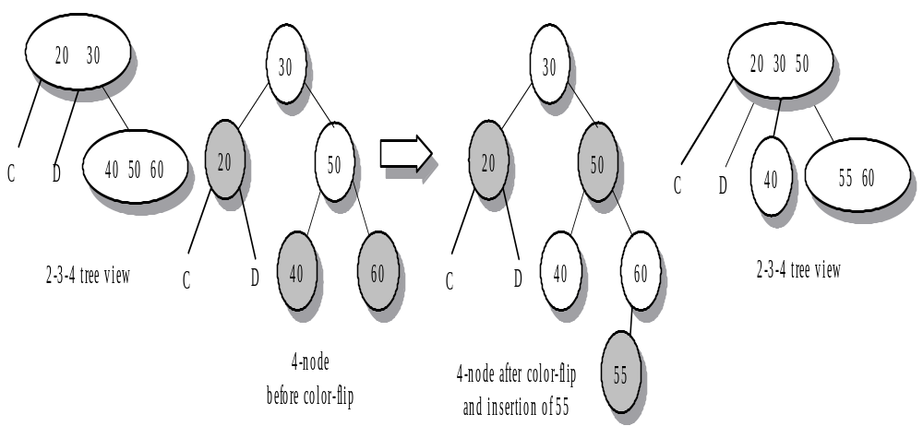
Right child of a Black parent P
Splitting a 4-node prior to inserting node 55

Slide 20
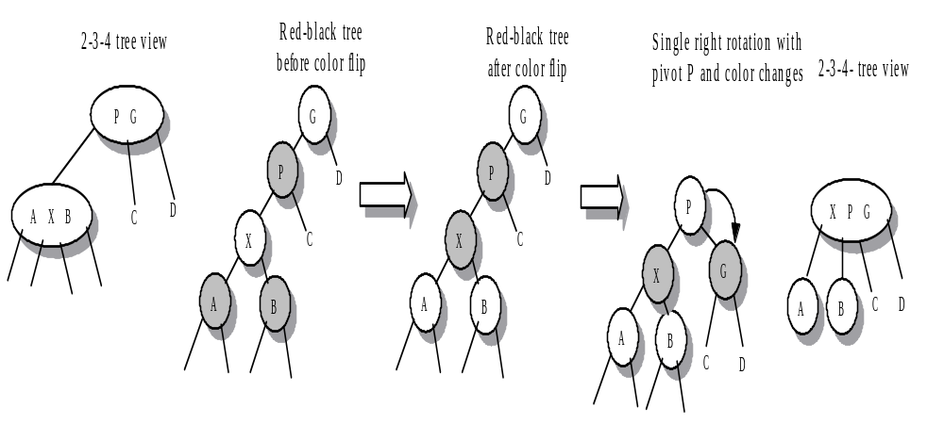
Left-left ordering of G, P, and X
Oriented left-left from G (grandparent of the BLACK node X)
Color flip
Using A Single Right Rotation
Color change

Slide 21
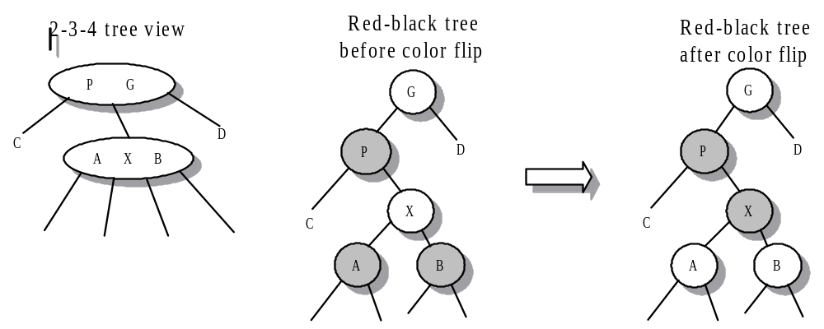
Left-right ordering of G, P, and X
Oriented Left-Right From G After the Color Flip
Color flip
Using A Double Rotation (single left-rotation, single right-rotation)
Color change
Notes:
Book p698 figure 12-16 for double rotation

Slide 22
Left-right ordering of G, P, and X
Oriented Left-Right From G After the Color Flip
Color flip
Using A Double Rotation (single left-rotation, single right-rotation)
Color change
Red-black tree after single
Left-rotation about X,
ignoring colors
Red-black tree after a single right-rotation about X and recoloring
G
P
D
G
X
X
D
P
C
X
G
A
B
B
A
B
D
P
C
C
A
Notes:
Book p698 figure 12-16 for double rotation

Slide 23
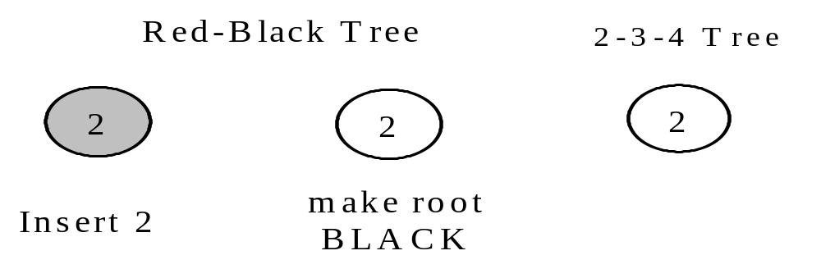
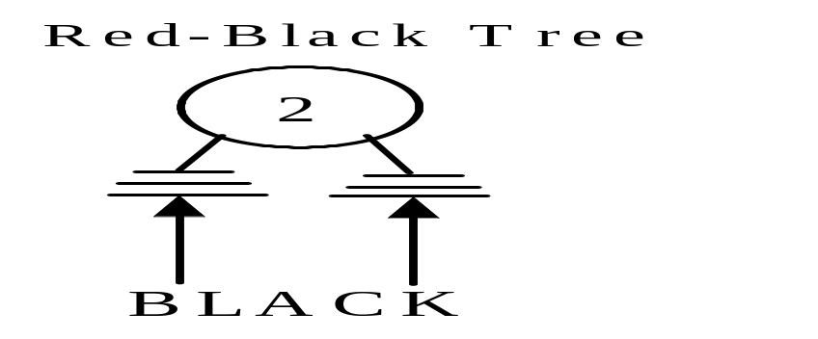
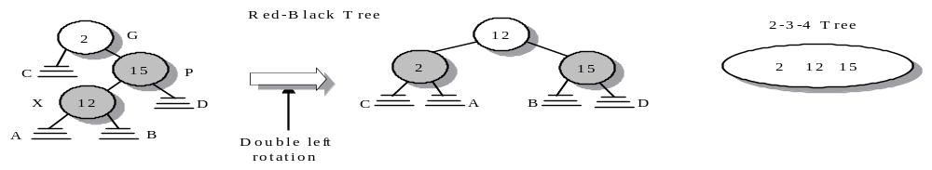
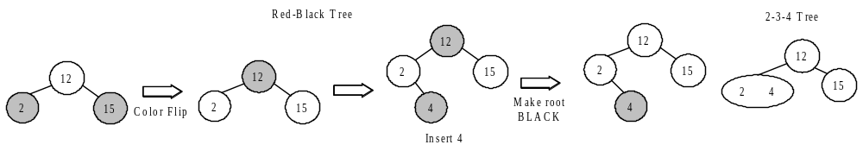
Building A Red-Black Tree
2, 15, 12, 4, 8, 10, 25, 35, 55, 11, 9, 5, 7

Slide 24
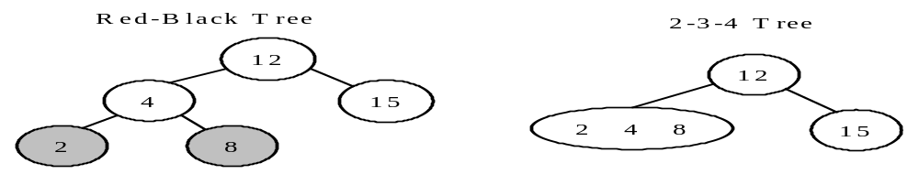
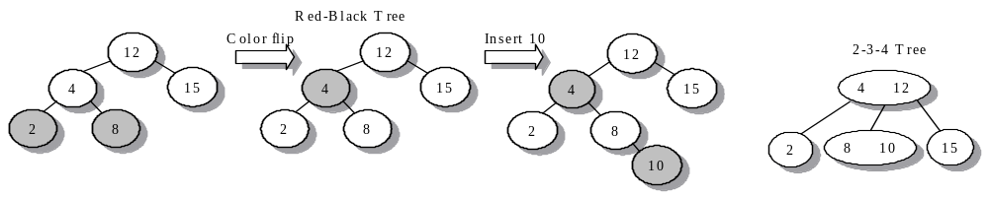
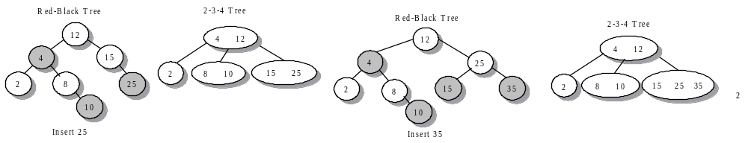
Building A Red-Black Tree (Cont…) 2, 15, 12, 4, 8, 10, 25, 35, 55, 11, 9, 5, 7

Slide 25
Erasing a Node in a Red-Black tree
More difficult to keep the property of a red-black tree
If the replacement node is RED, the BLACK height of the tree is not changes
If the replacement node is BLACK, make adjustments to the tree from the bottom up to maintain the balance
Notes:
Book 703: Fig. 12-19, 12-20

Slide 26
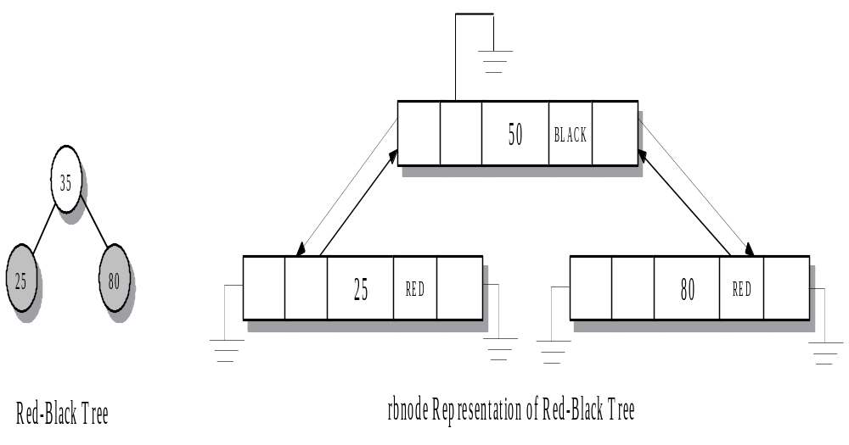
rbnode Representation of Red-Black Tree
35

Slide 27
Summary Slide 1
§- 2-3-4 tree
- a node has either 1 value and 2 children, 2 values and 3 children, or 3 values and 4 children
- construction of 2-3-4 trees is complex, so we build an equivalent binary tree known as a red-black tree

Slide 28
Summary Slide 2
§- red-black trees
- Deleting a node from a red-black tree is rather difficult.
- the class rbtree, builds a red-black tree

