Slide 1
Heapsort
Heap & Priority Queue

Slide 2
Outlines
  Maximum and Minimum Heaps
  Heap operations:
  pushHeap()
  popHeap()
  makeHeap()
  Heap Sort
  Priority Queue

Slide 3
Heap
A heap is a complete binary tree that defines an order relationship between a parent and its children
  Maximum heap: the value of a parent is greater than or equal to the value of each of its children
  Minimum heap: the value of the parent is less than or equal to the value of each of its children

Slide 4
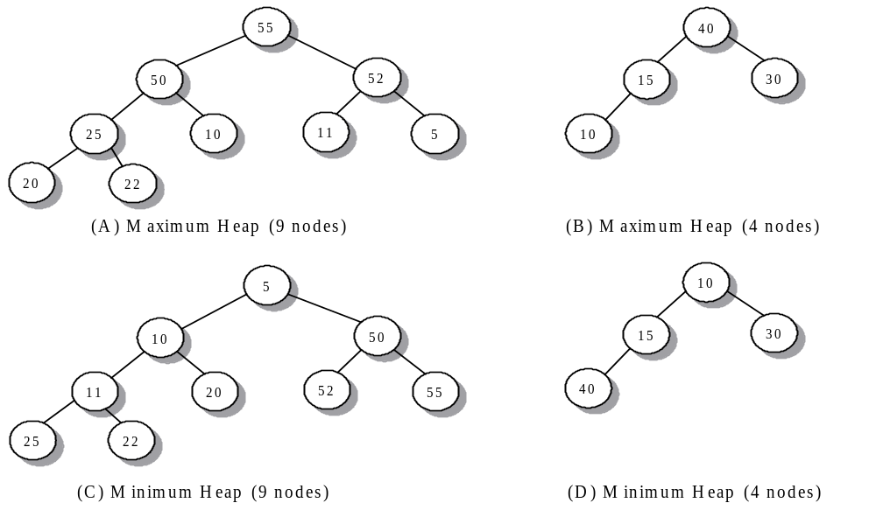
Maximum and Minimum Heaps Example

Slide 5
Example of Complete Binary Tree for a Vector
Build binary tree by using tree nodes: one data value and two pointers
Array based tree: array or vector is the storage structure
  Any array can represent a CBT (and vice-versa)
  The implementation of heaps is in an array or vector
63
For node i:
---left child is 2i+1
---right child: 2i+2
---parent is (i-1)/2
There is no pointer storage
Computation of left, right children, and parent is very fast
v[0]
30
40
v[1]
v[2]
10
25
8
38
v[3]
v[4]
v[5]
v[6]
5
3
18
v[7]
v[8]
v[9]
Notes:
Note: 14-3

Slide 6
Heap operations
Top operation: return the element at root
Push operation: insertion an element into heap
Pop operation: delete the element at root
Make operation: build a heap from an arbitrary vector

Slide 7
Push Operation: insertion an element into heap
Insert element at back of vector
If the heap ordering is destroyed, do heapify resume the heap property

Slide 8
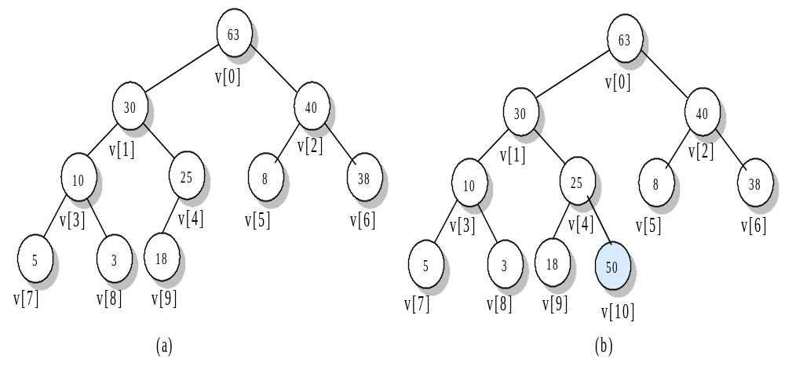
Example of insert 50 into heap

Slide 9
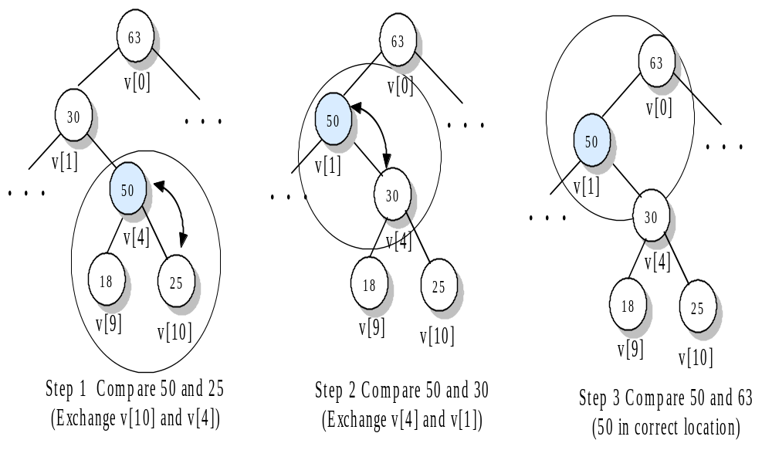
Example of Reorder the tree in pushHeap()

Slide 10
Example of Reorder the tree in pushHeap()
The moving a node up is along a path to the root.
How do we know the movement does not mess up the ordering along other paths?
63
63
63
v[0]
v[0]
v[0]
30
40
30
40
50
40
v[1]
v[2]
v[1]
v[2]
v[1]
v[2]
10
25
8
38
10
50
8
38
10
30
8
38
v[3]
v[4]
v[5]
v[6]
v[3]
v[4]
v[5]
v[6]
v[3]
v[4]
v[5]
v[6]
5
3
18
50
5
3
18
25
5
3
18
25
v[7]
v[8]
v[9]
v[7]
v[8]
v[9]
v[10]
v[8]
v[9]
v[10]
v[10]
Notes:
For question. See note 14-6

Slide 11
Pop Operation: delete the element at root
Exchange root element with element at back of vector (to make deletion easy)
Reheapify (shift-down) by moving new root down the tree until the heap ordering is resumed

Slide 12
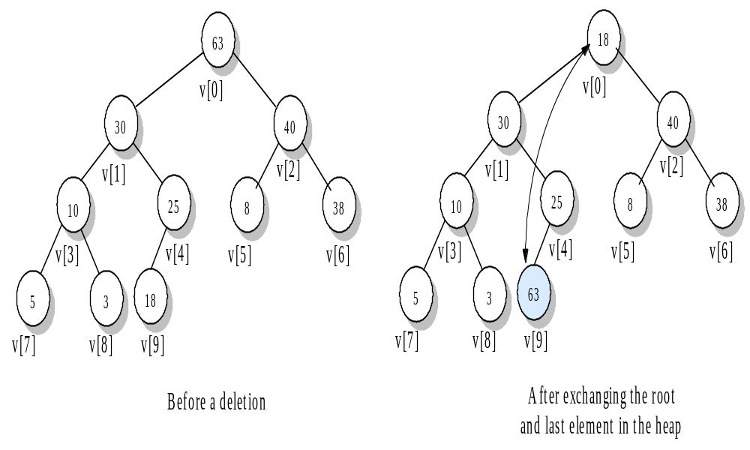
Example of Exchanging elements in popHeap()

Slide 13
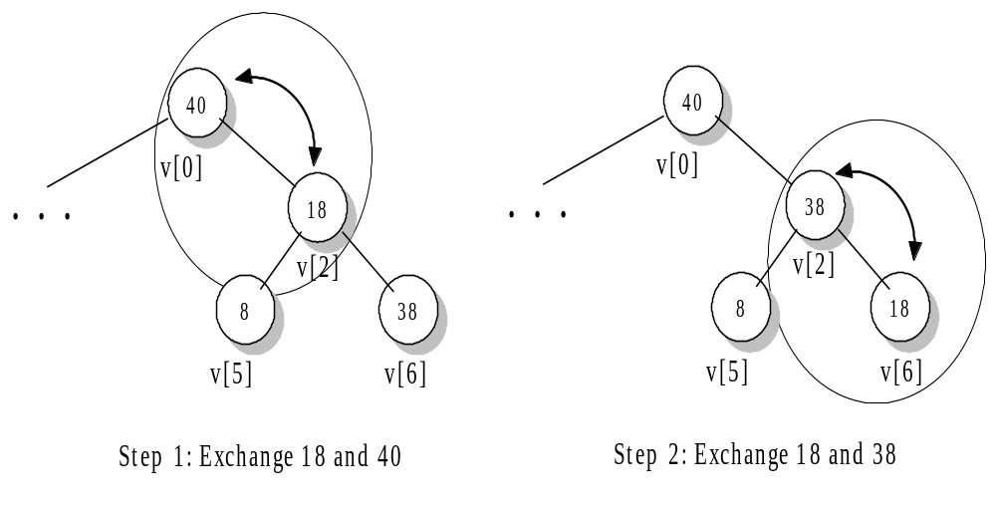
Example of Adjusting the heap for popHeap()

Slide 14
Make Operation: build a heap out of an arbitrary vector
Start at the node with index =(n-2)/2, which is the last non-leaf on the next-to-last level
Work from index =(n-2)/2 to index=0 and at each index, adjust heap

Slide 15
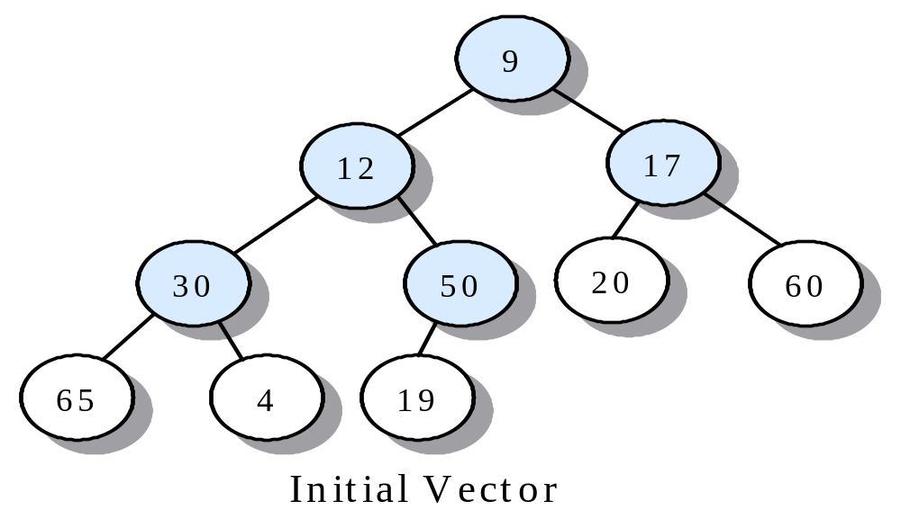
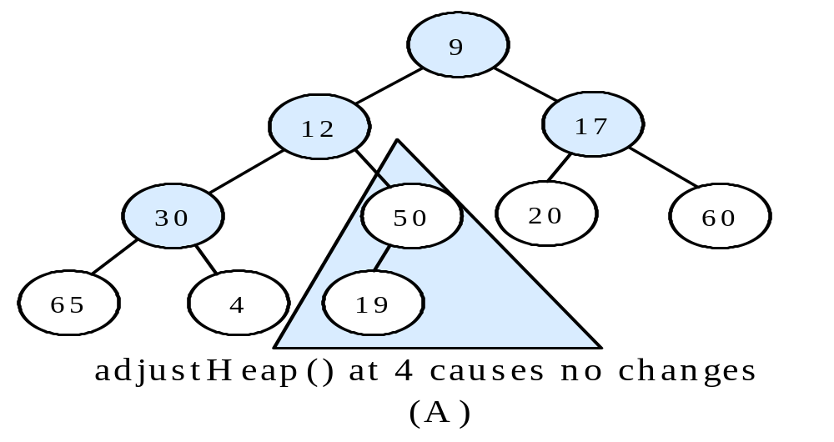
Example of Heapifying a Vector

Slide 16
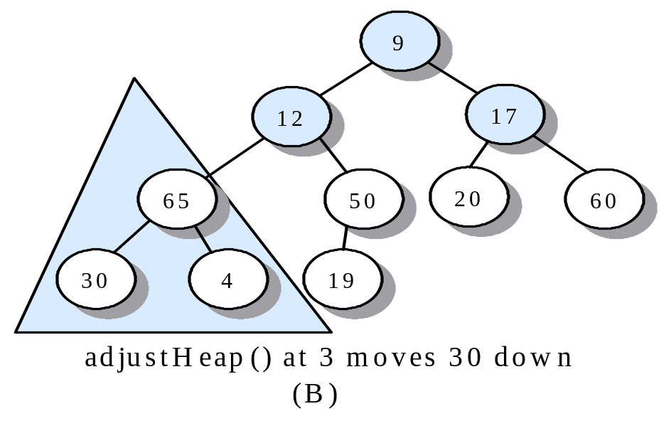
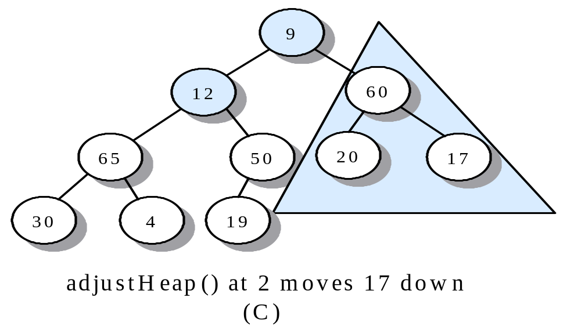
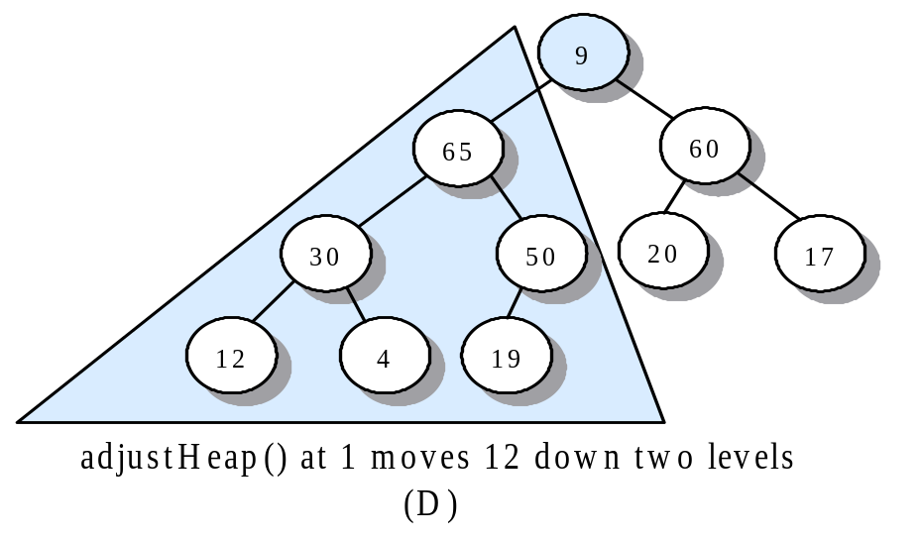
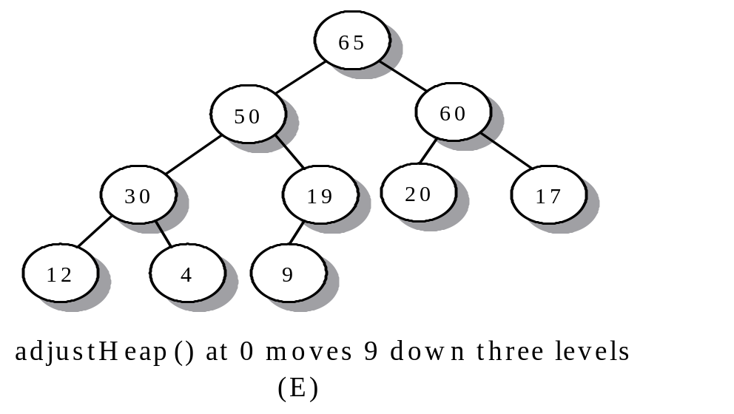
Example of Heapifying a Vector (Cont…)
Notes:
Note 14-8

Slide 17
Analysis of makeHeap
The total number of swaps in makeHeap is O(n)
Notes:
Note 14-9---14-10

Slide 18
Time complexity of heap operations
Top operation: O(1)
Push operation: O(lgn)
Pop operation: O(lgn)
Make operation: O(n)

Slide 19
Heapsort
Given a vector of size n in arbitrary order
  Heapify it (A heap, not sorted vector)
  For (i=n;i>1;i--)
    popHeap(v,i,comp) (sorted vector)

Slide 20
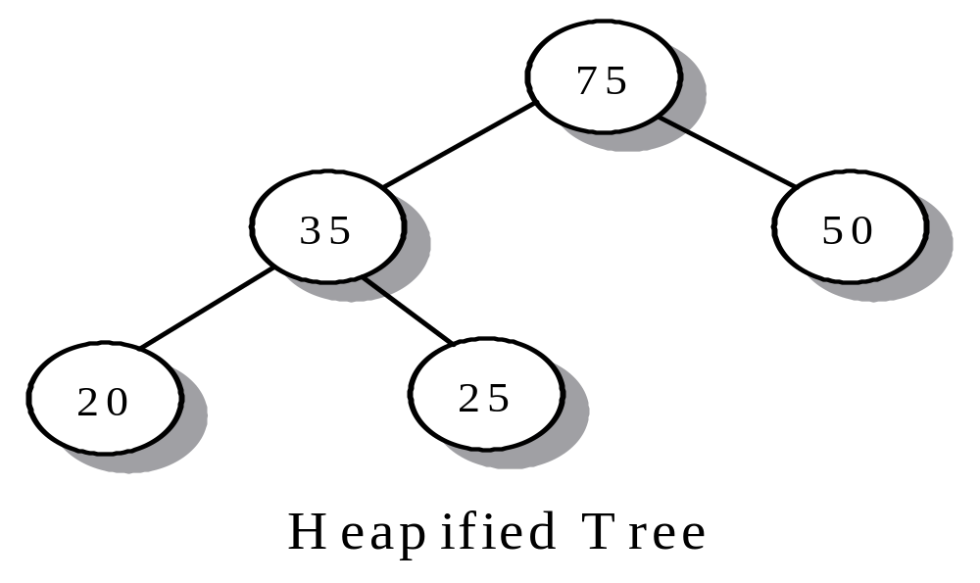
Example of Implementing heap sort
int arr[] = {50, 20, 75, 35, 25};
vector<int> v(arr, 5);

Slide 21
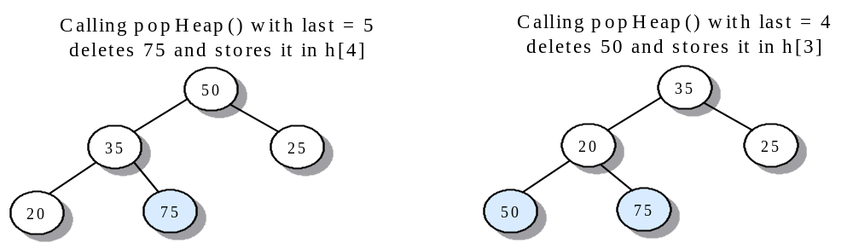
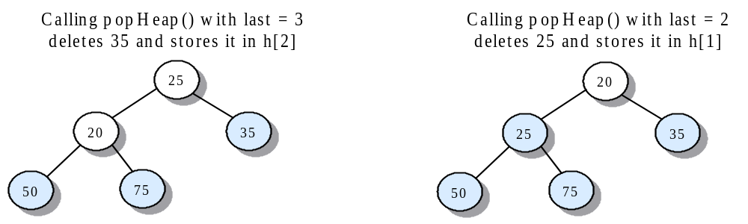
Example of Implementing heap sort (Cont….)

Slide 22
HeapSort
Implementation of heapSort
Time complexity: O(nlgn)

Slide 23
Priority queue
A priority queue is a queue in which the ‘top’ operation refers to the element that has highest priority and the ‘pop’ operation remove that element
  “Priority” is some property of an object that allows it to be prioritized with respect to other objects of the same type
Applications:
  Printer management
  Job priorities

Slide 24
Implementation of Priority queue
Sorted list
Balanced BST
(Binary) Heap
 | Sorted list | Balanced BST | (Binary) Heap
push | O(n) | O(lgn) | O(lgn)
pop | O(1) | O(lgn) | O(lgn)
top | O(1) | O(lgn) | O(1)
make | O(n²) | O(nlgn) | O(n)
structure
operation
Notes:
Note 14-1,2

Slide 25
Summary Slide 1
§- Heap
- an array-based tree that has heap order
- maximum heap: if v[i] is a parent, then v[i] ≥ v[2i+1] and v[i] ≥ v[2i+2] (a parent is ≥ its children)
- root, v[0], is the maximum value in the vector
- minimum heap: the parent is ≤ its children.
- v[0] is the minimum value
- Insertion: place the new value at the back of the heap and filtering it up the tree.

Slide 26
Summary Slide 2
§- Heap (Cont…)
- Deletion: exchanging its value with the back of the heap and then filtering the new root down the tree, which now has one less element.
- Insert and delete running time: O(log₂ n)
- heapifying: apply the filter-down operation to the interior nodes, from the last interior node in the tree down to the root
- running time: O(n)
- The O(n log₂ n) heapsort algorithm heapifies a vector and erases repeatedly from the heap, locating each deleted value in its final position.

