Slide 1
Graphs
Graph transversals
‹#›
Notes:
‹#›

Slide 2
Outline
Graph Categories
Digraph
Connectedness of Digraph
Adjacency Matrix, Set
vertexInfo Object
Breadth-First Search Algorithm
Depth first Search Algorithm
Strong Components
Graph G and Its Transpose G^{T}
‹#›

Slide 3
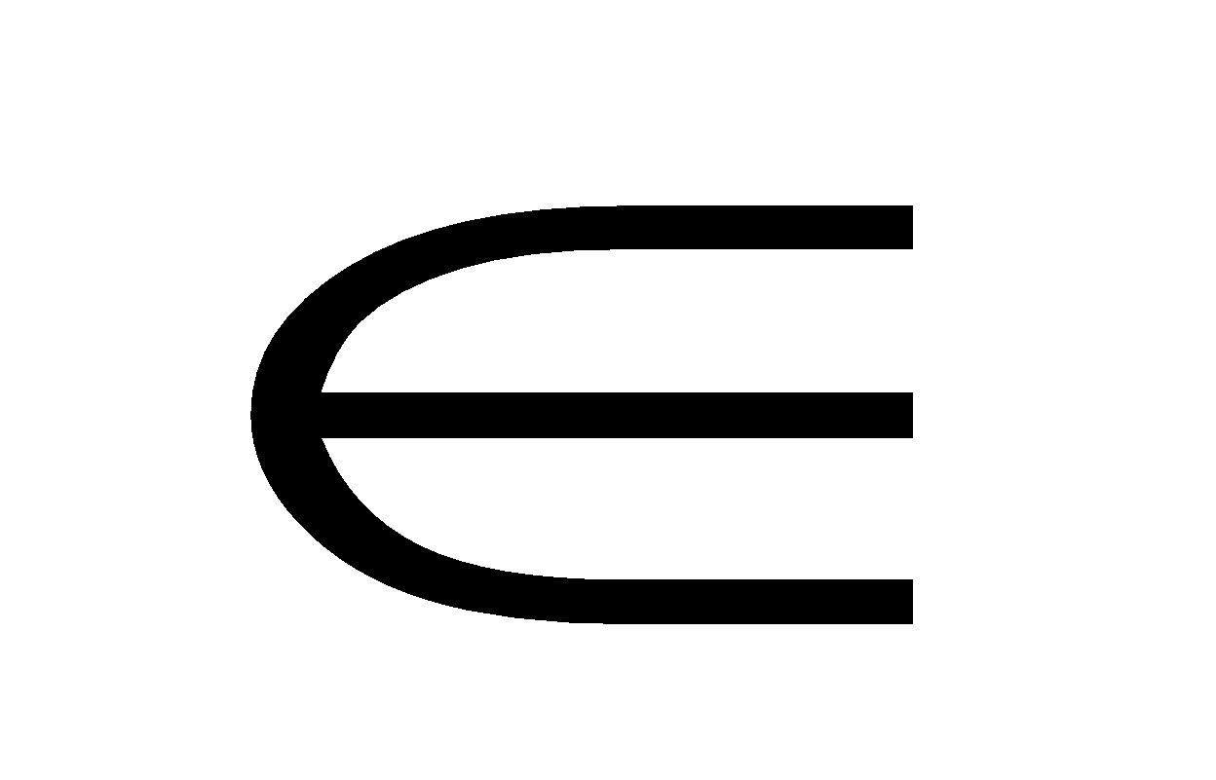


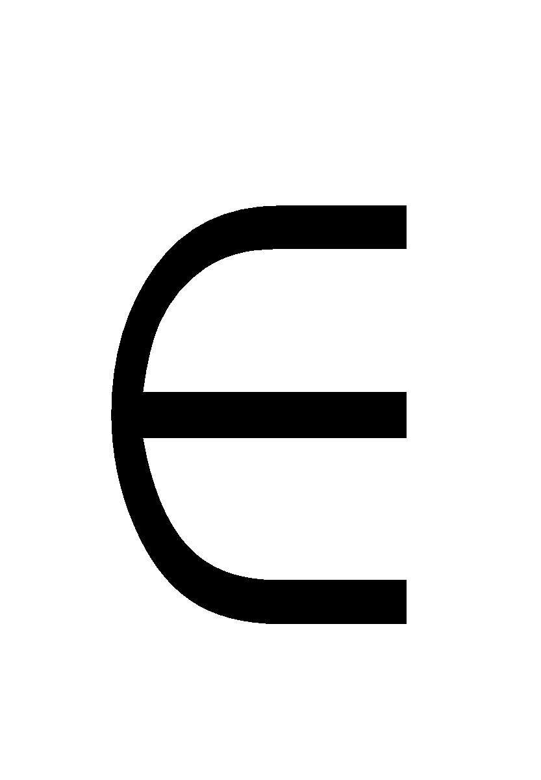
Graph Terminology
A graph G=(V, E) consists of a set V of vertices and a set E of edges that connect pair of vertices.
V={v₁, v₂, …, v_{n}}
E={e₁, e₂, …, e_{m}}
An edge e E is a pair (v_{i}, v_{j})
A subgraph G_{s}=(V_{s}, E_{s}) is a subset of the vertices and edges, where V_{s} V, E_{s} E
Two vertices, v_{i}, v_{j} are adjacent if and only if there is an edge e=(v_{i}, v_{j}) E
A path in a graph is a sequence of vertices v₀, v₁, v₂, …, v_{k} such that (v_{i}, v_{i+1}) E
Simple Path: each vertex occur only once
Cycle: there is a vertex appearing more than once on a path
‹#›

Slide 4
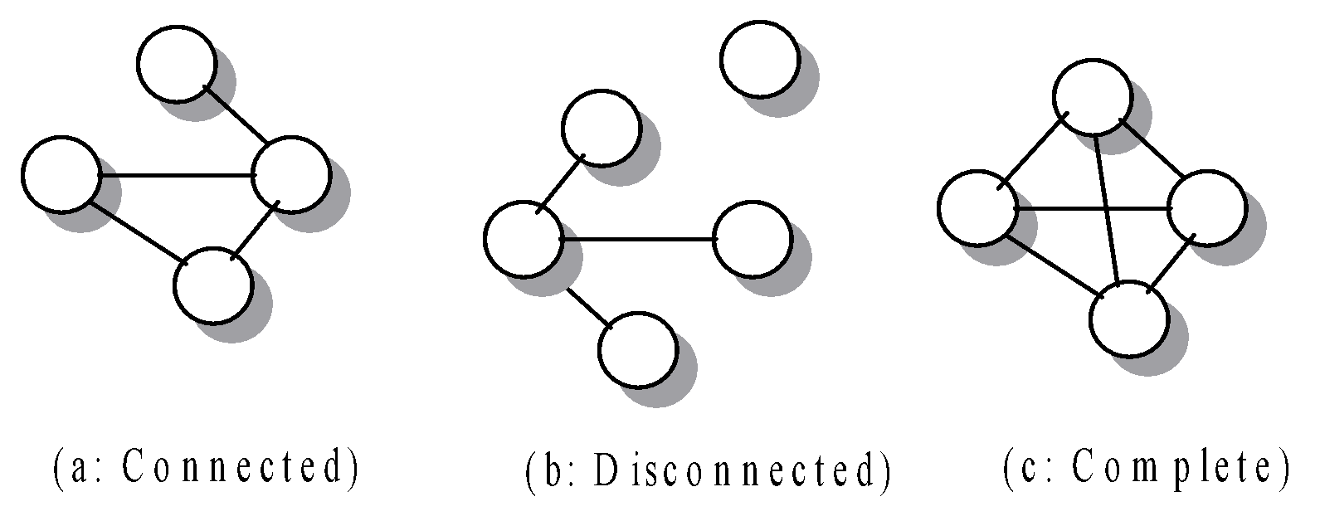
Graph Terminology
A graph is connected if each pair of vertices have a path between them
A complete graph is a connected graph in which each pair of vertices are linked by an edge
‹#›

Slide 5
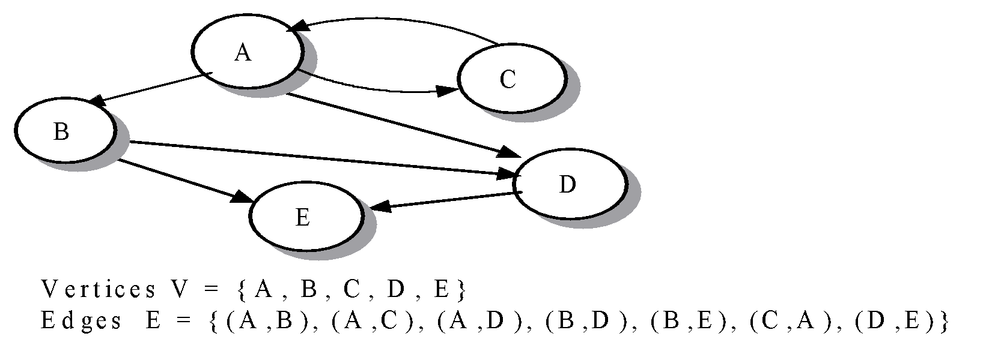
Directed Graphs
Graph with ordered edges are called directed graphs or digraphs, otherwise it is undirected.
The number of edges that emanate from a vertex v is called the out-degree of v
The number of edges that terminate on vertex is called the in-degree of v
‹#›

Slide 6
Directed Acyclic Graph (DAG)
A directed graph that has no cycle is called a directed acyclic graph (DAG)
Directed path
Directed cycle: a directed path of length 2 or more that connects a vertex to itself
A weighted digraph is a directed graph that associates values with the edges.
A weight edge e=(v_{i}, v_{j}, w_{t})
‹#›

Slide 7
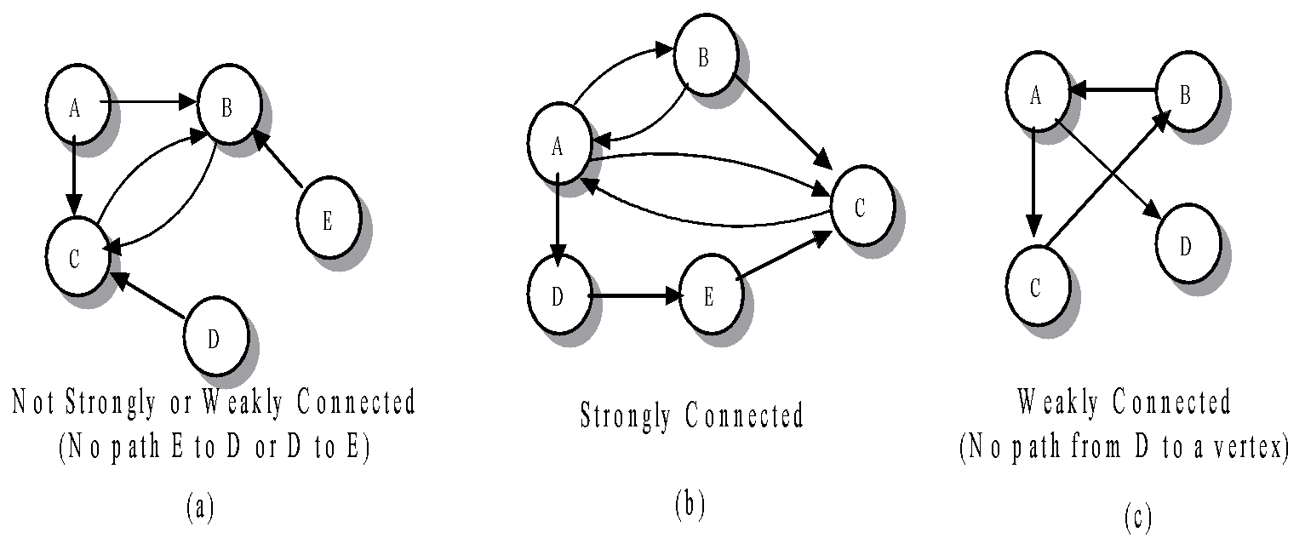
Connectedness of Digraph
Strongly connected if for each pair of vertices vi and vj, there is a path P(vi, vj)
Weakly connected if for each pair of vertices vi and vj, there is either a path P(vi, vj) or a path P(vj,vi).
‹#›

Slide 8
The Graph Class
Access the properties of a graph
Add or delete vertices and edges
Update the weight of an edge
Identify the list of adjacent vertices
‹#›

Slide 9
Representation of Graphs
Adjacency matrix
Adjacent set
‹#›

Slide 10
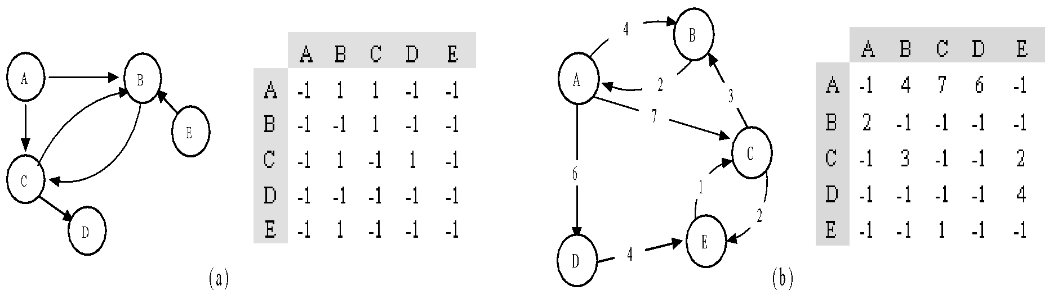
Adjacency Matrix
An n by n matrix, called an adjacency matrix, identifies the edges. An entry in row i and column j corresponds to the edge e = (v_{i}, v_{j}). Its value is the weight of the edge, or -1 if the edge does not exist.
‹#›

Slide 11
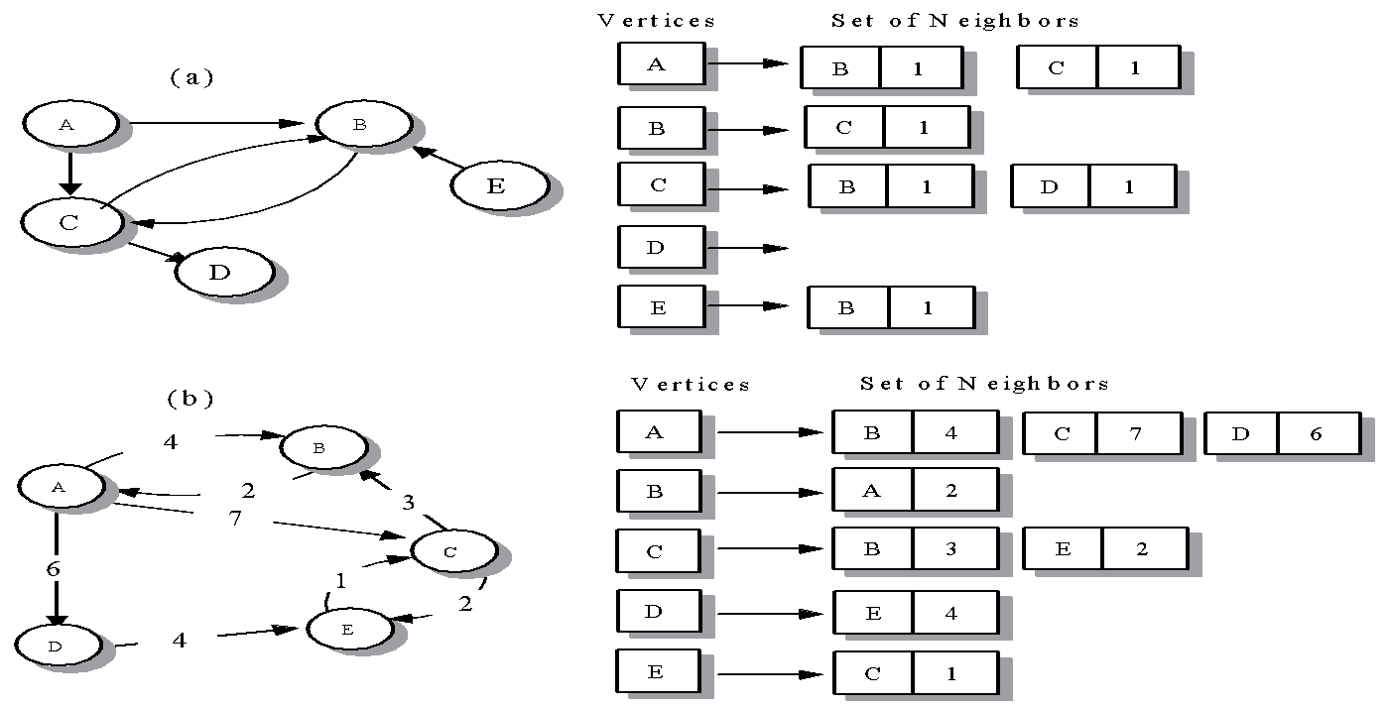
Adjacency Set
For each vertex, an element in the adjacent set is a pair consisting of the adjacent vertex and the weight of the edge.
‹#›

Slide 12
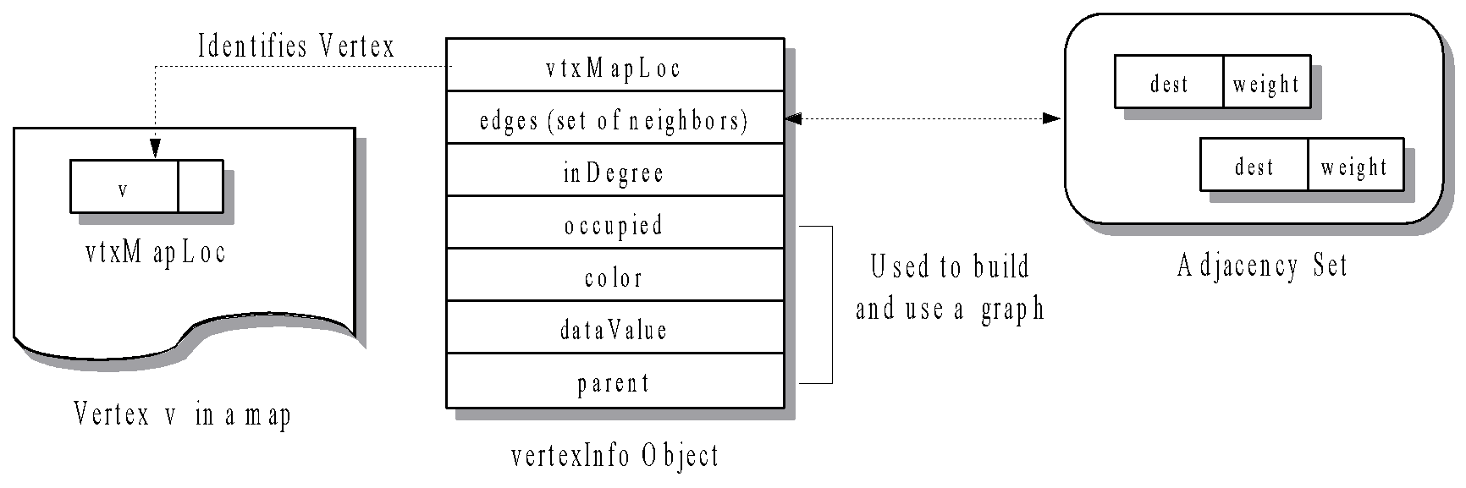
vertexInfo Object
A vertexInfo object consists of seven data members. The first two members, called vtxMapLoc and edges, identify the vertex in the map and its adjacency set.
‹#›

Slide 13
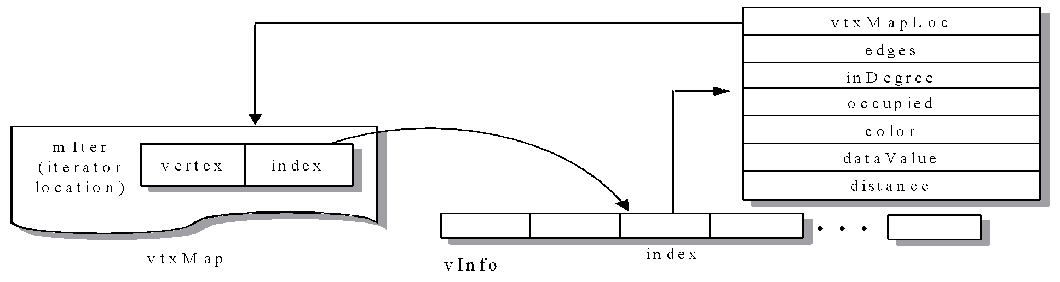
Vertex Map and Vector vInfo
To store the vertices in a graph, we provide a map<T,int> container, called vtxMap, where a vertex name is the key of type T. The int field of a map object is an index into a vector of vertexInfo objects, called vInfo. The size of the vector is initially the number of vertices in the graph, and there is a 1-1 correspondence between an entry in the map and a vertexInfo entry in the vector
‹#›

Slide 14
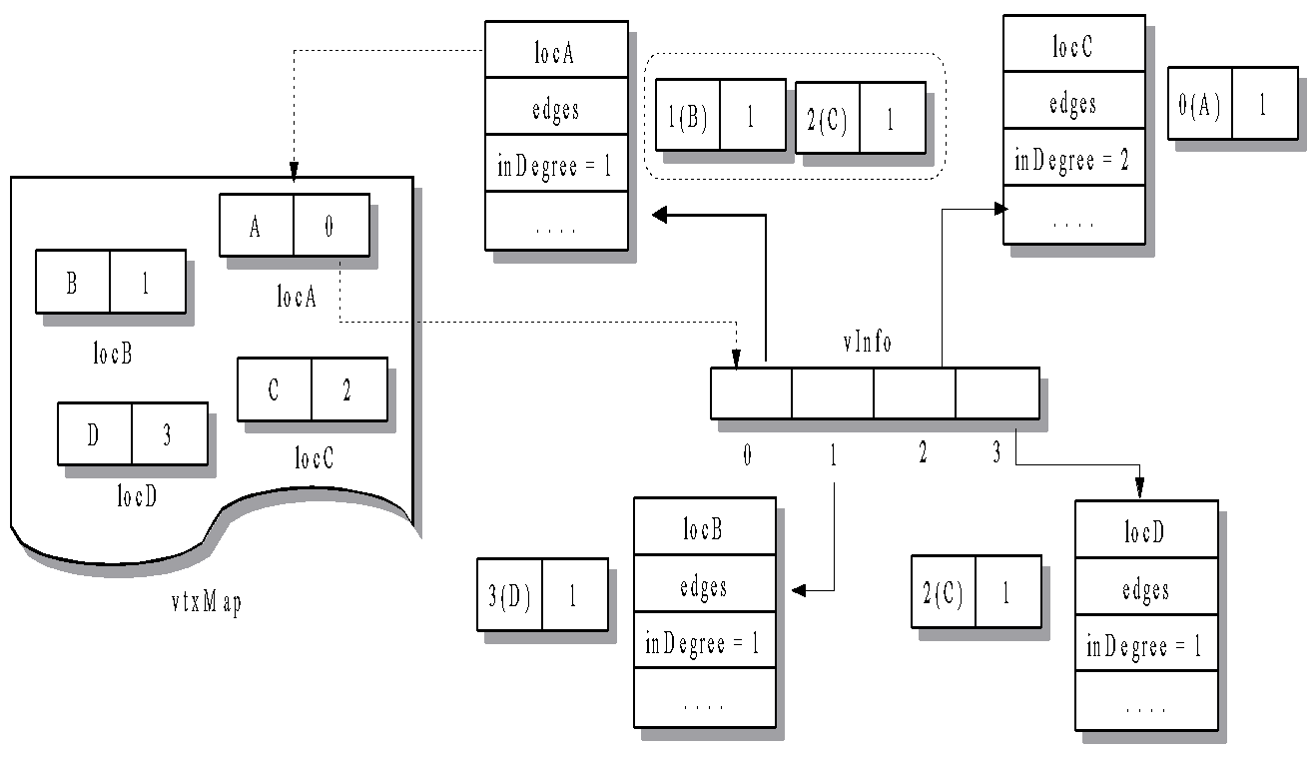
VtxMap and Vinfo Example
‹#›

Slide 15
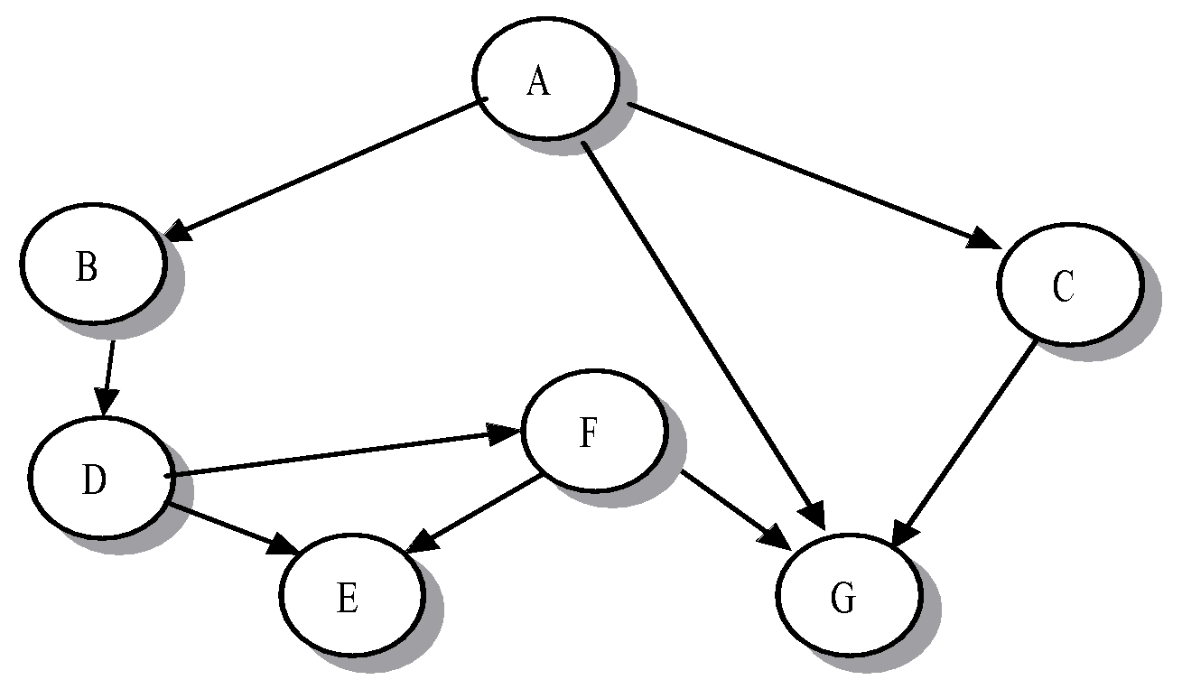
Graph Traversal Algorithms
Breadth-First Visit (Search): visits vertices in the order of their path length from a starting vertex. (generalizes the level-order scan in a binary tree)
Depth-First Visit (Search): traverses vertices of a graph by making a series of recursive function calls that follow paths through the graph. (emulate the postorder scan in a binary tree)
Finish all my neighbors before me
BFS: A,B,C,G,D,E,F
DFS (reverse order of processing): A,C,B,D,F,G,E
‹#›

Slide 16
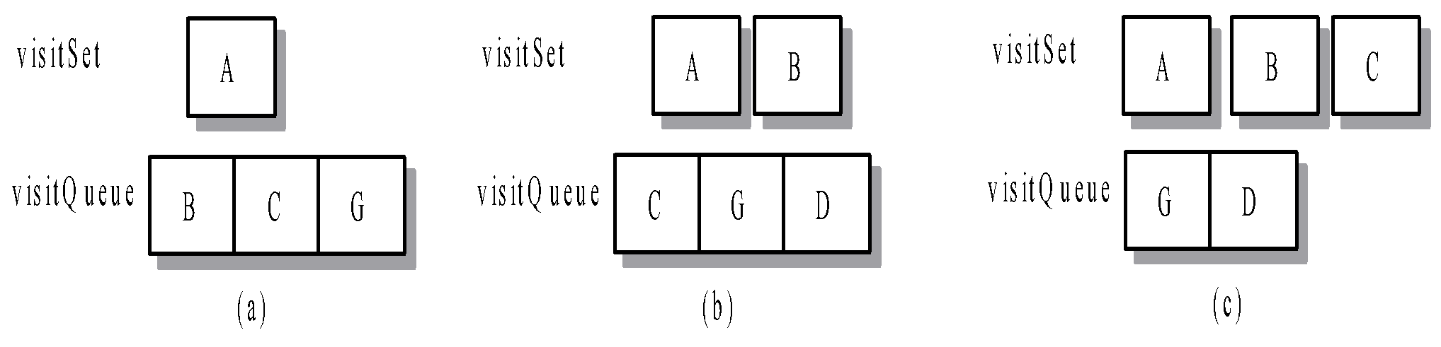

Breadth-First Search Algorithm
‹#›

Slide 17
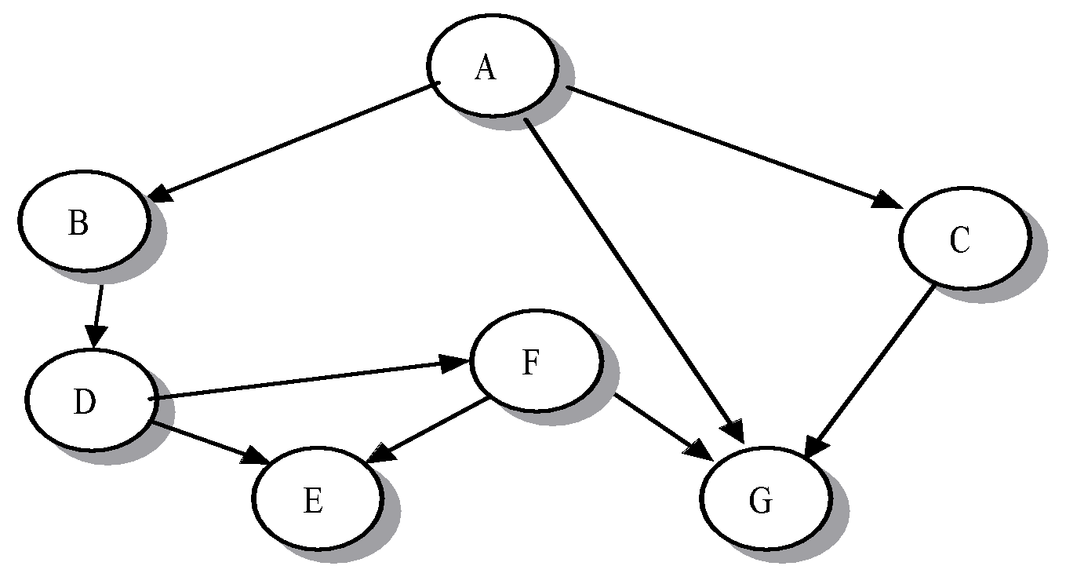
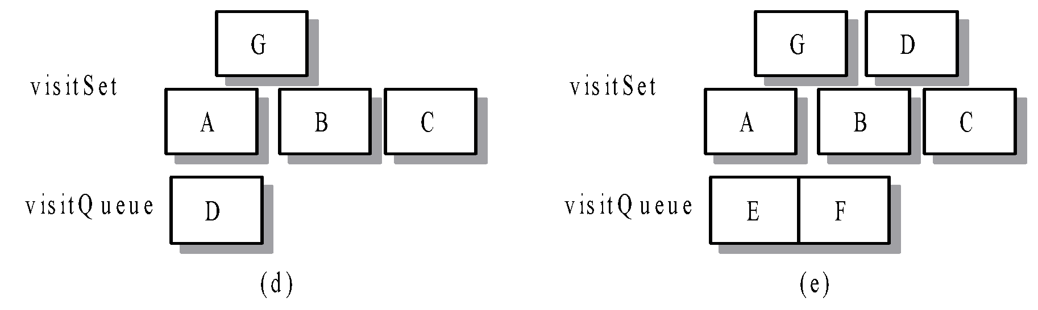
Breadth-First Search… (Cont.)
‹#›

Slide 18
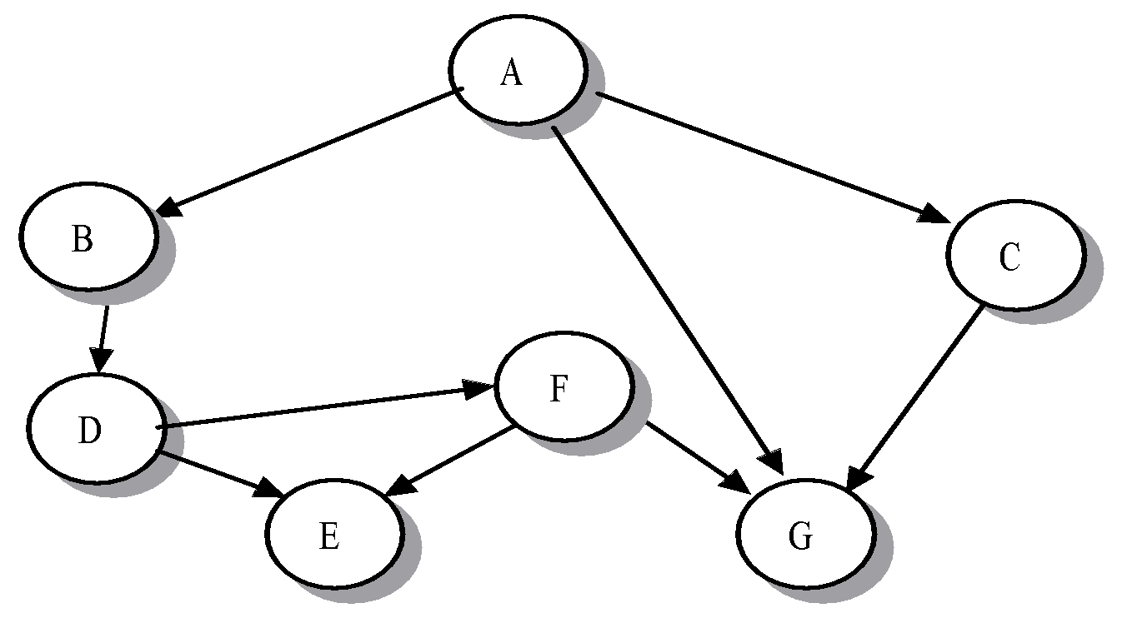
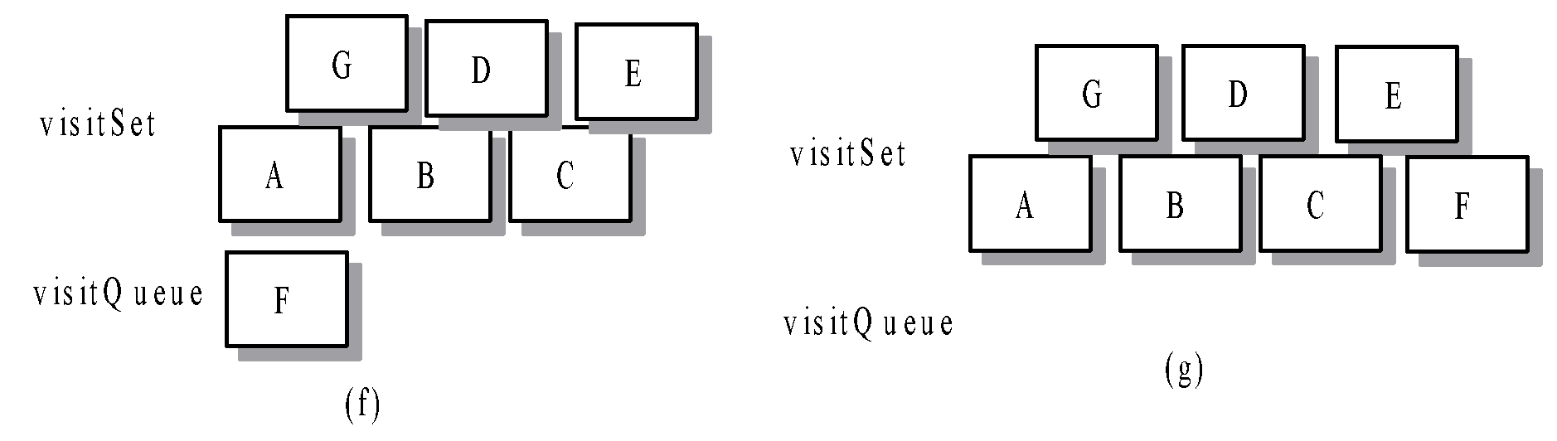
Breadth-First Search… (Cont.)
‹#›

Slide 19
Implementation of BFS algorithm
uses a queue to store the vertices awaiting a visit temporally.
At each iterative step, the algorithm deletes a vertex from the queue, mark it as visited, and then inserts it into visitSet, the set of visited vertices.
The step concludes by placing all unvisited neighbors of the vertex in the queue.
Each vertex is associate a color from WHITE, GRAY, BLACK.
Unvisited: (Initially) WHITE
In the process of being searched: (enter into queue) GRAY
Visited: (remove from queue) BLACK
Time complexity: O(|V|)+O(|E|)
‹#›

Slide 20
Depth-First Search Algorithm
Discovery order: A, B, D, E, F, G, C
Finishing order: E, G, F, D, B, C, A
‹#›

Slide 21
Depth-First Search… (Cont.)
A
B
C
E
D
F
G
Discovery order & finishing order?
‹#›

Slide 22
Implementing the DFS
dfsVisit()
Includes four arguments: a graph, a WHITE starting vertex, the list of visited vertices in reverse order of finishing times, and Boolean variable for checking cycle
Search only vertices that are reachable from the starting vertex
dfs()
Takes two arguments: a graph and a list
Repeatedly call dfsVisit()
Time complexity: O(|V|)+O(|E|)
dfsList: descending/reverse order of their visit (finish-time) order
‹#›

Slide 23
Graph Traversal Applications
Acyclic graphs
Topological sort
Strongly connected component
‹#›

Slide 24
Acyclic graphs
A graph is acyclic if it contains no cycles
Function acyclic() determine if the graph is acyclic
Back edge (v,w): current vertex v and a neighbor vertex w with color gray
‹#›

Slide 25
Topological sort
Topological order: if P(v,w) is a path from v to w, then v must occur before w in the list.
If graph is acyclic, defList produce a topological sort of the vertices
Implementation, performance, & applications
‹#›

Slide 26
Strong Components
A strongly connected component of a graph G is a maximal set of vertices SC in G that are mutually accessible.
A
C
Components
B
A, B, C
E
D, F, G
D
E
F
G
‹#›

Slide 27
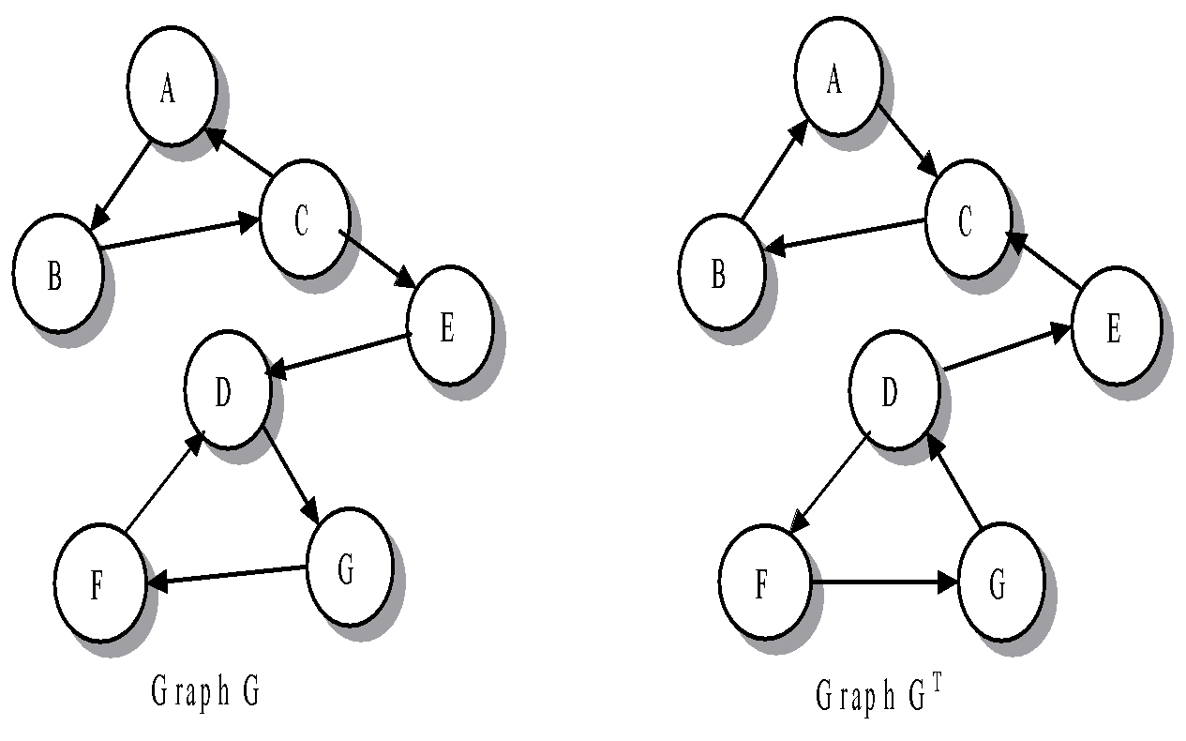
Graph G and Its Transpose G^{T}
The transpose has the same set of vertices V as graph G but a new edge set E^{T} consisting of the edges of G but with the opposite direction.
‹#›

Slide 28
Finding Strong Components
Algorithm
Step 1. Execute dfs() for graph
Step 2. Generate the transpose graph, G^{T}
Step 3. Execute a series of dfsVisit( ) calls for vertices using the order of the elements in dfsList obtained in step 1 as the starting vertices.
‹#›

Slide 29
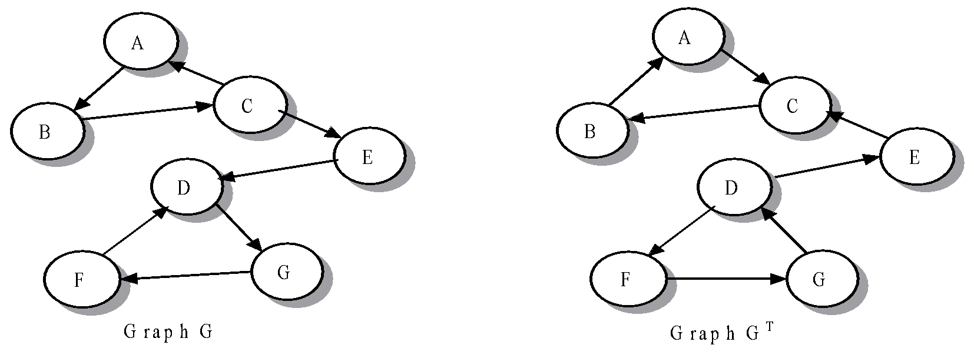
Finding Strong Components
Example, Verification, Implementation, performance
‹#›

Slide 30
Summary Slide 1
§- Undirected and Directed Graph (digraph)
- Both types of graphs can be either weighted or nonweighted.
‹#›
‹#›

Slide 31
Summary Slide 2
§- Breadth-First, bfs()
- locates all vertices reachable from a starting vertex
- can be used to find the minimum distance from a starting vertex to an ending vertex in a graph.
‹#›
‹#›

Slide 32
Summary Slide 3
§- Depth-First search, dfs()
- produces a list of all graph vertices in the reverse order of their finishing times.
- supported by a recursive depth-first visit function, dfsVisit()
- an algorithm can check to see whether a graph is acyclic (has no cycles) and can perform a topological sort of a directed acyclic graph (DAG)
- forms the basis for an efficient algorithm that finds the strong components of a graph
‹#›
‹#›

