Slide 1
Graph minimizations
Short paths and spanning trees

Slide 2
Outline
  Shortest-Path
  Dijkstra Minimum-Path Algorithm
  Minimum Spanning Tree
  Prim’s algorithm
  Kruskal’s algorithm

Slide 3
Graph-Minimization Algorithms
Shortest-Path Algorithm
Dijkstra’s Minimum-Path Algorithm
Minimum-Spanning Tree Algorithms

Slide 4
Shortest-Path algorithm
Find a shortest path (minimum number of edges) from a given vertex v_{s} to every other vertex in a directed graph
The shortest-path algorithm includes a queue that indirectly stores the vertices, using the corresponding vInfo index.
Each iterative step removes a vertex from the queue and searches its adjacency set to locate all of the unvisited neighbors and add them to the queue.

Slide 5
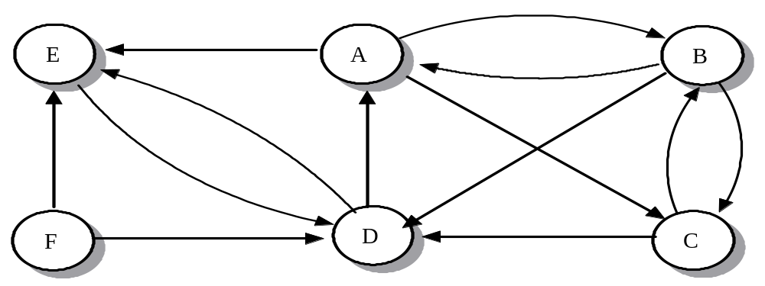
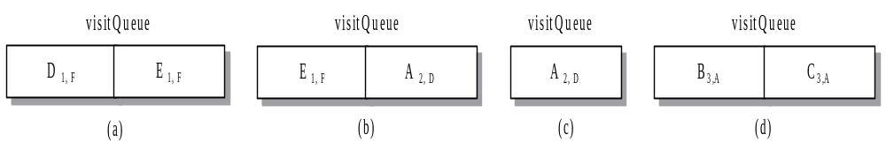
Shortest-Path Example
Example: Find the shortest path from F to C.
Notes:
Book 987-988
Note shortP1-3

Slide 6
Shortest-Path algorithm
Implementation
Performance
  Similar to BFS search, O(|V|+|E|)
Notes:
Note shortP1-3

Slide 7
Dijkstra Minimum-Path Algorithm
Find the minimum weight (minimum sum of edge weight) from a given vertex to every other vertex in a weighted directed graph
Use a minimum priority queue to store the vertices, using minInfo class, which contains a vInfo index and the pathWeight value
At each iterative step, the priority queque identifies a new vertex whose pathWeight value is the minimum path weight from the starting vertex

Slide 8
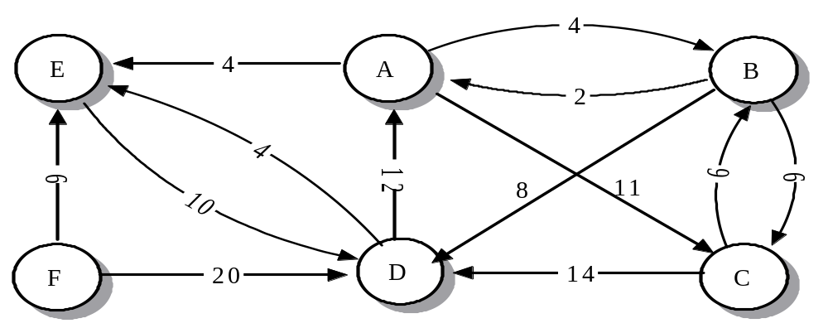
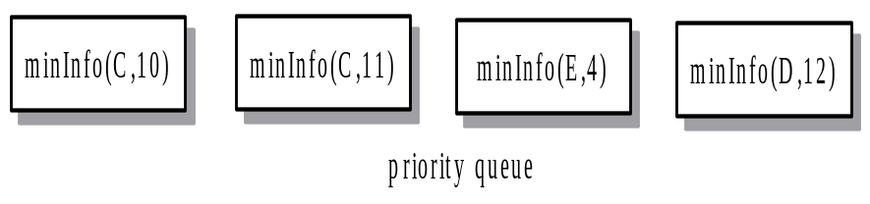
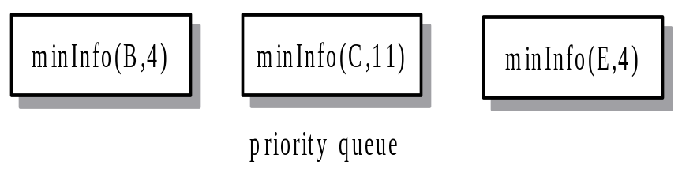
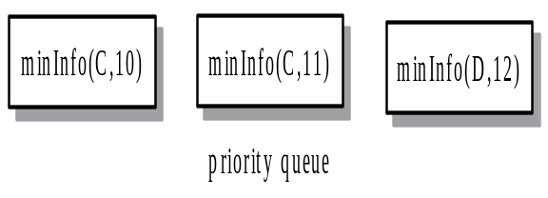
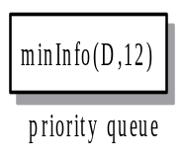
Dijkstra Minimum-Path Algorithm From A to D Example
minInfo(
A
,0)
priority queue

Slide 9
Dijkstra Minimum-Path Algorithm
The Dijkastra algorithm is a greedy algorithm
  at each step, make the best choice available.
  Usually, greedy algorithms produce locally optimum results, but not globally optimal
  Dijkstra algorithm produces a globally optimum result
Implementation
Running-Time Analysis
  O(|V|+|E|log|E|)

Slide 10
Minimum Spanning Tree Algorithms
Minimum Spanning Tree (For Undirected Graph)
  Tree: a connected graph with no cycles.
  Spanning Tree: a tree which contains all vertices in G.
    Note: Connected graph with n vertices and exactly n – 1 edges is Spanning Tree.
  Minimum Spanning Tree: a spanning Tree with minimum total weight

Slide 11
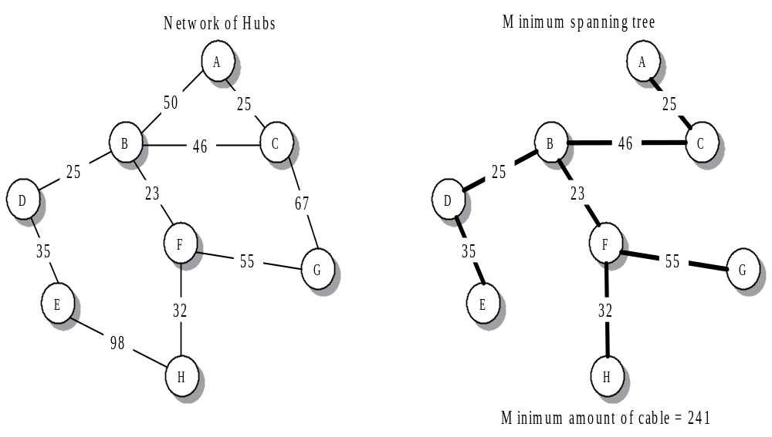
Minimum Spanning Tree Example

Slide 12
Prim’s Algorithm
Basic idea: Start from vertex u and let T ← Ø (T will contain all edges in the S.T.); the next edge to be included in T is the minimum cost edge(u, v), s.t. u is currently in the tree T and v is not in T.

Slide 13
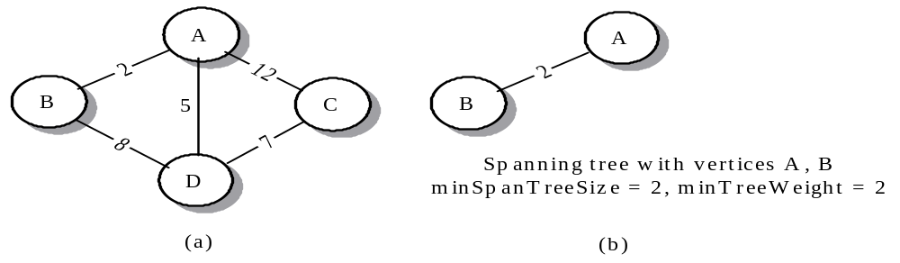
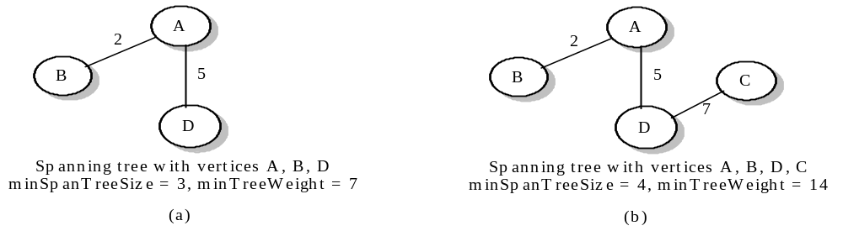
Prim’s Algorithm example

Slide 14
Implementation of Prim’s algorithm:
Using a priority queque of miniInfo objects to store information
  Color: White not in tree, Black in tree
  Data Value: the weight of the minimum edge that would connect the vertex to an existing vertex in tree
  parent
Each iterative steps similar to Dijkstra algorithm

Slide 15
Prim’s Minimum Spanning-Tree Algorithm example:
A
12
2
B
5
C
8
7
D
(a)
Notes:
Book: 1001-1002, step 1-step 4

Slide 16
Prim’s Minimum Spanning Tree Algorithm
Implementation
Running-Time Analysis
  O(|V|+|E|log|E|)

Slide 17
Kruskal’s Algorithm
Basic idea: Don’t care if T is a tree or not in the intermediate stage, as long as the including of a new edge will not create a cycle, we include the minimum cost edge
Example:
Step 1: Sort all of edges
(1,2) 10 √
(3,6) 15 √
(4,6) 20 √
(2,6) 25 √
(1,4) 30 × reject create cycle
(3,5) 35 √
10
30
1
2
50
25
4
45
3
40
20
35
6
5
55
15

Slide 18
Step 2: T
1
2
1
2
3
6
1
2
3
6
4
1
2
3
6
4
1
2
3
6
4
5

Slide 19
How to check: adding an edge will create a cycle or not?
If Maintain a set for each group
(initially each node represents a set)
Ex: set1 set2 set3
∴ new edge
from different groups ⇒ no cycle created
Data structure to store sets so that:
    The group number can be easily found, and
    Two sets can be easily merged
1
2
3
6
4
5
2
6

Slide 20
Kruskal’s algorithm
While (T contains fewer than n-1 edges) and (E ≠ ∅ ) do
Begin
Choose an edge (v,w) from E of lowest cost;
Delete (v,w) from E;
If (v,w) does not create a cycle in T
then add (v,w) to T
else discard (v,w);
End;
Time complexity: O(|V|+|E|log|E|)

Slide 21
Summary Slide 1
§- Dijkstra's algorithm
- if weights, uses a priority queue to determine a path from a starting to an ending vertex, of minimum weight
- This idea can be extended to Prim's algorithm, which computes the minimum spanning tree in an undirected, connected graph.

Slide 22
Summary Slide 2
§- Minimum Spanning Tree algorithm
- Prim’s algorithm
- Kruskal’s Algorithm

