Slide 1
Wireless Networks
Daniel Weitman
William Wolf

Slide 2
What is a Wireless Network?
Computers and devices are connected to a network through wireless communication
The connection is sent by radio frequency which is common among telecommunication
The protocols for the wireless network are defined by the institute of electrical and electronics engineers (IEEE)
The code defined for this protocol is 802.11 which encompases the family of wireless local area networks

Slide 3
History of Wireless Networks
WIFI was invented in 1997 after the IEEE created the guidelines of 802.11
Wireless networks and devices uses specific radio frequency to send information
Over time since 1997 there have been a variety of updates to the 802.11 which allow for more reliable and higher speed network connection
The future of technology is advancing to meet the demands of population which requires a more reliable data transfer
The most current reliable network includes 5G which is the 5th generation of updating speeds, range, and attempting to become universal

Slide 4
Types of Wireless Networks
(WWAN) - Wireless Wide Area Network
Used for linking hosts over large regions
Large network of cell-towers act as a hub for network traffic, receiving and transmitting data
ex) AT&T Cell network
(WMAN) - Wireless Metropolitan Area Network
Several mile network radius applying infrared light/radio waves
Helps with connect cities and large campuses
ex) 3G, 4G, LTE wireless connectivity

Slide 5
Types of Wireless Networks
(WLAN) - Wireless Local Area Network
Used for small scale network communication across nearby hosts
Commonly used in homes, small businesses, and offices
ex) A home router communicating with all devices connected to it
(WPAN) - Wireless Personal Area Network
Used to directly link a set of proximal host devices
Connects to other WPAN enabled personal devices without going through a hub
ex) Wireless bluetooth headphones to a phone

Slide 6
Wireless Network Protocols - IEEE 802.15 (Bluetooth)
Wireless interconnection of devices directly through a very short range wireless connection
Able to directly link WPAN enabled devices to one another
Benefits:
Reduces cost of having to connect all devices through wires
Minimal amount of interference from other devices when connected
Allows for a personal network without data going through a wireless access point
Examples:
Speakers
Keyboards & Mouse
Headphones
Phones

Slide 7
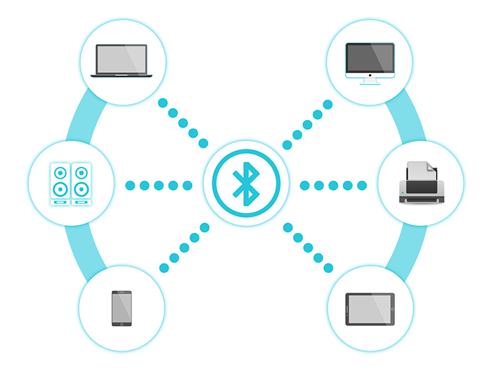
Bluetooth

Slide 8
Wireless Network Protocols - IEEE 802.16 (WiMAX)
Wireless Interoperability for Microwave Access
A base station connects all WiMAX compatible devices within a several mile radius
Each WiMAX device must have a receiver in order to get data from the network
Benefits:
Connects large areas where a wired infrastructure would be too expensive or impractical
Interoperability between WiMAX certified devices facilitates communication
Provides broadband access to the network
Examples:
3G
4G LTE

Slide 9
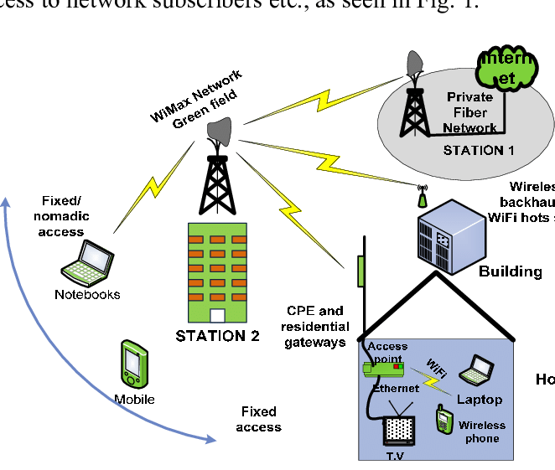
WiMAX

Slide 10
Wireless Network Protocols - IEEE 802.11 (WiFi)
Allows devices to connect wirelessly to a network
The most commonly used set of wireless protocols
Carrier-Sense Multiple Access w Collision Avoidance (CSMA/CA)
Employs half-duplex signaling
Benefits:
Reduces cost of having to connect all devices with physical wires such as ethernet
Extends the range where people can access the internet and communicate with other devices
Easy to add new devices and users to the network
Examples:
Laptop
Gaming console
Wireless phones

Slide 11
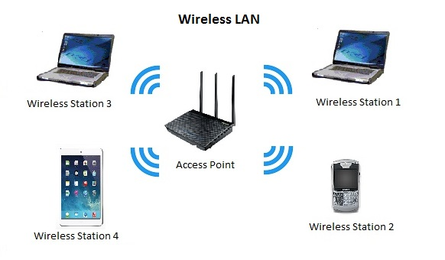
WiFi

Slide 12
Wireless Performance
Wireless networks usually have a smaller bandwidth compared to wired and thus a worse upstream and downstream
WiFi commonly use a standard of 2.4 or 5 GHz depending on the function of the network and goes as high as 60 GHz
Wireless networks suffer from a lot of consistencies depending on weather conditions, nearby structures, and electronic interference

Slide 13
Problems with Wireless Networks
Connection Quality
Radio-waves can receive a lot of interference from external factors such as weather conditions and other devices
Health Concerns
Humans living within a wireless network’s radius are constantly exposed to electromagnetic radiation
Increasing Users
Adding just a few users can dramatically influence the performance of a wireless network
Data Security
Since data within a wireless network is broadcasted throughout the entire network, it is susceptible to data leaks

Slide 14
CSMA/CA vs CSMA/CD
Collision Avoidance
Takes effect before the collision occurs
Attempt to reduce the amount of collisions that occur
Common in wireless networks
Collision Detection
Only takes effect after the collision has been detected
Attempt to minimize the recovery time after the collision
Common in wired networks

Slide 15
Implementation
Socket programming implementation with C language
The packet is created by the client and theGn sent to the server through a wireless connection
The server will then return a message to the client which acknowledges the packet was received by the server
The packets are sent using the TCP/IP protocol which directly relates to wireless connection

Slide 16
References
https://corecabling.com/common-wireless-network-issues/
https://www.tutorialspoint.com/wimax/wimax_quick_guide.htm
https://www.maketecheasier.com/how-does-bluetooth-work/
https://en.wikipedia.org/wiki/Wireless_network
https://computer.howstuffworks.com/wireless-network.htm
https://hpbn.co/introduction-to-wireless-networks/

