Slide 1
Endangered Species Database
Michael Mandulak, Ian Thomas, Billy Wolf,
Hannah Wichrowski, Daniel Weitman

Slide 2
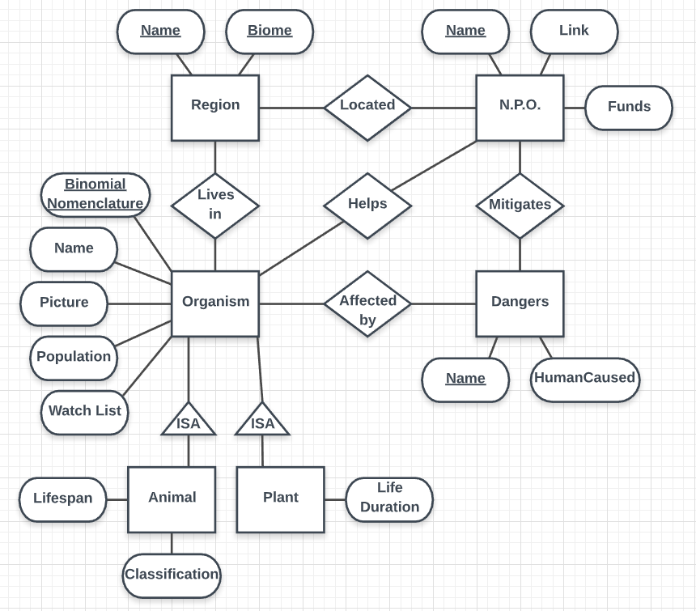
E/R Diagram

Slide 3
ER Diagram Changes
Added Picture as attribute to Organisms
Biome and Name a primary key of Region
Object-Oriented Approach to ER Approach for subclasses

Slide 4
Technologies Used
Server-Side
SQL
PHP
Client-Side
HTML, CSS, JS
jQuery
AJAX (both server/client side)

Slide 5
PHP
Build SQL queries for all of the database operations
Log-in handling
AJAX, Javascript with PHP for most of the website’s functionality

Slide 6
Security
Hashing used for administrator passwords
Database modifications can only be made by administrators
Direct link prevention for administrative pages

Slide 7
AJAX
Asynchronous JavaScript And XML
Uses JSON rather than XML
Used for admin functionality (modifying database records)

Slide 8
jQuery
Simple interface for interacting with document elements
Used in more interactive pages
Useful AJAX API

Slide 9
User Interface
No CSS Frameworks used
Minimal styling library used for admin panel
Most pages are fully responsive (mobile friendly)

Slide 10
Demo
http://acadweb1.salisbury.edu/~mmandulak1/ESD/index.php

