Slide 1

HPCL User Management System
& Website Development
Team However Part 2 Section A/B:
Grace Burton, Daniel Weitman, Billy Wolf, Alex English, Ian Thomas, Michael Mandulak

Slide 2
Goals of User Management System
& Website (overall)
Interface with & authenticate via LDAP directory database
Password recovery via email
Responsive UI (password reset via cell phone)
Ticketing system (via Trello integration)
Blog/announcement front page
Knowledge base

Slide 3
Goals of User Management System
& Website (Spring 2020 semester)
Create skeleton for user management system
Initial implementation and testing
Begin implementation of authentication system
Create skeleton for CMS
User interface design around “blog aesthetic” - article based
Begin implementation of ticketing system
Complete a working database

Slide 4
Timeline (User Management Application)
Create user authentication layer within LDAP, set up testing framework and mock API (start implementation).
Finish implementation, refine design for next semester. Have “skeleton” app done for the end of the semester.
March
May
February
April
Continue implementation and testing, ensuring a working “skeleton” application is present at most phases.
Finish setting up Docker client and attaching software needed to server. Run LDAP server and test through Ubuntu Docker image.

Slide 5
Implement Feature
Ascertain a needed feature in the CMS and create a working model with the new feature
Refine Feature
Make any necessary changes to the newly implemented feature and evaluate
Content Management System (CMS) “Timeline”
Test Feature
Check for feature functionality and effectiveness in the working model

Slide 6
Team Structure
Team leaders: Grace Burton, Alex English
Client: Richard Quackenbush
Meeting times with client: Monday and Wednesday 2-3 pm
Minute taker: Daniel Weitman
HCPL User Management System Team: Ian Thomas, Michael Mandulak, Alex English
Content Management System Team: Grace Burton, Daniel Weitman, Billy Wolf
Scrum Leader: Michael Mandulak
Github Master: Alex English

Slide 7
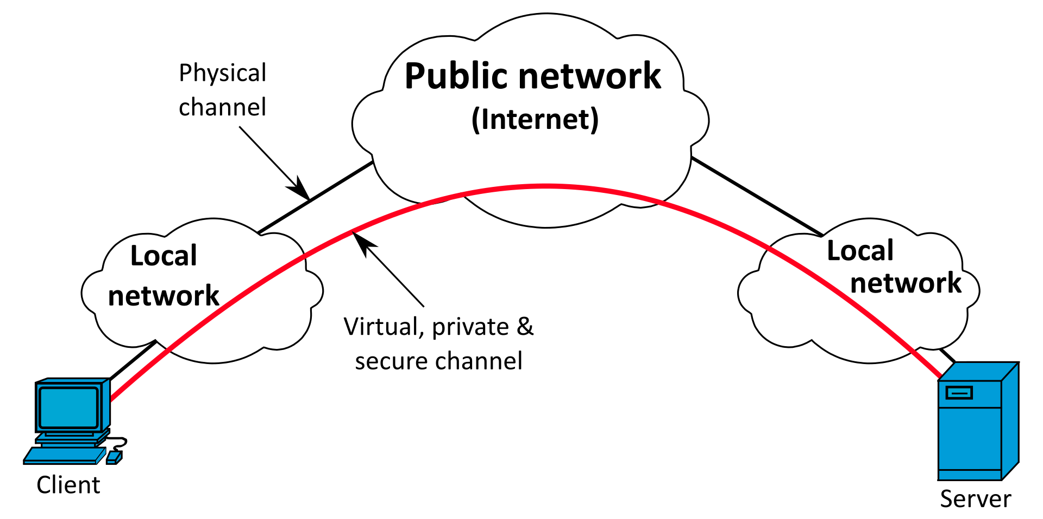
Docker
Docker creates a virtual network interface card “NIC” (which is basically a VPN).
Extends a private network across a public
network, and enables users to send and receive data across shared or public
networks as if their computing devices were directly connected to the private
network.

Slide 8
LDAP (Lightweight Directory Access Protocol)
Performs operations like:
Storing and retrieving data
Search for data within a limit
Authenticating clients (most useful to this project)
Secure protocol that deals with sensitive information such as passwords, 2fa
Lightweight protocol that uses efficient methods to encode and decode which makes it more lightweight compared to other modern protocols

Slide 9
References
https://dzone.com/articles/top-10-benefits-of-using-docker
https://docker-curriculum.com/
https://ldap.com/why-choose-ldap/

