Slide 1

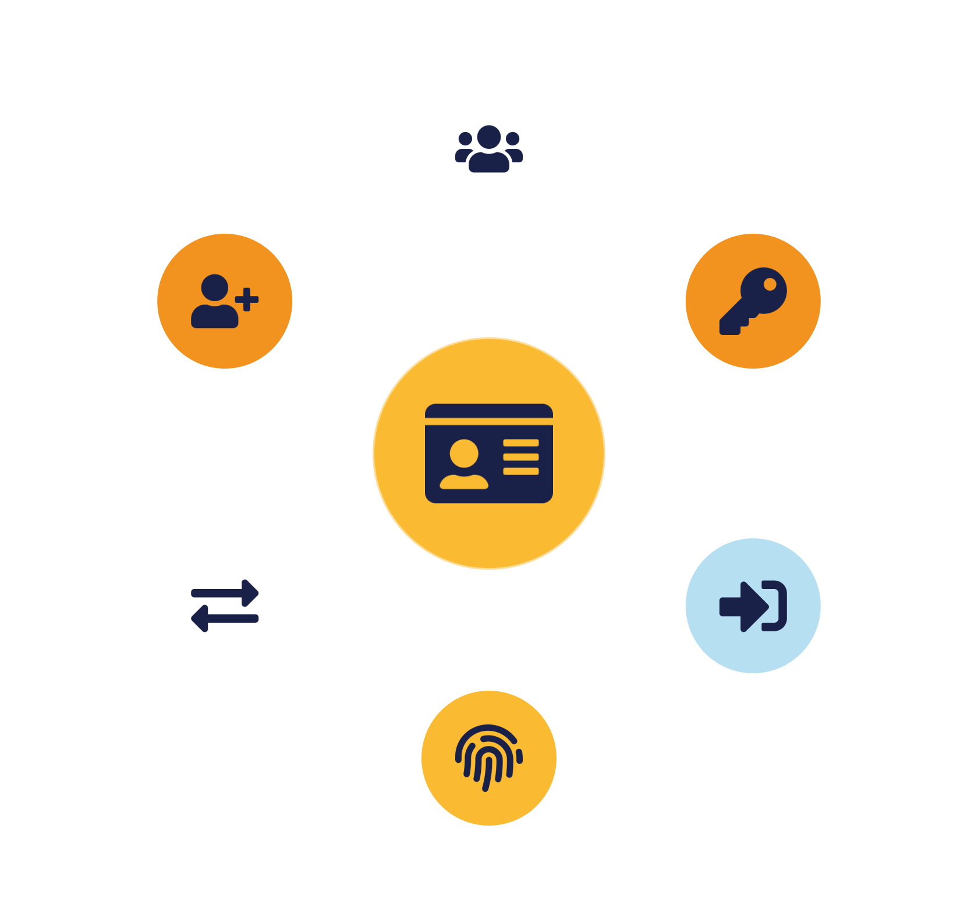
IKB42603 • Cloud Security
WEEK 7 · LESSON 7
Introduction to Identity Management in Cloud Computing
Identity lifecycle · Provisioning · Single sign-on · Federation
Universiti Kuala Lumpur · UniKL MIIT | Prof. Dr. Shahrulniza Musa

Slide 2

LEARNING OUTCOMES
What you will be able to do
1. Explain identity management
2. Manage provisioning & deprovisioning
The identity lifecycle and its building blocks.
Creating and removing identities safely.
3. Describe single sign-on (SSO)
4. Explain identity federation
One login across many services.
Trust across organisational boundaries.
5. Compare federation protocols
6. Recognise identity threats & PAM
SAML, OAuth 2.0 and OpenID Connect.
Protecting privileged accounts.
IKB42603 Cloud Computing Security Essentials
1
Notes:
Welcome to Lesson 7. Last week's access control decided what identities may do; today we look at the identities themselves — how they are created, proven, connected across systems, and retired. In the cloud, identity is the perimeter, so managing it well is foundational. Walk the six outcomes. This maps to CLO2. Note it deepens the IAM material from Lessons 2 and 5 and sets up the federated-authentication design patterns in Lesson 9. Give the framing: identity management answers 'who is in our systems, and how do we keep that trustworthy at scale?'

Slide 3



CONSTRUCTIVE ALIGNMENT
Curriculum alignment — CLO · PLO · MQF · clusters
Construct secure cloud computing operations that safeguard data integrity.
CLO 2
Programme outcome
Values & skills
Assessment
PLO2 · Cognitive Skills
MQF Level iii(a)
Bloom P3 (Precision)
VBE3 · Integrity
SC8 · Problem-Solving
Lab Assignment (CLO2)
Constructive alignment: CLO → PLO → MQF, with VBE (values) and SC (skills) clusters, assessed as shown.
IKB42603 Cloud Computing Security Essentials
2
Notes:
Constructive-alignment slide for the external examiner and MQF accreditation. Lesson 7 maps to CLO2 — secure cloud operations safeguarding data integrity — aligned to PLO2, MQF Level iii(a), Bloom P3, with the VBE3 integrity value and SC8 problem-solving skill, assessed through the Lab Assignment. Identity management is a core operational control behind CLO2.

Slide 4
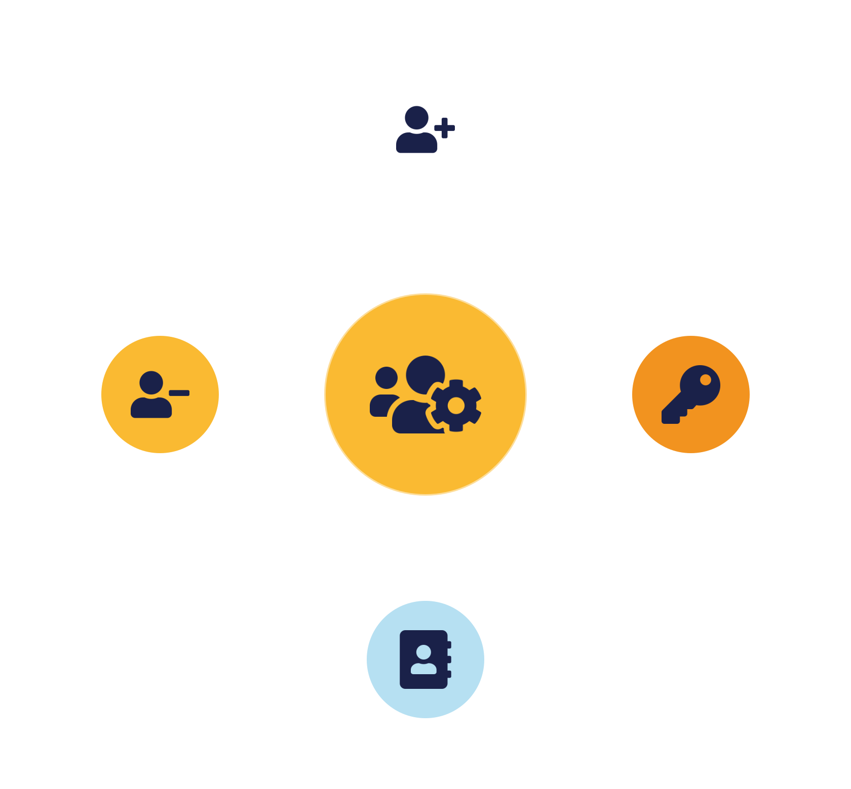
01
PART 1
Identity Management Foundations
Notes:
Establish what identity management is and its lifecycle. An identity is a digital representation of a user, service or device; managing it well over its whole life is what keeps authentication and access control trustworthy.

Slide 5

DEFINITION
What is identity management?
Creating, maintaining and retiring digital identities — and governing what they can access.
An identity = a user, service or device
Identity is the foundation of access.
Managed across its whole lifecycle
Machine identities now outnumber human ones — all must be managed across their whole life.
Stale identities are a top attack vector
IKB42603 Cloud Computing Security Essentials
3
Notes:
Define it: identity and access management, IAM, is the discipline of creating, maintaining and retiring digital identities and governing what they can access. An identity is a digital representation of a user, service or device — increasingly, machine identities outnumber human ones in the cloud. Stress the lifecycle framing on the slide: an identity is provisioned (created), managed (updated as roles change, credentials rotated), and eventually deprovisioned (removed when no longer needed). The security stakes: stale or orphaned identities are a top attack vector — the departed employee's account that was never disabled. Good identity management is therefore both a security control and an operational discipline, and it is the foundation the authentication and authorization from Lesson 5 stand on.

Slide 6





THE LIFECYCLE
The identity lifecycle
→
→
→
→
Provision
Authenticate
Authorize
Manage
Deprovision
Security lives in the whole loop: the biggest failures are over-privileged provisioning and forgotten deprovisioning.
IKB42603 Cloud Computing Security Essentials
4
Notes:
Walk the lifecycle as a flow. Provisioning creates the identity and grants initial access when someone joins or a service is deployed — ideally least-privilege from day one. Authentication proves the identity at each use (Lesson 5). Authorization governs what it may do. Management maintains it — updating roles as jobs change, rotating credentials, enforcing policy. Deprovisioning removes access promptly when the person leaves or the service is retired — the step most often neglected, leaving orphaned accounts. The teaching point: security depends on the WHOLE loop, not just the login. The most common identity failures are at the ends — over-privileged provisioning and forgotten deprovisioning. Automating this lifecycle, which we cover next, is how organisations keep it correct at scale.

Slide 7
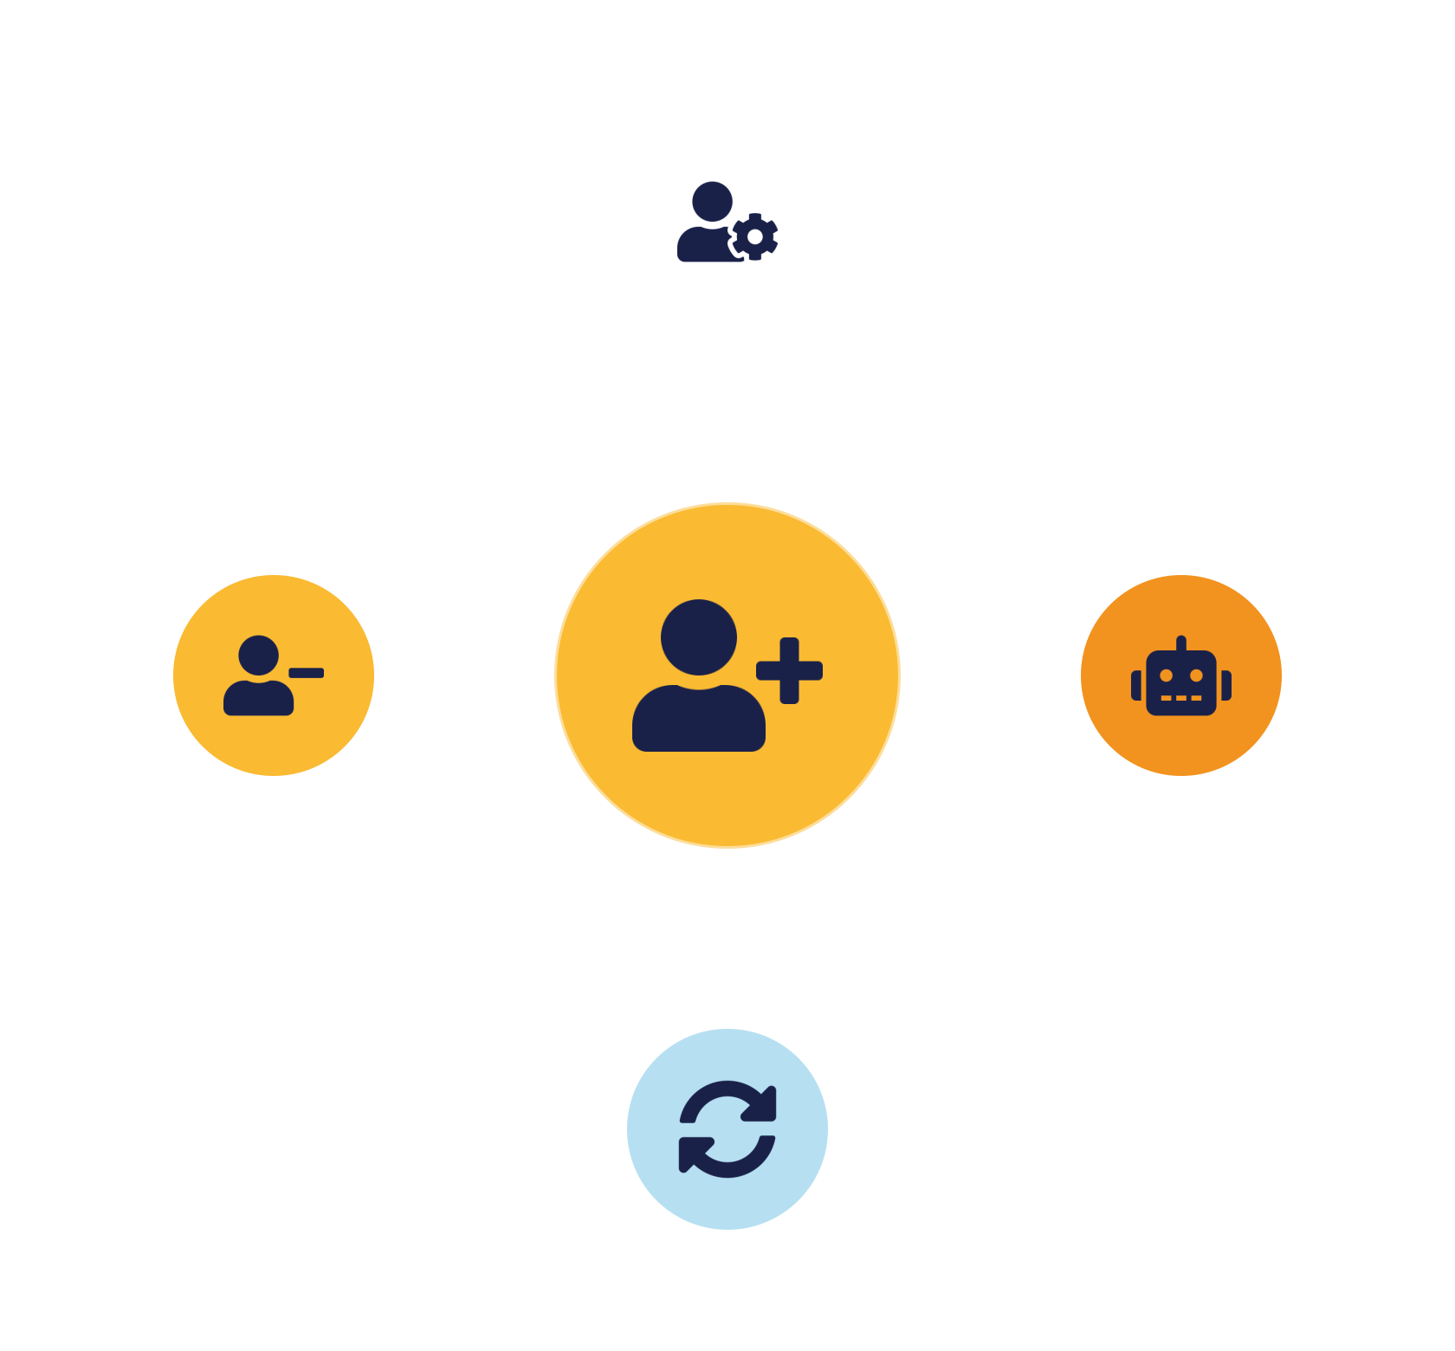
02
PART 2
Provisioning & Deprovisioning
Notes:
The bookends of the identity lifecycle, and where most identity risk lives. We cover how to create identities with the right access and — crucially — how to remove them cleanly, and how automation makes both reliable at scale.

Slide 8
CREATING & REMOVING
Provisioning & deprovisioning
Provisioning
Deprovisioning
Create the identity and grant initial access.
Remove access the moment it's no longer needed.
Least privilege from day one —
The most-neglected step — orphaned accounts
Role-appropriate access —
Revoke promptly & completely —
Triggered by joining / deployment —
Trigger on HR / project events —
IKB42603 Cloud Computing Security Essentials
5
Notes:
Provisioning is granting a new identity its accounts and access — the goal is least privilege from the start, giving only what the role needs, so you never have to claw back excess later. Deprovisioning is removing access when it is no longer needed — an employee leaves, a contractor's project ends, a service is decommissioned. Deprovisioning is the step organisations most often get wrong, and the cost is orphaned accounts: still-valid credentials with no owner, invisible and perfect for an attacker. Emphasise timeliness — access should be revoked the moment it is no longer needed, ideally automatically on an HR trigger. The pairing to remember: provision least-privilege, deprovision promptly and completely. Manual processes fail here at scale, which motivates automation on the next slide.

Slide 9



AT SCALE
Automated & just-in-time provisioning
Automated provisioning
Just-in-time access
Access reviews
Sync identities from HR/directory (SCIM) — join/move/leave flows automatically.
Grant access only when needed, for a limited time — no idle standing access.
Periodic recertification confirms access is still warranted.
Automation makes the lifecycle correct, timely and auditable — humans forget to deprovision.
IKB42603 Cloud Computing Security Essentials
6
Notes:
Manual identity management cannot keep up with cloud scale, so we automate it. Automated provisioning connects identity to authoritative sources — the HR system, a directory — so that joining, moving or leaving automatically creates, updates or removes access; the SCIM standard is the common protocol for syncing identities between systems. Just-in-time provisioning grants access only at the moment it is needed and for a limited time, rather than standing access that sits idle waiting to be abused — this shrinks the attack surface dramatically and enforces least privilege in time as well as scope. Add the governance layer: periodic access reviews (recertification) confirm that existing access is still warranted. The message: automation makes the lifecycle correct, timely and auditable — humans forget to deprovision; a well-designed system does not.

Slide 10
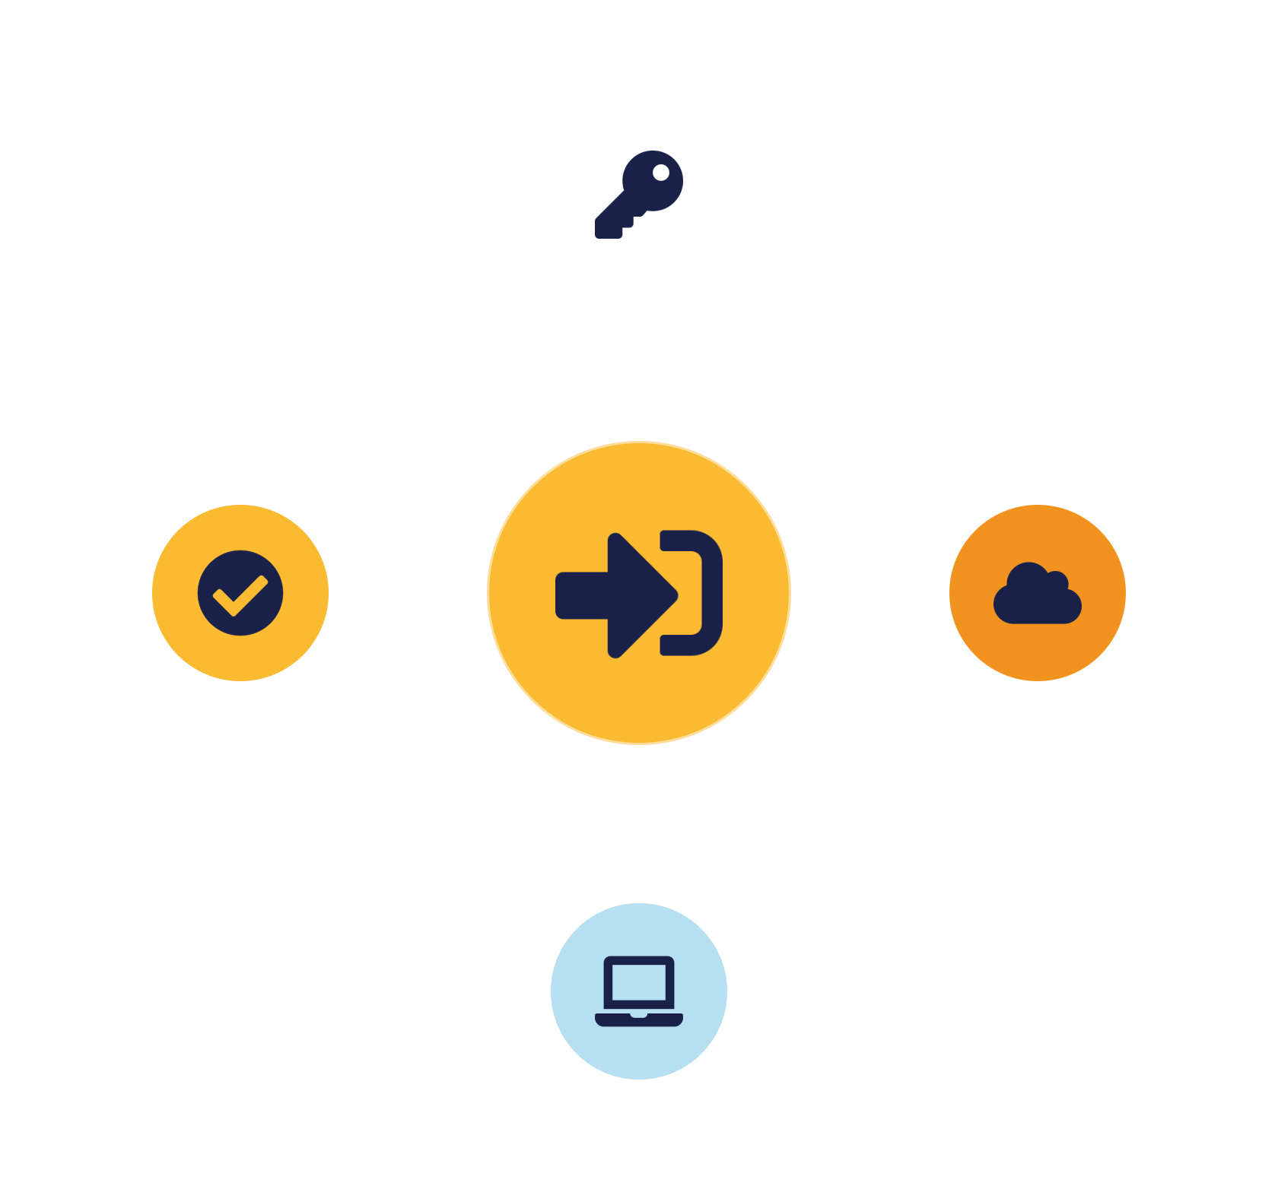
03
PART 3
Single Sign-On (SSO)
Notes:
One of the most valuable identity technologies: letting a user authenticate once and reach many services. It improves both security and usability — fewer passwords, one strong authentication to protect.

Slide 11



ONE LOGIN, MANY SERVICES
What is single sign-on?
Authenticate once, then reach many applications without logging in again.
Fewer passwords
One strong door
High-value target
Less reuse, fewer weak credentials.
Concentrate MFA on one login point.
Protect it well — its breach exposes many apps.
IKB42603 Cloud Computing Security Essentials
7
Notes:
Single sign-on lets a user authenticate once and then access many applications without logging in again. Explain the security case, which students sometimes doubt: fewer separate passwords means fewer weak and reused passwords, and one central authentication point is where you concentrate strong controls like MFA — you protect one strong door instead of twenty weak ones. The usability case is obvious — less friction, fewer password resets. The trade-off to acknowledge: that central point is also a high-value target, so it must be very well protected; if SSO is compromised, many services are exposed at once, which is exactly why MFA and monitoring on the identity provider are essential. Preview the mechanics next: SSO works by issuing a trusted token after the single authentication.

Slide 12


HOW IT WORKS
SSO token flow
→
→
→
1. Request app
2. Authenticate
3. Issue token
4. Access granted
User visits a service; redirected to the IdP.
IdP verifies identity once — password + MFA.
IdP issues a signed security token.
App trusts the token — no second login.
The token is signed and time-limited — trust in its signature (PKI) is what makes SSO work.
IKB42603 Cloud Computing Security Essentials
8
Notes:
Walk the flow on the slide so the mechanism is concrete. Step one: the user tries to reach an application (the service provider) and is redirected to the central identity provider. Step two: the identity provider authenticates the user — password plus MFA — once. Step three: it issues a signed security token asserting the user's identity. Step four: the application trusts that token (because it trusts the identity provider's signature) and grants access — no second login. For further apps, the existing session means the token is reissued silently. The key concepts: the identity provider is the single authenticator, the token is the portable proof, and trust in the token's signature is what makes it work. This same token-and-trust mechanism, extended across organisational boundaries, is federation — the next part. Note the token is time-limited and signed, connecting to PKI from Lesson 4.

Slide 13
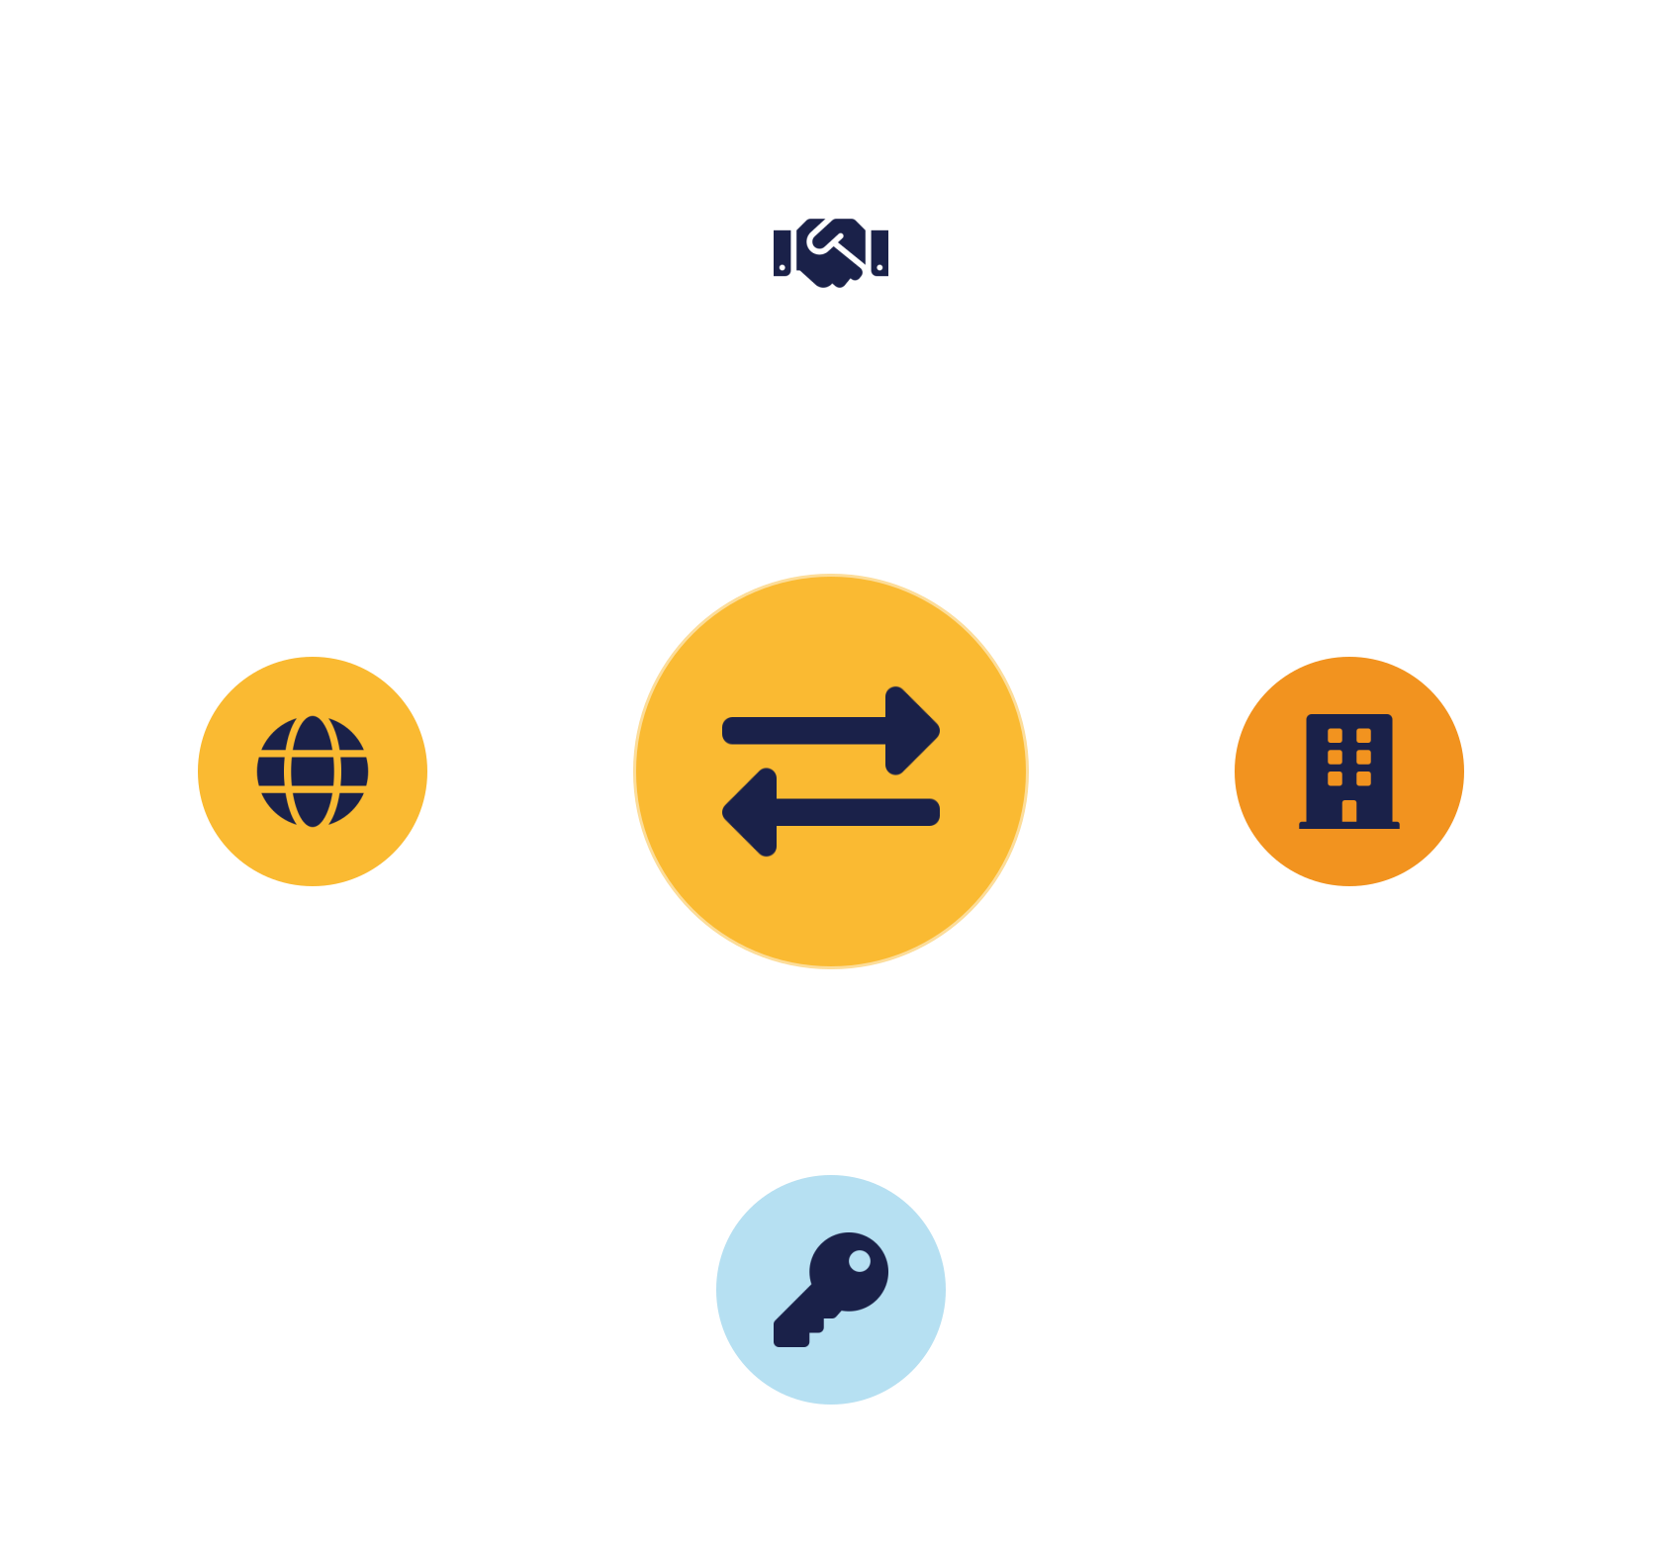
04
PART 4
Identity Federation
Notes:
Federation extends single sign-on across organisational boundaries — letting users from one trust domain access resources in another. It is how you log into a third-party service with your work or Google account.

Slide 14



TRUST ACROSS BOUNDARIES
What is identity federation?
One organisation trusts another's authentication — users' home identities work across the boundary.
Identity Provider (IdP)
Service Provider (SP)
Authenticates users and vouches for them.
Hosts the resource; trusts the IdP.
Your home domain — e.g. Google, corporate directory
The relying party — e.g. a SaaS app
Issues the assertion —
Trusts the assertion — via exchanged keys (PKI)
Central management & deprovision —
No separate account needed —
IKB42603 Cloud Computing Security Essentials
9
Notes:
Federation is an arrangement in which one organisation trusts another's authentication, so users authenticated in their home domain can access resources in a partner domain without a separate account. Two roles: the identity provider (IdP) authenticates users and vouches for them; the service provider (SP), or relying party, hosts the resource and trusts the IdP's assertion. Give the everyday example on the slide — logging into a third-party app 'with Google' or with your corporate account: Google is the IdP, the app is the SP. The benefit is huge in the cloud, where organisations use dozens of external SaaS services — federation means one home identity, centrally managed and deprovisioned, works everywhere, instead of dozens of separate accounts. The foundation is trust, established through exchanged cryptographic keys/certificates (PKI again). Protocols make this interoperable — next slide.

Slide 15
THE STANDARDS
Federation protocols — SAML, OAuth 2.0 & OIDC
SAML
OAuth 2.0
OpenID Connect
XML assertions — the established enterprise SSO standard. Authentication.
Delegated authorization — grant an app scoped access without your password.
Identity layer on OAuth 2.0 — modern web/mobile sign-in. Authentication.
Remember: SAML & OIDC authenticate (who you are); OAuth 2.0 authorizes (scoped access).
IKB42603 Cloud Computing Security Essentials
10
Notes:
Three protocols make federation interoperable, and students should know what each is for. SAML — Security Assertion Markup Language — is the established enterprise standard for SSO, exchanging XML assertions between IdP and SP; it is what most corporate and university SSO uses. OAuth 2.0 is an authorization framework — it lets a user grant an application limited access to their resources on another service without sharing their password (the 'allow this app to access your calendar' flow); note it is about delegated authorization, not authentication. OpenID Connect (OIDC) is an authentication layer built on top of OAuth 2.0 — it adds identity, issuing an ID token, and is the modern choice for web and mobile sign-in. The distinction to land: SAML and OIDC authenticate (prove who you are); OAuth 2.0 authorizes (grants scoped access). Modern cloud identity typically uses OIDC for login and OAuth for delegated access.

Slide 16
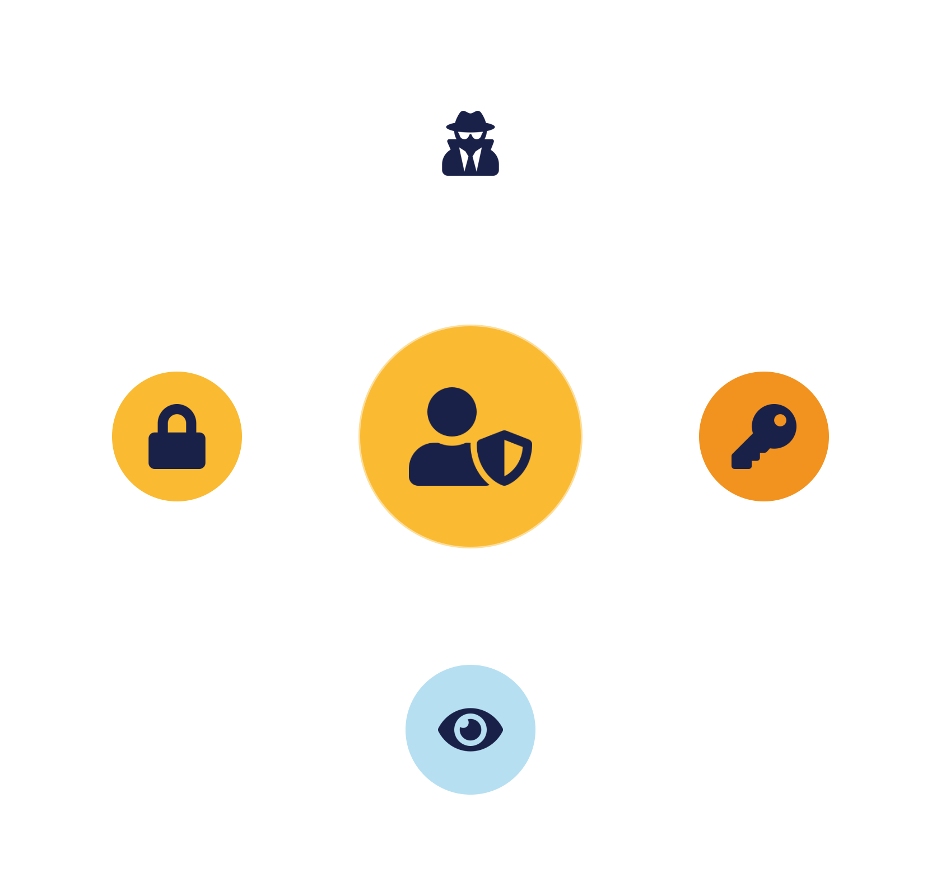
05
PART 5
Privileged Identity, Threats & Practice
Notes:
We finish with the highest-risk identities — privileged accounts — the threats identity systems face, and a case study applying the whole lesson.

Slide 17
THE CROWN JEWELS
Privileged access management (PAM) & identity threats
Privileged access mgmt
Identity threats
Extra controls for admin / root / service accounts.
Phishing & credential theft — MFA defeats most
Vault & rotate credentials —
Account takeover —
Just-in-time privilege — no standing admin
Privilege escalation — why least privilege matters
MFA, approval, session recording —
Orphaned / stale accounts —
IKB42603 Cloud Computing Security Essentials
11
Notes:
Not all identities are equal — privileged accounts (administrators, root, service accounts with broad rights) are the crown jewels, because compromising one hands over the environment. Privileged access management applies extra controls to them: vault and rotate their credentials, grant privilege just-in-time rather than standing, require MFA and approval, and record their sessions for audit. On the right, the threats identity systems face: phishing and credential theft (defeated by MFA), account takeover, privilege escalation (an attacker turning a normal account into an admin one — why least privilege matters), and orphaned or stale accounts (the forgotten deprovisioning from Part 2). The message: manage all identities well, but wrap your strongest controls around the privileged few — and monitor them closely, tying to Lesson 6. This directly enforces least privilege and separation of duties from Lesson 5.

Slide 18
APPLY IT
Case study — the forgotten account
An employee left months ago, but their broadly-privileged cloud account was never disabled. An attacker used the reused old credentials — no MFA, no one watching — to access company data.
What failed?
How to prevent?
No deprovisioning (orphaned account) · over-broad privilege · no MFA · no monitoring of dormant accounts.
Automate deprovisioning on HR triggers · least privilege · enforce MFA · monitor dormant-account use.
IKB42603 Cloud Computing Security Essentials
12
Notes:
Run as a think-pair-share. Scenario: an employee left the company months ago, but their cloud account was never disabled. It still had broad access. An attacker obtained the old credentials (reused on a breached site) and, with no MFA and no one watching a 'former employee' account, quietly used it to access company data. Ask the two questions. What failed? Deprovisioning was never done (orphaned account), the account had over-broad privilege, there was no MFA, and no monitoring flagged the dormant account waking up. How to prevent? Automate deprovisioning on HR triggers so leaving disables access immediately; apply least privilege; enforce MFA (which blocks reused credentials); and monitor for anomalous use of dormant accounts. The teaching point: this breach needed no clever hack — just a lifecycle gap. Identity management is security. Connect to shared responsibility — disabling the account was the customer's job. Let pairs report before consolidating.

Slide 19
BASELINE
Best practices — identity management
Automate the lifecycle
Enforce MFA + SSO
Reliable provisioning & deprovisioning.
Strong, concentrated authentication.
Least privilege & JIT
Protect privileged accounts
Minimal, time-boxed access.
PAM: vault, rotate, record.
Federate with standards
Review access regularly
SAML / OIDC, not scattered accounts.
Catch drift and orphans.
IKB42603 Cloud Computing Security Essentials
13
Notes:
Distil the lesson. Automate the identity lifecycle so provisioning and, critically, deprovisioning happen reliably. Enforce MFA and SSO to concentrate and strengthen authentication. Apply least privilege and just-in-time access so identities hold minimal, time-boxed rights. Protect privileged accounts with PAM. Federate with trusted partners using standard protocols rather than creating separate accounts everywhere. And review access regularly to catch drift and orphaned accounts. Tell students these map to CLO2. Preview: Lessons 8 and 9 assemble the controls from Lessons 3–7 into reusable security design patterns, starting with trusted platforms and VM protection.

Slide 20

RECAP
Key takeaways
1 Identity management governs the whole lifecycle — over-provisioning and forgotten deprovisioning are the top risks.
2 SSO gives one strong login across many services — protect that single door very well.
3 Federation extends trust across orgs via SAML, OAuth 2.0, OIDC — SAML/OIDC authenticate, OAuth authorizes.
4 Privileged accounts need the strongest controls (PAM); automation keeps identity correct at scale.
IKB42603 Cloud Computing Security Essentials
14
Notes:
Consolidate. One: identity management governs the whole identity lifecycle — the biggest risks are over-privileged provisioning and forgotten deprovisioning. Two: SSO gives one strong login across many services — protect that one door well. Three: federation extends trust across organisations via SAML, OAuth 2.0 and OIDC — SAML/OIDC authenticate, OAuth authorizes. Four: privileged accounts need the strongest controls (PAM), and automation keeps the whole system correct at scale. Ask students to name the lifecycle stages and which protocol authenticates vs authorizes. Preview Lesson 8: cloud security design patterns I.

Slide 21

Discussion & Q&A
Does single sign-on make an organisation more secure or less secure? Argue both sides.
Why is deprovisioning so often neglected — and what would you do to fix it?
Next week — Lesson 8: Cloud Computing Security Design Patterns I (trusted platform · VM encryption · resource access control)
Notes:
Close with the prompts. The first is a genuine trade-off: SSO concentrates risk on one point but lets you defend that point strongly and reduces password sprawl — a strong answer weighs both. The second surfaces the human/process gap and points to automation on HR triggers. Preview Lesson 8. Remind students this lesson maps to CLO2 and connects to the federated-authentication patterns in Lesson 9.

