Slide 1


IKB42603 • Cloud Security
WEEK 8 · LESSON 8
Cloud Computing Security Design Patterns I
Trusted platform · VM encryption & protection · Resource access control
Universiti Kuala Lumpur · UniKL MIIT | Prof. Dr. Shahrulniza Musa

Slide 2

LEARNING OUTCOMES
What you will be able to do
1. Explain security design patterns
2. Describe trusted-platform patterns
Reusable solutions to recurring problems.
TPM, measured boot, trusted resource pools.
3. Apply VM protection patterns
4. Apply resource access control patterns
VM encryption and hypervisor protection.
Authentication gateway and RBAC.
5. Combine patterns for defense in depth
6. Justify pattern choices (SC8)
Layering patterns into an architecture.
Integrated problem-solving for real designs.
IKB42603 Cloud Computing Security Essentials
1
Notes:
Welcome to Lesson 8. Over Lessons 3–7 we built a toolbox of controls; now we learn to assemble them into reusable, proven solutions called security design patterns. This is the SC8 integrated problem-solving skill in action — combining controls to solve recurring problems well. Today's patterns cluster around trusting the platform, protecting virtual machines, and controlling access to resources. Walk the outcomes. This maps to CLO2. Tell students a pattern is a named, reusable answer to a recurring design problem — learning the catalogue means they stop reinventing security from scratch and start composing tested solutions.

Slide 3



CONSTRUCTIVE ALIGNMENT
Curriculum alignment — CLO · PLO · MQF · clusters
Construct secure cloud computing operations that safeguard data integrity.
CLO 2
Programme outcome
Values & skills
Assessment
PLO2 · Cognitive Skills
MQF Level iii(a)
Bloom P3 (Precision)
SC8 · Integrated Problem-Solving
VBE3 · Integrity
Lab Assignment (CLO2)
Constructive alignment: CLO → PLO → MQF, with VBE (values) and SC (skills) clusters, assessed as shown.
IKB42603 Cloud Computing Security Essentials
2
Notes:
Constructive-alignment slide. Lesson 8 maps to CLO2 and especially exercises the SC8 integrated-problem-solving skill cluster — composing security controls into design patterns is the definition of integrated problem-solving. Aligned to PLO2, MQF Level iii(a), Bloom P3, with the VBE3 integrity value, assessed through the Lab Assignment.

Slide 4
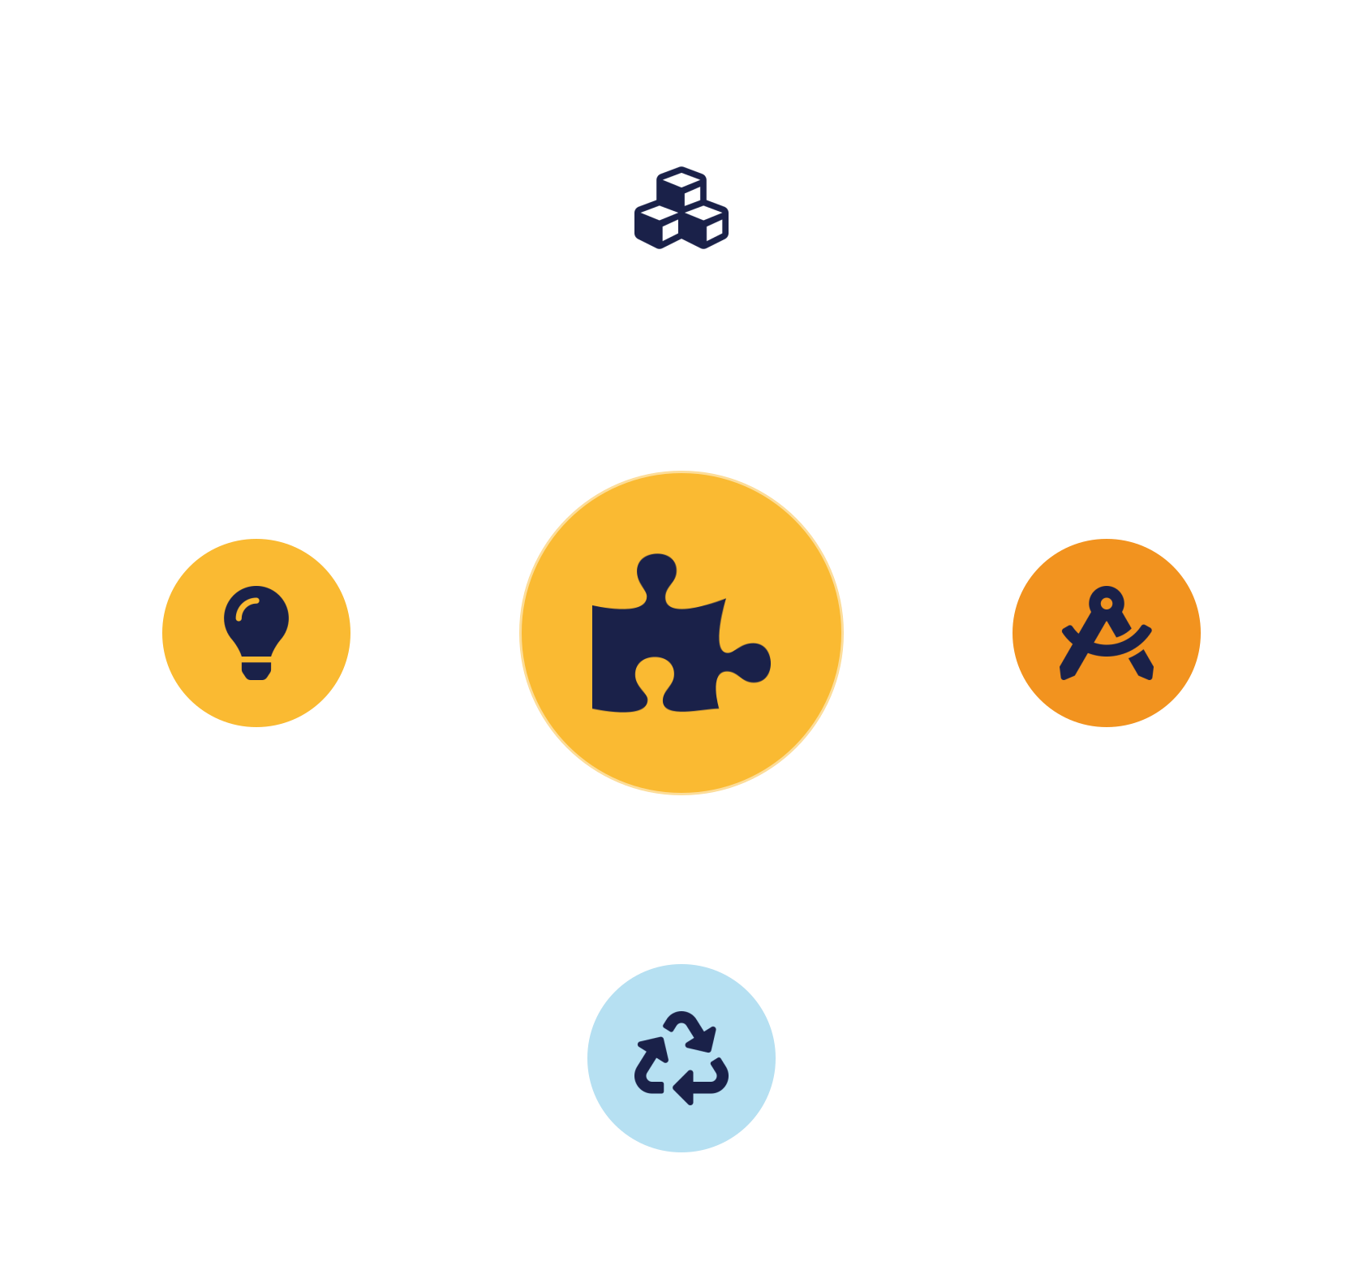
01
PART 1
What Are Security Design Patterns?
Notes:
Before the patterns, establish what a pattern is and why they matter. A design pattern is a named, reusable solution to a problem that recurs across many systems — captured so you can apply it repeatedly rather than solving from scratch each time.

Slide 5

DEFINITION
What is a security design pattern?
A documented, reusable solution to a recurring security problem in a given context.
Captures expertise in a named, shareable form
Compose controls, don't reinvent them.
Reuse a tested answer, don't reinvent
Real security is the right combination of controls — patterns are how professionals assemble them (SC8).
A shared vocabulary for design teams
IKB42603 Cloud Computing Security Essentials
3
Notes:
Define it: a security design pattern is a documented, reusable solution to a recurring security problem in a given context. Borrowed from software engineering, patterns capture hard-won expertise in a named, shareable form — a problem, the forces at play, and a proven solution. Stress the value on the slide. Reuse: you apply a tested answer instead of reinventing it. Common vocabulary: teams can say 'use the authentication gateway pattern' and everyone knows what that means. Fewer mistakes: patterns encode lessons from past failures. This is exactly the SC8 integrated-problem-solving skill — real security is rarely one control; it is the right combination, and patterns are how professionals compose them. Note patterns are not rigid rules; they are adaptable templates you tailor to context. Preview the pattern families next.

Slide 6



THE CATALOGUE
Pattern families in this course
Trusted platform
VM protection
Resource access control
Confidence the hardware & boot are genuine and unmodified.
Keep VMs and their data safe on shared hosts.
Gate who can reach cloud resources.
Lesson 9 adds: network security, DoS protection, federated authentication and key-management patterns.
IKB42603 Cloud Computing Security Essentials
4
Notes:
Give the map of the two-lesson pattern catalogue. This week, Patterns I: trusted-platform patterns that establish confidence the underlying hardware and boot are genuine and unmodified; VM protection patterns that keep virtual machines and their data safe on shared hosts; and resource access control patterns that gate who can reach cloud resources. Next week, Patterns II: network security, denial-of-service protection, federated authentication, and key management patterns. Note how the patterns build directly on the pillars from earlier lessons — trusted platform extends the hardening and measured boot from Lesson 5, VM protection extends the isolation from Lesson 3 and encryption from Lesson 4, and access control patterns extend Lessons 5 and 7. The point: patterns are not new theory; they are the disciplined packaging of what we have already learned into reusable building blocks.

Slide 7
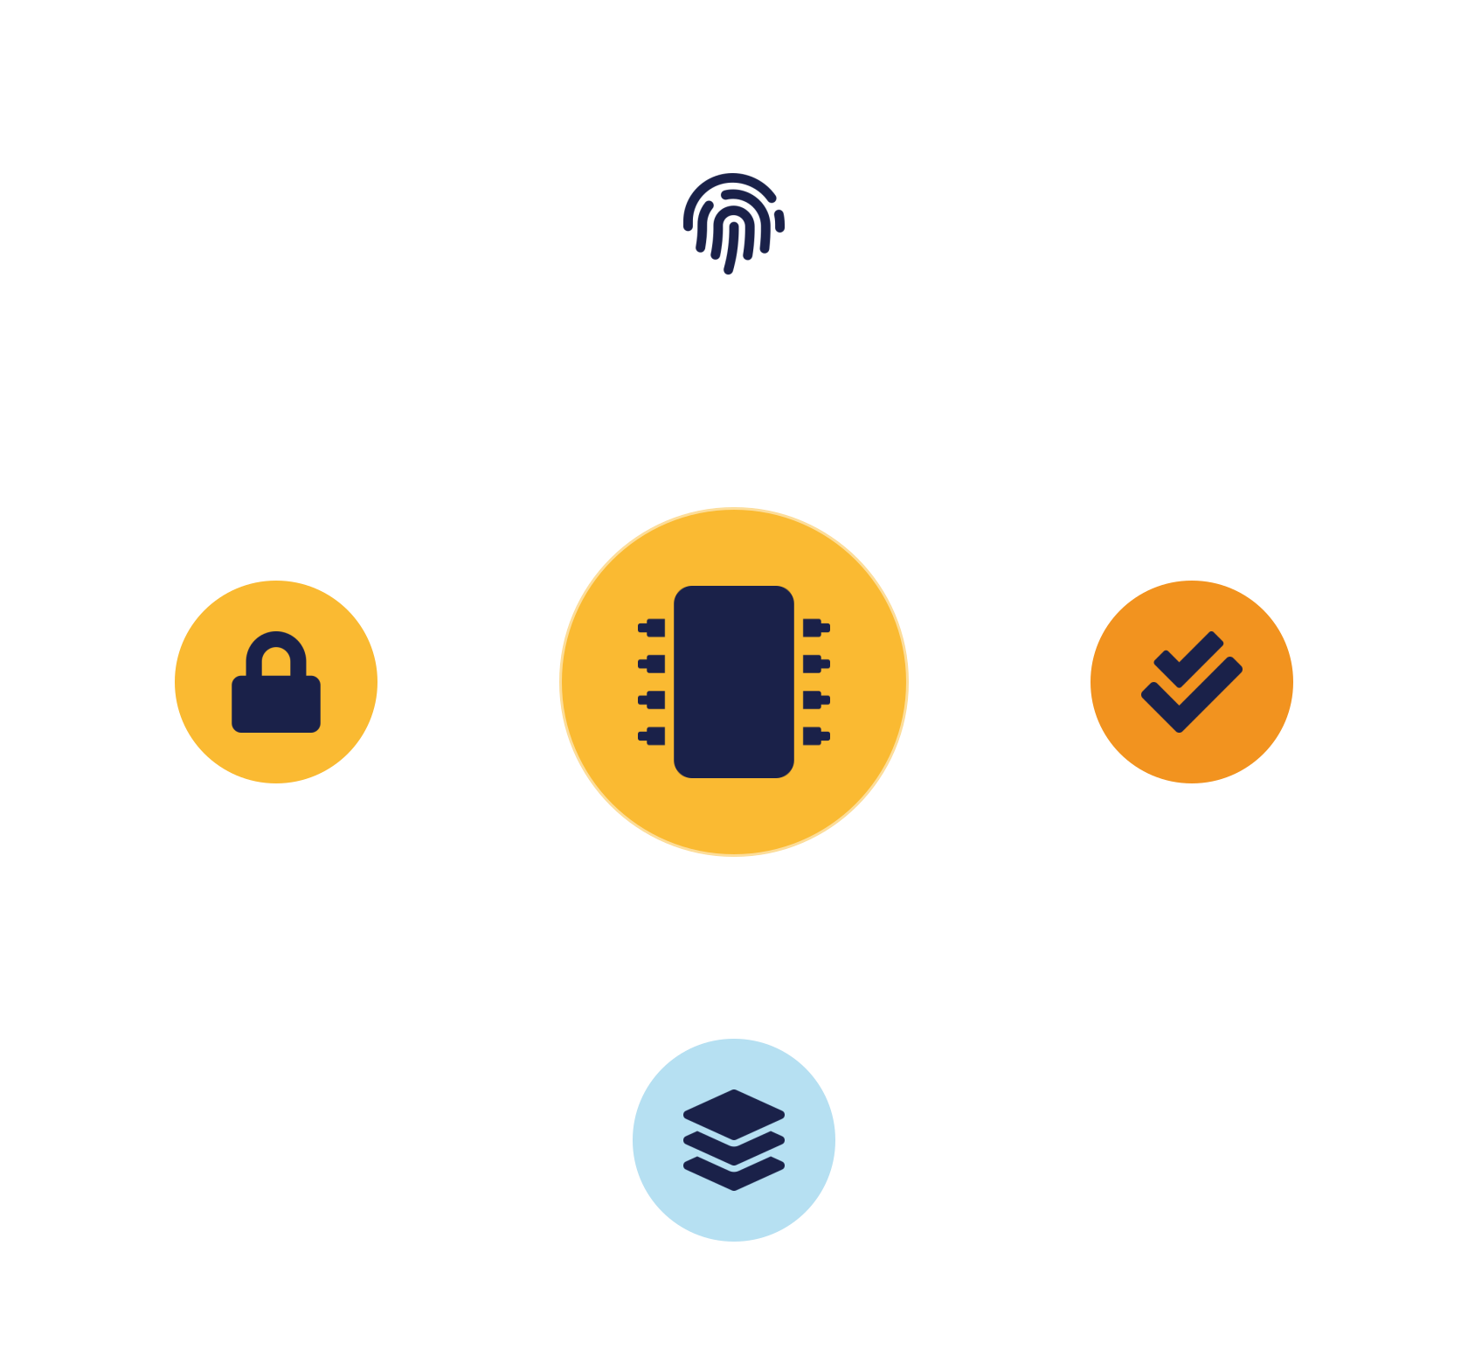
02
PART 2
Trusted Platform Patterns
Notes:
Everything you run in the cloud sits on hardware you do not own. Trusted-platform patterns give you cryptographic confidence that the hardware and boot process are genuine and unmodified — a foundation of trust before you place workloads on it.

Slide 8

PATTERN — TRUSTED PLATFORM
Trusted Platform Module & measured boot
Trusted Platform Module (TPM)
Measured boot & attestation
A secure chip: a hardware root of trust.
Prove the machine booted trusted software.
Stores keys & measurements — tamper-resistant
Measure each boot component — firmware → kernel
Cannot be extracted in software —
Record hashes in the TPM —
Basis for attestation —
Remote attestation verifies integrity —
IKB42603 Cloud Computing Security Essentials
5
Notes:
The trusted-platform pattern establishes a hardware root of trust. A Trusted Platform Module (TPM) is a dedicated secure chip that stores cryptographic keys and measurements in tamper-resistant hardware. Measured boot, from Lesson 5, uses it: at startup each component — firmware, bootloader, OS kernel — is measured (hashed) and the values recorded in the TPM, so you can later verify, through remote attestation, that the machine booted exactly the expected, unmodified software. Explain the problem it solves: in the cloud you cannot physically inspect the host, so how do you know it has not been tampered with beneath the OS — a rootkit, a malicious hypervisor? The trusted-platform pattern answers this with cryptographic evidence rather than trust-by-assumption. This is the bedrock the other patterns build on — there is little point encrypting a VM if the platform underneath is already compromised. It embodies security-by-design and the integrity goal of CIA at the deepest layer.

Slide 9



PATTERN — TRUSTED RESOURCE POOL
Trusted cloud resource pools
Attested host pool
Hardened golden images
Policy placement
Only hosts that pass TPM attestation join the trusted pool.
Every host starts from a known-good, minimal baseline.
Sensitive workloads run only on trusted-pool hardware.
Real requirement: regulated tenants can demand their data never touches an unattested host.
IKB42603 Cloud Computing Security Essentials
6
Notes:
The trusted resource pool pattern scales trusted platforms into a fleet. Instead of trusting individual servers ad hoc, you build a pool of hosts that have all passed attestation — verified via their TPMs to be running approved, unmodified firmware and hypervisors — and you place sensitive workloads only on hosts from that trusted pool. Combine this with hardened, minimal machine images (golden images from Lesson 5) so every host in the pool starts from a known-good, security-by-design baseline. The problem it solves: at cloud scale you cannot manually vet each machine, so you automate trust — a workload is only scheduled onto hardware that has cryptographically proven its integrity. Give the practical payoff: this lets a regulated tenant require that their data never touches an unattested host, a real requirement in finance and healthcare, which connects to the compliance lessons ahead. The pattern turns per-machine trust into a policy-enforced property of the whole environment.

Slide 10

03
PART 3
Virtual Machine Protection Patterns
Notes:
With a trusted platform beneath, we protect the virtual machines running on it. These patterns keep a VM's data confidential and its execution isolated, even from a curious or compromised host.

Slide 11


PATTERN — VM ENCRYPTION
Virtual machine encryption
Encrypt the VM
Key control
Virtual disks (and stopped memory) encrypted at rest.
Keys protected — released only to trusted hosts.
Unreadable from underlying storage —
Customer-managed keys — tenant control
Resists remanence & insider access —
Release on attestation — ties to trusted platform
Second line if isolation fails —
Confidential computing — encrypt memory in use
IKB42603 Cloud Computing Security Essentials
7
Notes:
The VM encryption pattern protects a virtual machine's data at rest — its virtual disks and, when stopped, its memory image — by encrypting them, so the VM's contents are unreadable to anyone who accesses the underlying storage, including other tenants after remanence or even a malicious insider at the provider. Key management is central, echoing Lesson 4: the encryption keys must be protected and, ideally, controlled by the tenant (customer-managed keys) and released only to attested, trusted hosts — combining with the trusted-platform pattern so a VM will only decrypt on hardware that has proven its integrity. The problem it solves: isolation (Lesson 3) keeps tenants apart in normal operation, but encryption adds a second line so that if isolation fails or storage is exposed, the data still resists. Mention the cutting edge — confidential computing, which encrypts VM memory even while running, protecting data in use. The pattern is defense in depth for the VM: trusted platform below it, encryption around it.

Slide 12

PATTERN — HYPERVISOR PROTECTION
Hypervisor protection
Minimal & hardened
Patch promptly
Attest integrity
Small attack surface; restricted, monitored management access.
Hypervisor flaws are high-value targets.
Prove the running hypervisor is genuine (trusted platform).
Stacked: trusted platform (hardware) + hypervisor protection (isolation) + VM encryption (workload) = defense in depth.
IKB42603 Cloud Computing Security Essentials
8
Notes:
The hypervisor protection pattern hardens the layer that creates and isolates VMs — the critical boundary from Lesson 3. Because compromising the hypervisor exposes every VM on the host, this pattern wraps it in layered controls: keep it minimal (a small attack surface), tightly restrict and monitor access to its management interface, patch it promptly against the high-value vulnerabilities attackers hunt for, and use the trusted-platform pattern to attest that the running hypervisor is the genuine, unmodified one. The problem it solves is the VM-escape and malicious-hypervisor threat: an attacker who breaks out of a VM aims for the hypervisor, and a tenant worries the provider's hypervisor could be tampered with. This pattern counters both — hardening resists escape, attestation resists tampering. Land the layered picture that closes this part: trusted platform verifies the hardware and boot, hypervisor protection secures the isolation layer, and VM encryption protects the workload — three patterns stacked into defense in depth for compute.

Slide 13
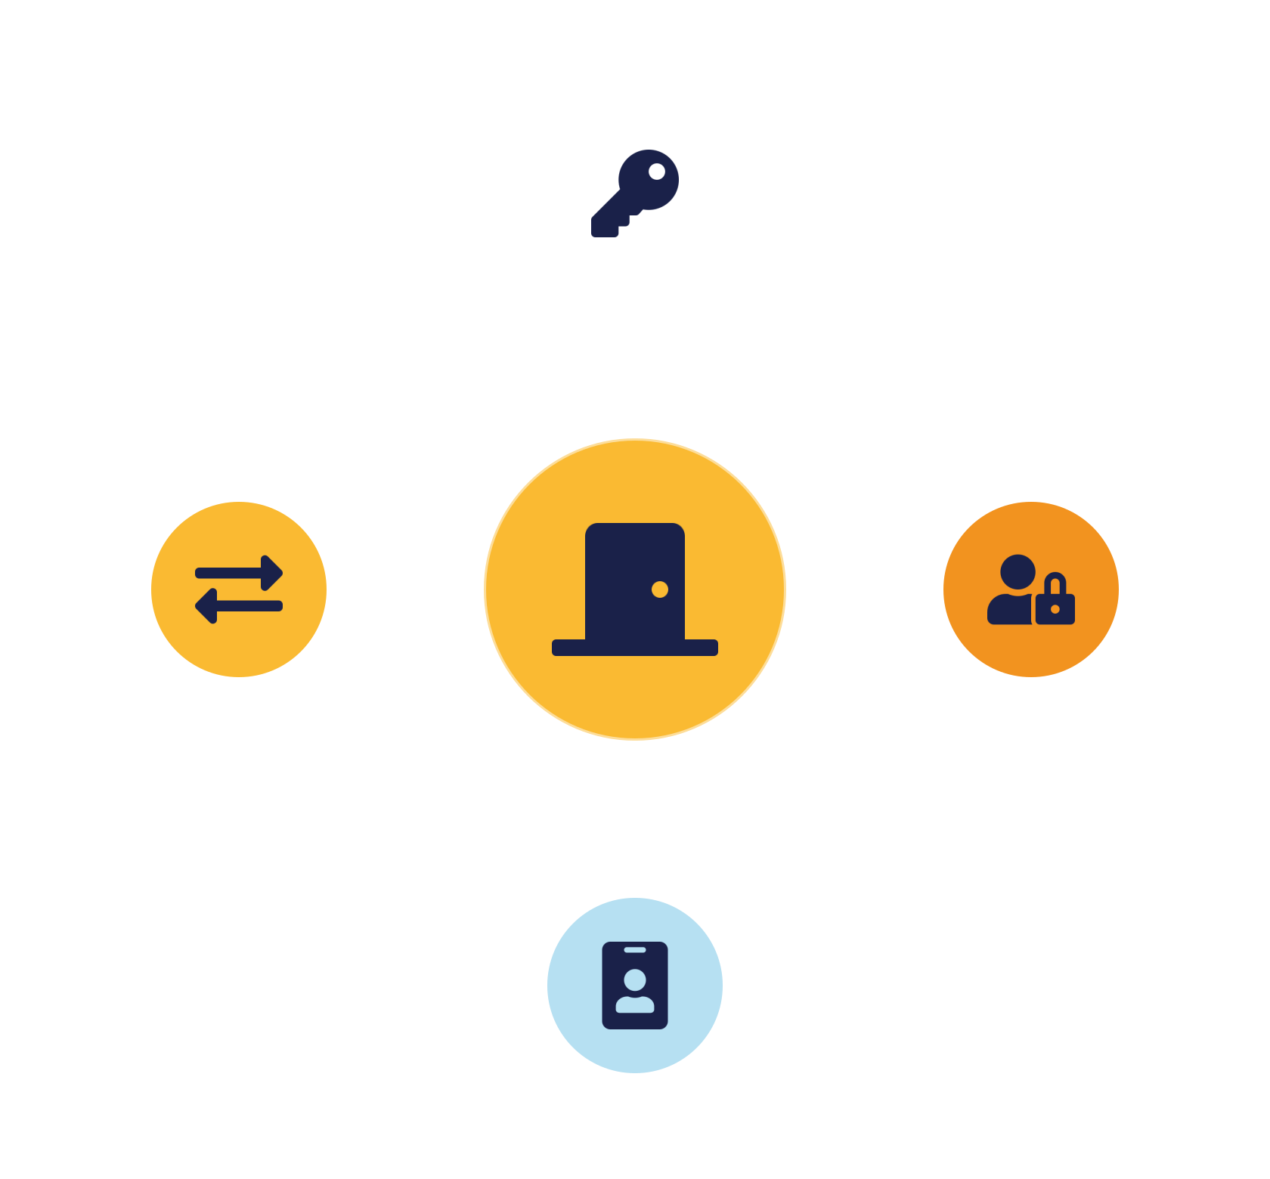
04
PART 4
Resource Access Control Patterns
Notes:
The final family this week gates access to cloud resources. These patterns package the access-control and identity work of Lessons 5 and 7 into reusable architectural components.

Slide 14

PATTERN — AUTHENTICATION GATEWAY
Cloud authentication gateway
A controlled front door
Zero trust in practice
All requests pass one authentication component.
No request reaches a resource unverified.
Verify identity — integrates SSO / federation
Regardless of network origin —
Enforce MFA & policy — in one place
Standardises authentication — closes per-service gaps
Consistent logging — for the audit trail
Protect the choke point well —
IKB42603 Cloud Computing Security Essentials
9
Notes:
The cloud authentication gateway pattern places a single, dedicated component in front of resources that handles authentication and initial authorization for all requests — a controlled front door. Every request must pass the gateway, which verifies identity (integrating with the SSO/federation from Lesson 7), enforces MFA, checks coarse authorization, and only then forwards the request to the resource. The problem it solves: without a gateway, every service implements its own authentication inconsistently, creating gaps; the gateway centralises and standardises it, so you enforce MFA and policy in one well-guarded place and get consistent logging for the audit trail. This is the architectural embodiment of zero trust — no request reaches a resource without passing the gate, regardless of network origin. Note the trade-off, familiar from SSO: the gateway is a high-value choke point that must be highly available and very well protected. It pairs naturally with the resource access control pattern next, which handles fine-grained decisions behind the gate.

Slide 15



PATTERN — RESOURCE ACCESS CONTROL
Resource access control (RBAC)
Role-based decisions
Least privilege by design
Encrypt in transit
Roles → identities; every operation checks roles vs policy.
Grant only what the role needs — consistently, auditably.
Protect authorised traffic between components; log decisions.
Gateway asks 'who are you?'; resource access control asks 'may you do this?' — authN then authZ, as components.
IKB42603 Cloud Computing Security Essentials
10
Notes:
Behind the gateway, the resource access control pattern makes fine-grained decisions about what an authenticated identity may do to a specific resource. It applies role-based access control from Lesson 5 as a reusable architectural element: permissions attach to roles, roles to identities, and every resource operation checks the identity's roles against a policy — enforcing least privilege by construction. Add two supporting practices on the slide: encrypt data in transit between components so that even authorised traffic cannot be eavesdropped (a small but important companion pattern), and log every access decision for auditing. The problem it solves: without a consistent access-control pattern, permissions sprawl inconsistently across services and drift into over-provisioning — the misconfiguration we keep meeting; the pattern gives one coherent, auditable model. Tie the part together: the authentication gateway answers 'are you who you say?', resource access control answers 'may you do this to this resource?' — authentication then authorization, packaged as reusable components. Together they realise least privilege and zero trust in architecture.

Slide 16

05
PART 5
Combining Patterns & Practice
Notes:
Patterns are most powerful when composed. We show how today's patterns stack into a secure architecture, apply them to a scenario, and set the habit of pattern-based design.

Slide 17
SC8 IN ACTION
Composing patterns into an architecture
Resource access control — least-privilege decisions
Authentication gateway — controlled front door
VM encryption — protect workload data
Hypervisor protection — secure isolation layer
Trusted platform — verified hardware & boot
Each pattern covers a different failure mode — stacked, they are defense in depth.
IKB42603 Cloud Computing Security Essentials
11
Notes:
This slide is the SC8 integrated-problem-solving payoff: no single pattern is a complete design; you compose them in layers. Read the stack on the slide from the ground up. Trusted platform gives a verified hardware and boot foundation. Hypervisor protection secures the isolation layer above it. VM encryption protects the workload's data. The authentication gateway gates all incoming access. Resource access control makes fine-grained, least-privilege decisions behind it. Each pattern covers a different failure mode, so together they form defense in depth — if one layer is bypassed, others still protect. The teaching point students must take into design work: when facing a real security requirement, ask 'which patterns apply, and how do they combine?' rather than reaching for a single control. This is exactly how professionals design secure cloud systems, and it is the skill the assignment and exam assess. It also sets up Lesson 9, which adds network, DoS, federation and key-management patterns to the toolkit.

Slide 18
APPLY IT
Case study — designing for a regulated tenant
A bank runs a sensitive workload in public cloud and requires: (a) data never on tampered hardware, (b) data unreadable to the provider, (c) only authorised staff can reach the service.
Which patterns for (a) & (b)?
Which patterns for (c)?
Trusted platform + trusted resource pool · VM encryption with customer keys + hypervisor protection.
Authentication gateway with MFA + federation · resource access control enforcing least privilege.
IKB42603 Cloud Computing Security Essentials
12
Notes:
Run as a design exercise. Scenario: a bank wants to run a sensitive workload in a public cloud and requires that (a) its data never runs on tampered hardware, (b) the data is unreadable to the provider, and (c) only authorised bank staff can reach the service. Ask students which patterns solve each requirement. Requirement (a): trusted platform plus trusted resource pool — attest hosts and place the workload only on verified hardware. Requirement (b): VM encryption with customer-managed keys released only to attested hosts, plus hypervisor protection. Requirement (c): authentication gateway with MFA and federation to the bank's identity provider, plus resource access control enforcing least privilege. The teaching point: a real requirement is met not by one control but by composing patterns — this is SC8 integrated problem-solving, and it is precisely the reasoning the assignment rewards. Have pairs map requirements to patterns before you reveal the mapping; this rehearses design thinking directly.

Slide 19
BASELINE
Best practices — designing with patterns
Start from a trusted platform
Encrypt VMs, control keys
Verify the foundation first.
Customer-managed, attested release.
Harden & attest hypervisors
Front resources with a gateway
Protect the isolation layer.
Central, consistent authentication.
Enforce least privilege
Compose patterns in layers
Resource access control by role.
Defense in depth (SC8).
IKB42603 Cloud Computing Security Essentials
13
Notes:
Distil the lesson into design habits. Start from a trusted platform — verify the foundation before trusting anything above. Encrypt VMs and control the keys. Harden and attest the hypervisor. Put a single authentication gateway in front of resources. Enforce least privilege with resource access control. And, above all, compose patterns in layers rather than relying on any one. Tell students these habits are the SC8 skill and are exactly what the assignment and exam assess. Preview: Lesson 9 continues the catalogue with network security, DoS protection, federated authentication and key-management patterns.

Slide 20
RECAP
Key takeaways
1 Security design patterns are reusable solutions — compose them rather than reinventing controls (SC8).
2 Trusted-platform patterns give cryptographic confidence in hardware and boot — the foundation.
3 VM protection patterns — encryption + hypervisor protection — keep workloads safe on shared hosts.
4 Resource access control patterns (gateway + RBAC) realise zero trust and least privilege in architecture.
IKB42603 Cloud Computing Security Essentials
14
Notes:
Consolidate. One: security design patterns are reusable solutions — compose them rather than reinventing controls (SC8). Two: trusted-platform patterns give cryptographic confidence in the hardware and boot, the foundation for everything above. Three: VM protection patterns — encryption and hypervisor protection — keep workloads safe on shared hosts. Four: resource access control patterns (authentication gateway + RBAC) gate access, realising zero trust and least privilege in architecture. Ask students to name a pattern for each of the three families. Preview Lesson 9: security design patterns II.

Slide 21

Discussion & Q&A
Why is a trusted platform the foundation for the other patterns — what breaks if it is missing?
For a workload you know, which two patterns would you apply first, and why?
Next week — Lesson 9: Cloud Computing Security Design Patterns II (network security · DoS protection · federated auth · key management)
Notes:
Close with the prompts. The first draws out that encryption and access control are undermined if the platform beneath is compromised — trust must start at the bottom. The second rehearses design judgement. Preview Lesson 9. Remind students the Assignment (CLO3) was due around this week per the plan, and that pattern-composition (SC8) is assessed.

