Slide 1

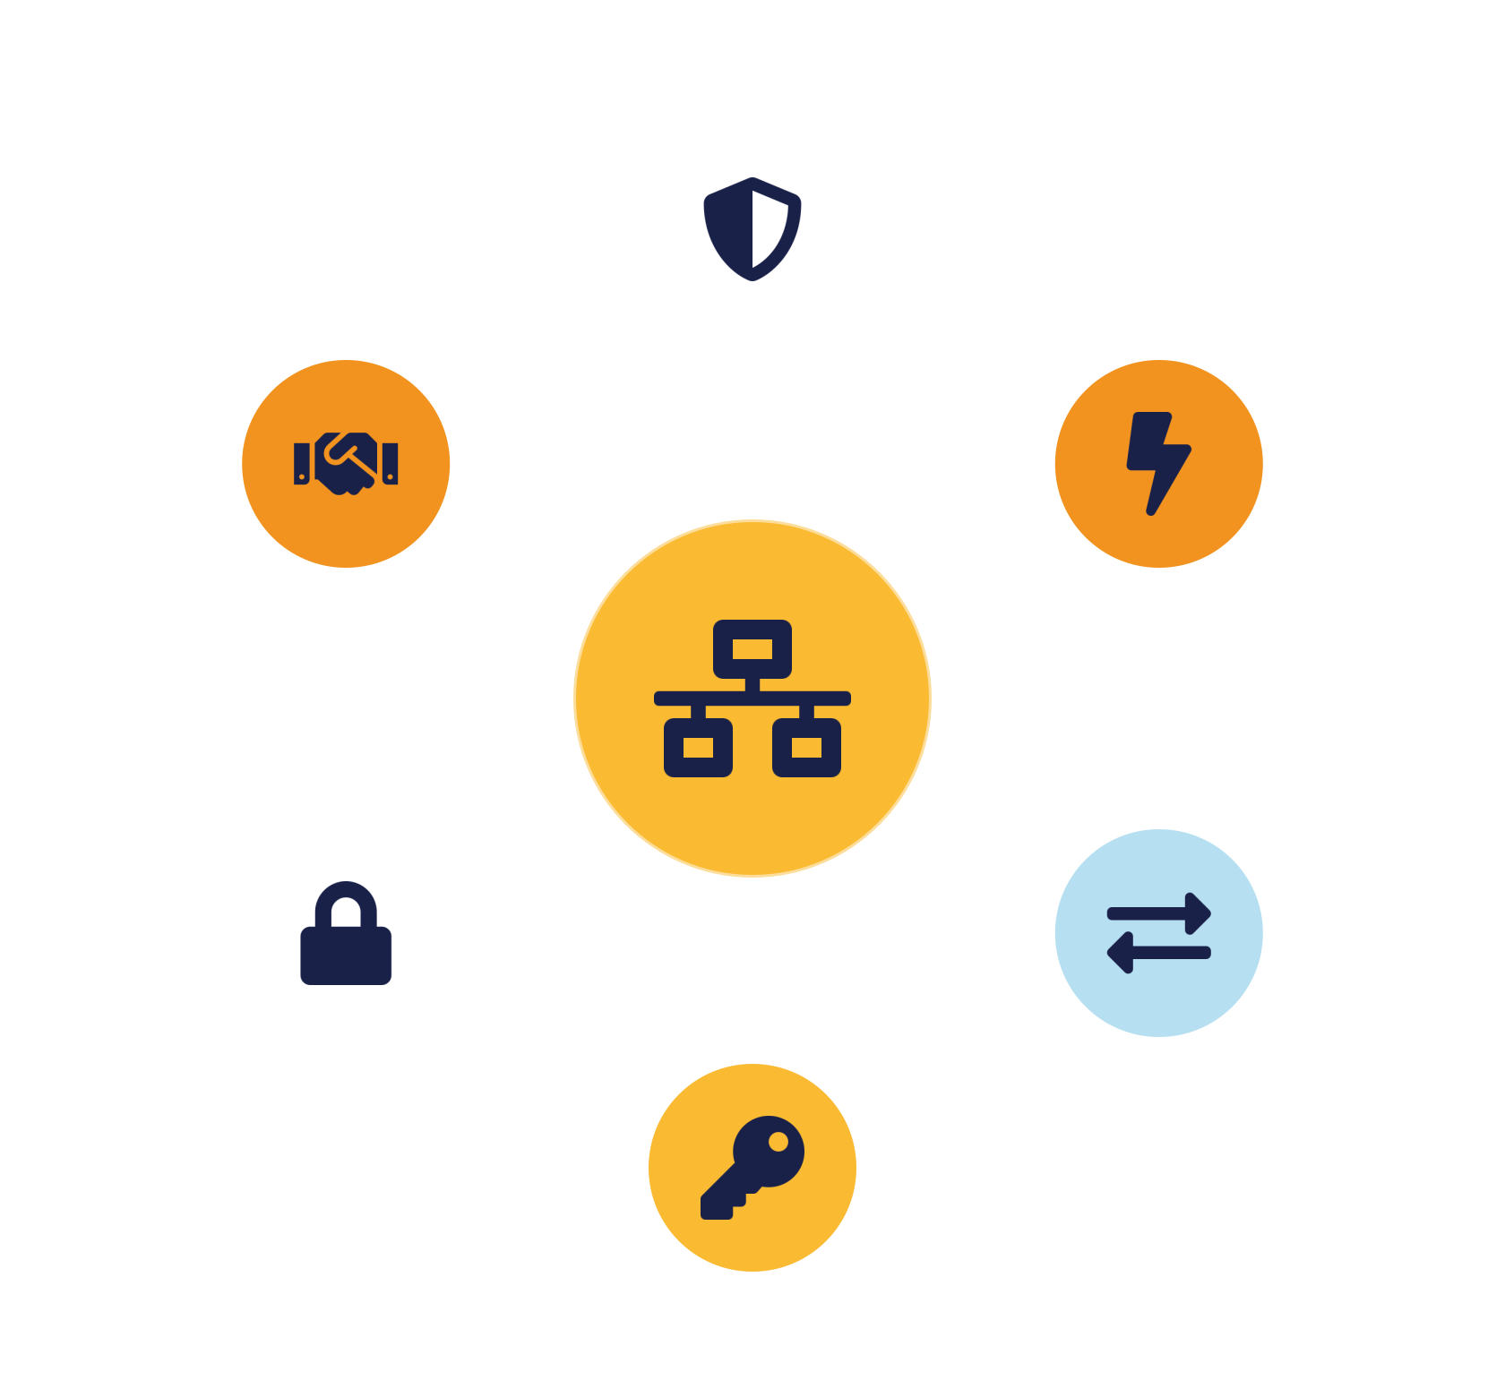
IKB42603 • Cloud Security
WEEK 9 · LESSON 9
Cloud Computing Security Design Patterns II
Network security · DoS protection · Federated authentication · Key management
Universiti Kuala Lumpur · UniKL MIIT | Prof. Dr. Shahrulniza Musa

Slide 2

LEARNING OUTCOMES
What you will be able to do
1. Apply network security patterns
2. Apply DoS protection patterns
Secure connections and virtual perimeters.
Absorb, filter and rate-limit attacks.
3. Apply federated authentication patterns
4. Apply key management patterns
Trust brokers and identity federation.
KMS, HSM and envelope encryption.
5. Compose patterns into architectures
6. Justify pattern trade-offs
Layered, resilient designs (SC8).
Cost, complexity and resilience.
IKB42603 Cloud Computing Security Essentials
1
Notes:
Welcome to Lesson 9, the second half of the design-pattern catalogue. Last week we covered trusted platform, VM protection and resource access control; today we add four more families — network security, denial-of-service protection, federated authentication, and key management. As before, the skill is SC8 integrated problem-solving: composing these patterns into resilient architectures. Walk the outcomes. This maps to CLO2. Remind students that patterns build on earlier pillars — network patterns extend Lesson 3's segmentation, federation extends Lesson 7, key management extends Lesson 4 — packaged now as reusable design components.

Slide 3



CONSTRUCTIVE ALIGNMENT
Curriculum alignment — CLO · PLO · MQF · clusters
Construct secure cloud computing operations that safeguard data integrity.
CLO 2
Programme outcome
Values & skills
Assessment
PLO2 · Cognitive Skills
MQF Level iii(a)
Bloom P3 (Precision)
SC8 · Integrated Problem-Solving
VBE3 · Integrity
Lab Assignment (CLO2)
Constructive alignment: CLO → PLO → MQF, with VBE (values) and SC (skills) clusters, assessed as shown.
IKB42603 Cloud Computing Security Essentials
2
Notes:
Constructive-alignment slide. Lesson 9 continues the design-pattern work of CLO2 and the SC8 integrated-problem-solving cluster, aligned to PLO2, MQF Level iii(a), Bloom P3, with the VBE3 integrity value, assessed through the Lab Assignment.

Slide 4
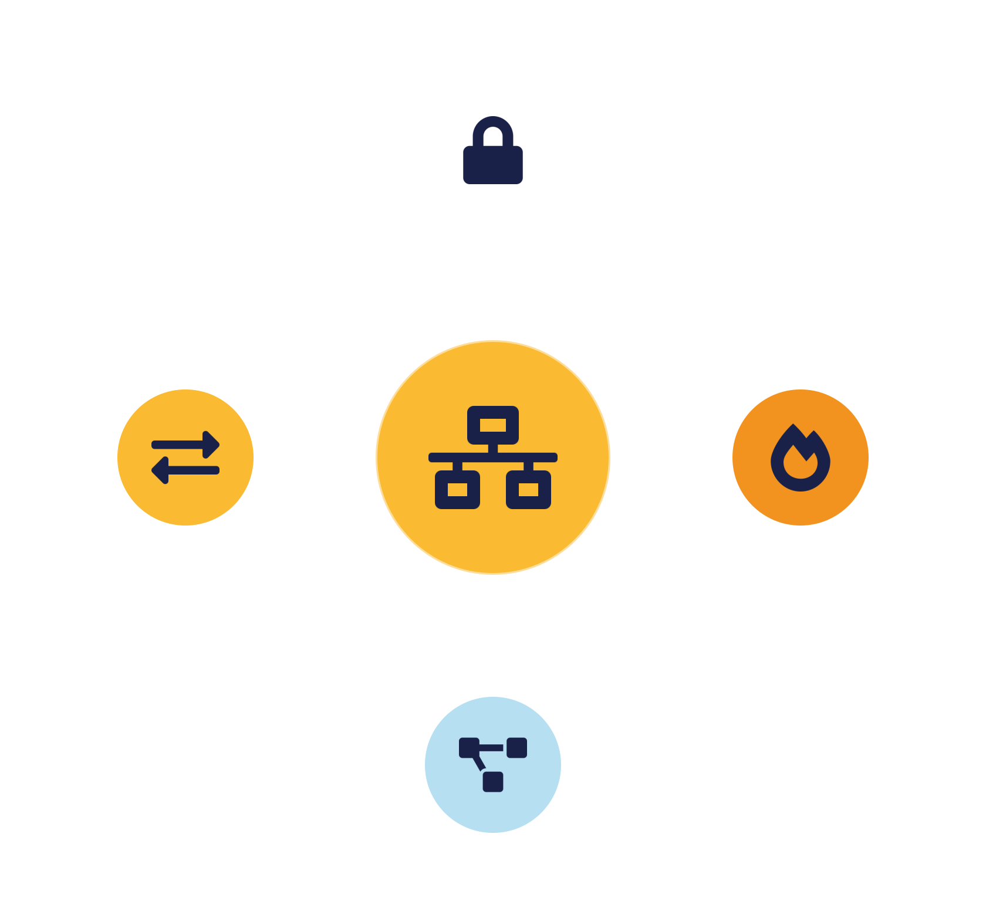
01
PART 1
Network Security Patterns
Notes:
In the cloud you do not own the wires, so network security is achieved through software-defined patterns: secure connections, virtual perimeters and segmentation. These package Lesson 3's network isolation into reusable design elements.

Slide 5


PATTERN — SECURE CONNECTION
Secure connection & virtual perimeter
Secure connection
Virtual perimeter
Encrypt & authenticate traffic in transit.
A firewall boundary rebuilt in software.
TLS for application traffic —
Virtual firewalls & security groups —
VPN / private links for networks —
Default-deny, least privilege —
Defeats eavesdropping & MITM —
Easy to apply — easy to misconfigure —
IKB42603 Cloud Computing Security Essentials
3
Notes:
The secure-connection pattern ensures all traffic to and between cloud resources is encrypted and authenticated in transit — TLS for application traffic, VPN or private connectivity for network links between sites and the cloud. It solves eavesdropping and man-in-the-middle from Lesson 3: even on shared, untrusted networks, intercepted traffic is unreadable and tampering is detectable. The virtual perimeter pattern rebuilds the traditional firewall boundary in software: virtual firewalls and security groups wrap resources, so only permitted flows reach them — default-deny, least privilege for the network. Together they answer 'how do I protect traffic and control who can connect when I don't control the physical network?' The cloud makes these patterns easy to apply broadly — a security group is a few lines of configuration — but that same ease means they are easy to misconfigure, so review is essential. These patterns are the network foundation the DoS and federation patterns build on.

Slide 6


PATTERN — SEGMENTATION
Segmentation & micro-perimeters
Virtual Private Cloud
Tier segmentation
Micro-segmentation
Each environment gets its own isolated network space.
Separate web / app / data tiers — internet can't reach data directly.
Isolate each workload — zero trust for the network.
Design habit: segment by default, connect by exception — confine lateral movement.
IKB42603 Cloud Computing Security Essentials
4
Notes:
The segmentation pattern divides the cloud network into isolated zones so that a compromise in one cannot spread freely — the containment principle from Lesson 3, packaged as design. Three levels on the slide. Virtual Private Clouds give each environment its own isolated network space. Subnet and tier segmentation separates, say, the web tier from the database tier so the internet-facing part cannot directly reach the data. Micro-segmentation goes furthest, isolating individual workloads so each service talks only to the specific others it must — the network expression of zero trust. The problem solved: flat networks let an attacker who lands anywhere move laterally to everything; segmentation confines them. Software-defined networking makes these boundaries programmable and fine-grained, which is why micro-segmentation is practical in the cloud where it was not on physical networks. The design habit: segment by default and connect by exception. This pattern pairs with the secure-connection pattern — segment the network, and encrypt the connections that cross segments.

Slide 7
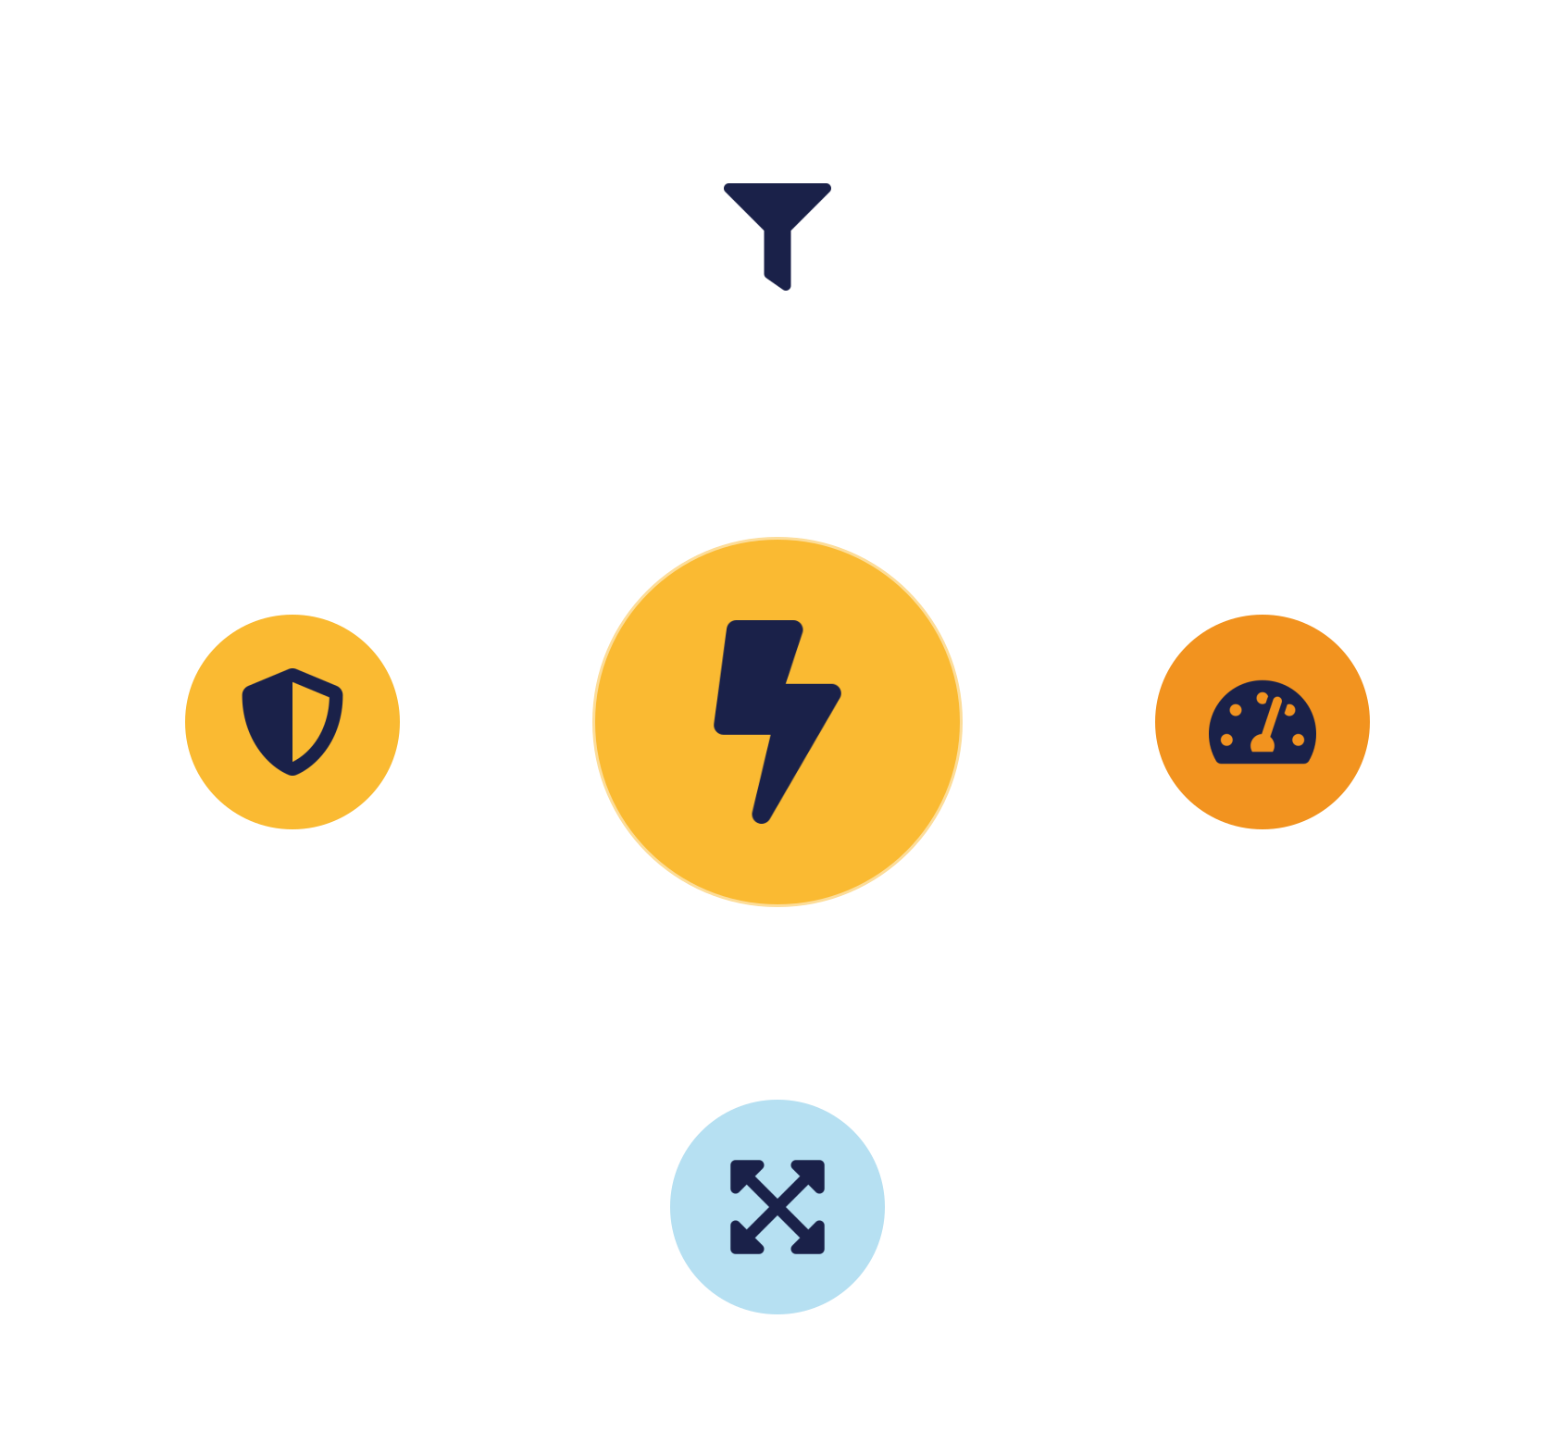
02
PART 2
Denial-of-Service Protection Patterns
Notes:
Availability is a security goal, and denial-of-service attacks target it directly by flooding a service until legitimate users cannot reach it. These patterns keep services available under attack.

Slide 8



THE THREAT + PATTERN
DoS / DDoS protection
Filter & scrub
Rate limiting
Absorb & scale
Inspect traffic; drop malicious packets before they land.
Cap requests per source — no single client can flood.
Elasticity + CDN spread and soak up large volumes.
Watch out: scaling alone under attack causes Economic Denial of Sustainability — combine with filtering & rate limits.
IKB42603 Cloud Computing Security Essentials
5
Notes:
A denial-of-service attack overwhelms a service with traffic so legitimate users are denied access; a distributed DoS uses many compromised machines at once, making it far harder to block. This attacks the Availability leg of CIA. The DoS-protection pattern layers several defences. Traffic filtering and scrubbing: inspect incoming traffic and drop malicious packets before they reach the service, often via a specialised scrubbing service. Rate limiting: cap how many requests any source may make, so no single client can flood you. Absorb and scale: use the cloud's elasticity and content delivery networks to spread and soak up large volumes across many edge locations. The problem solved: a single server is easily overwhelmed; these patterns distribute and filter the load so the service stays up. Flag the cloud-specific twist we met in Lesson 1 — Economic Denial of Sustainability: naive auto-scaling under attack keeps you online but runs up a ruinous bill, so DoS protection must combine scaling with filtering and rate limits, not scaling alone.

Slide 9


LAYERED DEFENCE
A resilient DoS-protection architecture
CDN / edge — absorb & cache across the globe
DDoS scrubbing — filter volumetric attacks
Web application firewall — block malicious requests
Rate limiting — cap abusive clients
Bounded auto-scaling — handle legitimate surges
Each layer removes a class of attack traffic — the origin sees only clean load.
IKB42603 Cloud Computing Security Essentials
6
Notes:
Show how the DoS patterns compose into a resilient front end, reading the flow on the slide from the internet inward. Edge/CDN first: a content delivery network absorbs and caches traffic across many global locations, keeping most load away from your origin. A DDoS scrubbing service or protection layer then filters volumetric attacks. A web application firewall inspects application-layer requests and blocks malicious ones. Rate limiting caps per-client requests. Finally, elastic auto-scaling behind all of this handles legitimate surges — bounded by budget limits to avoid the economic-denial trap. Each layer removes a class of attack traffic, so the origin sees only clean, manageable load. The teaching point: DoS resilience is not one product but a composed pipeline of patterns, each covering a different attack scale — volumetric at the edge, application-layer at the WAF, abusive clients at the rate limiter. This is the SC8 composition skill applied to availability, and it mirrors the layered thinking from every pillar.

Slide 10
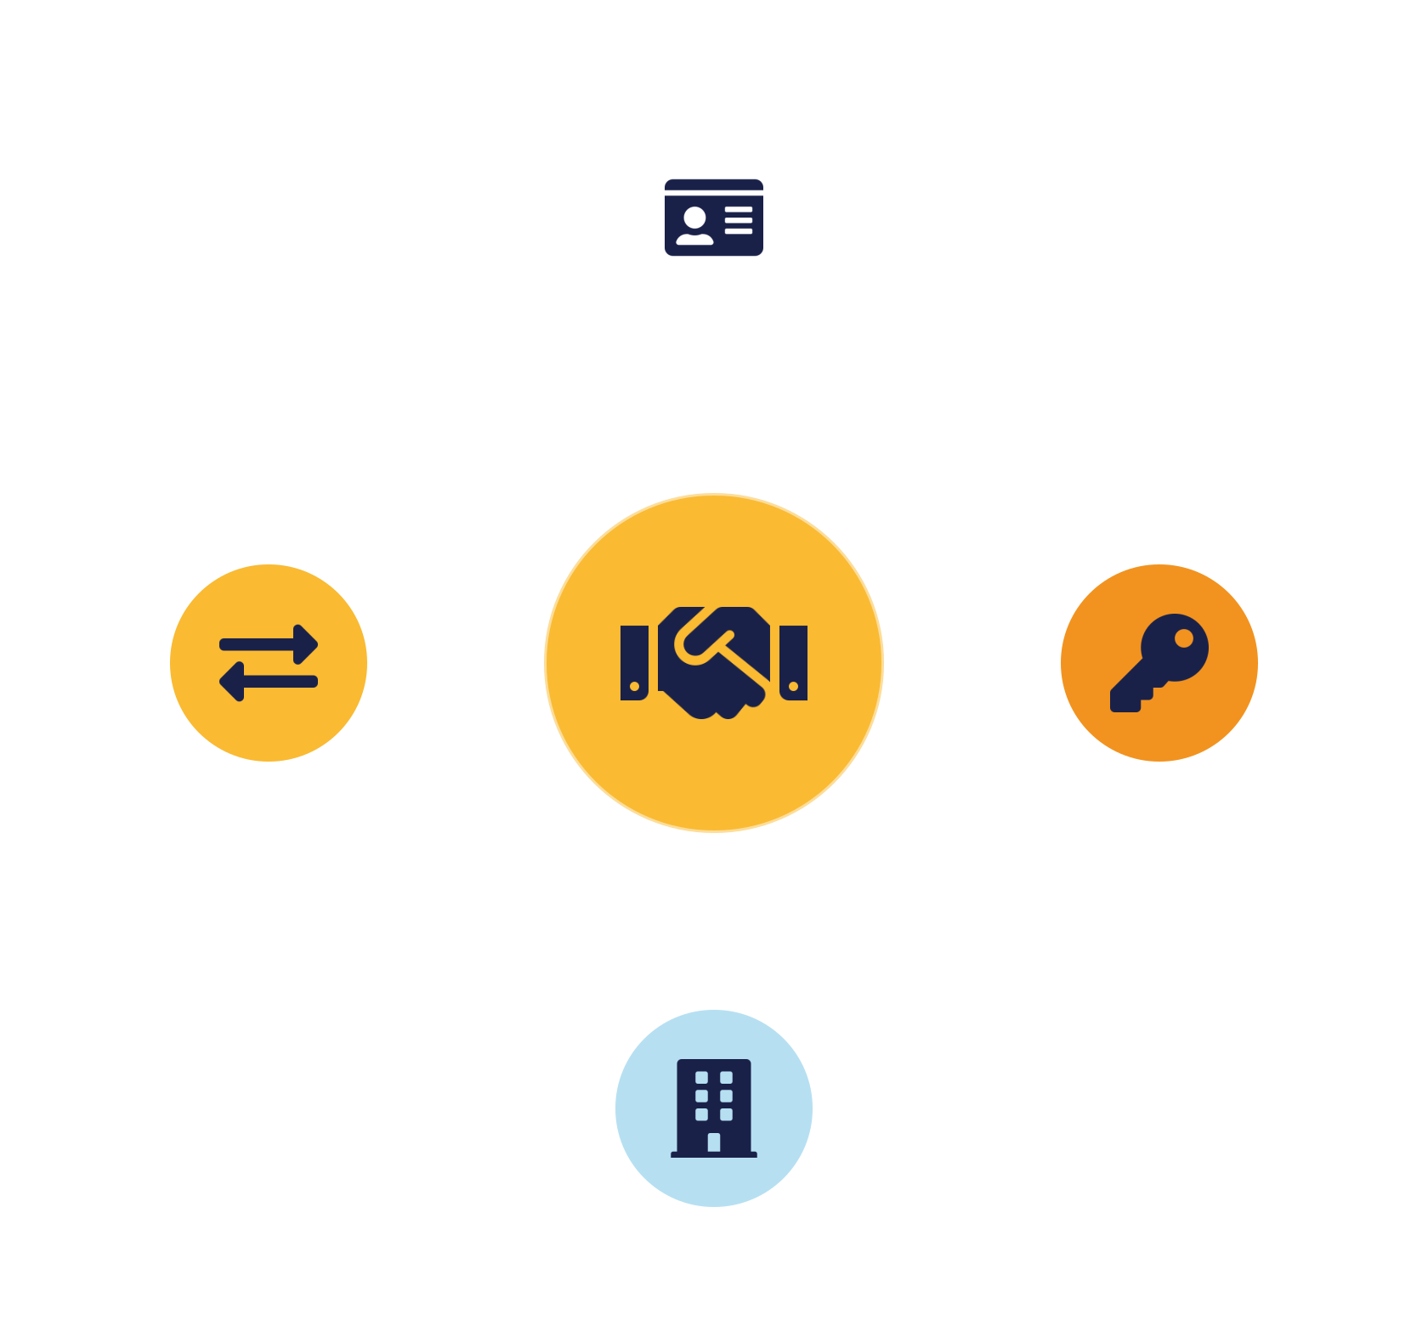
03
PART 3
Federated Authentication Patterns
Notes:
These patterns package the identity federation of Lesson 7 into reusable design components — letting users authenticate once, in their home domain, and reach many services across trust boundaries.

Slide 11


PATTERN — FEDERATED AUTHENTICATION
Federated authentication & trust broker
Federated authentication
Trust broker
Accept identities from a trusted external IdP.
One trusted hub instead of N×M trust links.
Users use home credentials — SAML / OIDC
Translates between IdPs & SPs —
No separate accounts —
Central MFA & policy —
Central deprovisioning —
Protect the hub well — high-value point
IKB42603 Cloud Computing Security Essentials
7
Notes:
The federated authentication pattern lets a service accept identities authenticated by a trusted external identity provider, so users use their home credentials — from Lesson 7. The trust-broker pattern generalises this to many-to-many relationships: instead of every service provider establishing direct trust with every identity provider (an N-times-M mess), a central identity broker sits in the middle, trusted by all, and translates between them. The broker authenticates via the appropriate IdP and issues a token the service accepts. The problem solved: at cloud scale, organisations use dozens of services and multiple identity sources, and direct pairwise trust does not scale; the broker reduces it to each party trusting one broker. Add the benefit of central control — one place to enforce MFA, apply conditional-access policy, and log all authentication. The trade-off, familiar by now, is that the broker is a high-value single point that must be highly available and strongly protected. This pattern is what powers enterprise single sign-on across cloud SaaS estates.

Slide 12


PATTERN — IDENTITY GATEWAY
SSO gateway & conditional access
SSO gateway
Conditional access
Adaptive response
One entry point federates to the right IdP for all apps.
Evaluate device, location & risk on every request.
Step-up MFA or block based on context — zero trust.
Zero trust made concrete: trust is continuously evaluated, not granted once and forgotten.
IKB42603 Cloud Computing Security Essentials
8
Notes:
The SSO gateway pattern places a single sign-on entry point in front of an estate of applications, combining the authentication gateway from Lesson 8 with federation: users authenticate once at the gateway, which federates to the right identity provider, and then reach all connected apps. Layered on top is conditional access — the gateway evaluates context on each request (device health, location, risk signals) and adapts, for example requiring an extra MFA prompt for a login from a new country or blocking access from an unmanaged device. This is zero trust made concrete: trust is not granted once and forgotten; it is continuously evaluated. The problem solved: static authentication cannot tell a legitimate user from an attacker using stolen-but-valid credentials; conditional access adds the behavioural and contextual signals that catch the difference. Tie the part together: federated authentication establishes WHO across boundaries, the trust broker scales that trust, and the SSO gateway with conditional access enforces it intelligently at the door — the identity patterns compose just like the network ones.

Slide 13
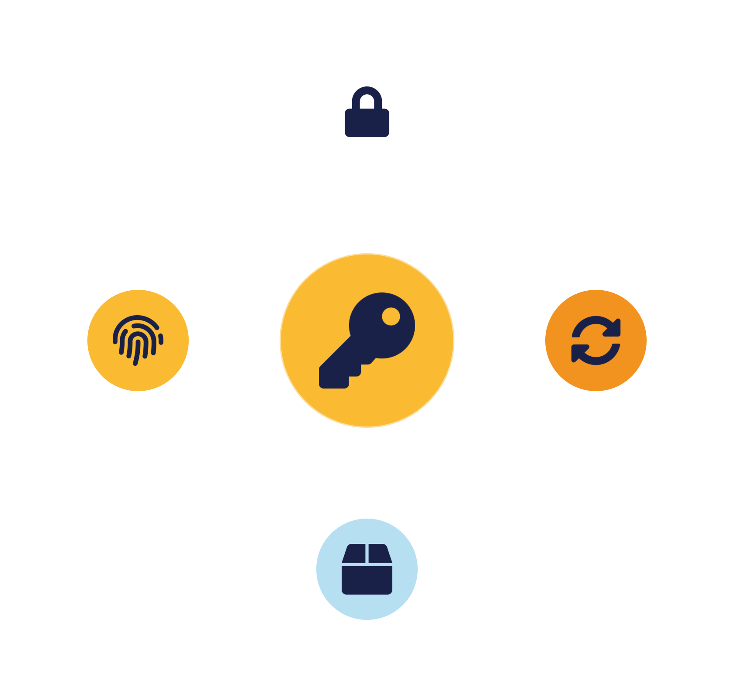
04
PART 4
Key Management Patterns
Notes:
Encryption from Lesson 4 is only as strong as its keys. These patterns package secure key management into reusable components — the key-management service, hardware security modules, and envelope encryption.

Slide 14


PATTERN — KEY MANAGEMENT SYSTEM
Cryptographic key management system
Key Management Service (KMS)
Hardware Security Module (HSM)
Centralise the whole key lifecycle.
Keys in tamper-resistant hardware.
Generate, store, rotate, revoke — one hardened service
Keys never leave the device — used, not extracted
No keys in code or config —
Highest assurance —
One place to audit key use —
Customer-managed / BYOK — control & separation
IKB42603 Cloud Computing Security Essentials
9
Notes:
The key-management-system pattern centralises the whole key lifecycle — generation, storage, distribution, rotation, revocation — into a dedicated, hardened service, rather than scattering keys through application code and config. A Key Management Service (KMS) provides this as a managed component; for the highest assurance, a Hardware Security Module (HSM) stores keys in tamper-resistant hardware from which they can never be extracted, only used. The problem solved: the most common way good encryption fails is poor key handling — hard-coded keys, keys stored beside the data, keys never rotated; centralising into a KMS/HSM fixes all of these and gives one place to audit and control key use. Add the cloud choice from Lesson 4: provider-managed keys are convenient, customer-managed keys (in the tenant's KMS or bring-your-own-key to an HSM) give control and separation from the provider — a shared-responsibility and compliance decision. This pattern underpins the VM encryption and per-tenant patterns and is where 'encryption' becomes trustworthy.

Slide 15



PATTERN — ENVELOPE & PER-TENANT KEYS
Envelope encryption & per-tenant keys
Envelope encryption
Per-tenant keys
Crypto erasure & rotation
Data key encrypts data; master key (in KMS/HSM) encrypts the data key.
Each tenant's key unlocks only their data — reinforces isolation.
Destroy a key to delete data; rotate to limit exposure.
Key management is the trust anchor beneath VM encryption, storage isolation and secure deletion.
IKB42603 Cloud Computing Security Essentials
10
Notes:
Two refinements that make key management scale. Envelope encryption solves the problem of protecting millions of data keys: you encrypt data with a fast, local data key, then encrypt that data key with a master key held in the KMS/HSM — so only the small master key needs the expensive hardware protection, while the many data keys travel safely wrapped alongside the data. It combines the speed of symmetric encryption with the strong protection of a central master key. Per-tenant keys, from Lessons 3 and 4, give each tenant their own keys, so one tenant's key never unlocks another's data — reinforcing isolation — and enabling clean cryptographic erasure: destroy a tenant's key and their data is instantly, provably unrecoverable. The problems solved: envelope encryption makes strong key protection practical at massive scale; per-tenant keys make multi-tenant isolation and deletion cryptographically enforceable. Close the part: these key patterns are the trust anchor beneath VM encryption, storage isolation and secure deletion — get key management right and those all become dependable; get it wrong and they all fail quietly.

Slide 16

05
PART 5
Composing Patterns & Practice
Notes:
We assemble all the Lesson 8 and 9 patterns into a complete secure architecture, apply them to a scenario, and set the pattern-based design habit.

Slide 17


SC8 IN ACTION
A complete pattern-based architecture
DoS protection + virtual perimeter — resilient, filtered edge
Federated auth + SSO gateway + conditional access
Segmented network — confine any breach
Trusted platform + hypervisor protection + VM encryption
KMS + envelope + per-tenant keys — trustworthy encryption
Given a requirement, ask which patterns apply and how they compose — not which single product to buy.
IKB42603 Cloud Computing Security Essentials
11
Notes:
Bring both pattern lessons together into one picture of a secure cloud service, reading the layers on the slide. At the edge, DoS protection and a virtual perimeter keep the front resilient and filtered. Federated authentication with an SSO gateway and conditional access controls who gets in. A segmented network confines any breach. The workload runs on a trusted platform with hypervisor protection and VM encryption. Data is protected by a KMS with envelope and per-tenant keys. And everything is monitored (Lesson 6). Each layer is a pattern from Lessons 8 or 9, each covering a distinct failure mode, and together they form defense in depth across availability, identity, network, compute and data. The teaching point — the culmination of the SC8 thread — is the design method: given a requirement, ask which patterns apply and how they compose, rather than reaching for a single product. This is how professionals design secure cloud systems, and it is exactly what the assignment and exam reward.

Slide 18

APPLY IT
Case study — a public-facing SaaS under attack
A startup's public SaaS faces a DDoS attack, is probed for weak logins, and must keep each customer's data encrypted and isolated — all at once.
Which patterns for the attacks?
Which patterns for the data?
DoS pipeline (CDN, scrubbing, WAF, rate limiting, bounded scaling) · federated SSO + MFA + conditional access · segmentation.
KMS with envelope + per-tenant keys · VM encryption · monitoring across all layers.
IKB42603 Cloud Computing Security Essentials
12
Notes:
Run as a design exercise. Scenario: a startup runs a public SaaS that suffers a DDoS attack while also being probed for weak logins, and it handles customer data that must stay encrypted and isolated per customer. Ask which patterns address each need. For the DDoS: the DoS-protection pipeline — CDN/edge absorption, scrubbing, WAF, rate limiting, and bounded auto-scaling to avoid economic denial. For the login probing: federated authentication with an SSO gateway, MFA and conditional access to block risky logins, over a segmented network. For the data: a KMS with envelope and per-tenant keys, plus VM encryption. The teaching point: a realistic scenario hits multiple attack surfaces at once, and the answer is a composition of patterns across families — availability, identity and data — exactly the SC8 integrated-problem-solving the course assesses. Have pairs map needs to patterns before revealing the mapping. Emphasise that no single vendor product covers all three; the architecture does.

Slide 19
BASELINE
Best practices — pattern-based network & crypto design
Encrypt every connection
Segment the network
Rebuild the perimeter in software.
Connect by exception.
Layer DoS defences
Federate with a trust broker
Filter, rate-limit, absorb; bound scaling.
Plus conditional access.
Centralise keys (KMS/HSM)
Compose across families
Envelope + per-tenant keys.
Defense in depth (SC8).
IKB42603 Cloud Computing Security Essentials
13
Notes:
Distil both pattern lessons. Encrypt every connection and rebuild the perimeter in software. Segment the network and connect by exception. Layer DoS defences — filter, rate-limit and absorb, with bounded scaling. Federate authentication through a trust broker with conditional access. Centralise keys in a KMS/HSM with envelope and per-tenant keys. And, above all, compose patterns across families into defense in depth. Tell students this is the SC8 skill the assignment and exam assess. Preview: Lessons 10 and 11 shift from technical design to governance — policy, compliance, risk and reporting — the CLO3 material and the focus of the assignment.

Slide 20

RECAP
Key takeaways
1 Network patterns — secure connections, virtual perimeters, segmentation — protect traffic and confine breaches.
2 DoS-protection patterns keep availability under attack — filter, rate-limit, absorb; bound the scaling.
3 Federated auth patterns (trust broker, SSO gateway, conditional access) scale identity across boundaries.
4 Key-management patterns (KMS/HSM, envelope, per-tenant keys) make encryption trustworthy at scale.
IKB42603 Cloud Computing Security Essentials
14
Notes:
Consolidate both pattern lessons. One: network security patterns — secure connections, virtual perimeters and segmentation — protect traffic and confine breaches without owning the wires. Two: DoS-protection patterns keep availability under attack by filtering, rate-limiting and absorbing — with bounded scaling to avoid economic denial. Three: federated authentication patterns (trust broker, SSO gateway, conditional access) scale and enforce identity across boundaries. Four: key-management patterns (KMS/HSM, envelope, per-tenant keys) make encryption trustworthy at scale. And the overarching skill: compose patterns into defense in depth (SC8). Ask students to name a pattern from each family. Preview Lesson 10: policy, compliance and risk management.

Slide 21

Discussion & Q&A
Why can't auto-scaling alone defend against a DDoS attack — what else is required?
Where would you place your strongest key-management controls, and why?
Next week — Lesson 10: Policy, Compliance & Risk Management in Cloud Computing (ISO 27018 · CSA STAR · SLAs)
Notes:
Close with the prompts. The first surfaces Economic Denial of Sustainability — scaling keeps you up but bankrupts you, so filtering and rate limits are essential. The second draws out KMS/HSM, customer-managed and per-tenant keys as the crown-jewel controls. Preview Lesson 10, which shifts to governance and compliance (CLO3). Remind students the design-pattern composition skill (SC8) is assessed.

