Slide 1

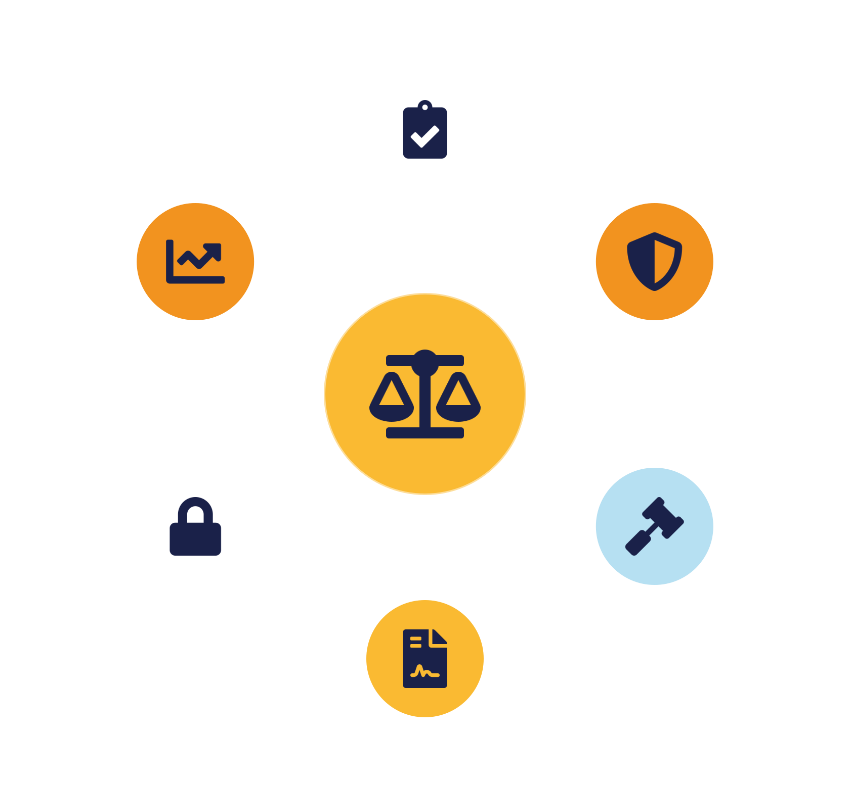
IKB42603 • Cloud Security
WEEK 10 · LESSON 10
Policy, Compliance & Risk Management in Cloud Computing
Governance · Standards (ISO · PCI DSS · CSA STAR) · Risk · Legal & privacy · SLAs
Universiti Kuala Lumpur · UniKL MIIT | Prof. Dr. Shahrulniza Musa

Slide 2

LEARNING OUTCOMES
What you will be able to do
1. Explain cloud governance & policy
2. Recognise key compliance standards
How organisations direct and control security.
ISO 27017/27018, PCI DSS, NIST, GDPR.
3. Use the CSA STAR program
4. Apply the risk-management process
CCM, CAIQ and provider transparency.
Identify, assess, treat, monitor.
5. Understand legal, forensics & privacy
6. Evaluate SLAs
Jurisdiction, sovereignty, e-discovery.
Metrics, responsibilities and remedies.
IKB42603 Cloud Computing Security Essentials
1
Notes:
Welcome to Lesson 10. The course now shifts from technical controls to governance — the policies, standards, risk decisions and contracts that make cloud security accountable and lawful. This is CLO3 territory, assessed by the assignment and the presentation, and it carries the VBE3 professional-integrity value. Frame it: technology answers 'can we secure it?'; governance answers 'are we managing it responsibly, legally, and to an agreed standard?' Walk the outcomes. Tell students that in professional practice, security and compliance are inseparable — a control that is not documented, assessed and contracted may as well not exist to an auditor or a court.

Slide 3



CONSTRUCTIVE ALIGNMENT
Curriculum alignment — CLO · PLO · MQF · clusters
Present cloud services' compliance with SLAs and data-privacy obligations with professional integrity.
CLO 3
Programme outcome
Values & skills
Assessment
PLO9 · Ethics & Professionalism
MQF Level iii(f)
Bloom A2 (Respond)
VBE3 · Integrity
A2 · Professionalism
Assignment (CLO3)
Constructive alignment: CLO → PLO → MQF, with VBE (values) and SC (skills) clusters, assessed as shown.
IKB42603 Cloud Computing Security Essentials
2
Notes:
Constructive-alignment slide. Lesson 10 maps to CLO3 — presenting compliance with SLAs and data-privacy obligations with professional integrity — aligned to PLO9 (ethics and professionalism), MQF Level iii(f), and Bloom's affective level A2. It carries the VBE3 integrity value strongly (managing others' data and compliance honestly) and is assessed through the Assignment on SLA and data-privacy. Use it to show the shift from technical outcomes to the professional-integrity outcome.

Slide 4
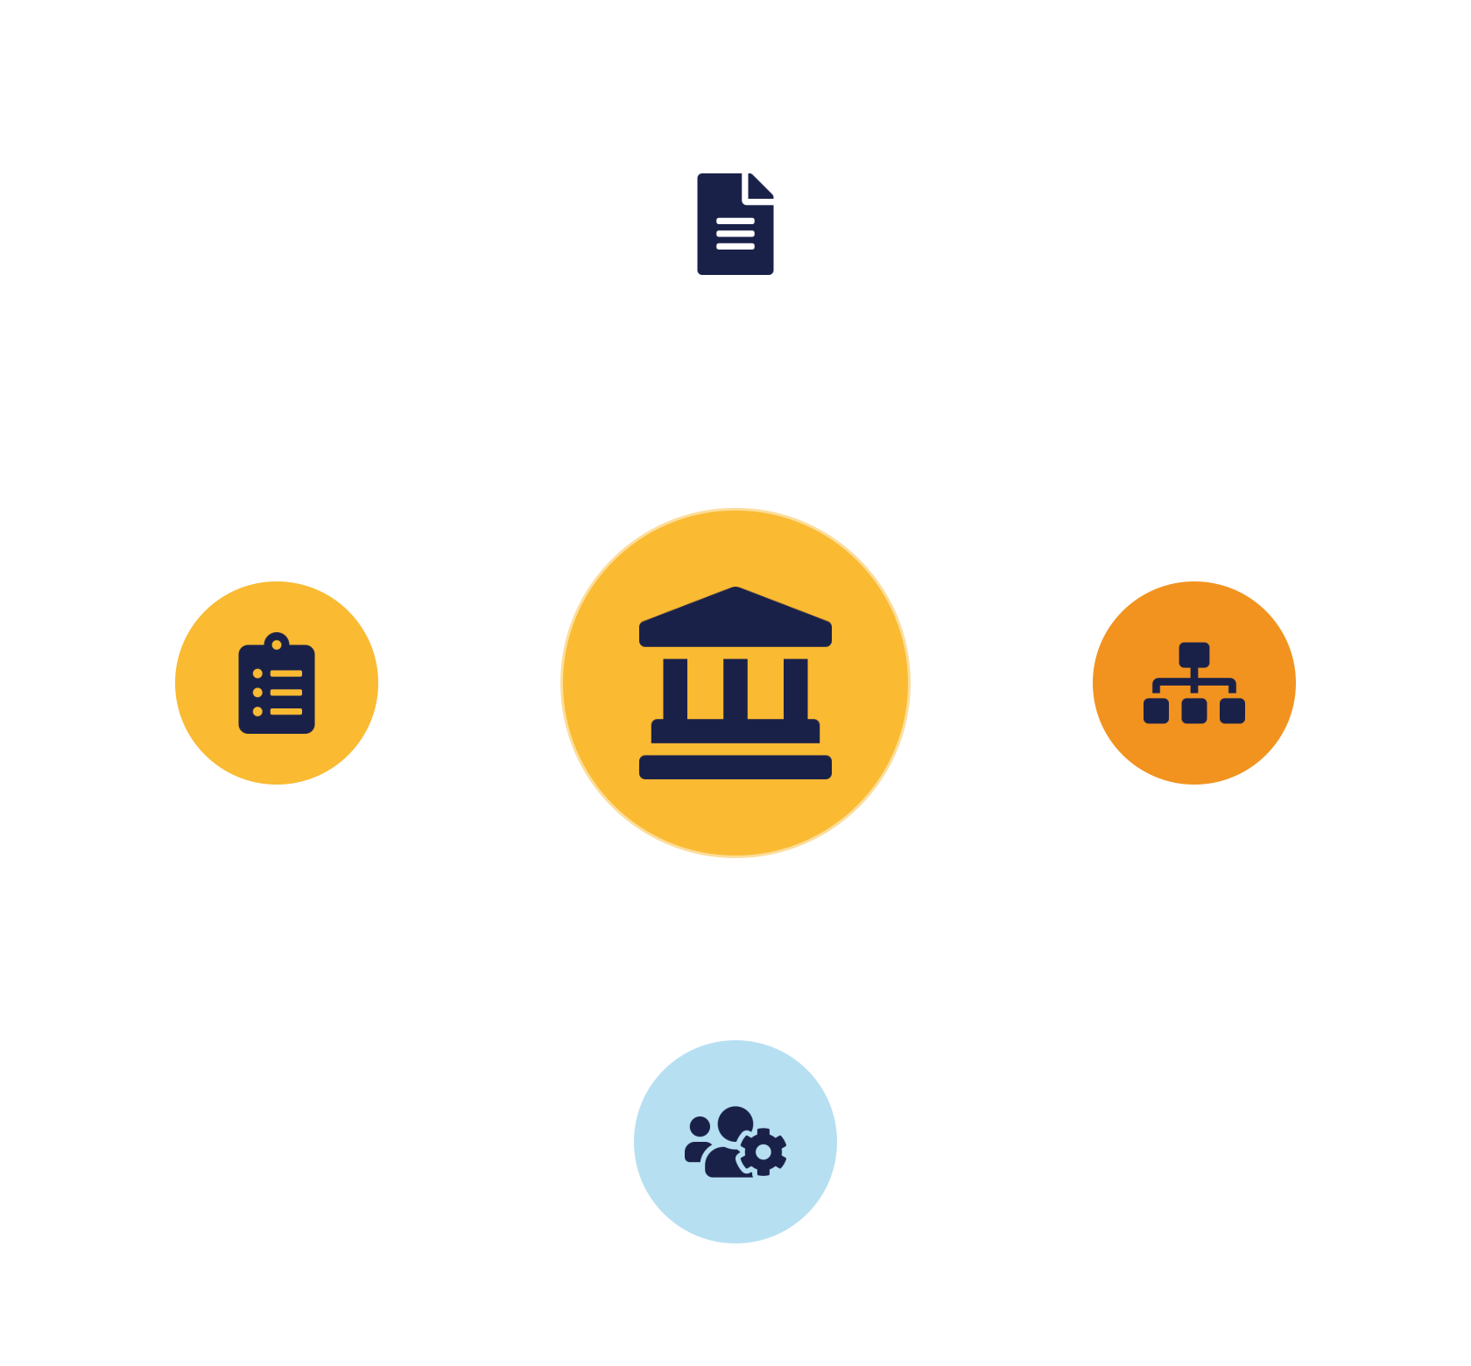
01
PART 1
Governance & Policy
Notes:
Governance is how leadership directs and controls security to meet objectives and obligations; policy is how governance is expressed. Without them, security is ad hoc and unaccountable.

Slide 5

DEFINITION
What is cloud governance?
The framework of decisions, policies and accountability that aligns cloud use with objectives, risk appetite and the law.
Governance is what auditors inspect.
Governance directs; management runs
Assigns accountability for each control
A control that isn't documented, owned and assessed may as well not exist to a regulator or a court.
Must be embedded — self-service moves fast
IKB42603 Cloud Computing Security Essentials
3
Notes:
Define it: cloud governance is the framework of decision-making, policies and accountability that ensures cloud use aligns with the organisation's objectives, risk appetite and legal obligations. Contrast governance with management: management runs security day to day; governance sets the direction, assigns accountability, and checks that management is doing the right things. Stress the shared-responsibility connection from Lesson 1 — governance is where an organisation formally decides which controls are theirs versus the provider's, and holds someone accountable for each. Note the cloud twist on the slide: because self-service lets anyone spin up resources in seconds, governance must be embedded (guardrails, policy-as-code) rather than relying on manual gatekeeping. The message: governance turns scattered technical controls into a coherent, accountable program — it is what an auditor, a regulator or a board actually inspects.

Slide 6



EXPRESSING GOVERNANCE
Security policies
Information security policy
Topic policies
Standards & procedures
Top-level, leadership-signed — how the program runs and what it protects.
Acceptable use, access, data classification, encryption, incident response.
Concrete, testable requirements — often enforced as policy-as-code.
Good policy is specific, owned and enforced — and it's the yardstick auditing checks against.
IKB42603 Cloud Computing Security Essentials
4
Notes:
Policies are how governance is written down and enforced. Explain the hierarchy on the slide. At the top sits the information security policy — the leadership-signed statement of how the security program is run and what it aims to protect; it should carry business-leadership sign-off to give it authority. Beneath it, topic-specific policies cover areas like acceptable use, access control, data classification, encryption and incident response. Below those, standards and procedures give the concrete, testable requirements — 'MFA is required for all admin access', 'data classified Confidential must be encrypted'. In the cloud, the most effective policies are enforced automatically as guardrails or policy-as-code, so violations are prevented or flagged rather than relying on people to remember. The teaching point: good policy is specific, owned, and enforced — vague policies no one can test are theatre. Policies are also the yardstick auditing (Lesson 6) checks against, tying governance to monitoring.

Slide 7
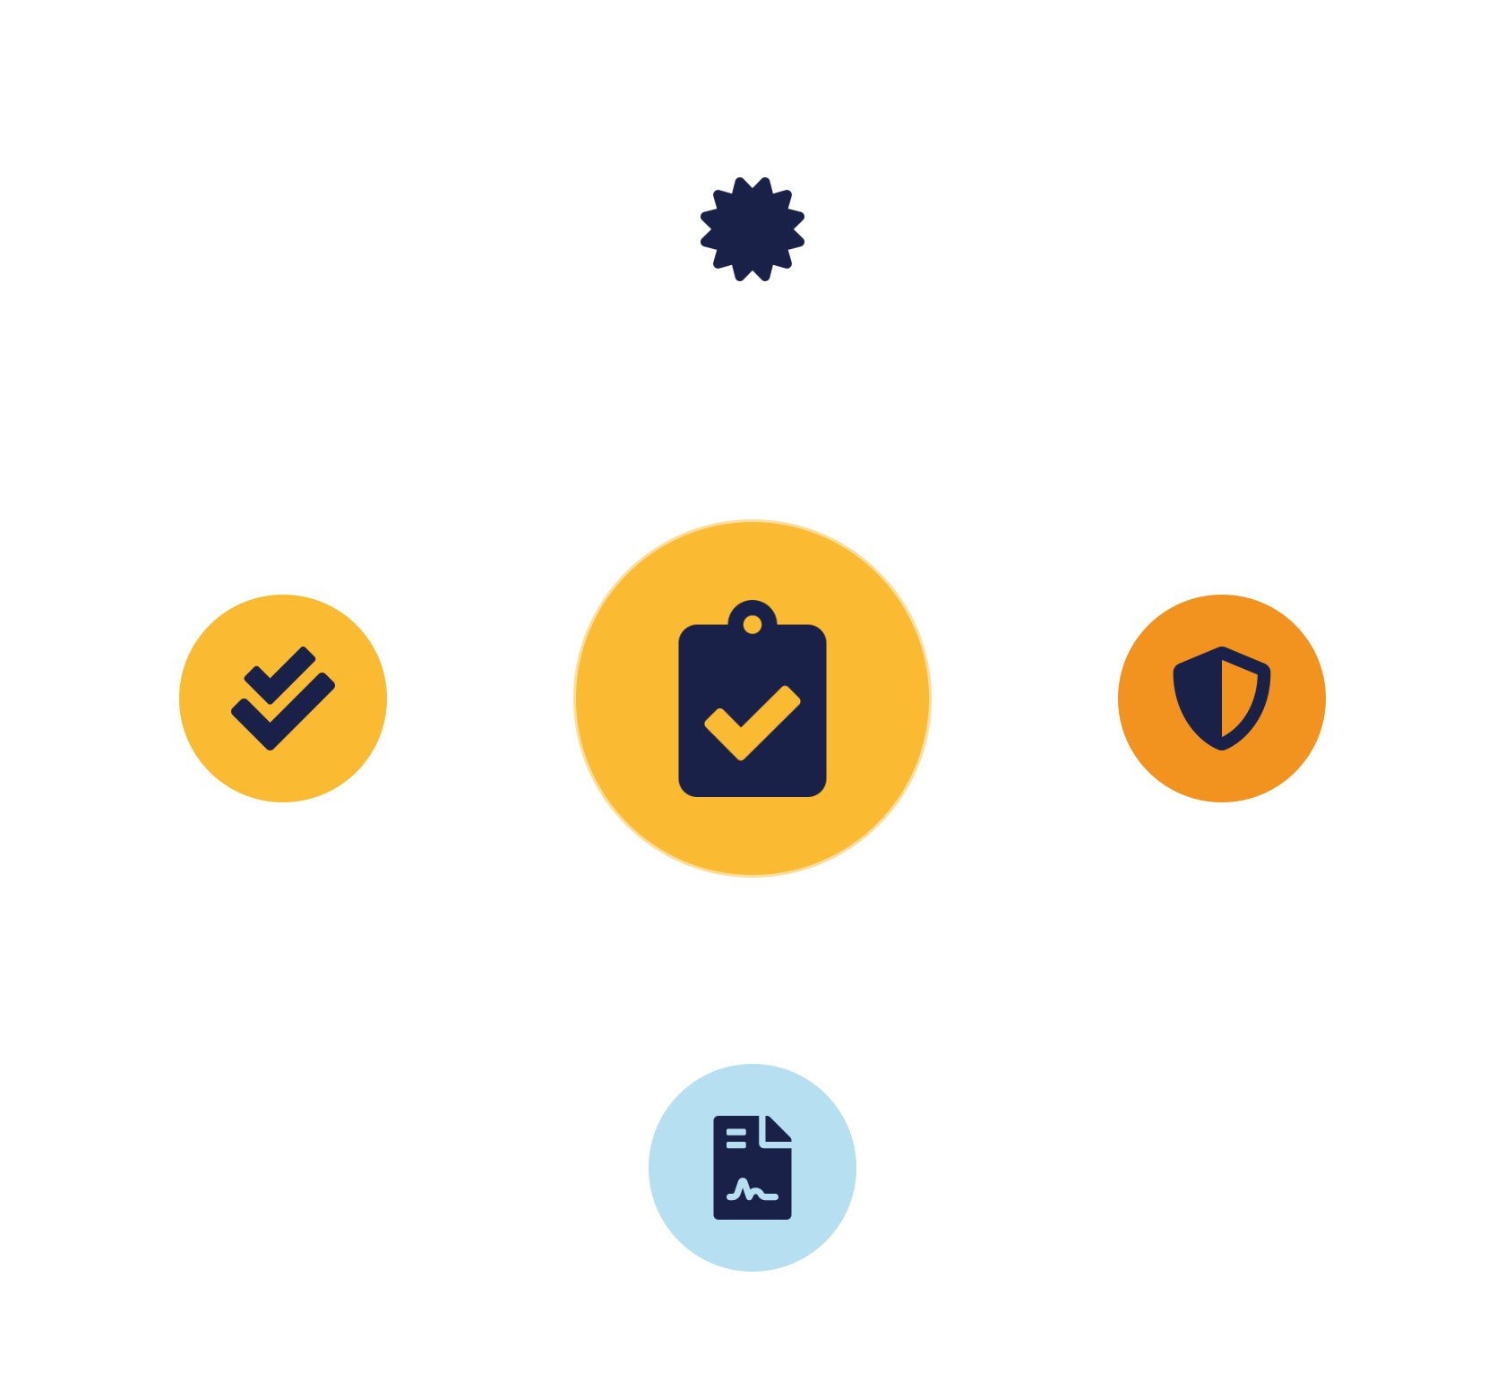
02
PART 2
Compliance & Standards
Notes:
Compliance means demonstrably meeting external obligations — laws, regulations and standards. We survey the frameworks that matter most in the cloud and the CSA STAR program that assesses providers against them.

Slide 8


WHY IT MATTERS
Compliance & key standards
Security & cloud standards
Data & industry rules
ISO/IEC 27001 — information security management
ISO/IEC 27018 — protecting PII in the cloud
ISO/IEC 27017 — cloud-specific controls
PCI DSS — payment-card data (Lesson 11)
NIST SP 800-53 / RMF — control catalogue & risk
GDPR / PDPA — privacy law with real penalties
IKB42603 Cloud Computing Security Essentials
5
Notes:
Compliance is demonstrably meeting the external obligations that apply to your data and industry — and 'demonstrably' is the operative word: you must be able to prove it with evidence, which is why the audit trail and documentation matter. Survey the standards on the slide, which students should recognise by name and purpose. ISO/IEC 27001 is the general information-security management standard; 27017 adds cloud-specific security controls; 27018 focuses on protecting personal data (PII) in the cloud — directly relevant to privacy. PCI DSS governs the handling of payment-card data, the subject of next week's case study. NIST SP 800-53 and the Risk Management Framework are the widely adopted US control catalogues. GDPR (and Malaysia's PDPA) are privacy laws with real penalties. The point: different data and industries trigger different obligations, and cloud adds the twist that responsibility is shared — the provider may be certified, but you must still configure and use the service compliantly. This sets up CSA STAR next, which is how you assess a provider's compliance.

Slide 9


ASSESSING PROVIDERS
CSA STAR, CCM & CAIQ
Cloud Controls Matrix
CAIQ
STAR registry
Cloud control catalogue mapped to ISO, PCI & more — meet many at once.
Standard questionnaire providers complete to document each control.
Providers publish assessments & certifications — compare postures.
STAR answers: 'how do I know my provider is secure?' — with evidence, not marketing.
IKB42603 Cloud Computing Security Essentials
6
Notes:
The Cloud Security Alliance provides the tools to assess and compare cloud providers, which students should know by name. The Cloud Controls Matrix (CCM) is a cloud-specific catalogue of security control objectives, mapped to many other standards — so meeting the CCM helps you meet ISO, PCI and others at once. The Consensus Assessments Initiative Questionnaire (CAIQ) is a standard questionnaire providers complete to document how they meet each CCM control — a transparency instrument. STAR, the Security Trust Assurance and Risk program, is the registry where providers publish their CAIQ self-assessments and third-party certifications, so customers can compare providers' security postures and make risk-aware choices. Explain the value: instead of trusting marketing, a customer can inspect a provider's STAR entry to see concrete evidence of controls. STAR has levels — self-assessment through independent third-party certification and continuous monitoring — giving increasing assurance. This is the practical answer to 'how do I know my provider is secure?' and it directly supports the shared-responsibility and compliance decisions governance must make.

Slide 10
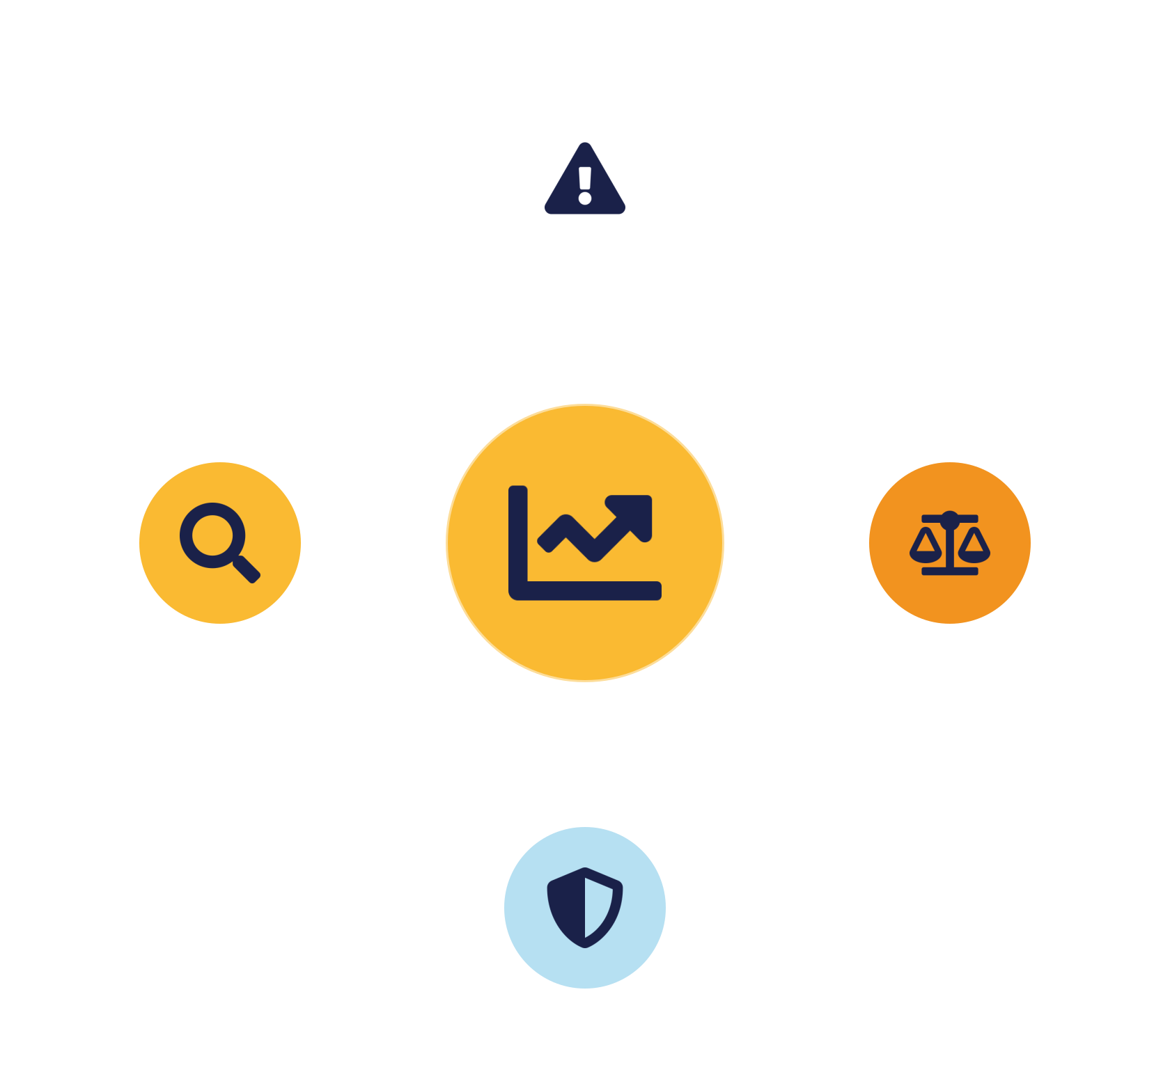
03
PART 3
Risk Management
Notes:
Compliance sets a floor; risk management decides where to invest above it. It is the disciplined process of identifying what could go wrong, how bad it would be, and what to do about it.

Slide 11



THE PROCESS
The risk-management process
→
→
→
Identify
Assess
Treat
Monitor
Risk = likelihood × impact. The goal is not zero risk but reducing it to an acceptable level (risk appetite).
IKB42603 Cloud Computing Security Essentials
7
Notes:
Walk the risk cycle on the slide. Identify: find the assets, threats and vulnerabilities — in the cloud this starts with knowing where data lives and how it flows (threat modeling). Assess: estimate each risk's likelihood and impact, often combined into a risk rating, to prioritise — you cannot fix everything, so you rank. Treat: decide what to do about each risk (the four options on the next slide). Monitor: risks change as the environment and threats evolve, so review continuously — the cloud changes fast. Stress that risk is measured as likelihood times impact, and the goal is not zero risk (impossible) but reducing risk to an acceptable level defined by the organisation's risk appetite, a governance decision. Connect to earlier lessons: the controls we have studied are risk treatments, and monitoring (Lesson 6) feeds the ongoing risk picture. This process is how professionals justify what to secure first — exactly the reasoning the assignment expects.

Slide 12



DECIDING WHAT TO DO
Risk treatment options
Mitigate
Transfer
Avoid
Accept
Apply controls to reduce likelihood or impact.
Share financial impact — insurance, contracts. Not accountability.
Stop the risky activity altogether.
Consciously accept low risk — documented & authorised.
Deliberate, documented choices — 'accept' is legitimate only when explicitly owned (VBE3).
IKB42603 Cloud Computing Security Essentials
8
Notes:
Once a risk is assessed, there are four standard treatment options — a framework students should memorise. Mitigate (reduce): apply controls to lower likelihood or impact — the most common choice and what most of this course has been about. Transfer (share): shift the financial impact to another party, for example through cyber-insurance or by contracting a provider to handle it — but note you can transfer financial impact, not accountability. Avoid: stop doing the risky activity altogether — for example, decide not to store a particularly sensitive data type in the cloud. Accept: consciously accept the risk when it is low or the cost of treatment exceeds the benefit — but acceptance must be a documented, authorised decision, not neglect. Add the key metrics on the slide that inform these choices — likelihood, impact, and residual risk (what remains after treatment). The teaching point: risk management is about deliberate, documented choices, not eliminating all risk — and 'accept' is a legitimate option only when explicitly owned. This is the professional-integrity (VBE3) discipline behind CLO3.

Slide 13
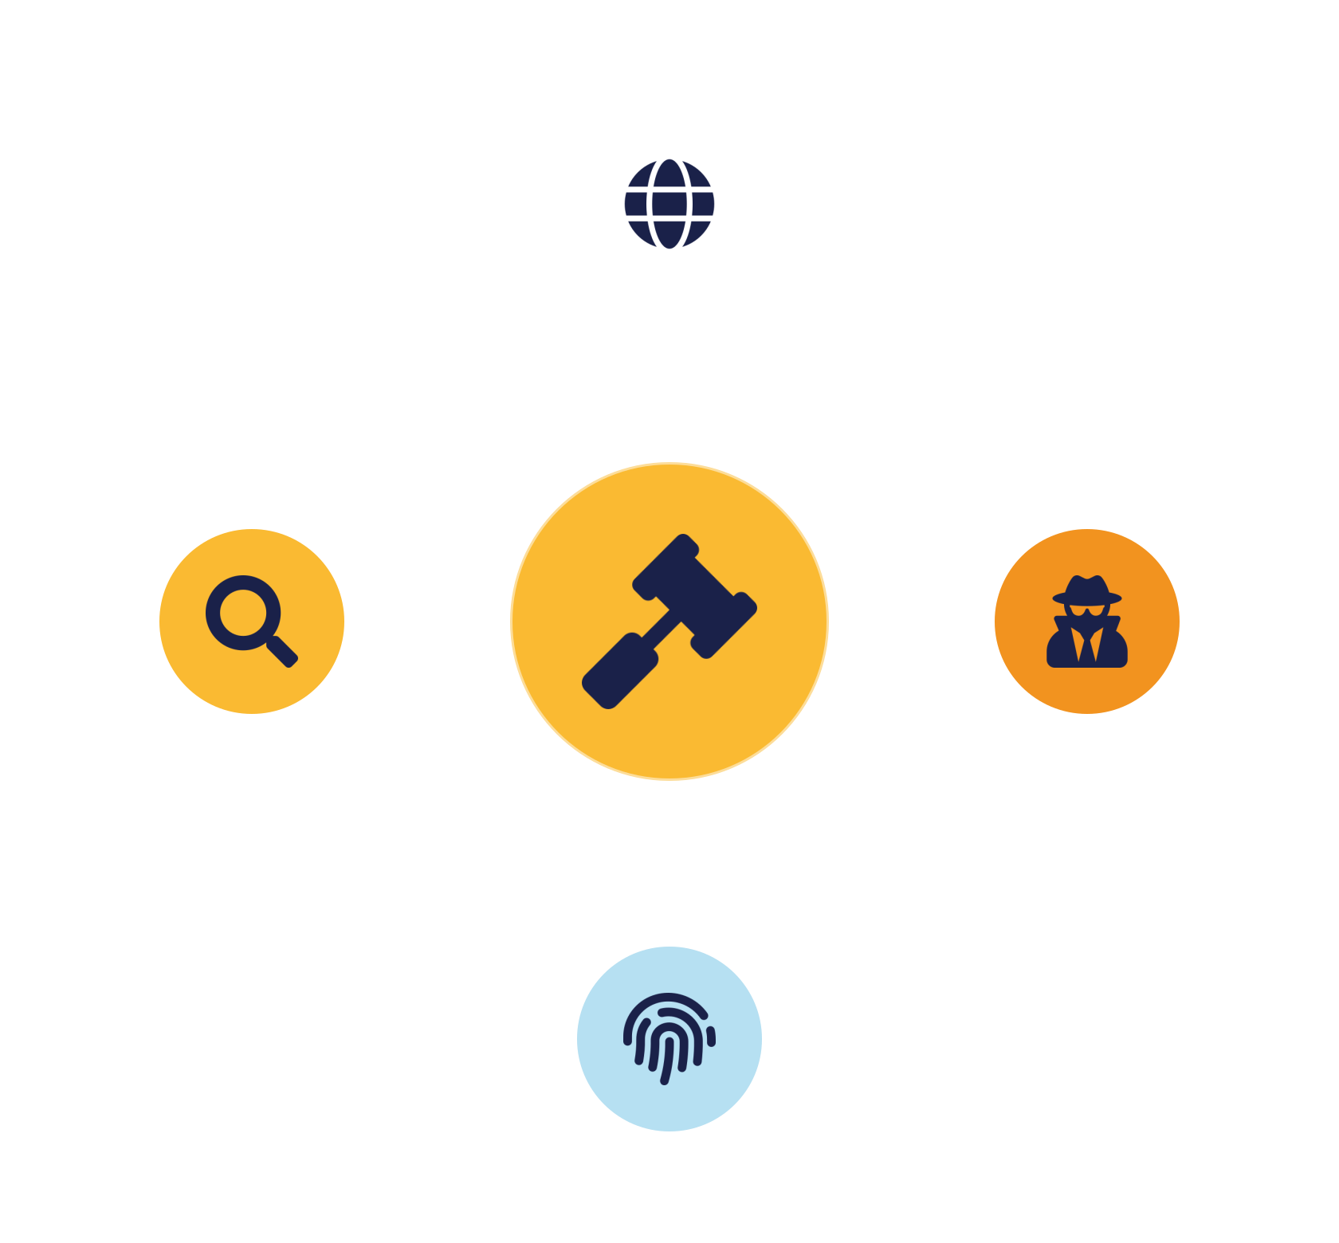
04
PART 4
Legal, Forensics & Privacy
Notes:
The cloud crosses borders, which raises hard legal questions about where data lives, who can compel access to it, and how you investigate incidents on infrastructure you don't own.

Slide 14


WHERE DATA LIVES
Jurisdiction & data sovereignty
Jurisdiction
Data sovereignty
Which country's laws apply to your data?
Some data must stay within borders.
Depends on storage, org & user location —
Residency requirements — gov, finance, health
Possibly several regimes at once —
Cross-border transfer limits — e.g. GDPR
Foreign governments may compel access —
Control where data is stored — region selection
IKB42603 Cloud Computing Security Essentials
9
Notes:
In the cloud, your data may physically reside in another country, which triggers legal complexity students must appreciate. Jurisdiction: the laws that apply to your data can depend on where it is stored, where your organisation is, and where your users are — potentially several regimes at once. Data sovereignty: many countries and sectors require that certain data stay within national borders, or forbid it leaving — Malaysia's regulatory environment and sectors like government and finance have such requirements. Cross-border transfer: laws like GDPR restrict moving personal data to countries without adequate protection. The practical consequence on the slide: you must know and control WHERE your data is stored, which is why providers offer region selection and why governance must set data-residency policy. Add the sobering point that a foreign government may be able to compel a provider to disclose data under its own laws, regardless of your wishes — a real consideration for sensitive data. The lesson: cloud is global, but law is territorial, and reconciling the two is a governance obligation.

Slide 15



PROTECTING PEOPLE
Privacy & data protection
Privacy principles
Individual rights
Key laws
Collect minimally, use for stated purposes, keep secure, retain briefly.
Access, correction, erasure — the 'right to be forgotten'.
GDPR · Malaysia PDPA · ISO 27018 · sector health rules.
You remain the data controller — accountable for personal data even when the provider processes it.
IKB42603 Cloud Computing Security Essentials
10
Notes:
Privacy law protects personal data — information about identifiable individuals — and non-compliance carries heavy penalties and reputational damage. Cover the essentials on the slide. Privacy principles: collect only what you need, use it only for stated purposes, keep it accurate and secure, and retain it only as long as necessary — echoing the data-protection lifecycle from Lesson 4. Individual rights: modern laws grant people rights over their data — access, correction, and erasure (the 'right to be forgotten', which is why provable deletion from Lesson 4 is a legal requirement). Key laws: GDPR in Europe, Malaysia's Personal Data Protection Act (PDPA), and sector rules like health-data protection. ISO 27018 gives cloud-specific PII controls. The cloud angle: when you use a cloud service to process personal data, you remain the data controller responsible for it, even though the provider processes it — shared responsibility applied to privacy. The message for future professionals: privacy is not optional or purely legal; it is a design and governance obligation, and the VBE3 integrity value expects you to protect people's data conscientiously. This directly sets up next week's PHI case study.

Slide 16
AFTER AN INCIDENT
Cloud forensics & e-discovery
Cloud forensics
E-discovery
Chain of custody
Hard: no owned hardware, ephemeral resources — immutable logs are key evidence.
Locate & produce specific data — needs a known data map.
Handle evidence so its integrity is provable in court.
Arrange forensic support & data access in the contract — after an incident is too late.
IKB42603 Cloud Computing Security Essentials
11
Notes:
When an incident or legal dispute occurs, you must be able to investigate and produce evidence — and the cloud makes this harder. Cloud forensics: gathering evidence about an incident is complicated by not owning the hardware, by data being spread across regions, and by resources being ephemeral (a compromised VM may be gone before you image it) — which is exactly why the tamper-proof, immutable logging from Lesson 6 is essential; those logs are often the only durable evidence. E-discovery: legal proceedings may require you to locate and produce specific data, which is difficult if you do not know where your data is or cannot search it — reinforcing the data-mapping and governance discipline. Chain of custody: evidence must be collected and handled so its integrity is provable in court, connecting back to integrity controls. The practical takeaways on the slide: log everything immutably in advance, know your data map, and agree forensic support and data access with your provider in the contract — because after an incident is too late to arrange it. This bridges the technical monitoring pillar to legal accountability.

Slide 17
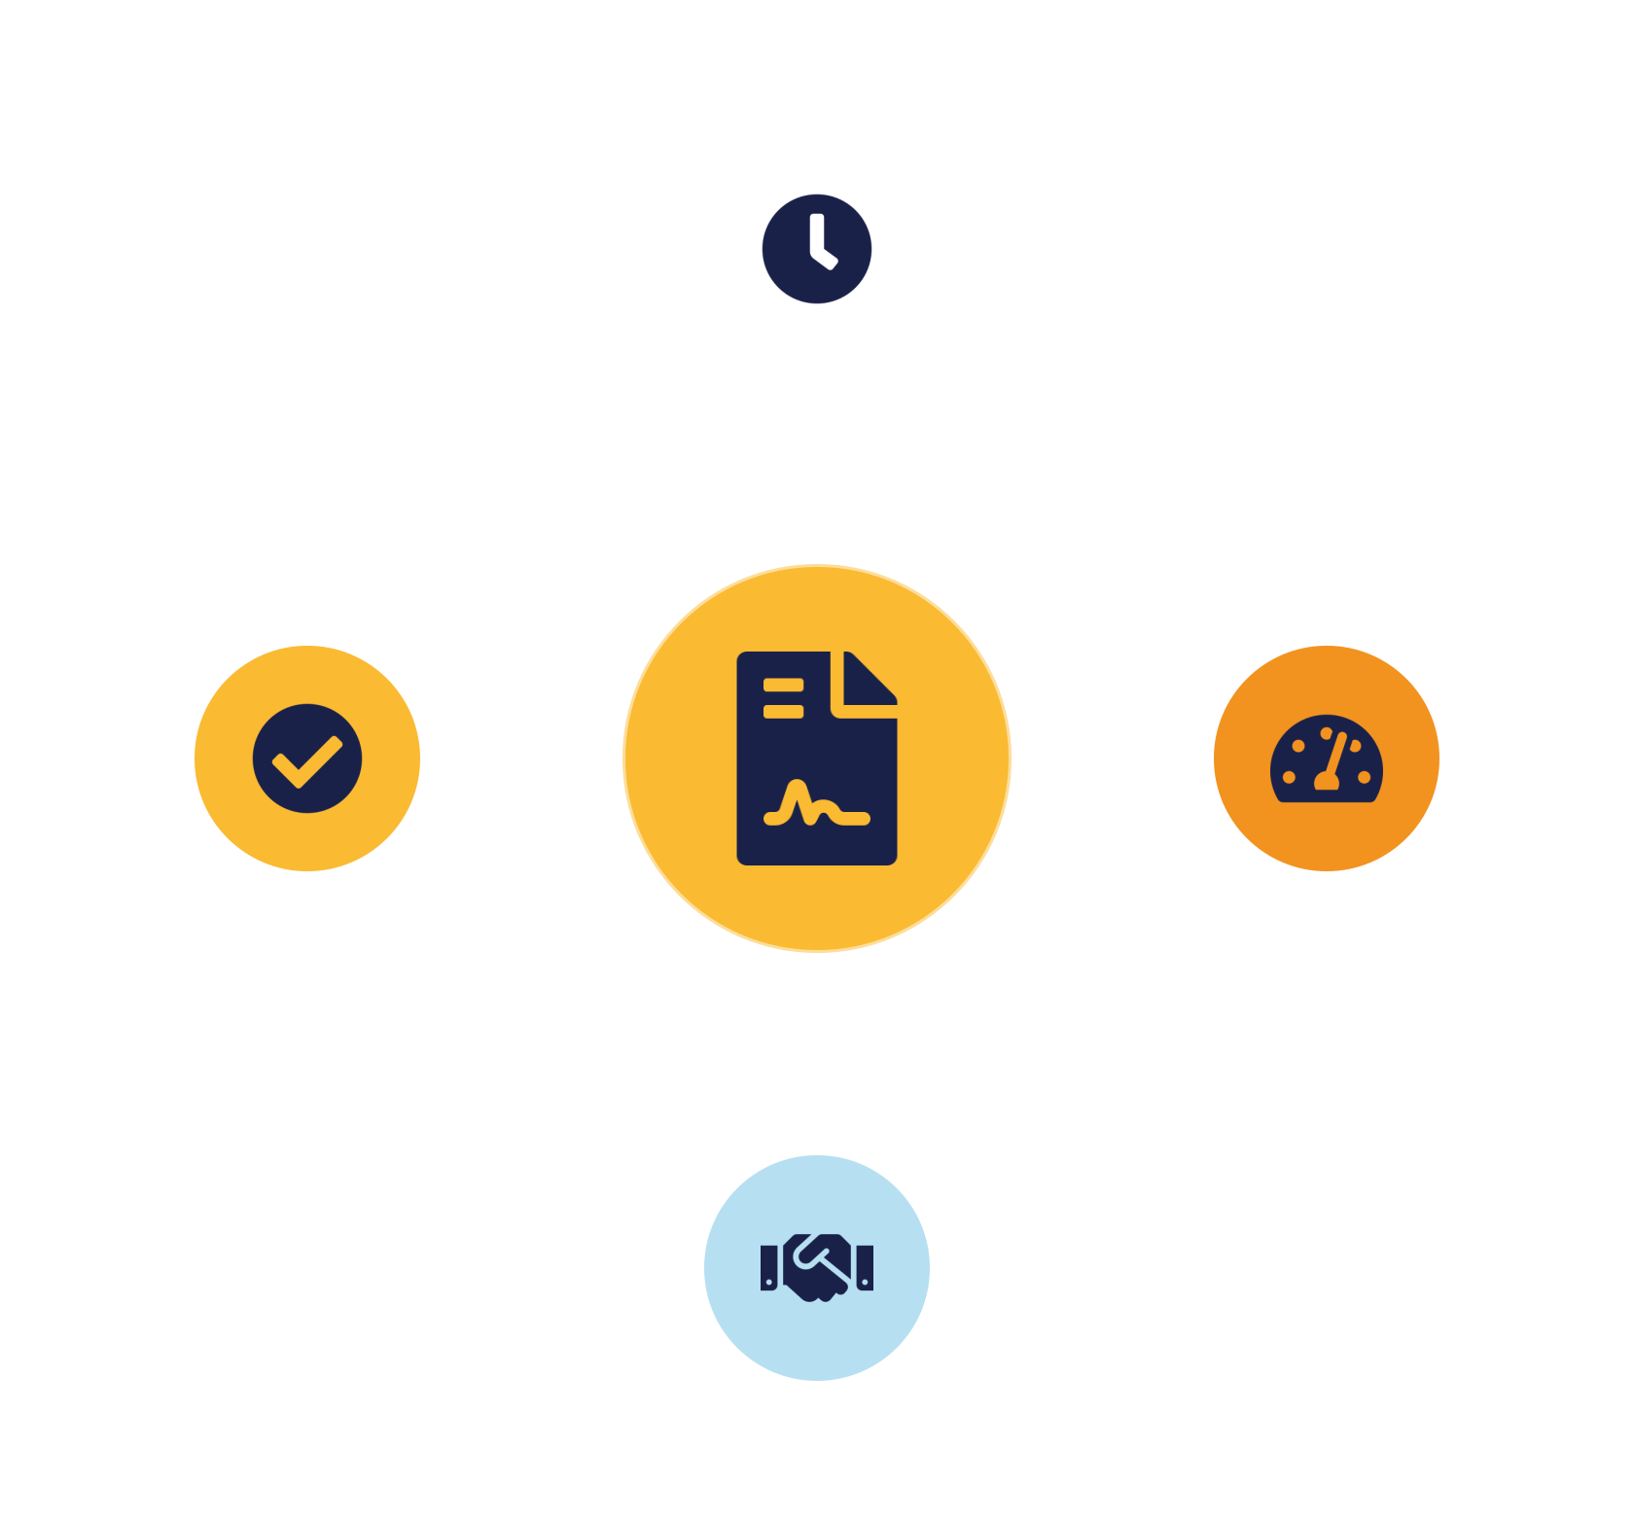
05
PART 5
SLAs, Case Study & Practice
Notes:
The service-level agreement is the contract that turns provider promises into measurable, enforceable obligations. It is where much of governance, compliance and risk becomes concrete — and it is central to CLO3.

Slide 18


THE CONTRACT
Service Level Agreements (SLAs)
Commitments & metrics
Terms & remedies
Availability (the 'nines') — measurable uptime
Responsibilities matrix — who secures what
Performance & support times —
Remedies — service credits if missed
Measurable = enforceable —
Breach notice, audit rights, exit — data location & deletion
IKB42603 Cloud Computing Security Essentials
12
Notes:
The SLA is the formal contract defining what the provider commits to and what happens if they fall short — the instrument that makes the shared-responsibility model legally concrete. Cover the components on the slide. Service commitments and metrics: measurable targets like uptime/availability (the famous 'number of nines'), performance and support response times — measurable, because a promise you cannot measure is unenforceable. Responsibilities: who is accountable for what, including security duties — the shared-responsibility matrix written into contract. Remedies: what the customer is owed if targets are missed, typically service credits — though note credits rarely cover the true cost of an outage, so critical workloads need their own resilience. Security & compliance terms: data handling, breach notification timelines, audit rights, data location, and what happens to your data when the contract ends (exit and deletion). The teaching point that carries into CLO3: reading and negotiating an SLA is a core professional skill — it is where you verify the provider will actually meet your compliance and data-privacy obligations, and where you hold them accountable with professional integrity (VBE3). Students will assess SLAs against data-privacy obligations in the assignment.

Slide 19

APPLY IT
Case study — the compliance gap
A health startup moved patient data to the cloud to save cost — without checking the provider's compliance, setting data-residency, or reading the SLA. A provider breach exposed the data; penalties followed.
What failed?
How to prevent?
Governance: no compliance assessment (STAR/CAIQ) · no residency/privacy controls · unread SLA · still the data controller.
Assess provider vs standards first · set residency & privacy policy · negotiate SLA (breach notice, audit) · manage risk explicitly.
IKB42603 Cloud Computing Security Essentials
13
Notes:
Run as a discussion. Scenario: a healthcare startup moved patient data to a cloud provider to save cost, but never checked the provider's compliance, set no data-residency policy, and signed the default SLA without reading the security and breach-notification terms. A breach at the provider exposed patient data; the startup learned of it weeks late and faced regulatory penalties because it could not show it had managed the risk. Ask the two questions. What failed? A governance failure — no compliance assessment (they could have checked the provider's STAR/CAIQ), no data-residency or privacy controls (ISO 27018/PDPA obligations ignored), and an unread SLA with weak breach-notification terms; the startup remained the data controller and accountable. How to prevent? Assess the provider against standards before adopting, set data-residency and privacy policy, negotiate SLA terms for breach notice and audit rights, and manage the risk explicitly. The teaching point: technical security alone would not have saved them — the failure was governance, compliance and contract, which is precisely CLO3. Let pairs report before consolidating; connect to VBE3 professional integrity — managing others' data responsibly.

Slide 20
BASELINE
Best practices — governance & compliance
Establish governance
Map your obligations
Clear policies, named accountability.
Which laws & standards apply.
Assess providers (STAR)
Run risk continuously
Evidence before adoption.
Document treatment decisions.
Control data location & privacy
Read & negotiate SLAs
Meet sovereignty and law.
Measurable, enforceable terms.
IKB42603 Cloud Computing Security Essentials
14
Notes:
Distil the lesson. Establish governance with clear policies and named accountability. Map your obligations — which laws and standards apply to your data. Assess providers against standards using CSA STAR before adopting. Run the risk process continuously and document treatment decisions. Control data location and privacy to meet sovereignty and law. And read and negotiate SLAs so provider promises are measurable and enforceable. Tell students these are the CLO3 skills and the heart of the assignment and presentation. Preview: next week, Lesson 11 applies all of this to concrete compliance assessment and reporting — with the PCI DSS and patient-data case study.

Slide 21
RECAP
Key takeaways
1 Governance and policy turn scattered controls into an accountable program — what auditors inspect.
2 Compliance = demonstrably meeting standards & laws; CSA STAR assesses providers with evidence.
3 Risk management is continuous — identify, assess, treat (mitigate/transfer/avoid/accept), monitor.
4 The cloud raises legal, sovereignty & privacy duties — the SLA makes provider responsibilities enforceable.
IKB42603 Cloud Computing Security Essentials
15
Notes:
Consolidate. One: governance and policy turn scattered controls into an accountable program — it is what auditors inspect. Two: compliance means demonstrably meeting standards and laws (ISO 27017/27018, PCI DSS, GDPR/PDPA), and CSA STAR lets you assess providers with evidence. Three: risk management is a continuous identify-assess-treat-monitor cycle, and treatment is a documented choice among mitigate, transfer, avoid, accept. Four: the cloud raises legal, sovereignty and privacy obligations, and the SLA is the contract that makes provider responsibilities enforceable. Ask students to name the four risk-treatment options and one standard for privacy. Preview Lesson 11: compliance assessment and reporting.

Slide 22

Discussion & Q&A
If your provider is certified compliant, are you compliant? Why or why not?
Which risk-treatment option is most often misused as an excuse for inaction — and how would you guard against it?
Next week — Lesson 11: Cloud Compliance Assessment & Reporting (PCI DSS · protecting health information · SLAs)
Notes:
Close with the prompts. The first is the crucial shared-responsibility point: provider certification covers their layer; you must still configure and use the service compliantly and remain the data controller. The second draws out that 'accept' is often neglect in disguise — guard against it with documented, authorised acceptance. Preview Lesson 11. Remind students this lesson underpins the Assignment (CLO3) on SLA and data-privacy, and carries the VBE3 professional-integrity value.

