Slide 1


IKB42603 • Cloud Security
WEEK 11 · LESSON 11
Cloud Compliance Assessment & Reporting
Assessment process · PCI DSS · Protecting health information · SLAs & reporting
Universiti Kuala Lumpur · UniKL MIIT | Prof. Dr. Shahrulniza Musa

Slide 2

LEARNING OUTCOMES
What you will be able to do
1. Run a compliance assessment
2. Apply PCI DSS in the cloud
The audit lifecycle and STAR levels.
Scope, tokenization, shared responsibility.
3. Protect health information (PHI)
4. Report compliance credibly
Safeguards for sensitive personal data.
Evidence, audit reports, continuous compliance.
5. Evaluate SLAs for data privacy
6. Present a compliance case
Holding providers to obligations.
Communicate findings with integrity (VBE3).
IKB42603 Cloud Computing Security Essentials
1
Notes:
Welcome to Lesson 11, the capstone of the compliance strand and the lesson most directly tied to your assignment. Last week we covered governance, standards and risk in principle; today we make it concrete — how compliance is actually assessed, reported and demonstrated, using two of the most demanding real-world regimes: PCI DSS for payment data and health-information protection for patient data. This is CLO3, assessed by the assignment and your presentation, and it carries the VBE3 professional-integrity value. Walk the outcomes. Tell students that by the end they should be able to assess a cloud service against a standard, protect regulated data, and report compliance credibly — exactly what the assignment asks. The lesson deliberately mirrors the assignment scenario.

Slide 3



CONSTRUCTIVE ALIGNMENT
Curriculum alignment — CLO · PLO · MQF · clusters
Present cloud services' compliance with SLAs and data-privacy obligations with professional integrity.
CLO 3
Programme outcome
Values & skills
Assessment
PLO9 · Ethics & Professionalism
MQF Level iii(f)
Bloom A2 (Respond)
VBE3 · Integrity
A2 · Professionalism
Assignment
Presentation
Constructive alignment: CLO → PLO → MQF, with VBE (values) and SC (skills) clusters, assessed as shown.
IKB42603 Cloud Computing Security Essentials
2
Notes:
Constructive-alignment slide. Lesson 11 maps to CLO3 — presenting compliance with professional integrity — aligned to PLO9, MQF Level iii(f), Bloom A2, carrying the VBE3 integrity value. It is assessed through the Assignment and the compliance Presentation, so this lesson is the most direct rehearsal of the CLO3 assessment. Emphasise the professional-integrity dimension to students.

Slide 4
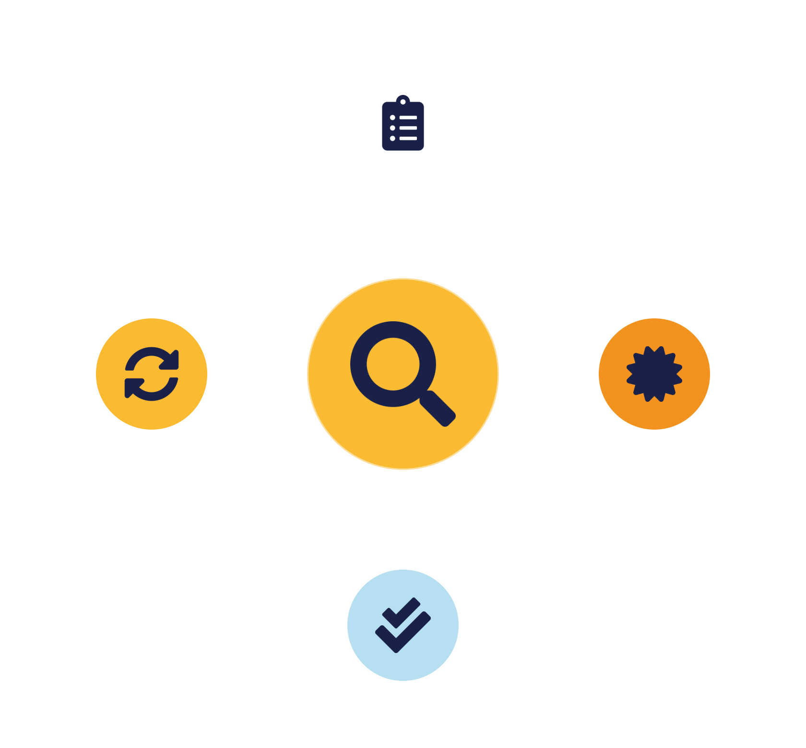
01
PART 1
The Compliance Assessment Process
Notes:
Compliance is not a one-off tick-box; it is an ongoing assessment cycle. We cover how you actually evaluate a system or provider against a standard, and the levels of assurance that different assessment methods give.

Slide 5



THE CYCLE
How compliance is assessed
→
→
→
Scope
Assess
Report
Remediate & monitor
Evidence is everything: 'we think we're compliant' is worthless; 'here is proof for each control' is compliance.
IKB42603 Cloud Computing Security Essentials
3
Notes:
Walk the assessment lifecycle on the slide. Scope: define exactly what is being assessed — which systems, data and controls are in scope; getting scope right is half the battle, as we'll see with PCI. Assess: evaluate the in-scope controls against the standard's requirements, gathering evidence for each — configurations, logs, policies, screenshots. Report: document findings, gaps and remediation, producing the compliance report or attestation. Remediate and re-assess: fix gaps and verify, because compliance is only meaningful once gaps are closed. Then monitor continuously, because compliance drifts as systems change. Stress the evidence theme: an assessment is only as good as the evidence behind it — 'we think we're compliant' is worthless; 'here is proof for each control' is compliance. This is where the tamper-proof audit trail from Lesson 6 pays off, providing the durable evidence. The cycle repeats, because a system compliant today can drift out of compliance tomorrow.

Slide 6


LEVELS OF ASSURANCE
Assessment methods & CSA STAR levels
Self-assessment
Third-party audit
Continuous monitoring
Provider documents controls (CAIQ). Transparent but unverified — lowest assurance.
Independent assessor certifies (STAR L2). Much higher assurance.
Automated, ongoing verification. Catches drift — highest assurance.
Match the assurance level to the data's sensitivity — regulated data warrants certification + monitoring.
IKB42603 Cloud Computing Security Essentials
4
Notes:
Different assessment methods give different levels of trust, and CSA STAR from Lesson 10 organises them into levels students should know. Self-assessment: the organisation or provider evaluates itself, typically documenting controls in the CAIQ questionnaire — useful and transparent, but lowest assurance because it is unverified. Third-party audit: an independent, accredited assessor verifies the controls and issues a certification or attestation (STAR Level 2) — much higher assurance because someone external checked. Continuous monitoring: automated, ongoing verification of controls (STAR's continuous level) — the highest assurance, because it catches drift in near real time rather than at an annual snapshot. Map this to the STAR registry: providers publish self-assessments and certifications there so customers can see the assurance level. The teaching point: assurance is a spectrum, and the level you require should match the sensitivity of your data — self-assessment may suffice for low-risk data, but regulated payment or health data warrants third-party certification and continuous monitoring. This directly informs how students should assess the provider in their assignment scenario.

Slide 7
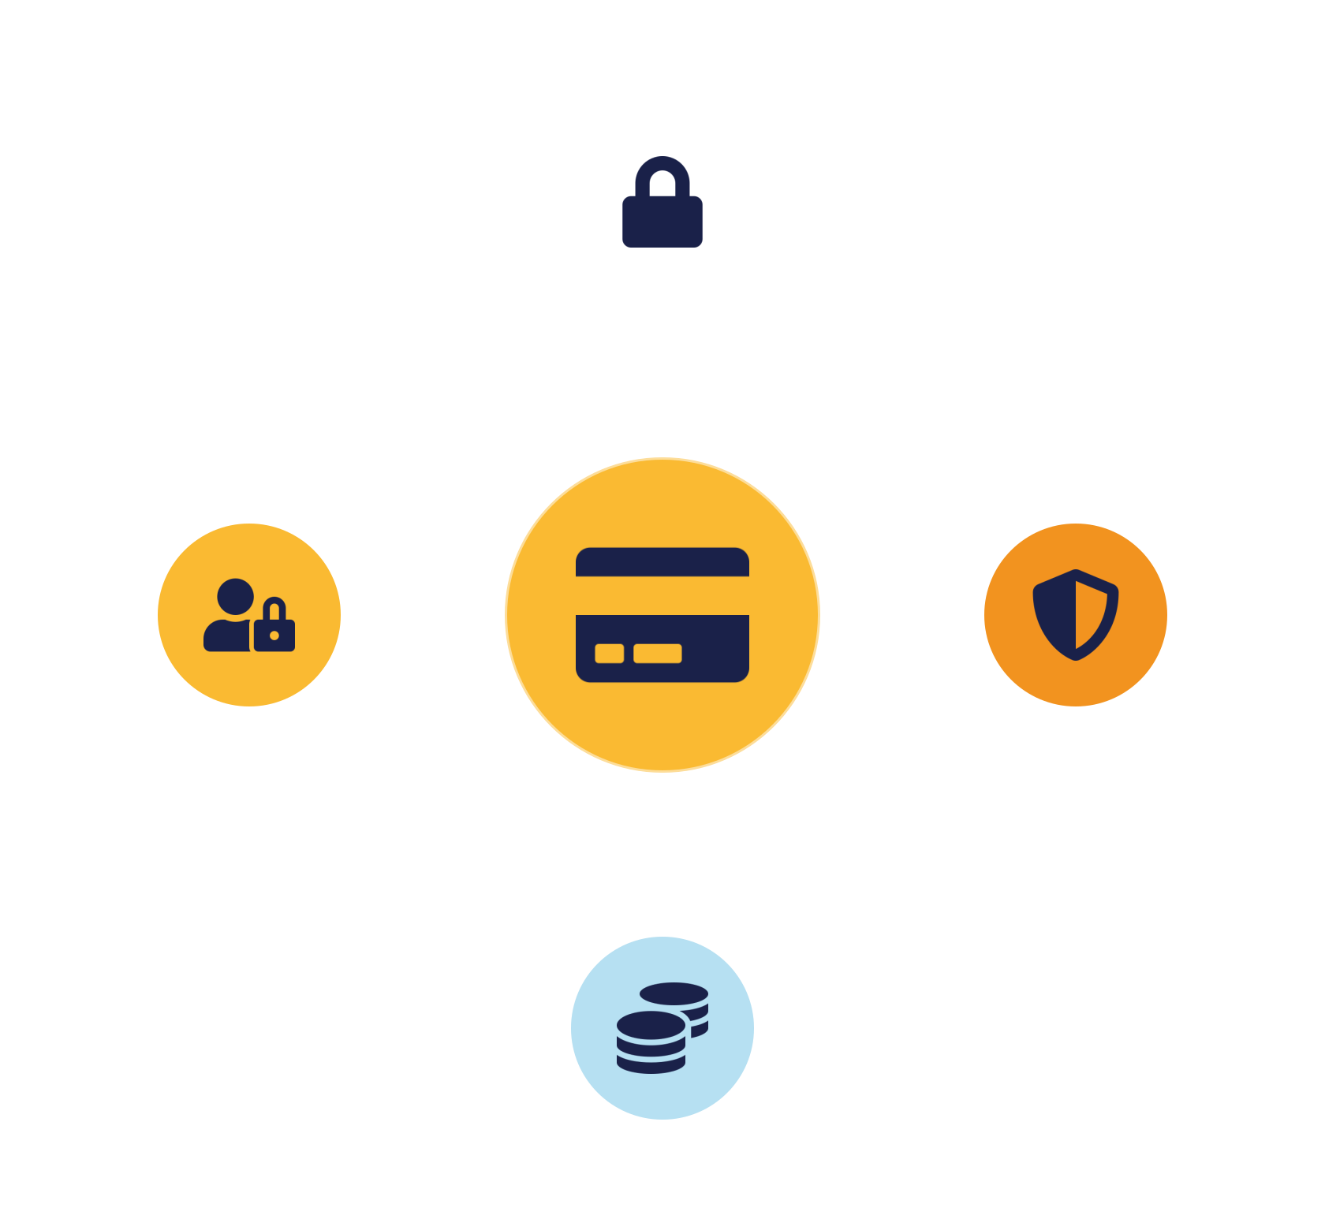
02
PART 2
PCI DSS in the Cloud
Notes:
The Payment Card Industry Data Security Standard governs any organisation that stores, processes or transmits payment-card data. It is strict, widely enforced, and a perfect example of assessing and reducing compliance scope in a multi-tenant cloud.

Slide 8


THE STANDARD
PCI DSS — protecting payment-card data
Secure the environment
Control & verify
Secure network — firewalls, no default passwords
Strong access control — need-to-know, unique IDs
Protect cardholder data — encrypt at rest & in transit
Monitor & test — logging, regular testing
Vulnerability management — anti-malware, secure dev
Security policy — documented & maintained
6 goals · 12 requirements — essentially this whole course applied to one data type, with audits.
IKB42603 Cloud Computing Security Essentials
5
Notes:
PCI DSS is a mandatory standard for anyone handling payment-card data, organised into six control goals covering twelve requirements. Summarise the goals on the slide rather than memorising all twelve: build and maintain a secure network (firewalls, no vendor defaults); protect cardholder data (encryption in storage and transit); maintain a vulnerability-management program (anti-malware, secure development); implement strong access control (need-to-know, unique IDs, physical security); regularly monitor and test networks (logging, testing); and maintain an information-security policy. Point out how these map onto everything we have studied — segmentation, encryption, access control, monitoring, policy — PCI is essentially our whole course applied to one data type with mandatory rigor and audits. Stress the enforcement: non-compliance can mean fines, higher transaction fees, or losing the ability to process cards at all — real business consequences. This sets up the crucial cloud angle next: how to reduce the scope of what must be compliant.

Slide 9



THE SMART MOVE
PCI DSS in a multi-tenant cloud
Tokenize to cut scope
Shared responsibility
Segment & prove
Replace card numbers with tokens — most systems leave PCI scope.
Provider's PCI cert covers infra; you must configure & use it compliantly.
Isolate the card-data environment — and demonstrate it to the assessor.
Compliance is an architecture problem: design to minimise scope, then prove isolation with evidence.
IKB42603 Cloud Computing Security Essentials
6
Notes:
The key insight for cloud PCI compliance is scope reduction: the fewer systems that touch cardholder data, the fewer must be assessed, so smart architecture shrinks the compliance burden. The most powerful technique is tokenization from Lesson 4 — replace the card number with a token everywhere except one tightly-controlled vault, so the rest of your systems never hold real card data and fall out of PCI scope entirely; this is why tokenization is standard in payments. Second, shared responsibility: in the cloud, a PCI-certified provider covers the infrastructure controls, but you remain responsible for how you configure and use the service — a provider's PCI certification does not make you compliant, it is a building block. Third, multi-tenancy and segmentation: you must ensure your cardholder-data environment is strongly isolated from other tenants and from your own non-card systems, using the segmentation patterns from Lessons 3 and 9, and be able to prove that isolation to an assessor. The teaching point: compliance is an architecture problem — design to minimise scope, use the provider's certifications as evidence, and prove your isolation. This is the reasoning the assignment's PCI tenant scenario demands.

Slide 10

03
PART 3
Protecting Health Information
Notes:
Health data — personal health information, or PHI — is among the most sensitive data any system holds, and protecting it is both a legal obligation and an ethical one. This is the second regulated data type in the assignment scenario.

Slide 11



THE MOST SENSITIVE DATA
Personal health information (PHI)
Data about a person's health that can identify them — among the most sensitive, most regulated data of all.
Highly sensitive & permanent
Heavily regulated
A duty of care (VBE3)
Exposure causes lasting harm — it can't be reissued like a card.
HIPAA-style laws · PDPA · ISO 27018 for cloud PII.
Protecting patient data protects people at their most vulnerable.
IKB42603 Cloud Computing Security Essentials
7
Notes:
Personal health information is data about an individual's health, care or payment for care that can identify them — and it is exceptionally sensitive because its exposure can cause discrimination, distress and irreversible harm, and it cannot be reissued like a stolen card number. Explain why it demands the highest protection on the slide: it is highly sensitive and permanent; it is heavily regulated — by health-privacy laws such as HIPAA internationally, Malaysia's PDPA, and ISO 27018 for cloud PII; and breaches carry severe penalties and profound loss of trust. Frame the professional-integrity angle (VBE3): handling patient data is a duty of care, not just a compliance checkbox — a future IT professional protecting health records is protecting real people at their most vulnerable. The cloud tension: healthcare increasingly uses cloud for cost and capability, so the question is not whether to use the cloud but how to use it in a way that protects PHI to the required standard. The next slide gives the concrete safeguards.

Slide 12


THE SAFEGUARDS
Controls for protecting PHI
Technical safeguards
Administrative & contractual
Encrypt PHI everywhere — rest, transit, backups
Policies, training, risk assessment —
Strict least-privilege access — need-to-know + MFA
Provider agreement (BAA) — protect + report breaches
Tamper-proof access logs — who saw what, when
Data residency & breach notice —
IKB42603 Cloud Computing Security Essentials
8
Notes:
The safeguards for PHI are a rigorous application of controls from across the course — this slide shows how the whole course serves one demanding requirement. Technical safeguards: encrypt PHI at rest, in transit and in backups (Lesson 4); enforce strict least-privilege, need-to-know access control with MFA (Lesson 5); and log every access to PHI in tamper-proof form for audit (Lesson 6) — in healthcare, who looked at a record and when is itself regulated. Administrative safeguards: policies, staff training, and risk assessments (Lesson 10). Physical and contractual: ensure the provider offers a suitable agreement (a Business Associate Agreement or equivalent) committing them to protect the PHI and report breaches, and confirm data residency meets the law. The teaching point: there is no single 'PHI control' — protection comes from composing encryption, access control, monitoring, governance and contract, exactly the integrated approach the course has built toward. Emphasise breach notification: health-data breaches must be reported promptly, so detection and monitoring are compliance requirements, not just good practice. This is precisely the scenario students address in the assignment.

Slide 13

04
PART 4
Reporting & Continuous Compliance
Notes:
Compliance must be demonstrated, not just achieved. We cover how to report it credibly with evidence, and why compliance must be maintained continuously rather than proven once a year.

Slide 14


DEMONSTRATING IT
Compliance reporting & evidence
Scope & findings
Evidence for every claim
Gaps & remediation plan
What was assessed; what met the standard and what didn't.
Configs, logs, policies, tests — unsupported claims fail.
Document known issues with owners and timelines.
Report honestly (VBE3): overstating compliance or hiding gaps is both an ethical failure and a legal risk.
IKB42603 Cloud Computing Security Essentials
9
Notes:
Reporting is how you communicate and prove compliance to auditors, regulators, customers and leadership. A good compliance report, per the slide, does three things. It states scope and findings clearly — what was assessed, what met the standard, and what did not. It backs every claim with evidence — configurations, logs, policies, test results — because unsupported claims fail an audit. And it documents gaps with a remediation plan and timeline, showing that known issues are being managed, which auditors and regulators expect. Add the audience point: different readers need different views — an executive summary for leadership, detailed evidence for assessors, an attestation for customers. Tie to the durable audit trail from Lesson 6: much of the evidence comes from immutable logs and configuration records, which is why you must capture them in advance. The professional-integrity angle (VBE3): reporting must be honest — overstating compliance or hiding gaps is both an ethical failure and a legal risk. This slide directly informs how students should structure their assignment write-up and presentation.

Slide 15

NOT A SNAPSHOT
Continuous compliance
Automated monitoring
Continuous evidence
Drift detection
CSPM checks configs vs controls continuously — flag or auto-fix.
Keep the audit trail current — audits read existing proof.
Alert when a control slips — before it becomes a finding.
Security monitoring and compliance monitoring are the same activity — they check the same controls.
IKB42603 Cloud Computing Security Essentials
10
Notes:
Compliance is often treated as an annual event, but cloud environments change daily — new resources, new configurations, new risks — so a system compliant at audit time can drift out of compliance within days. Continuous compliance addresses this. Automated monitoring and posture management (the CSPM tools from Lesson 6) continuously check configurations against the required controls and flag or auto-remediate violations in near real time. Continuous evidence collection keeps the audit trail always current, so an audit becomes reading existing evidence rather than a scramble. Drift detection alerts you when a control slips — a bucket made public, encryption disabled — before it becomes a breach or a finding. The teaching point that closes the compliance strand: modern cloud compliance is a continuous, largely automated discipline, not a once-a-year documentation exercise; the tooling that provides security monitoring also provides compliance monitoring, because they check the same controls. This is where the technical pillars and the governance strand of the course finally merge — monitoring serves both security and compliance at once.

Slide 16

05
PART 5
Case Study, Presentation & Practice
Notes:
We finish by applying everything to a combined PCI-plus-PHI scenario — mirroring the assignment — and by preparing to present a compliance case with professional integrity, which is the CLO3 skill your presentation assesses.

Slide 17
APPLY IT
Case study — a multi-tenant SaaS with cards & health data
A multi-tenant SaaS processes both payment-card data (PCI DSS) and patient health information on shared cloud infrastructure. As the compliance assessor, how do you make it compliant?
For the card data (PCI)?
For the health data (PHI)?
Tokenize to cut scope · segment & isolate the card environment · encrypt · use provider PCI cert · prove isolation.
Encrypt + strict least-privilege access · immutable access logs · provider agreement & residency · breach notification.
IKB42603 Cloud Computing Security Essentials
11
Notes:
This is the course's integrating case, mirroring the assignment. Scenario: a SaaS company serves multiple tenants and processes both payment-card data (subject to PCI DSS) and patient health information (subject to health-privacy law) on shared cloud infrastructure. Ask students to reason as a compliance assessor. For PCI: reduce scope by tokenizing card data, segment and isolate the cardholder-data environment from other tenants and from the PHI systems, encrypt everywhere, use the provider's PCI certification as evidence, and prove isolation. For PHI: encrypt and strictly control access, log every access immutably, ensure a suitable provider agreement and data residency, and enable breach notification. Across both: assess the provider via STAR, manage risk, negotiate SLAs covering breach notice and audit rights, and report honestly with evidence. The teaching point: real compliance combines multiple regimes on shared infrastructure, and the answer is disciplined scoping, strong isolation, layered controls, provider assessment, and evidence-based reporting — everything the course has built. Let pairs work it before revealing. Emphasise VBE3 integrity — protecting cards and health data is protecting real people.

Slide 18


THE CLO3 SKILL
Presenting a compliance case
Know your audience
Honest findings & gaps
Evidence + plan
Leadership wants risk & cost; assessors want evidence. Tailor depth.
Lead with the true picture — hiding gaps destroys credibility (VBE3).
Support every claim; give a clear, owned remediation plan.
The CLO3 skill: communicate a compliance judgement clearly and with professional integrity.
IKB42603 Cloud Computing Security Essentials
12
Notes:
Your assessment for this course, CLO3, is to present a compliance case, so this slide is practical preparation. A strong compliance presentation, per the slide, does three things. Know your audience: leadership wants risk and cost in plain terms; assessors want evidence and detail; tailor the depth accordingly. Lead with the assessment and the gaps, honestly — decision-makers need the true picture, and hiding gaps destroys credibility and violates professional integrity (VBE3). And support every claim with evidence and a clear remediation plan, so the case is credible and actionable. Add delivery tips: structure it as scope, findings, gaps, plan; use clear visuals over dense text; and be ready to defend your reasoning, since a compliance case must withstand questions. Connect explicitly to the assignment and the presentation week: this is the skill you are assessed on — not just knowing controls, but communicating a compliance judgement clearly and with integrity to the people who must act on it. Encourage students to practise explaining a control's purpose in one plain sentence, because that clarity is what distinguishes a professional.

Slide 19

BASELINE
Best practices — compliance assessment & reporting
Scope tightly, reduce by design
Assess providers with evidence
Tokenize, segment — less to assess.
STAR before you rely on them.
Protect regulated data in layers
Collect evidence continuously
Encrypt, access control, immutable logs.
Painless audits.
Monitor drift & remediate
Report honestly, tailored
Before it becomes a finding.
Evidence + plan, for the audience (VBE3).
IKB42603 Cloud Computing Security Essentials
13
Notes:
Distil the lesson. Scope tightly and reduce scope by design — tokenize, segment — so less must be compliant. Assess providers with evidence via STAR before relying on them. Protect regulated data (cards, PHI) with layered controls — encryption, access control, immutable logging. Collect evidence continuously so audits are painless. Monitor for drift and remediate promptly. And report honestly, with evidence and remediation plans, tailored to the audience. Tell students these are exactly the CLO3 skills their assignment and presentation assess, carried out with VBE3 professional integrity. Note this is the last lesson-content week — Weeks 12 to 14 are consolidation, review and final assessment.

Slide 20

RECAP
Key takeaways
1 Compliance is an ongoing, evidence-based cycle — assurance rises from self-assessment to continuous monitoring.
2 PCI DSS shows compliance is architecture — reduce scope (tokenize, segment), use certs, prove isolation.
3 Health information demands the strongest layered safeguards and honest breach handling — a duty of care.
4 Report honestly with evidence, maintain compliance continuously, and present it clearly (CLO3, VBE3).
IKB42603 Cloud Computing Security Essentials
14
Notes:
Consolidate the compliance strand. One: compliance is an ongoing, evidence-based assessment cycle — scope, assess, report, remediate, monitor — with assurance rising from self-assessment to third-party audit to continuous monitoring. Two: PCI DSS shows that compliance is an architecture problem — reduce scope by tokenizing and segmenting, use provider certifications, and prove isolation. Three: health information demands the strongest layered safeguards and honest breach handling — a duty of care. Four: report compliance honestly with evidence, maintain it continuously, and present it clearly — the CLO3 skill. Ask students to explain how they'd reduce PCI scope and name one PHI safeguard. This closes the taught content; Weeks 12–14 consolidate, review and assess. Congratulate them on completing the security journey from cloud fundamentals to professional compliance practice.

Slide 21

Discussion & Q&A
How would you reduce PCI DSS scope for a cloud application — and why does scope reduction matter?
If a provider is certified but you find a gap in how you use the service, who is accountable — and what would you do?
Ahead — Week 12: consolidation & compliance presentation · Week 13: course review · Week 14: final assessment
Notes:
Close the taught course. The first prompt rehearses the tokenize-and-segment reasoning central to the assignment. The second returns to the shared-responsibility theme that has run through the whole course: provider certification does not transfer your accountability, and you must remediate your own misuse. Preview the closing weeks — consolidation and the compliance presentation (Week 12), review across CLO1–CLO3 (Week 13), and the final assessment (Week 14). Thank the students and remind them the Assignment and presentation assess CLO3 with VBE3 professional integrity.

