Slide 1


IKB42603 • Cloud Security
WEEK 12 · CONSOLIDATION
Consolidation: Secure Cloud Service Design & Compliance Presentation
Bringing it together · The design brief · Presenting compliance with integrity
Universiti Kuala Lumpur · UniKL MIIT | Prof. Dr. Shahrulniza Musa

Slide 2

THIS WEEK
What we will do this week
1. Synthesise the whole course
2. Apply the design blueprint
Pillars, patterns and governance as one picture.
Compose a secure, compliant cloud service.
3. Work the consolidation brief
4. Structure a compliance presentation
Design against real requirements.
Scope, findings, gaps, remediation.
5. Present with professional integrity
6. Meet the assessment rubric
Honest, evidence-based (VBE3).
Know exactly what is graded (CLO3).
IKB42603 Cloud Computing Security Essentials
1
Notes:
Welcome to Week 12, the consolidation week. There is no new theory today — instead we assemble everything from Weeks 1 to 11 into a single coherent picture and prepare the compliance presentation that assesses CLO3. Walk the objectives. Explain the shape of the week: first we review the whole secure-design-and-compliance story, then we work the consolidation design brief, then we prepare and deliver the presentation with professional integrity. Tell students this is where the course's threads — the four pillars, the design patterns, and the governance/compliance layer — come together into the skill of designing and defending a secure, compliant cloud service. Emphasise that the presentation is graded (CLO3, VBE3), so today's guidance is directly exam-relevant.

Slide 3



CONSTRUCTIVE ALIGNMENT
Curriculum alignment — CLO · PLO · MQF · clusters
Present cloud services' compliance with SLAs and data-privacy obligations with professional integrity.
CLO 3
Programme outcome
Values & skills
Assessment
PLO9 · Ethics & Professionalism
MQF Level iii(f)
Bloom A2 (Respond)
VBE3 · Integrity
A2 · Professionalism
Compliance Presentation (CLO3)
Constructive alignment: CLO → PLO → MQF, with VBE (values) and SC (skills) clusters, assessed as shown.
IKB42603 Cloud Computing Security Essentials
2
Notes:
Constructive-alignment slide. Week 12 maps to CLO3 — presenting compliance with SLAs and data-privacy obligations with professional integrity — aligned to PLO9, MQF Level iii(f), Bloom A2, carrying the VBE3 integrity value. It is assessed directly by the compliance presentation this week, so this is the most direct rehearsal of the CLO3 assessment.

Slide 4

01
PART 1
The Whole Course in One Picture
Notes:
Before designing, let us see the entire course as one connected system — the foundations, the four pillars, the design patterns, and the governance layer that wraps them.

Slide 5



SYNTHESIS
The course, connected
Governance & compliance — policy, risk, standards, SLAs, reporting (W10–11)
Identity & design patterns — compose controls into architectures (W7–9)
Four pillars — isolation · data protection · access control · monitoring (W3–6)
Foundations — cloud, CIA, principles, shared responsibility (W1–2)
Threads through every layer: shared responsibility · the CIA triad · defense in depth · integrity (VBE3).
IKB42603 Cloud Computing Security Essentials
3
Notes:
Walk the course as a single layered stack, bottom to top. Foundations (Weeks 1–2): what the cloud is, the CIA triad, and the design principles — defense in depth, least privilege, zero trust, security by design — all under the shared-responsibility model. The four pillars (Weeks 3–6): secure isolation, data protection, access control, and monitoring — the operational core. Identity and design patterns (Weeks 7–9): identity management and the reusable pattern catalogue that composes controls into architectures. Governance and compliance (Weeks 10–11): policy, risk, standards, SLAs and reporting that make it accountable and lawful. Stress the vertical threads that run through every layer: shared responsibility (who secures what), the CIA triad (what we protect), defense in depth (layered controls), and integrity/professional responsibility (VBE3). The point of consolidation: these are not eleven separate topics but one discipline — designing and governing secure cloud systems — and the design brief next asks students to use all of it together.

Slide 6




THE BLUEPRINT
A secure, compliant cloud service — reference design
Resilient edge + segmented network — DoS protection, virtual perimeter
Federated identity — SSO, MFA, conditional access, least privilege
Trusted platform + hypervisor protection + VM encryption
Data protection — KMS, envelope & per-tenant keys, secure deletion
Monitoring & tamper-proof logging — detect, respond, prove
Governance wrapper — policy, risk, standards, SLAs, reporting
Your checklist: for any secure service, confirm every layer is addressed — and can be evidenced.
IKB42603 Cloud Computing Security Essentials
4
Notes:
This is the reference architecture that composes the whole course, and the template for the design brief. Read the layers: a resilient, filtered edge (DoS protection, virtual perimeter); federated identity with SSO, MFA and conditional access controlling who gets in; a segmented network confining any breach; workloads on a trusted platform with hypervisor protection and VM encryption; data protected by a KMS with envelope and per-tenant keys; monitoring and tamper-proof logging across everything; and a governance wrapper of policy, risk management, standards compliance and SLAs. Each element is a control or pattern from a specific lesson, and together they deliver confidentiality, integrity and availability for a multi-tenant service — provably, to a compliance standard. Tell students: this blueprint is their mental checklist for the brief — for any secure cloud service, ask whether each layer is addressed. It is also the structure a strong compliance presentation follows, mapping requirements to these controls with evidence.

Slide 7

02
PART 2
The Consolidation Design Brief
Notes:
Now we apply the blueprint. The consolidation brief asks each team to design a secure, compliant cloud service for a realistic scenario and defend the design — the integrating task of the course.

Slide 8


THE BRIEF
Design a secure, compliant cloud service
Design a multi-tenant cloud service handling regulated data (e.g. a health + payments platform for Malaysian SMEs) — and defend it.
Isolate tenants
Protect data
Control access
Compute, network, storage.
Across its full lifecycle.
Identity, MFA, least privilege.
Detect & respond
Demonstrate compliance
Deliver a presentation
Monitoring & incident response.
Standards, privacy law, SLA.
Requirements → controls → evidence.
IKB42603 Cloud Computing Security Essentials
5
Notes:
Give the brief. Scenario: your team is engaged to design a multi-tenant cloud service that handles regulated data — for example a health-and-payments platform serving Malaysian SMEs. Requirements on the slide: keep tenants isolated; protect data across its lifecycle; control who gets in; detect and respond to incidents; and demonstrate compliance with the relevant standards and privacy law, backed by an appropriate SLA. Deliverable: a secure design plus a compliance presentation that maps requirements to controls with evidence. Explain the expectation: this is not about naming one product but composing the pillars, patterns and governance from the whole course into a defensible architecture — the SC8 integrated-problem-solving skill, presented with CLO3 professional integrity. Encourage teams to use the reference blueprint as scaffolding and to be explicit about which lesson each design choice draws on. This brief mirrors the assignment and the exam's scenario style, so working it well is direct preparation.

Slide 9

DESIGN CHECKLIST
Map requirements to controls
Requirement → control
Control → evidence
Isolation — multitenancy, virtualization, segmentation
Detection — SIEM, tamper-proof logs, IR plan
Data — encryption, KMS, per-tenant keys, deletion
Compliance — ISO/PCI/PDPA mapping, risk register, SLA
Access — IAM, MFA, RBAC, federation
Proof — diagrams, policies, provider STAR
IKB42603 Cloud Computing Security Essentials
6
Notes:
Give teams a working method: for each requirement, name the control(s) and pattern(s) that satisfy it, and the evidence you would show. On the slide, the mapping. Isolation → multi-tenancy controls, hardened virtualization, segmentation (Weeks 3, 9); evidence: architecture diagram, segmentation rules. Data protection → encryption everywhere, KMS with per-tenant keys, secure deletion (Weeks 4, 9); evidence: key-management design, encryption settings. Access → IAM, MFA, RBAC, federation (Weeks 5, 7); evidence: role matrix, MFA policy. Detection → SIEM, tamper-proof logs, incident-response plan (Week 6); evidence: monitoring architecture, IR runbook. Compliance → standards mapping (ISO/PCI/PDPA), risk register, SLA terms (Weeks 10, 11); evidence: control-to-standard mapping, STAR assessment of the provider. The teaching point: a defensible design is a requirement-to-control-to-evidence chain, which is exactly what the compliance presentation must show. Encourage teams to build this as a table — it is the backbone of both the design and the talk.

Slide 10
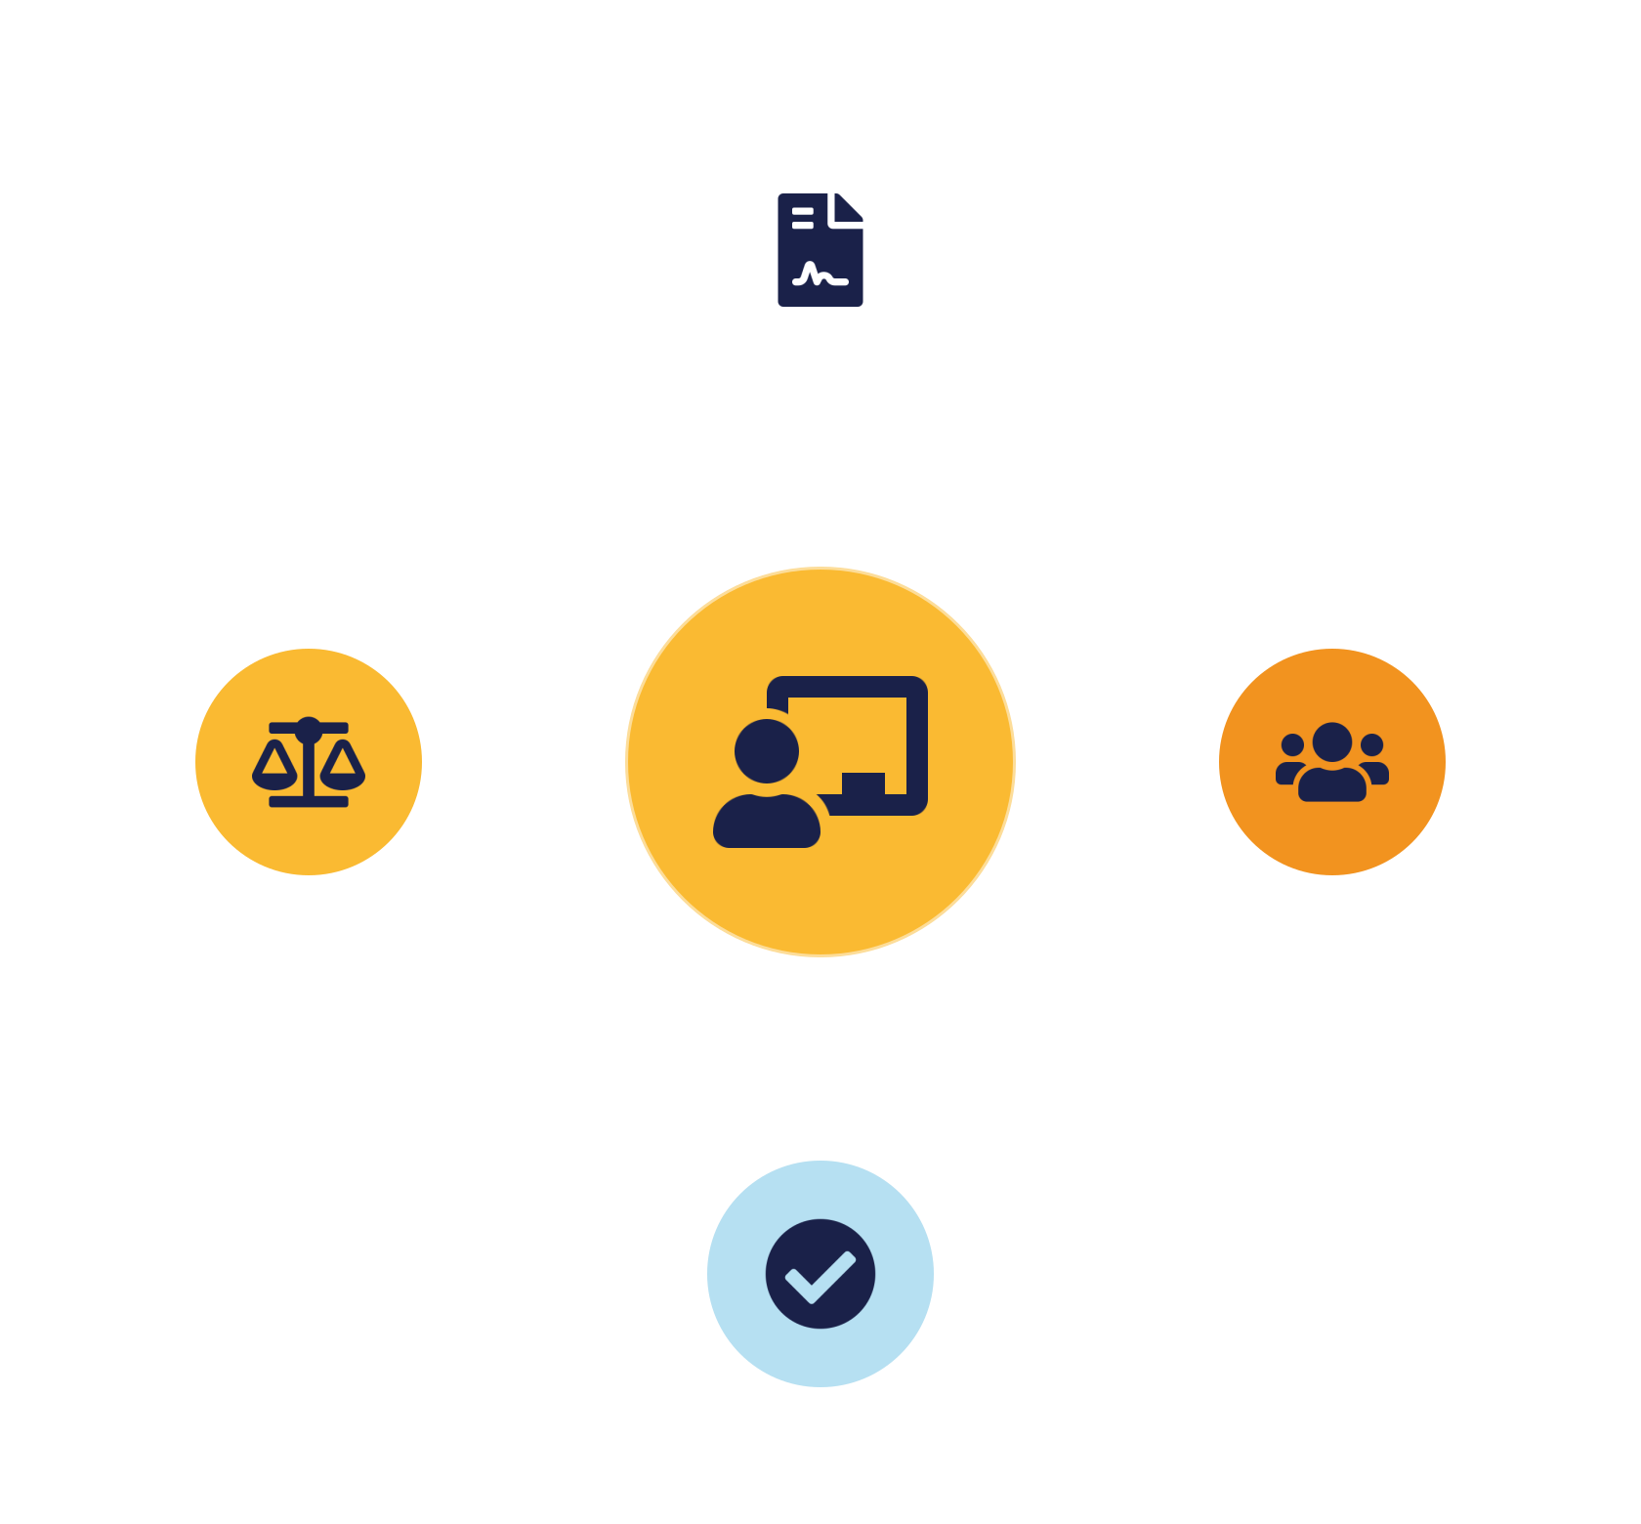
03
PART 3
The Compliance Presentation
Notes:
The deliverable that assesses CLO3. A compliance presentation communicates whether — and how — a cloud service meets its obligations, to an audience that must act on it. We cover what to include, how to structure it, and how to present with integrity.

Slide 11


STRUCTURE
How to structure the presentation
1 · Scope
2 · Design
3 · Assessment
4 · Gaps & plan
5 · Evidence
Service, data, obligations.
Requirements → controls.
How well it meets each — honestly.
Weaknesses, owners, timeline.
Diagrams, policies, attestations.
The flow is a story: scope → design → assessment → gaps → evidence. Never a feature list; never hide gaps.
IKB42603 Cloud Computing Security Essentials
7
Notes:
Give a clear, rubric-friendly structure students can follow. One: context and scope — the service, the data it handles, and which obligations apply (which standards and laws). Two: the design — the secure architecture, mapping each requirement to the controls and patterns that satisfy it. Three: the assessment — how well the design meets each obligation, honestly, including where it falls short. Four: gaps and remediation — the known weaknesses with an owned plan and timeline to close them. Five: evidence — the diagrams, policies, configurations and provider attestations that back every claim. Close with a clear recommendation. Stress the flow: scope → design → assessment → gaps → evidence is a story a decision-maker can follow and trust. Warn against two failure modes: a pure feature list with no assessment against obligations, and hiding gaps to look complete. Both fail the integrity test. Tell students the assessors look for this structure and for the requirement-to-control-to-evidence chain from the previous slide.

Slide 12

THE CLO3 SKILL
Presenting with professional integrity (VBE3)
Be honest about gaps
Evidence every claim
Tailor to the audience
Lead with the true picture — candour is rewarded and required.
'Here is the control and the proof' — not 'we're compliant'.
Risk & cost for leaders; detail for assessors — same truth.
Handling others' data (payments, health) truthfully is a duty of care — the mark of a professional (VBE3).
IKB42603 Cloud Computing Security Essentials
8
Notes:
This slide is the heart of CLO3 and the VBE3 value. Presenting a compliance case is not just delivery skill; it is an ethical act — decision-makers rely on your honesty. Three principles. Be honest about gaps: lead with the true picture; overstating compliance or hiding a weakness is a professional and legal failure, and assessors specifically reward candour. Support every claim with evidence: 'we are compliant' means nothing; 'here is the control and the proof' is a compliance case. Tailor to the audience: give leadership the risk and cost in plain language, give assessors the detailed evidence — the same truth at the right depth. Add delivery craft on the slide: clear visuals over dense text, a logical structure, and readiness to defend your reasoning under questions. Land the professional-identity point: as future IT professionals handling other people's data — payments, health records — presenting compliance truthfully is part of the duty of care the course has emphasised throughout. This is what separates a competent technologist from a trustworthy professional.

Slide 13

04
PART 4
Delivery, Checklist & Wrap
Notes:
Finally, the practical craft of delivering well, a readiness checklist, and the discussion that closes the consolidation.

Slide 14

DELIVERY
Presentation do's and don'ts
Do
Don't
Structure clearly — scope → design → assessment → gaps → evidence
Read dense slides verbatim —
Use diagrams — architecture and data flows
Give a feature list — with no assessment
Map requirement → control → evidence —
Hide or gloss over gaps —
Rehearse timing & assign roles —
Claim compliance without evidence —
IKB42603 Cloud Computing Security Essentials
9
Notes:
Practical delivery advice. Do: structure clearly (scope → design → assessment → gaps → evidence); use diagrams to show architecture and data flows; map every requirement to a control and its evidence; state assumptions; and rehearse timing so you finish cleanly. Do be ready to defend design trade-offs — assessors will probe why you chose one control over another, which is the SC8 reasoning. Don't: read dense slides verbatim; present a feature list with no assessment against obligations; hide or gloss over gaps; or claim compliance without evidence. Don't overrun — a disciplined, well-timed talk signals professionalism. Encourage teams to assign speaking roles, to anticipate the likely questions (data residency, key control, breach notification, tenant isolation), and to have a one-sentence justification ready for each major design decision. The meta-message: clarity, honesty and evidence win — polish is welcome but never a substitute for a sound, defensible case.

Slide 15
RECAP
Consolidation checklist
1 The course is one connected discipline — foundations, four pillars, patterns, governance — bound by shared threads.
2 A secure service composes controls across every blueprint layer — and evidences each.
3 A compliance presentation follows scope → design → assessment → gaps → evidence, with proof.
4 Present with professional integrity — honest, evidence-based, audience-appropriate (CLO3, VBE3).
IKB42603 Cloud Computing Security Essentials
10
Notes:
Consolidate the week. One: the course is one connected discipline — foundations, four pillars, patterns, and a governance wrapper, bound by shared responsibility, CIA, defense in depth and integrity. Two: a secure service composes controls across every layer of the reference blueprint — and you should be able to evidence each. Three: a compliance presentation follows scope → design → assessment → gaps → evidence, mapping requirements to controls with proof. Four: present with professional integrity — honest about gaps, evidence-based, audience-appropriate — because that is what CLO3 and VBE3 assess. Ask teams to self-check their design against the blueprint and their talk against the structure. Preview Week 13: a systematic review across CLO1–CLO3 before the final assessment.

Slide 16

Discussion & Q&A
In your design, which single control would you defend as most important — and how would you evidence it?
Where is the hardest compliance gap to close, and what is your honest remediation plan?
Next week — Week 13: Course Review & Synthesis across CLO1–CLO3
Notes:
Close the consolidation. The first prompt rehearses defending a design decision with evidence — core to the presentation. The second rehearses honest gap-handling, the VBE3 integrity skill. Use the remaining time for teams to present and peer-review against the structure and rubric. Preview Week 13's systematic review. Remind students the presentation assesses CLO3 with professional integrity.

