Slide 1
Generating rules for API Evolution
David Wettstein, 17.05.16

Slide 2

API Evolution
APIs change over time
Changes need to be updated in your code manually

Slide 3
Project goal
API changes can cause problems in projects using an older version of the API
Get automatically detected and packaged rules, such that you know what changed

Slide 4
APIEvolutionMiner (AEM)
APIEvolutionMiner¹
extract rules by monitoring API changes
mined at revision level in code history
¹ Hora A., Etien A., Anquetil N., Ducasse S., Valente M. T. APIEvolutionMiner: Keeping API evolution under control. In proceedings of CSMR-WCRE 2014.

Slide 5
APIEvolutionMiner (AEM)
Investigated
Jenkins CI jobs from Inria RMoD
AEM source code

Slide 6



APIEvolutionMiner (AEM)
Result: We can run it for any project per script
AEM
AEM

Slide 7
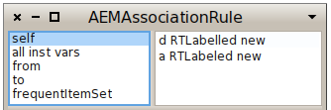

Problems with AEM
Custom rule format:
Wanted:

Slide 8

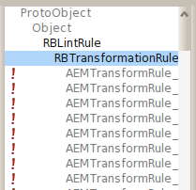
Problems with AEM
AEM does not create RBLintRule!
Main task:
AEM

Slide 9
Our approach
Focus on automatically discovered changes of type “one to one”
Generate subclasses of RBTransformationRule within code
using subclass: and compile:

Slide 10
Difficulties
Differences in change pattern:
RTLabelled new => RTLabeled new
? builder: => ? addedInBuilder:
? translateBy: => ? translate:to:

Slide 11
RBTransformationRule
Uses RBParseTreeRewriter for doing a search & replace in the parse tree
Works also with placeholders (e.g. ``@object)

Slide 12
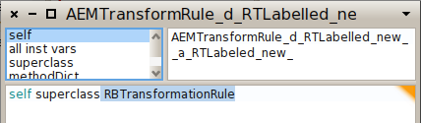
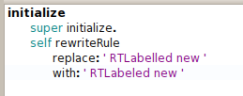
Solution
RTLabelled new => RTLabeled new
This one is easy ☺

Slide 13
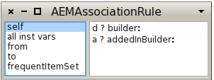
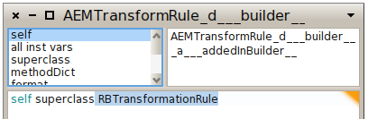

Solution
? builder: => ? addedInBuilder:

Slide 14
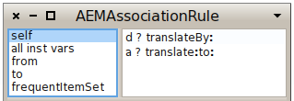

What about this?
? translateBy: => ? translate:to:
Different number of arguments! Which one to take?

Slide 15
Example: Roassal2
68 automatic rules by AEM
57 convertible into RBTransformationRule

Slide 16
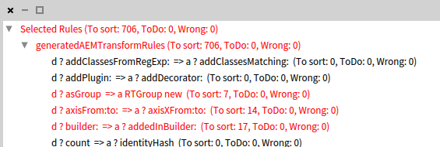
Results in Critic Browser
Load Roassal2 version 1.4
706 critics found by 37 of 57 rules

Slide 17
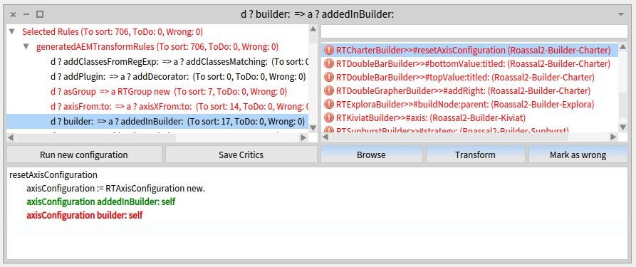
Results in Critic Browser
? builder: => ? addedInBuilder:

Slide 18
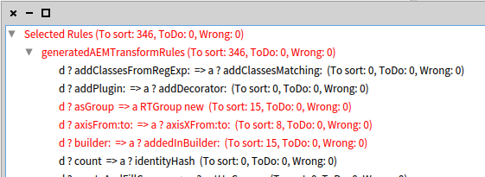
Results in Critic Browser
Load Roassal2 version 1.28 (13.05.16)
346 critics found by 20 of 57 rules

Slide 19
Future work
Integrate the code into a CI service
AEM still runs on Pharo 2

Slide 20
Summary
APIs change over time
APIEvolutionMiner cannot update changes automatically
Our extension can do this

