Slide 1





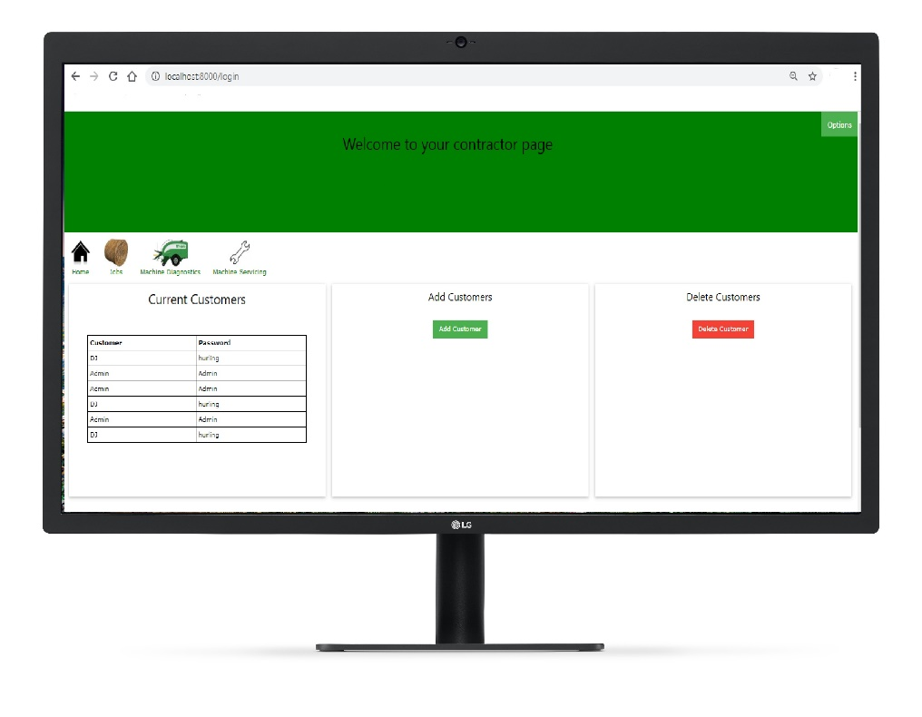


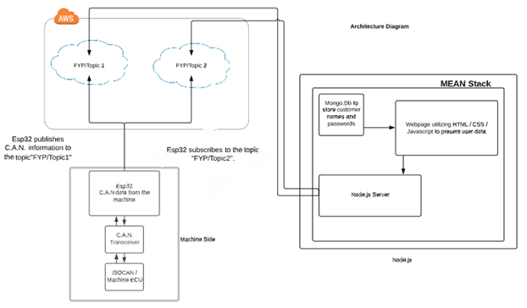
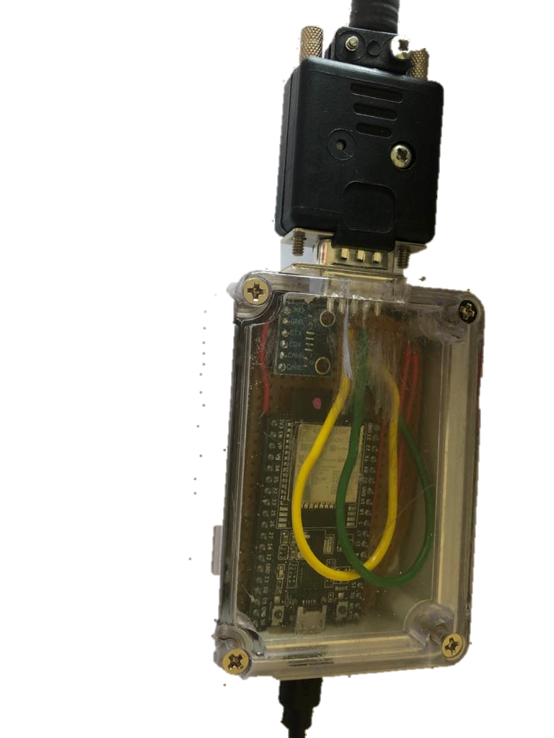


CANview
Denis Whelan
BEng (Hons) Software & Electronic Engineering
Key Technologies and software
Atom.io
MEAN Stack
Mongo.DB
Express.js
Node.js
JavaScript
HTML / CSS
Robo3T
Arduino IDE
McHale Fusion3 ISOCAN and E.C.U
ESP32
C.A.N Transceiver
MQTT
Introduction
This project sets out give the user the most up to date information about their machine.
This is accomplished by keeping a constant communication between the user and the machine through the Controller Area Network (C.A.N) and by utilizing the cloud to store and view the data.
What is CANview?
CANview is an external unit that connects into the E.C.U of a vehicle.
Once connected the user can access information stored on their machine using the online webpage.
GitHub: https://github.com/dwhelan97/ServiceMonitoringSystemFYP
LinkedIn: https://www.linkedin.com/in/deniswhelansoftwareeleceng/

