Slide 1
The Cake Pattern
Dustin Whitney
CTO Pellucid Analytics
@dustinwhitney

Slide 2
What is The Cake Pattern?
IoC/Dependency Injection using only Scala
Offers the same functionality as Spring/Guice, but using Scala language constructs instead of a framework
Also gives compile time errors instead of runtime
Useful for Testing or Environment Specific setup
It’s easy to understand
Useful and practical everyday!

Slide 3
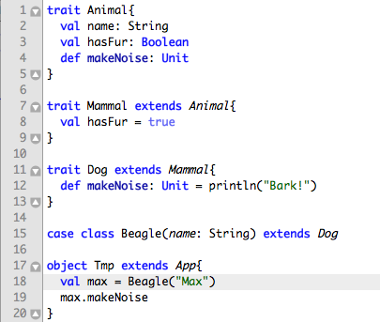
It’s all about traits

Slide 4
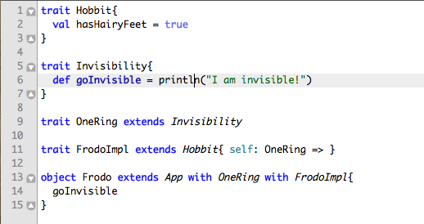
Self Types

