Slide 1
Simulated Environment
What scripts should I call?
“exampleInit” and
“exampleCallbak”
Robot States
agentBehavior.m
Call once
Pass variable aux
Physics States
Initialize variables, read *.mat files, etc.
exampleInit.m
Call in the main loop Pass variable sensor
Rendering
Modified variable motor
exampleCallback.m
Read from sensor and write to motor
etc.

Slide 2
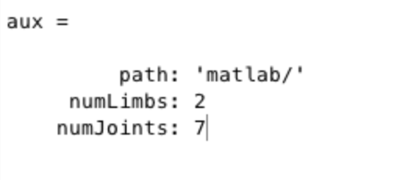
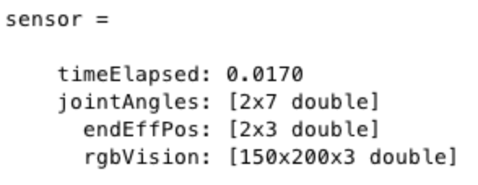
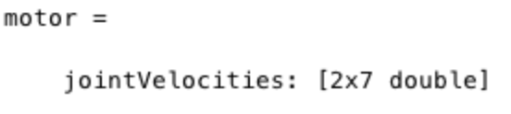

Slide 3
exampleInit.m
duration = 0;
rotationDir = 1;
exampleCallback.m
duration = duration + sensor.timeElapsed;
if duration > 5
rotationDir = -rotationDir;
motor.jointVelocities(:) = 0.5 * rotationDir;
duration = 0;
end

