Slide 1
The B2B2C Marketplace Growth & Retention Framework
Tracing Enterprise Capital Efficiency from Lead Acquisition to Longitudinal Customer Loyalty
Dwi Budi Setyonugroho

Slide 2
The B2B2C Marketplace Growth & Retention Framework
Tracing Enterprise Capital Efficiency from Lead Acquisition to Longitudinal Customer Loyalty
[B2B Lead Funnel]
[Relational Analytics Core]
[B2C Customer Loyalty Matrix]
The Blueprint
This project connects two separate worlds that usually don't talk to each other: B2B Merchant Sales Operations and B2C Consumer Product Retention.
The Value
We are tracking every dollar from the initial marketing contact down to long-term buyer engagement.
Notes:
Welcome. Today, I am sharing the B2B2C Marketplace Growth & Retention Framework. In most organizations, marketing focuses entirely on merchant acquisition, while product management focuses entirely on customer retention. I engineered this project to bridge that operational gap, building a data pipeline that maps lead acquisition spend directly to long-term consumer transaction value.

Slide 3
Evaluating the Corporate Growth Paradox
The B2B Focus
Budget Allocation Risk. Marketing spends heavy capital acquiring merchants based on conversion volume rather than actual downstream merchant value.
The B2C Focus
The Leaky Bucket Phenomenon. Growth breaks down completely if newly acquired merchant inventory fails to generate compounding, high-value repeat customer behavior.
The Disconnect
Buying high traffic numbers means nothing if those channels bring in low-value merchants.
The Consequence
The business gets stuck on an expensive acquisition treadmill to keep GMV growing.
Notes:
Before diving into code, let's look at the business problem. Our organization faces a growth paradox. We are allocating acquisition budget based on top-of-funnel lead volumes, completely blind to downstream quality. If we onboard hundreds of low-value sellers whose inventory can't keep buyers coming back, we are stuck operating a 'leaky bucket'—dangerously reliant on continuous, expensive ad spend to maintain marketplace growth.

Slide 4
Decoupled 3-Tier Data Pipeline Architecture
Raw CSV Source Tables
SQL Server Storage Layer (analytics Schema)
Lightweight Jupyter Notebook (.ipynb) / Power BI Desktop Interface
The Operational Problem
Forcing front-end visualization engines (like Power BI or Tableau) to compute massive, row-by-row timestamp difference loops creates crippling processing lag and system crashes.
The Engineering Solution
I built an optimized relational analytics warehouse layer directly inside the local SQL Server instance, offloading all heavy transformations and window calculations to the database cluster.
Notes:
To solve this sustainably, I designed a decoupled data pipeline. A common mistake is forcing front-end reporting engines to crunch complex date truncations and window functions over millions of rows, which leads to heavy dashboard lag. Instead, I isolated our core tables inside a type-safe database layer inside SQL Server. The database runs the heavy mathematical operations, outputting lightweight aggregated arrays that allow our visualization interface to run lightning-fast.

Slide 5
Diagnostic Analytics: Marketing Channel Yield & Conversion Efficiency
Rank | Marketing Channel | Total GMV Generated | Conversion Rate % | AVG Days to Close
1 | unknown | $213.7K | 16.29 % | 41.3
2 | organic_search | $207.0K | 11.80 % | 50
3 | paid_search | $155.3K | 12.30 % | 56.6
4 | social | $43.5K | 5.56 % | 61
The Volume Engines
organic_search and paid_search are steady baseline pillars, capturing over $207,023 and $155,277 in gross marketplace volume.
The Anomaly
The unknown origin vector displays our highest financial output ($213,742.70 total GMV) and a spectacular conversion profile (16.29%), yielding $194.49 in revenue per lead.
The Capital Drain
social traffic attracts high lead volume (1,350 leads) but suffers from a weak 5.56% conversion rate and takes a punishing 61 days to close.
Notes:
Now for the hard evidence. The diagnostic pipeline revealed two critical insights. First, our organic and paid search channels are highly stable baseline drivers. However, the data uncovered a major anomaly: an 'unknown' traffic segment that converts at an elite 16.29% and generates our highest yield per lead. Conversely, our 'social' ad spend is a major operational drain—bringing in high volumes but converting at a dismal 5.56% with a slow 61-day sales cycle.

Slide 6
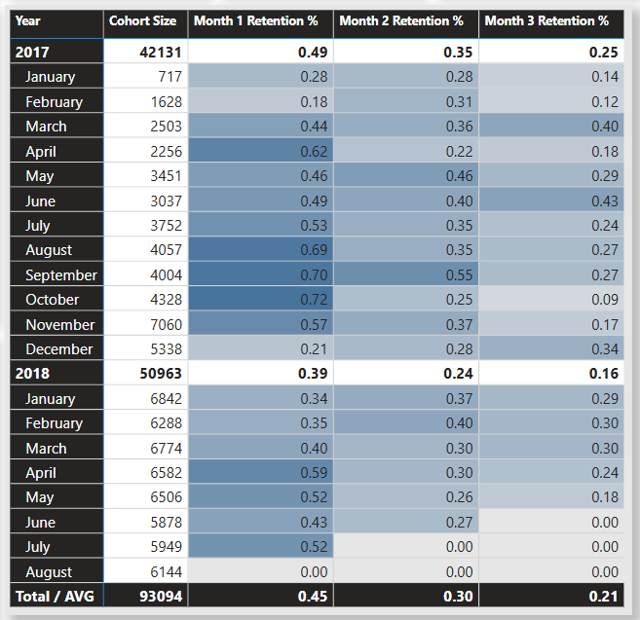
Descriptive Analytics: Customer Longitudinal Cohort Retention Analysis
The Mathematical Strategy
We grouped customers into cohorts based on their true "first purchase month" using window partitions, calculating chronological return gaps over rolling monthly intervals.
The Hard Reality
Across almost every high-volume 2017-2018 vintage, Month 1 customer retention crashes drastically well below 1% (e.g., Jan 2017 sits at 0.28%, March 2017 at 0.44%, and October 2017 at 0.72%).
The Diagnosis
The platform possesses a potent customer acquisition machine but a highly volatile customer lifecycle.
Notes:
Moving to the B2C side, we confront our platform's retention health. By tracking unique customer footprints longitudinally over rolling month indexes, the cohort matrix reveals an undeniable pattern. Across all historical cohorts, our Month 1 retention drops drastically below 1%. This proves our thesis: our customer acquisition machine is working, but our customer retention engine is broken. We are spending heavily to win customers who buy once and never return.

Slide 7
Data-Driven Corporate Directives for Leadership
Directive 1
De-Anonymize the High-Yield Channel. Immediately deploy product and web operations teams to audit and unmask the unknown traffic channel. It generates our highest yield; we must identify it to scale it.
Directive 2
Throttle or Redesign Social Budgets. Freeze or aggressively optimize capital allocation away from broad social campaigns. It acts as an operational resource drain.
Directive 3
Pivot to Bottom-of-Funnel Nurturing. Shift a substantial portion of marketing capital from expensive top-of-funnel customer acquisition into automated lifecycle retention triggers (loyalty rewards, smart email re-engagement, and vendor verification safeguards).
Notes:
To drive bottom-line impact, I have structured three clear corporate directives for leadership. First, we must immediately deploy engineering to track down and identify that high-performing 'unknown' traffic source so we can replicate it. Second, we need to freeze or optimize our broad 'social' ad spend to stop burning cash on a low-converting channel. Finally, because buyer retention drops instantly, we must pivot our focus from expensive top-of-funnel customer acquisition toward bottom-of-funnel lifecycle nurture programs to plug the leak in our marketplace bucket. Thank you.

Slide 8
THANK YOU
Dwi Budi Setyonugroho
+62 851-8611-1556
setyonugrohodwibudi@gmail.com
budinugroho.com

