Slide 1


GrabShare: The Construction of a Realtime Ridesharing Service
Dominic Widdows, Jacob Lucas,
Muchen Tang, Weilun Wu
Grab Technologies

Slide 2

What is GrabShare?
Grab is Southeast Asia’s foremost ridehailing platform
“It’s an app” - and much more
Creating the safest transport platform
Making transportation accessible to all
Improving the livelihoods of our partners
Taxis, Cars, Bikes, Shuttles
GrabShare - Shared cars and taxis
https://www.grab.com/sg/share/
Singapore, Manila, Kuala Lumpur, Jakarta, Ho Chi Minh City, Hanoi, Medan
Notes:
2M rides in first 2 months in Singapore

Slide 3
Tech Ecosystem
Drivers
Autonomous agents
Want to earn money
Passengers
Want to move around
Connections Sporadic
This is the cloud!
“The Cloud” (backend, where I work)

Slide 4
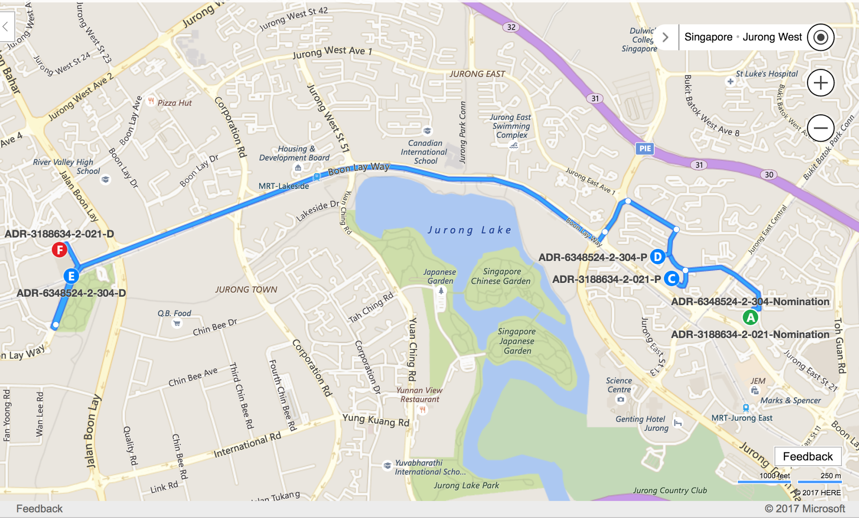
Scheduling
ETA to pickup
Overlap
Travel time increase for each passenger
Angle between bookings
Notes:
Open mind - Listen. There will be sharing from other countries. Opportunity to learn from others
Challenge each other - Don’t be afraid to question, discussions are healthy
Respect each other - Others may have different POVs

Slide 5
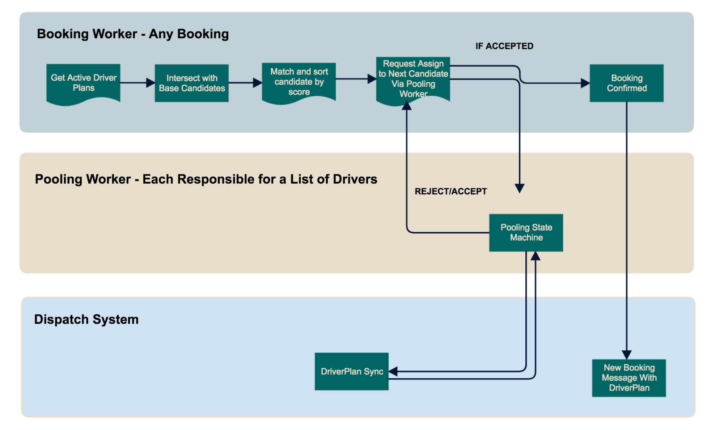
Backend System Architecture

Slide 6
Lots of other teams!
Pricing
The more efficient, the bigger discount
But we have to predict this for first passenger ...
Driver Training
Feedback
Yes there are complaints
Yes we pay attention to them!
Travel Time Estimates
Road Data
Realtime Traffic Data
Moving Southeast Asia Forward!

Slide 7
Thank you!
(And please try it out)
Feedback to: dominic.widdows@grab.com

Slide 8
Template

