Slide 1


Which Language Operations to Implement First with Quantum Computers?
Dominic Widdows,
Quantum NLP Conference
Oxford, 2019-12-06
Notes:
See https://docs.google.com/document/d/138IdcphjB69gr4GNaYp9LqJEdaIE1UmqBRm0n5-BZHQ/edit

Slide 2


Goal of this talk
Things that work well on Quantum Computers
NLP with Vectors
Text Search
Factorization
(Shor’s algorithm)
“Database Search”?
(Grover’s algorithm)
Doubling dimensions
Tensor products
Classification
Logic
Doubling dimensions
Tensor products
Composition
Analogy
Inference

Slide 3
Backstory Assumptions (“the 1900s”)
We know (something about) what quantum mechanics and quantum theory are
They use vectors, Hilbert spaces, inner product for Born rule
We know something about vector models for search and “semantic similarity”
They use vectors, Hilbert spaces, inner product for relevance, it’s a juggernaut by now (2019)
We don’t seem to have noted the overlap yet ...

Slide 4
Then all of a sudden … (back in ~2004)
We noticed a big overlap
Keith van Rijsbergen, Geometry of Information Retrieval
Bob Coecke, Peter Bruza, Jerome Busemayer
… please yell names from the audience ...
Geometry and Meaning (Dominic’s old book)
Then neural nets got really big (physically and socially)
AI / NLP folks start using “embeddings” a lot
But what does it have to do with “language”?

Slide 5
Language operations using vectors
Negation, disjunction
Analogy
Composition
Syntactic
Semantic (e.g., noun-noun or adjective-noun)
Implication / Classification
Conditionals and conditional probability
Rewrites, e.g., spelling correction, string matching

Slide 6
Negation
“Semantic vectors only do similarity and addition. It’s hardly semantics if you can’t even do negation!” (A good friend, January 2001 - good point, challenge accepted!)
“a NOT b” should have no similarity with b.
How about a - (a⋅b)b?
Works well for removing unwanted areas of meaning
(Quick demo)

Slide 7
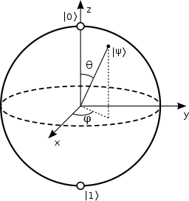
NOT - Perpendicular or Opposite?
|1〉
|ψ〉
θ
|0〉

Slide 8
Removing Multiple Meanings
If we want a NOT (b OR c), use Gram-Schmidt process to make result orthogonal to all unwanted meanings …
Gets good results (eventually), gives a “disjunction”
What’s “NOT a” really?
Antonyms for adjectives, but what for nouns?
Aristotle points out “substance has no contrary”
Negation alternatives - words should be positive definite operators? (see Lewis)

Slide 9
Positive Disjunctions
We saw that a OR b might be the plane spanned by a and b
Compare with Boolean set union (too open?) and taxonomic least common ancestor (too closed?)
So there might be something useful there ...
Sometimes in language extend disjoined ingredients into an inferred class, sometimes we don’t
“It’s 50 or 60 miles. Take bus 23 or 34.”

Slide 10
Disjunctions and Classes / Kinds
Subspaces overgenerate
Each example adds a dimension unless the vectors are (perfectly) linearly dependent
Can this be smoothed in some way?
“Plain old clusters?”
Convex hull, centroid, distance-to-nearest,
Positive definite (density) operators?
Used for hyponymy (Lewis)
How to learn classes from examples?
How to map new examples to clusters?

Slide 11
Relations as Classes of Pairs
“Parent-Child”
Darth Vader, Princess Leia
Debbie Reynolds, Carrie Fisher
Lord Byron, Ada Lovelace
Henry VIII, Elizabeth I
And here we have … Entanglement!
Because ∑p_{j}⨂c_{j} is not p⨂c for any p, c
Used in practice with Medline for relations like TREATS (Cohen & Widdows)

Slide 12
Analogical Reasoning
Paris is to France as Berlin is to …
A : B :: C : ? searched for as neighbors to C + B - A
Various analogy test sets, best results for geography
Also demonstrates weakness of vector spaces, Euclid’s (famously dodgy and flat) 5th axiom
But obviously, that’s just the beginning of what analogy can do

Slide 13
Pairwise Composition
Vector sum
Tensor product
Dyad
Some projection of one of these
Circular convolution
Circular correlation
“Red flowers” - Classical form (Boolean intersection)
Red wine, Redneck, Red State, Red rag
Tiger moth, Tiger economy, Tiger mom
Water wheel, wagon wheel, cog wheel, spinning wheel, flywheel, ...

Slide 14
Ambiguity Resolution
Tiger - striped, fierce, demanding, …
Is it a superposition of all senses until it’s observed in a sentence with other elements?
Some disambiguation implementations have (implicitly) assumed this and disambiguated using (something like) Born’s rule
Can quantum mechanical interference model something like this?

Slide 15
Spelling Correction as Ambiguity Resolution?
Most obvious in Vietnamese
com, cơm, côm, cốm, cộm, cỏm, cổm, cỗm, …
Mainly with food search, com means cơm=rice
What about putting more left out characters back?
Welcome to Indonesian :)

Slide 16
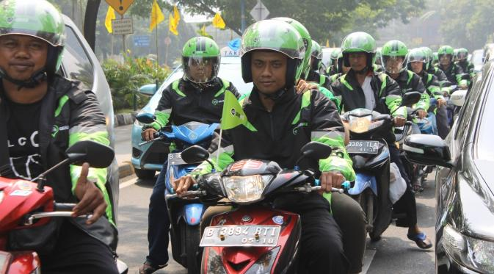
What are Grab users
saying?
Grab has a lot of cross-lingual driver-passenger pairings.
Around half of dialogs are trying to find each other.
 | Indonesian | Meaning | Dictionary Translation
What they “should” type | Dimana, Bapak? | Where are you, sir? | Where, Dad?
What they really type | dmn pak | Where are you, sir? | dmn pack

Slide 17
What are the words like?
Wikipedia | GrabChat | Destination Search | GrabFood Search
yang dan di dari pada ini adalah dengan dalam untuk tahun oleh sebagai juga ke merupakan ia menjadi atau tidak sebuah itu | saya ok di iya pak mas oke sy depan hai masuk tunggu ya dmn yg dimana posisi blok bapak d iyaa no | jl jalan jln stasiun no 1 2 pasar taman 3 hotel gang terminal masjid blok raya rs perumahan kantor a gg bank | ayam nasi mie geprek bakso goreng martabak kfc seblak sate bensu pizza bakar roti es pisang padang burger warung bubur

Slide 18
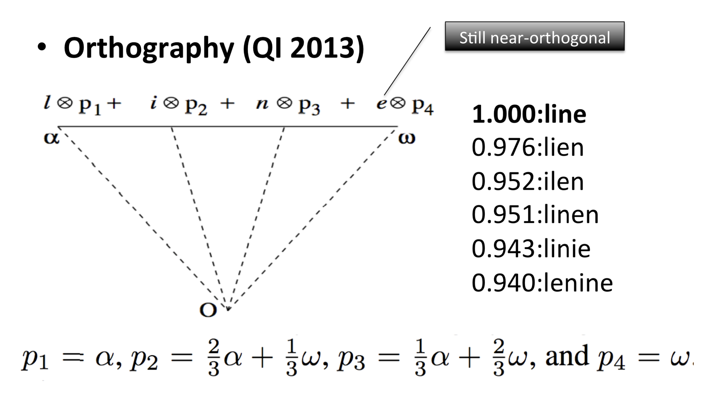
How might we make a character vector?

Slide 19
Typical Indonesian Keyword Rewrites
Keyword | Frequency | Better Keyword?
baso | 8165475 | bakso
pizz | 2151233 | pizza
sambel | 1721238 | sambal
cak | 1570015 | cake
brownis | 1522639 | brownies
piz | 1466907 | pizza
chiken | 1443847 | chicken
mart | 1325622 | marta
gepre | 1323937 | geprek
hoka | 1252692 | hok
richees | 1222863 | richeese
chattime | 1173077 | chatime
dominos | 1074740 | domino
bakmie | 1034623 | bakmi
rica | 1029169 | rice
roket | 998852 | rocket
gepr | 963568 | geprek

Slide 20
Things to note about these Orthographic Vectors
How to
pip install semvecpy
Why to try complex values?
Binding is O(dim)
Add phase angles
O(dim log(dim)) with reals
Fast Fourier Transform

Slide 21
Conditional (Quantum?) Probability
Lots of rewrite rules are something like
P(what we wish user had written | what user wrote)
… and lots of the rest of language modelling is based on conditional probability
Quantum conditional probability for Quantum LMs?
For sequence models, is there another “interference” way to think of this?

Slide 22
Thank you!
tanks tnks tank's thaks thnks thank's tenks thankz thax thq tankz thank.s thansk tankyou tkhs tkx thenks thaxs tengs thc
Terima Kasih!
trmaksih trimkash trimasih trrimakasih trimkasi timakasih terimahkasih terimksih terimaksi teeimakasih kasihpak kasieh kacih kazih kshh kasiiihh kseh kcih kasiiihhh kasihhhhhh

Slide 23
Template

