Slide 1
Low Power People Counting using Capon
Algorithm and Results
July 2024

Slide 2
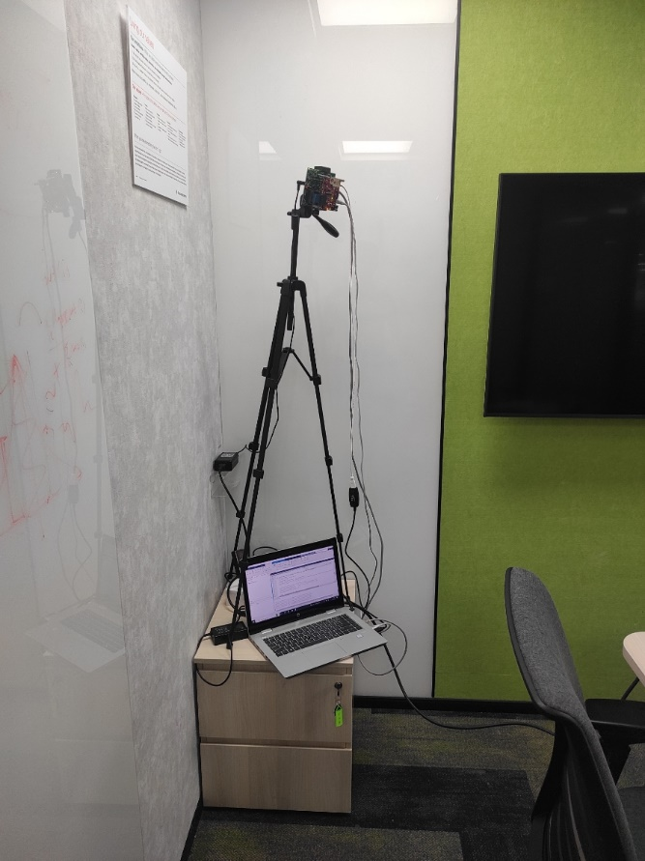
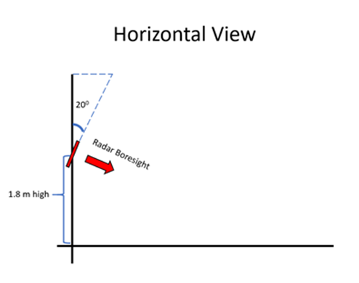
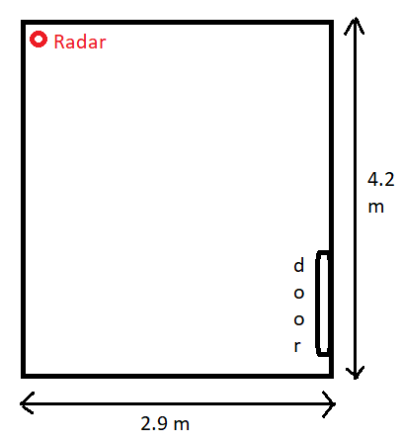
Data Collection
Setup
Azimuth = 45°, Elevation = 20°, Height = 1.8 m
LV1F-C8

Slide 3
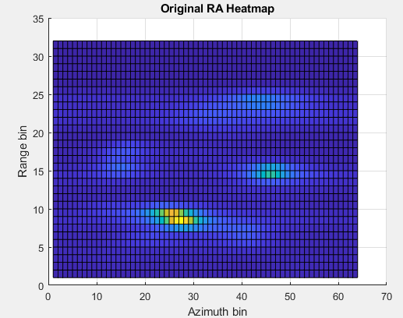
Algorithm (Pre-processing)
Range-Azimuth
Accumulate
RA
Heatmap
Capon
mean
1 frame
RA heatmap
100 frames
There are five
people here

Slide 4
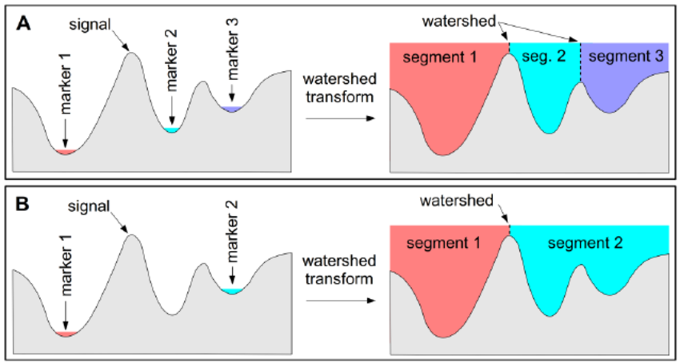
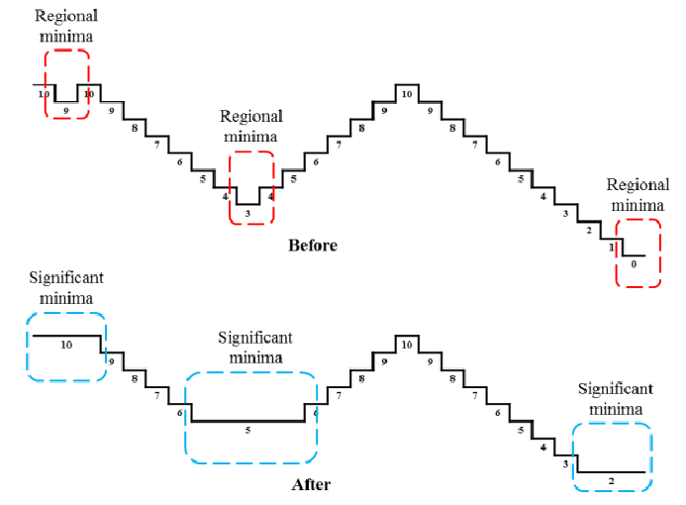

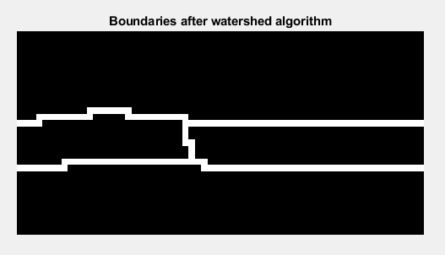
Algorithm (Step 1: Watershed Algorithm)
Watershed algorithm
H-Minima transform
RA heatmap
Normalize ->
convert to image ->
invert
Watershed with
H-minima
transform

Slide 5
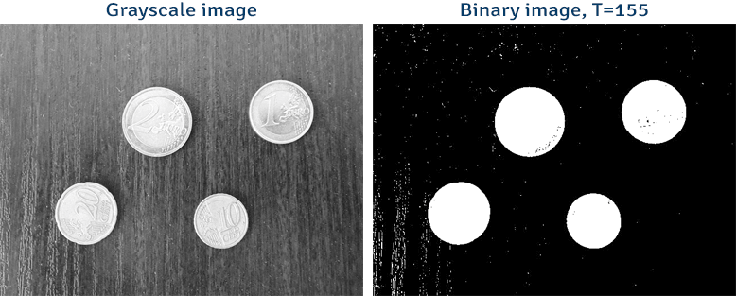
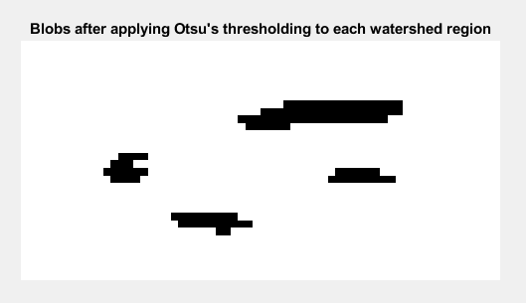

Algorithm (Step 2: Otsu’s Thresholding on watershed regions)
Otsu’s method is a thresholding technique used in computer vision and image processing to perform automatic image thresholding
We get 4 blobs. $num_{people}=4$
Otsu’s Thresholding
on each watershed region

Slide 6
Results
Num People | Filename | 0 error (%) |  | 1+- Error (%) |  | Mode of number of people (one min)
5 | adc_data_0000_0000 | 0 | 4.05 | 0 | 0 | 5 | 5
 | adc_data_0001_0000 | 12.15 |  | 0 |  | 4
 | adc_data_0002_0000 | 0 |  | 0 |  | 5
4 | adc_data_0000_0000 | 0.4 | 0.8 | 0 | 0 | 4 | 4
 | adc_data_0001_0000 | 2.48 |  | 0 |  | 4
 | adc_data_0002_0000 | 0 |  | 0 |  | 4
3 | adc_data_0000_0000 | 9.72 | 10.85 | 0 | 1.42 | 3 | 3
 | adc_data_0001_0000 | 6.28 |  | 0 |  | 3
 | adc_data_0002_0000 | 16.84 |  | 4.39 |  | 3
2 | adc_data_0000_0000 | 0 | 10.33 | 0 | 0 | 2 | 2
 | adc_data_0001_0000 | 31 |  | 0 |  | 1
 | adc_data_0002_0000 | 0 |  | 0 |  | 2
1 | adc_data_0000_0000 | 2.02 | 0.67 | 0 | 0 | 1 | 1
 | adc_data_0001_0000 | 0 |  | 0 |  | 1
 | adc_data_0002_0000 | 0 |  | 0 |  | 1

