Slide 1
ECE2002 J-Component
Review 2
Line following robot

Slide 2
Group members
Dwij Sheth 16BLC1048
Prakhar S Mathur 16BLC1099
Aditya Kshettri 16BLC1113
Yash Jain 16BLC1074

Slide 3
Line following robot- Basic principle
Line sensor works on the principle of reflection and absorption of light
Reflection of light on white surface is More.
Reflection of light on black surface is Less.
Line sensor is a combination of LDR (Light Dependent Resistor) and LED (Light Emitting Diode) which works on phenomenon of Reflection and Absorption.
White color surface reflects the most of the color falling on them while Black color surface absorbs all the light falling on them.
So, a major part of light emitted by LED is reflected by white surface and so, LDR detects it.

Slide 4
Basic Circuit
The circuit can be basically divided into the following parts:
Power Supply
Motor Driver
Logic sensor ( Comparator + Line sensor plate)
Inverter IC section (part of the logic circuit)

Slide 5
Block Diagram

Slide 6
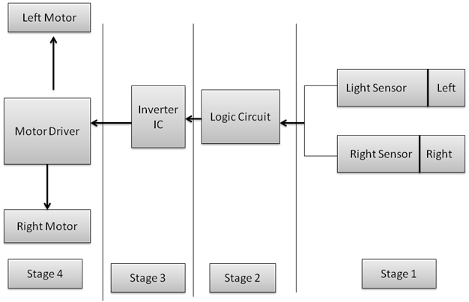

Slide 7
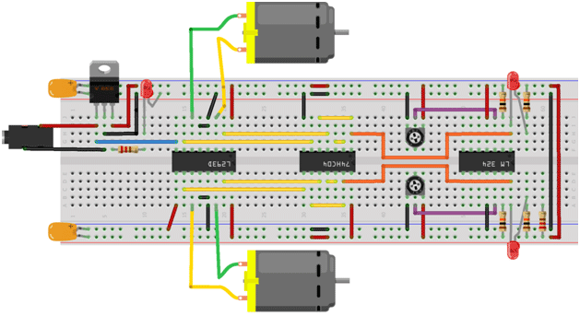
Breadboard schematic of the circuit diagram

Slide 8
Circuit diagram

Slide 9
Components required
Resistors (220Ω, 10kΩ)
20kΩ potentiometers
White LEDs and LDRs
IC7805
IC 7404
L293D motor driver IC
LM324 IC
Motors x 2
Castor wheel , 2x robotic wheels
Robotic chassis
Wires

Slide 10
Functions of electronic components
White LEDs and LDRs- for detecting marked path
IC7805 - voltage converter IC giving 5V output
IC 7404- NOT gate IC for inversion of inputs
L293D motor driver IC - for amplifying current and working the motors
LM324 IC - op amp to boost inputs from
Motors x 2- to drive wheels

Slide 11
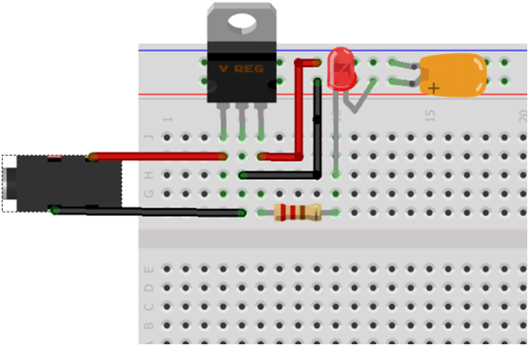
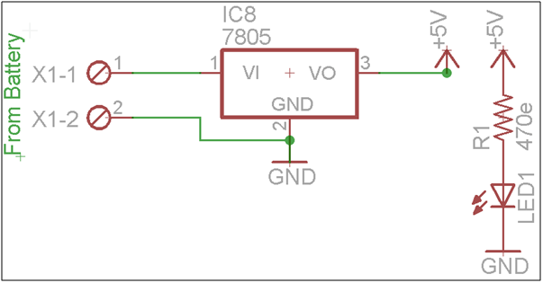
Power supply circuit

Slide 12
Power supply circuit
The 9V/12V input from the battery comes and is brought down with the help of the IC 7805 to 5V
An LED along with a suitable resistor is also used to indicate perfect functioning of the power supply circuit

Slide 13
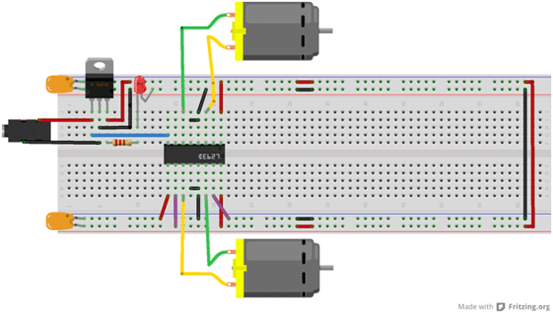
Motor driver circuit

Slide 14
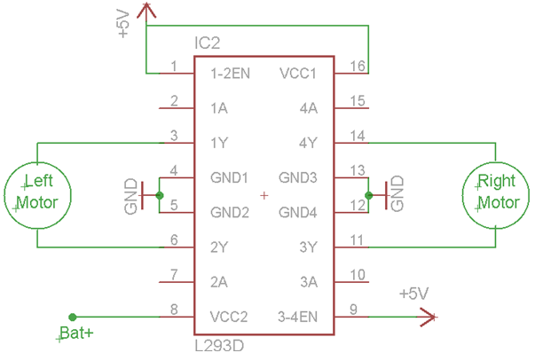
Motor driver circuit
The motor driver circuit is basically the IC L293D which is used to run the motors . The IC boosts the input current before feeding it to the motors for successful operation

Slide 15
Connections of Motor driver circuit
Connect one wire of first motor with the o/p1 pin of L293D IC. And second one is with second o/p2 of L293D IC.
The motor should be rotate in clockwise direction from your front side. If the motor rotate in anticlockwise direction than make it in clockwise direction by exchanging it’s wire with L293 o/p pins.
Connect one wire of second motor with the o/p3 pin of L293D IC. And second one with second o/p4 of L293D IC.
Now the motor should be rotate in anticlockwise direction from your front side. If the motor rotate in clockwise direction than make it in anticlockwise direction by exchanging it’s wire with L293D o/p pins.
Now the chassis should be moves in the forward direction.

Slide 16
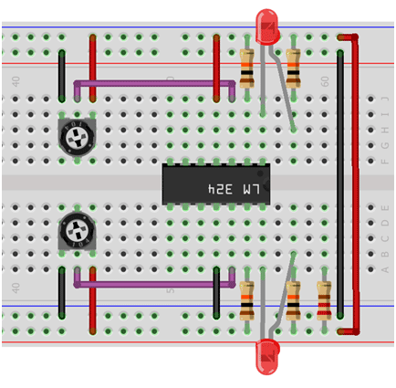
Comparator circuit

Slide 17
Comparator circuit and sensor plate
Comparator LM324 IC is used to generate logic which is used to drive the motor and led. Here the comparator IC is used to perform comparison between the reference voltage which is set at it’s non inverting input terminal and it’s inverting terminal voltage.
Sensor plate section consists of two LDR sensor and two led. Make the positive terminal of led and ldr are common and negative terminal of led and LDR are common.

Slide 18
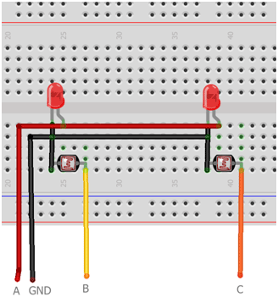
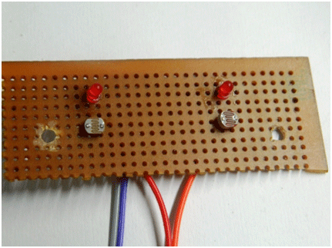
Sensor plate
Circuit for sensor plate Actual breadboard circuit of sensor plate

Slide 19
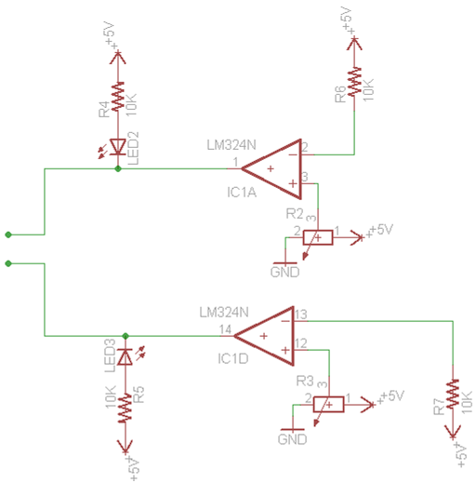
Comparator circuit diagram

Slide 20
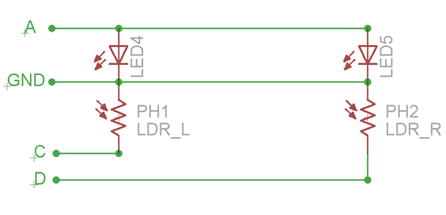
Sensor plate circuit diagram

Slide 21
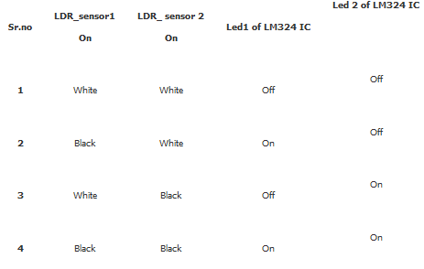
Calibration chart for bot

Slide 22
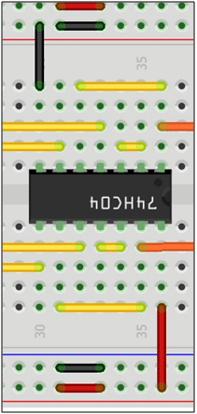
Inverting IC circuit
Inverting IC stage of (HD74LS04) IC
This section is used for to drive the motor by converting signal into the it’s invert form. If you have give 1 on it than it’s outcome will be 0 and if you have give 0 than it’s outcomes will be 1.

Slide 23
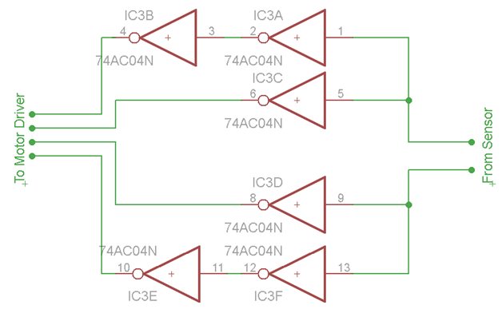
Circuit diagram of inverter section

Slide 24
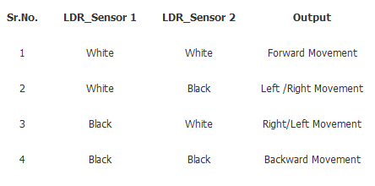
Robot movement chart w.r.t. sensor plate

Slide 25
Mechanical integration of the bot
The wheels connected to their respective motors will be placed towards the back side of the chassis. The castor wheel (freely moving multidirectional wheel ) will be placed at the center of the front side of the chassis. The free motion of castor wheel allows the bot to easily change directions.
The PCB will be mounted on the chassi and fixed to it by means of screws.
A set of batteries will be connectede together and placed using a holder to provide power to the bot .
The sensor plate will be placed in front of the bot on the botto side of the chassis facing the floor to sense the surface under the bot for its motion.

Slide 26
Applications
Industrial Applications: These robots can be used as automated equipment carriers in industries replacing traditional conveyer belts.
Automobile applications: These robots can also be used as automatic cars running on roads with embedded magnets.
Domestic applications: These can also be used at homes for domestic purposes like floor cleaning etc.
Guidance applications: These can be used in public places like shopping malls, museums etc to provide path guidance.

Slide 27
Thank You

