Slide 1
Caesar Cipher
By Daniel Williams and nikolas pavlovic

Slide 2
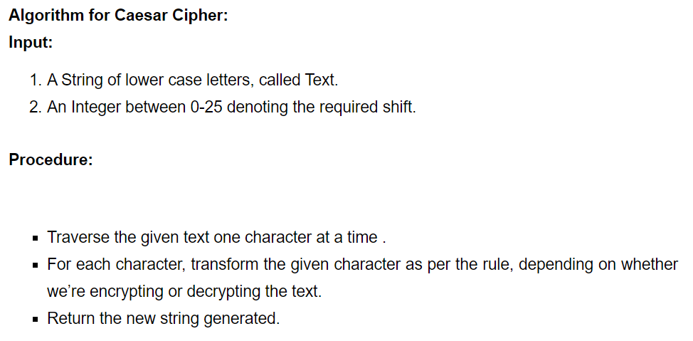
How to code a Caesar cipher

Slide 3
Caesar cipher example
Rule = add 2
Input = A
Encryption = C
Decryption = A

Slide 4

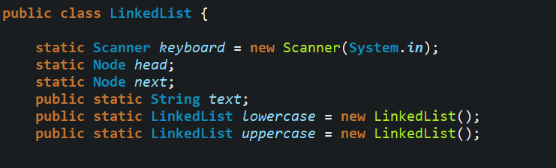
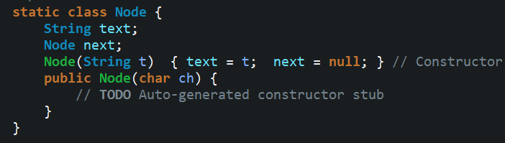
How to initialize a linked list
Node is its own class because it is a Noun/thing.
Verbs/actions that a Noun does, would be its methods.
In our project, Node and LinkedList are classes, while encryption/decryption are methods.

Slide 5
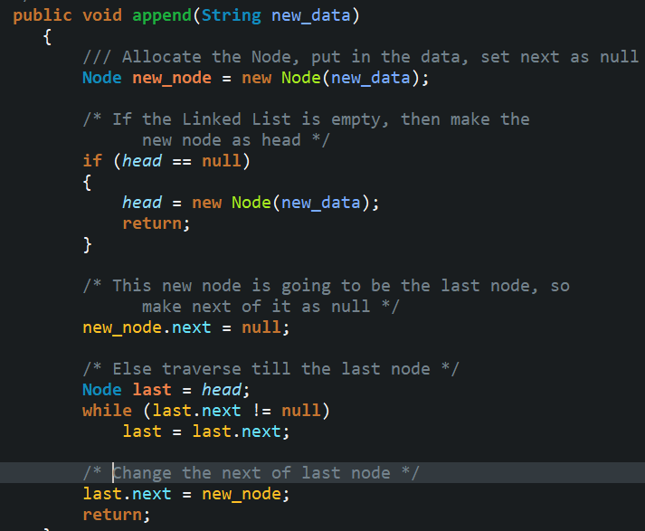
Appending a linked list
We must parse user input for numbers and special characters, only accepting lowercase and uppercase letters
A good algorithm will ignore these parameters without adding them to the list or breaking the program

Slide 6
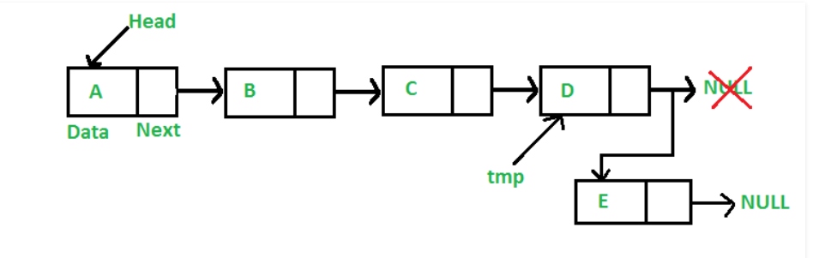
Appending a linked list
NULL

Slide 7
Appending a linked list
NULL

Slide 8
Appending a linked list
NULL

Slide 9
Appending a linked list

Slide 10
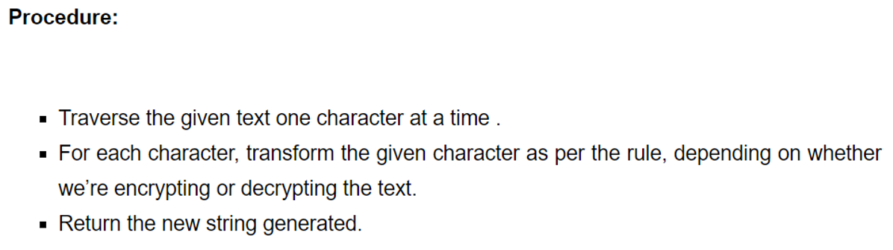
encryption
Once our Linked List has been populated, we pass it through an encryption method.
We must again, parse for numbers and special characters as these will not be encrypted by this program

Slide 11

decryption
Decrypting is nearly the same as encryption, simply backwards
If our encryption adds a letter shift, our decryption must subtract the same letter shift amount

Slide 12
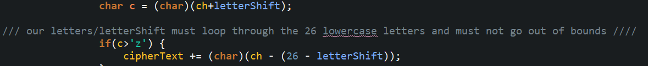
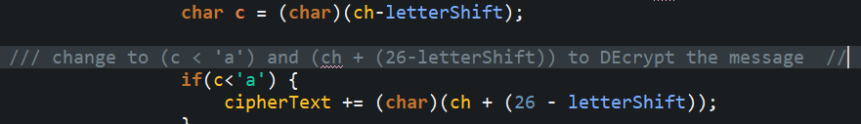
ENCRYPTION
DECRYPTION

Slide 13
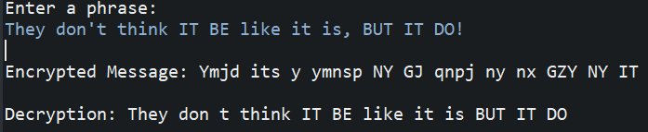
Caesar cipher
Final result with letter shift of five (5).

Slide 14
Final notes
All non-letters are replaced with whitespace through a regex expression below.
String str = text.replaceAll("[^\\p{Alnum}]+", " ");

